Slide 1
Yield Modeling with EXOSIMS for HabEx
Dr. Rhonda Morgan
Jet Propulsion Laboratory, California Institute of Technology
June 13, 2016
© 2016 California Institute of Technology. Government sponsorship acknowledged.

Slide 2
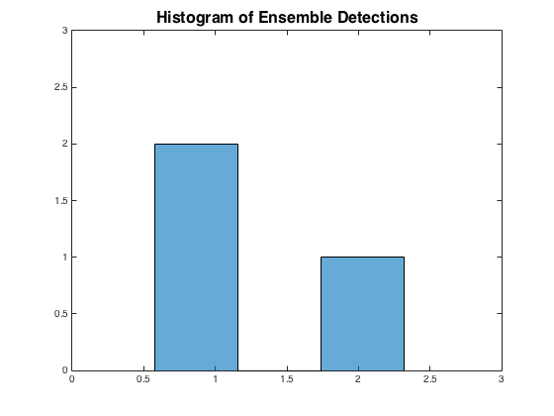
What is EXOSIMS? https://github/dsavransky/EXOSIMS
EXOSIMS is a yield software architecture in which every model component can be independently upgraded/changed.
A Monte Carlo approach allows for dynamic constraints in the scheduling of the design reference mission (DRM), such as star shade fuel consumption and responses to detections.
Creates ensembles of DRMs which can be analyzed statistically.
✔
✔
✖
2 Detections
✖
✔
✖
1 Detection
✖
✔
✖
1 Detection

Slide 3
A Single DRM run
EXOSIMS keeps track of time and lists the start time of a new observation. For this demo run the mission lasted 36 days.
The observing time was dominated by the 1 day optical overhead time.

Slide 4
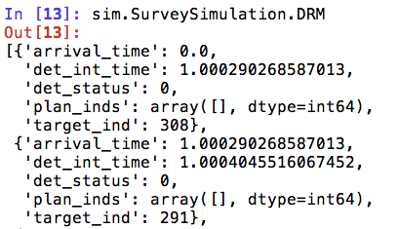
Single DRM output
EXOSIMS does not (yet) automatically write out the data and generate analysis graphs for the user.
The results of the run and all parameters are stored as python objects (mix of arrays, dictionaries, lists , etc.)
1st star visited
Index of planet In list of synthetic planets
Detection integration time (days).
Detection status:
0 = null detection
1 = detection
-2 = false alarm
-1 = missed detection
Index of star used in target list (TargetList.Name)

Slide 5
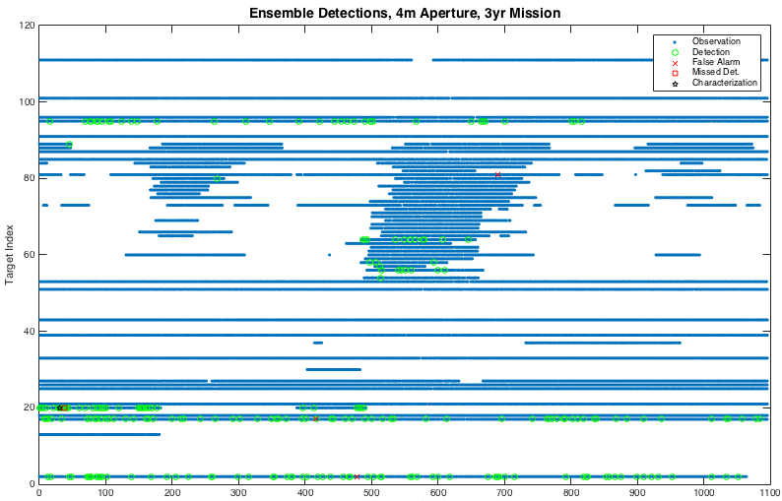
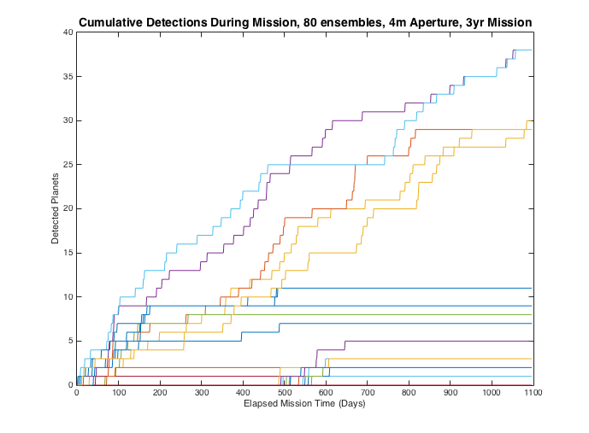
Ensemble of DRMs Output
The ensemble output is a list of DRMS:
Sim.SurveySimulation.DRM[:]
Illustrative Output
Still Debugging Results

Slide 6
Initial Ensemble Runs Performed
Diam m | Mission yrs | Char. lambda | Num. DRMs | Machine | Num. threads | Runtime hrs
4 | 3 | 1 um | 80 | aftac3 | 40 | 8
4 | 3 | 400 nm | 80 | aftac3 | 40 | 14.4
8 | 6 | 1 um | 100 | aftac3 | 40 | 82
8 | 3 | 400 nm | 80 | aftac3 | 40 | 44
The first set of ensemble DRMs were run using parallel processing on a 48 core server.
In progress is running parallel over ssh to a potential 131 cores.
The runs are in the shake down phase. Debugging is in process.
Dmitry Savransky is working to increase code speed
Larger target lists result in longer run times

Slide 7
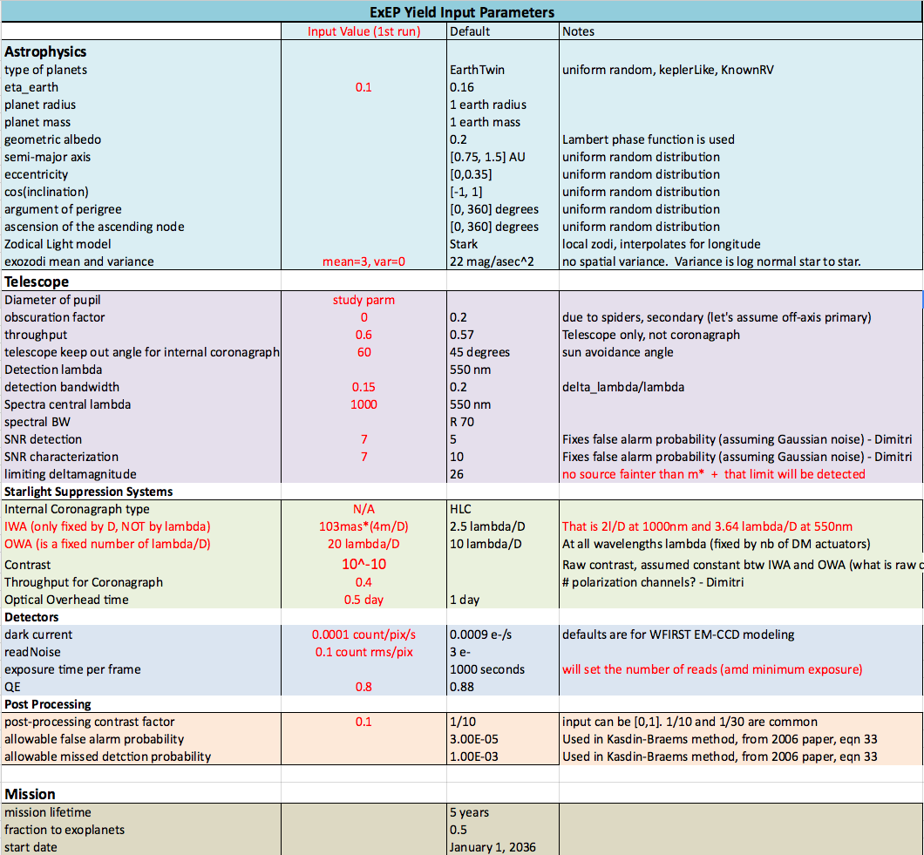
Inputs
https://docs.google.com/spreadsheets/d/1-w1eybYV6nyX02kH7eoNWie8UinzlVnLM4F-64AagHw

Slide 8
Yield study goals
Yield modeling of key point designs and trades
The first study is sensitivity to aperture diameter
We also want to look at
Coronagraph only
Coronagraph + star shade hybrid
Star shade + star shade + star shade + …

Slide 9
How do we know the code is right?
Validate against other codes
Many options exist: Stark, Traub, Nemati
A good top level comparison of results at the finish line
Compares Monte Carlo outputs on complex codes
Many assumptions (~100) in yield code drive the results
Point-check the physics
A good grassroots, bottom up approach
Done in smallest chunks of code sensible (unit tests)
Each test is tailored to that unit of code
Some test software things
Some test physics results against expected values

Slide 10
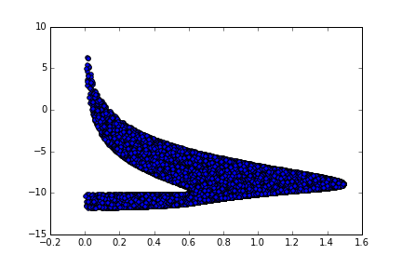
Brown Completeness Cloud Unit Test Qualitative Example
I scaled this axis to match Brown
The y-axis is incorrect due to a discovered unit mismatch (km to AU)
Brown 10^8 samples
10^5 samples in ExYM
10^5 samples in EXOSIMS
BrownCompleteness
This case duplicates Brown’s values for verification

Slide 11
Test Case for C_{p}, C_{b}, T_{int}
Use Known RV planets from IPAC portal
Validated Matlab code computes photon counts from planet and background and detector noise sources and calculates integration time

Slide 12
Choose missing data to design for a good software test
We verified that a range of planet radii were represented. Planet radius was calculated from planet mass (from IPAC).
A variety of inclinations and phase anomalies were chosen to span the parameter space

Slide 13
How much code has been tested?
We have written 2714 lines of test code for 134 functions.
Test code will be delivered to github and can be used for regression testing.

Slide 14
Remaining Testing
Unit Tests
Resolve Integration Time Discrepancies
Validate KeepOut window
Hand Trace scheduler decisions
End to End Testing
Shakedown of initial ensemble runs
Cross validation with Chris Stark’s AYO code is planned for FY17 under the Standard Definitions and Evaluation Team

Slide 15
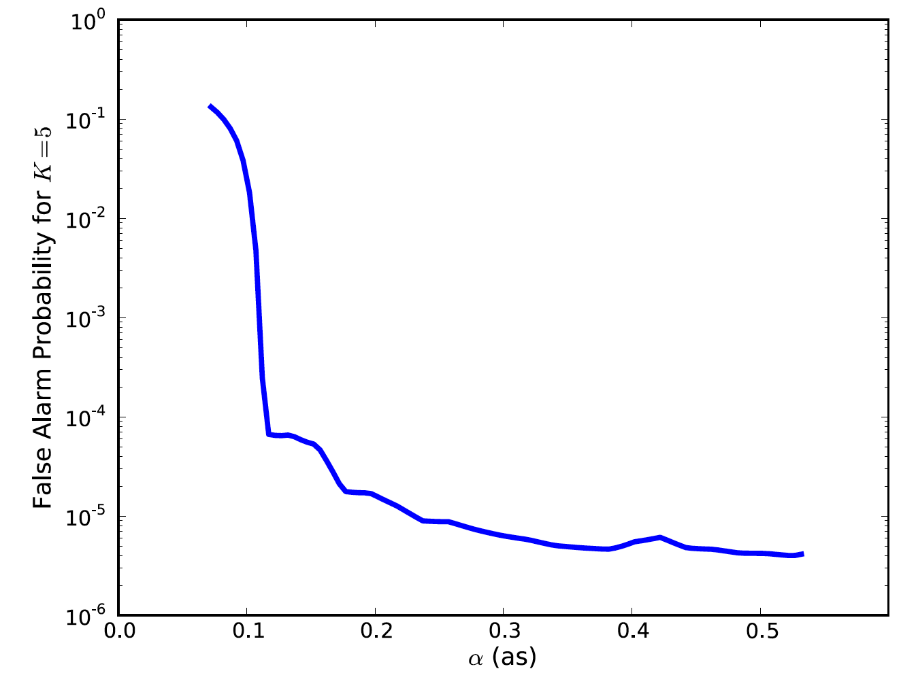
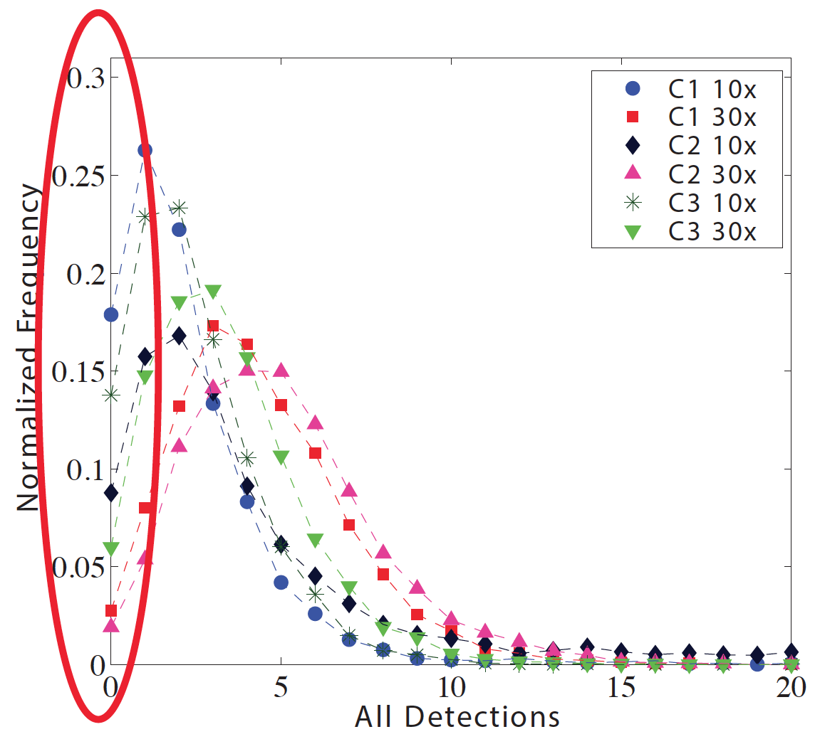
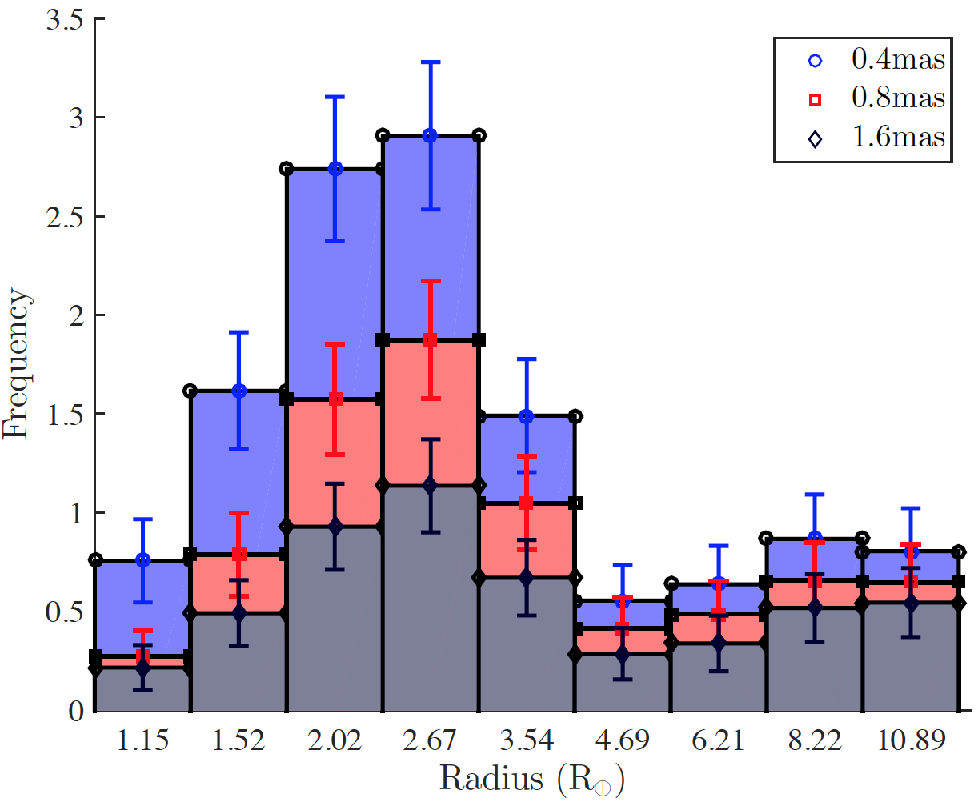
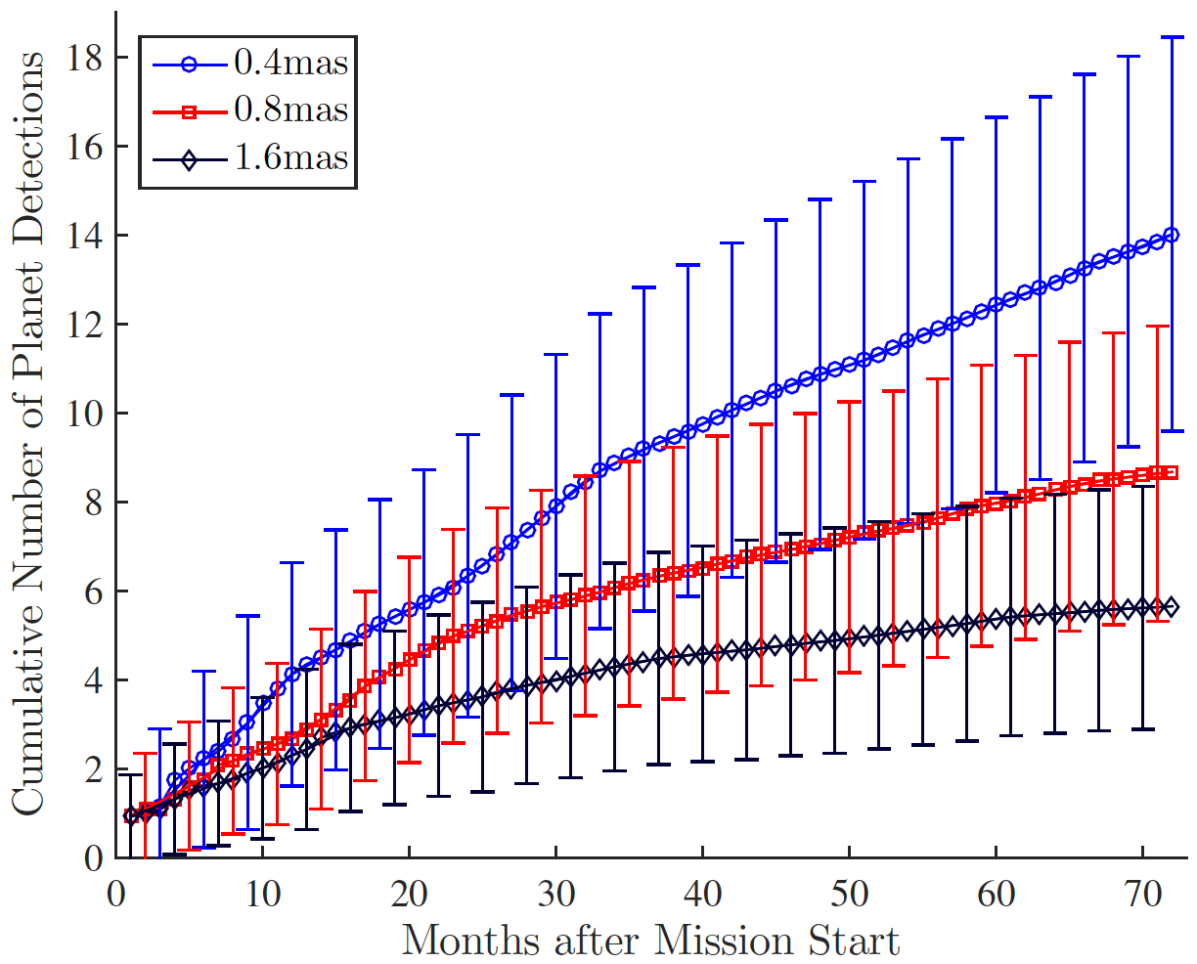
Anticipated Output Products
False Alarm Probability varies with separation
Mission Failure Modes
Instrument Bias
Mission Execution
Savransky and Garret, 2015

Slide 16
backup

Slide 17
Simulated Mission Ensemble
Monte Carlo DRMs (Design Reference Missions)
Planet Populations
Star
Catalog
Simulate Universe_{j}
(populate planets)
Schedule
Mission_{j}
Yield
Stats
Detect
Instrument
Characterize
Simulate a universe by sampling planet population distributions
Schedule a mission using spacecraft and mission observing constraints
Dynamically respond to detections
Repeat with a new universe 1,000 times

Slide 18
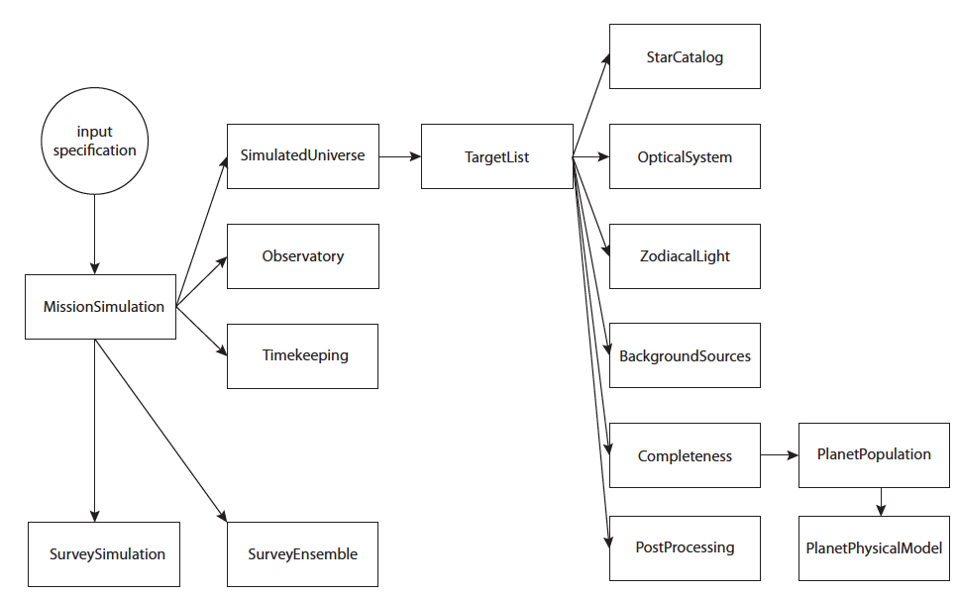
EXOSIMS Architecture
Discovery of synthetic planets
EXOCAT1
HabZoneExoearthUniverse
KasdinBraems
KeplerLikeUniverse
Nemati
WFIRSTObservatoryL2
Stark
GalaxiesFaintStars
KeplerLike1
BrownCompleteness
EarthTwinHabZone1
EarthTwinHabZone2
D. Savransky, 2016
FortneyMarleyCahoyMix1

Slide 19
EXOSIMS Architecture
Characterization of Known planets
KasdinBraems
KnownRVPlanetsUniverse
KnownRVPlanetsTargetList
Nemati
WFIRSTObservatoryL2
Stark
GalaxiesFaintStars
KnownRVPlanets
D. Savransky, 2016

Slide 20
Draft Input Parameter Request
ExEP Yield Input Parameters
 | Input | Default | Notes
Astrophysics
type of planets |  | EarthTwin | uniform random, keplerLike, KnownRV
EarthTwin
eta_earth |  | 0.16
planet radius |  | 1 earth radius
planet mass |  | 1 earth mass
geometric albedo |  | 0.2 | Lambert phase function is used
semi-major axis |  | [0.75, 1.5] AU | uniform random distribution
eccentricity |  | [0,0.35] | uniform random distribution
cos(inclination) |  | [-1, 1] | uniform random distribution
argument of perigree |  | [0, 360] degrees | uniform random distribution
ascension of the ascending node |  | [0, 360] degrees | uniform random distribution
Zodical Light model |  | Stark | local zodi, interpolates for longitude
exozodi mean and variance |  | 22 mag/asec^2 | no spatial variance. Variance is log normal star to star.
Telescope
Diameter of pupil | study parm
shape factor |  | pi/4 | shapeFac * D^2 = Area
obscuration factor |  | 0.2 | due to spiders, secondary
throughput |  | 0.57 | Telescope only, not coronagraph
telescope keep out angle |  | 45 degrees | sun avoidance
Detection lambda |  | 550 nm
detection bandwidth |  | 0.2 | delta_lambda/lambda
Spectra central lambda |  | 550 nm
spectral BW |  | R 70
SNR detection |  | 5
SNR characterization |  | 10
limiting deltamagnitude |  | 26
minimum completeness |  | 0.1
integration time cutoff |  | 30 days | maximum allowed integration time
Occulters
Internal Coronagraph type |  | HLC
IWA |  | 2.5 lambda/D
OWA |  | 10 lambda/D
Contrast
Throughput for Coronagraph
delta_mag limit |  | 26
DetectionTimeMultiplier |  | 1 | 2 for polarizations, another 2 for RDI
CharacterizationTime Multiplier |  | 1 | 2 for polarizations
Optical Overhead time |  | 1 day
starshade diameter tip to tip
number of starshade distances
starshade distance |  |  | km
starshade blue edge |  |  | nm
starshade red edge |  |  | nm
Detectors
imaging or spectrometer
dark current |  | 0.00009 e-/s | defaults are for WFIRST EM-CCD
readNoise |  | 3 e-
exposure time per frame |  | 1000 seconds
QE |  | 0.88
R |  | 70
CIC |  | 0.0013
ENF |  | 1.414 | sqrt(2)
EM CCd gain |  | 500
Post Processing
post-processing contrast factor |  | 1/10 | input can be [0,1]. 1/10 and 1/30 are common
allowable false alarm probability |  | 3.00E-05
allowable missed detction probability |  | 1.00E-03
Mission
mission lifetime |  | 5 years
fraction to exoplanets |  | 0.5
start date |  | January 1, 2036
Observatory
settlingTime |  | 1 day | after repointing, especially for occulter formation flying
occulter slew thrust |  | 450 mN
occulter slew Isp |  | 4160 | specific impulse
occulter initial wet mass |  | 6000 kg
Telescope spacecraft mass |  | 5800 kg
occulter station keeping Isp |  | 220 | specific impulse
default burn portion for slew |  | 0.05

