Slide 1
For this activity, you will play the roles of scientists and engineers. Have you ever wanted to travel to Mars? Have you wondered what goes into planning a mission to Mars? You and your team will design a mission to Mars. Just like NASA mission designers, you will have a catalog of mission hardware from which you can choose. Also, just like NASA mission designers, you will have budgets for mass, power and cost that you must keep in balance.

Slide 2
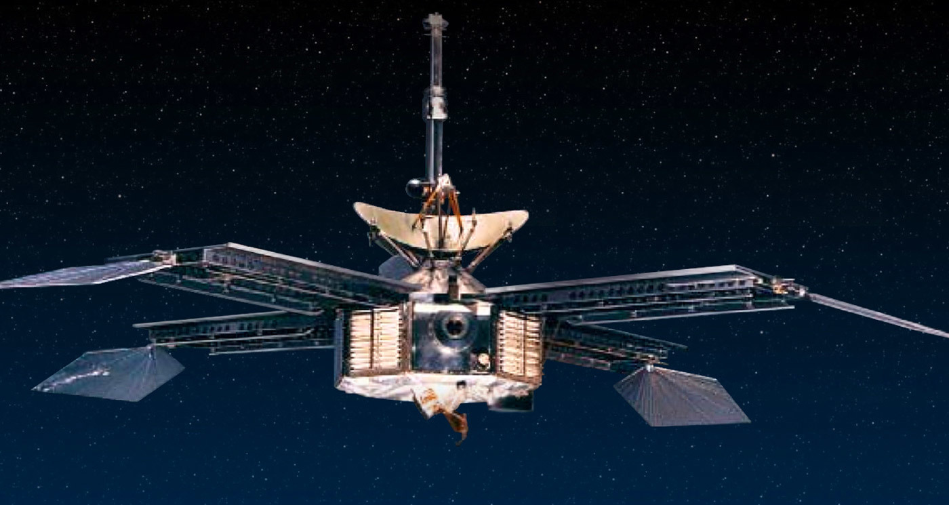
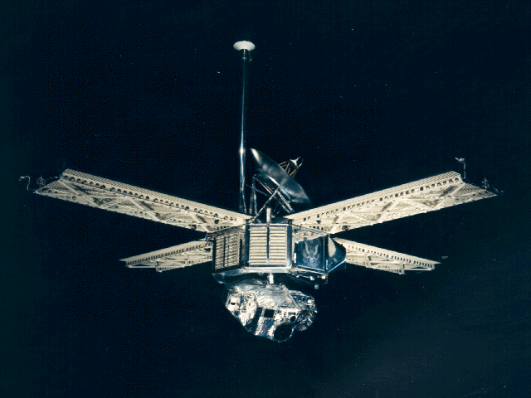
Mission Type: Flyby
Typically one of the first mission types to a planet or set of moons.
Notes:
Right-click images and select Hyperlink – Open Hyperlink for links to mission overviews:
Between 1962 and 1973, NASA's Jet Propulsion Laboratory designed and built 10 spacecraft named Mariner to explore the inner solar system -- visiting the planets Venus, Mars and Mercury for the first time, and returning to Venus and Mars for additional close observations. The Mariners were all relatively small robotic explorers, each launched on an Atlas rocket with either an Agena or Centaur upper-stage booster, and weighing less than half a ton (without onboard rocket propellant).
Mariner 3 and 4 were identical spacecraft designed to carry out the first flybys of Mars. Mariner 3 was launched on November 5, 1964, but the shroud encasing the spacecraft atop its rocket failed to open properly, and Mariner 3 did not get to Mars. Three weeks later, on November 28, 1964, Mariner 4 was launched successfully on an eight-month voyage to the red planet.
The spacecraft flew past Mars on July 14, 1965, collecting the first close-up photographs of another planet. The pictures, played back from a small tape recorder over a long period, showed lunar-type impact craters (just beginning to be photographed at close range from the Moon), some of them touched with frost in the chill Martian evening. The Mariner 4 spacecraft was not expected to survive much longer than the eight months to its Mars flyby encounter, but actually lasted about three years in solar orbit, continuing long-term studies of the solar wind environment and making coordinated measurements with Mariner 5, a sister ship launched to Venus in 1967.
Mariner 6 and 7 were the second pair of Mars missions in NASA's Mariner series of solar system exploration in the 1960s and early 1970s. As with the other Mariners, each launched on an Atlas rocket with either an Agena or Centaur upper-stage booster and weighed less than half a ton (without onboard rocket propellant).
In 1969, Mariner 6 and Mariner 7 completed the first dual mission to Mars, flying by over the equator and south polar regions and analyzing the Martian atmosphere and surface with remote sensors, as well as recording and relaying hundreds of pictures. By chance, both flew over cratered regions and missed both the giant northern volcanoes and the equatorial grand canyon that was discovered later. Their approach pictures did, however, show that the dark features on the surface long seen from Earth were not canals, as once interpreted in the 1800s.

Slide 3
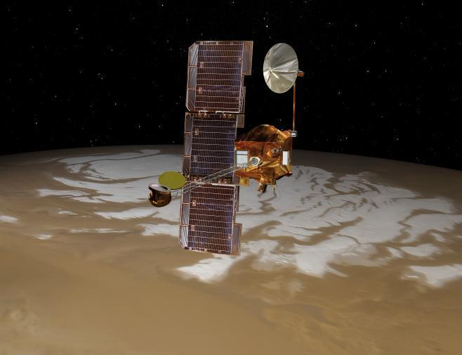
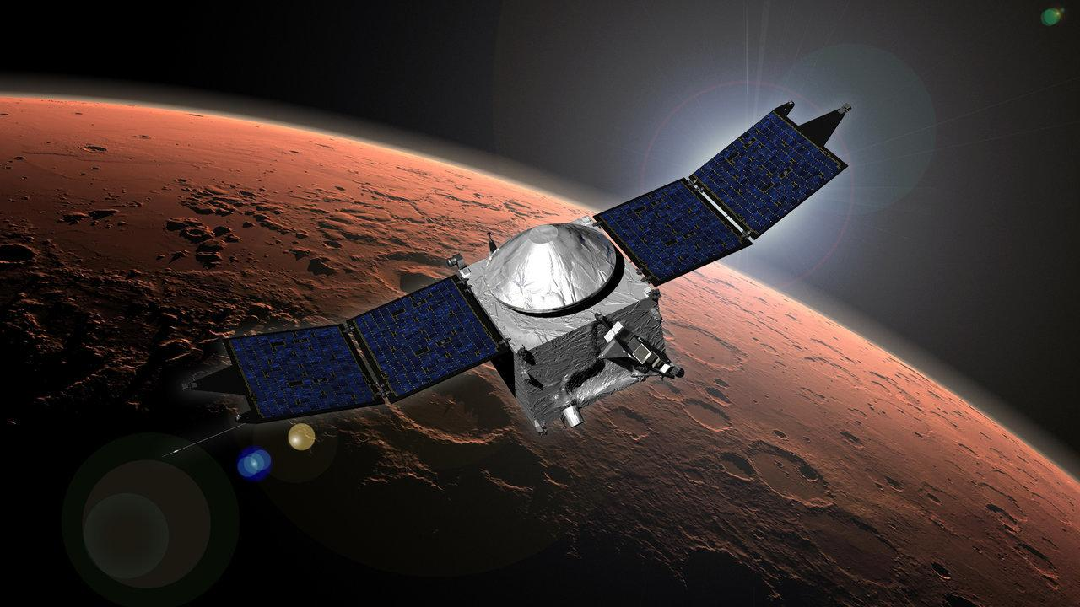
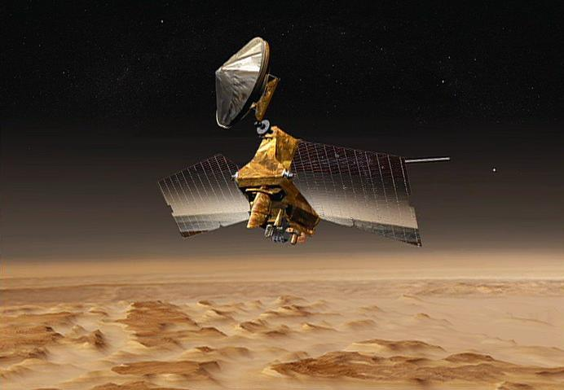
Mission Type: Orbiters
Typically the second mission type to collect global data, such as photos of the surface and general mineral make-up of the planet.
Notes:
Right-click images and select Hyperlink – Open Hyperlink for links to mission overviews:
The 2001 Mars Odyssey mission is NASA's longest-lasting spacecraft at Mars. The spacecraft launched on April 7, 2001, and arrived at Mars on October 24, 2001, 0230 Universal Time (October 23, 7:30 pm PDT/10:30 EDT). Its mission includes making the first global map of the amount and distribution of many chemical elements and minerals that make up the Martian surface. It successfully completed its primary science mission from February 2002 through August 2004. The orbiter's extended operations continue today.
Measurements by Odyssey have enabled scientists to create maps of minerals and chemical elements and identify regions with buried water ice. Images that measure the surface temperature have provided spectacular views of Martian topography. Early in the mission, Odyssey determined that radiation in low-Mars orbit -- an essential piece of information for eventual human exploration because of its potential health effects -- is twice that in low-Earth orbit.
The Odyssey orbiter is a communications relay for rovers and landers on Mars including the Mars Exploration Rovers "Spirit" and "Opportunity," the Mars Phoenix lander and the Mars Science Laboratory's Curiosity rover. Images and other measurements from Mars Odyssey help identify potential landing sites for rovers and landers.
NASA's Mars Reconnaissance Orbiter, launched in August, 2005, carries the most powerful camera ever flown on a planetary exploration mission for homing in on details of Martian terrain with extraordinary clarity. While previous cameras on other Mars orbiters were able to identify objects no smaller than a dinner table, this camera is able to spot something as small as a dinner plate. This capability provides not only an astoundingly detailed view of the geology and structure of Mars, but helps identify obstacles that could jeopardize the safety of future landers and rovers.
The Mars Reconnaissance Orbiter also carries a sounder to find subsurface water, an important consideration in selecting scientifically worthy landing sites for future exploration.
Other science instruments on this multitasking, multipurpose spacecraft identify surface minerals and study how dust and water are transported in the Martian atmosphere. A second camera acquires medium-resolution images that provide a broader geological and meteorological context for more detailed observations from higher-resolution instruments.
The Mars Reconnaissance Orbiter also serves as the first installment of an "interplanetary Internet," a crucial service for future spacecraft. As the first link in a communications bridge back to Earth, the Mars Reconnaissance Orbiter is used by several spacecraft.
MAVEN (Mars Atmospheric and Volatile EvolutioN) is the second mission selected for NASA's Mars Scout program, an initiative for smaller, low-cost, competed missions led by a principal investigator. Responsive to high-priority science goals listed in the National Academy of Science's 2003 decadal survey on planetary exploration, MAVEN is obtaining critical measurements of the Martian atmosphere to help understand dramatic climate change on the red planet over its history.
Long ago, Mars once had a denser atmosphere that supported liquid water on the surface. At that time, Mars might have had environmental conditions to support microbial life, as the long-term presence of water is necessary to life as we know it. However, as part of dramatic climate change, most of the Martian atmosphere was lost to space long ago. Features such as dry channels and minerals that typically form in water remain to provide a record of Mars' watery past, but the thin Martian atmosphere no longer allows water to be stable at the surface.
MAVEN is providing information on how and how fast atmospheric gases are being lost to space today, and inferring from those detailed studies what happened in the past. Studying how the Martian atmosphere was lost to space can reveal clues about the impact that change had on the Martian climate, geologic, and geochemical conditions over time, all of which are important in understanding whether Mars had an environment able to support life.
The first spacecraft ever to make direct measurements of the Martian atmosphere, MAVEN carries eight science instruments that are taking measurements of the upper Martian atmosphere. MAVEN can also dip to an altitude 80 miles above the planet to sample Mars' entire upper atmosphere. The spacecraft is able to provide communications relay support for landers and rovers on the Martian surface.

Slide 4
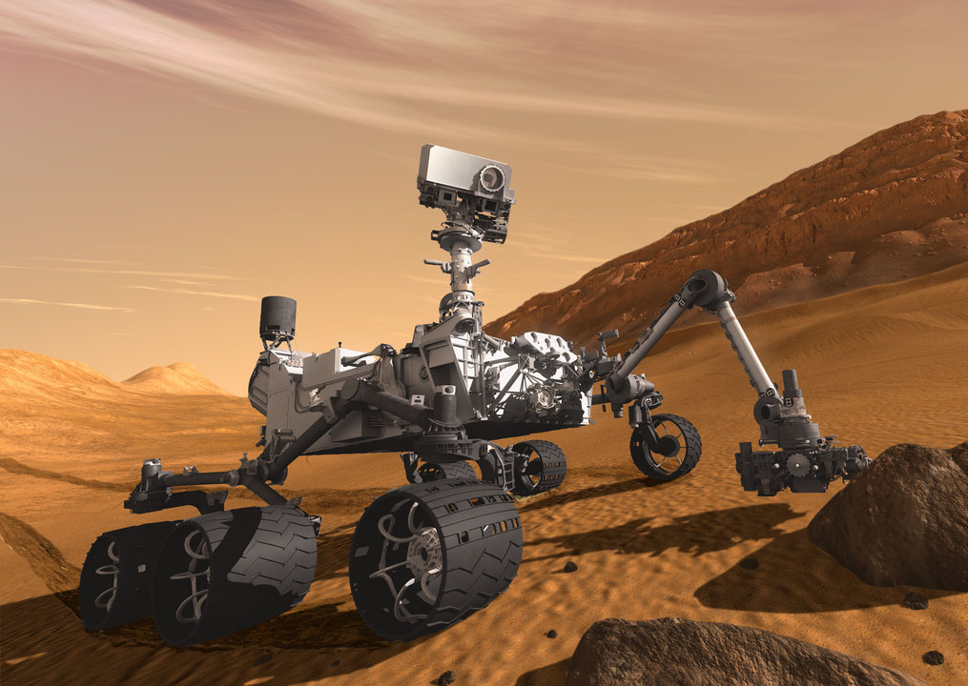
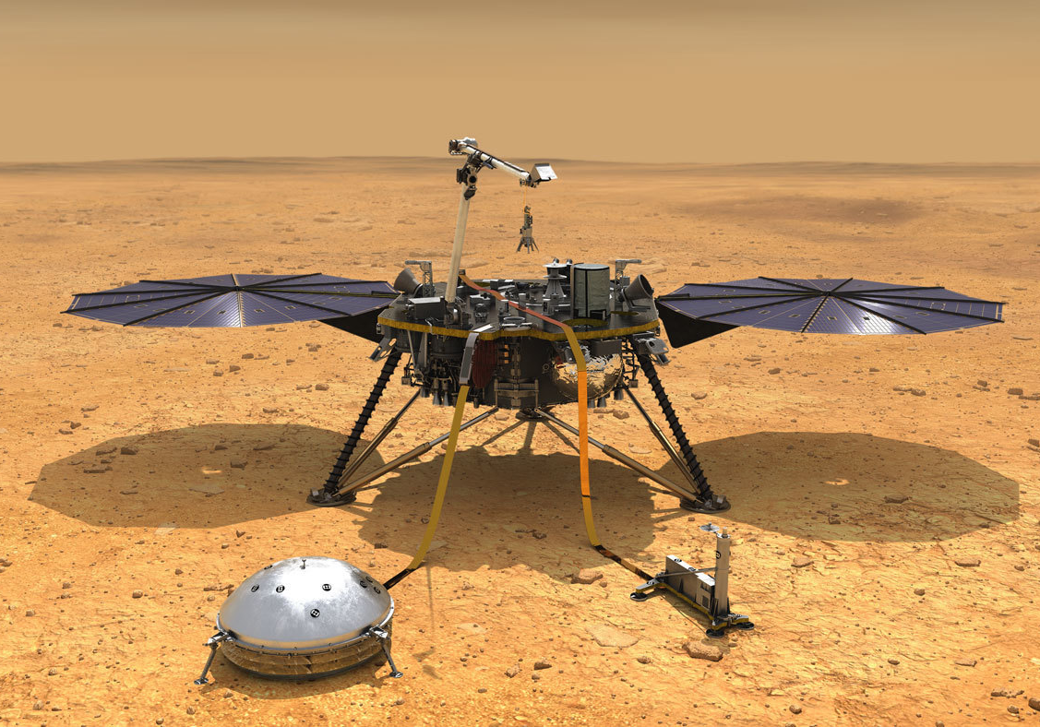
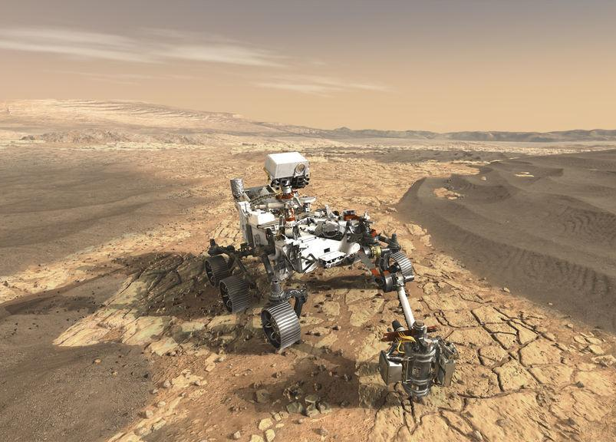
Mission Type: Landers and Rovers
Typically the third mission type to collect data, such as up-close photos of and mineral composition in one particular spot on the planet.
Notes:
Right-click images and select Hyperlink – Open Hyperlink for links to mission overviews:
Part of NASA's Mars Science Laboratory mission, Curiosity is the largest and most capable rover ever sent to Mars. It launched November 26, 2011 and landed on Mars at 10:32 p.m. PDT on Aug. 5, 2012 (1:32 a.m. EDT on Aug. 6, 2012). Mars Science Laboratory arrived at Mars through technological innovations that tested a completely new landing method. The spacecraft descended on a parachute, then during the final seconds before landing, the landing system fired rockets to allow it to hover while a tether lowered Curiosity to the surface. The rover landed on its wheels, the tether was cut, and the landing system flew off to crash-land a safe distance away.
It is fit to climb over knee-high obstacles and travels about 100 feet (30 meters) per hour, depending on instrument activity, the terrain, and visibility its cameras have of the path ahead. The rover carries a radioisotope power system that generates electricity from the heat of plutonium's radioactive decay. This electrical power source has already far exceeded its required operating lifespan on Mars' surface of at least one full Martian year (687 Earth days). The generator provides greater mobility and flexibility in operating the rover regardless of season or sunlight. The steady flow of electrical power enhanced the science payload capability and permitted consideration of landing sites at a greater range of latitudes than was possible on previous rovers.
Curiosity set out to answer the question: Did Mars ever have the right environmental conditions to support small life forms called microbes? Early in its mission, Curiosity's scientific tools found chemical and mineral evidence of past habitable environments on Mars. It continues to explore the rock record from a time when Mars could have been home to microbial life.
Curiosity explores Gale Crater and acquires rock, soil, and air samples for onboard analysis. The car-size rover is about as tall as a basketball player and uses a 7 foot-long arm to place tools close to rocks selected for study. Curiosity's large size allows it to carry an advanced kit of 10 science instruments. It has tools including 17 cameras, a laser to vaporize and study small pinpoint spots of rocks at a distance, and a drill to collect powdered rock samples. It hunts for special rocks that formed in water and/or have signs of organics.
Curiosity carries the biggest, most advanced instruments for scientific studies ever sent to the Martian surface. The history of Martian climate and geology is written in the chemistry and structure of the rocks and soil. Curiosity reads this record by analyzing powdered samples drilled from rocks. It also measures the chemical fingerprints present in different rocks and soils to determine their composition and history, especially their past interactions with water.
InSight (Interior Exploration using Seismic Investigations, Geodesy and Heat Transport) is a NASA Discovery Program mission that will place a single geophysical lander on Mars to study its deep interior. But InSight is more than a Mars mission - it is a terrestrial planet explorer that will address one of the most fundamental issues of planetary and solar system science - understanding the processes that shaped the rocky planets of the inner solar system (including Earth) more than four billion years ago.
By using sophisticated geophysical instruments, InSight will delve deep beneath the surface of Mars, detecting the fingerprints of the processes of terrestrial planet formation, as well as measuring the planet's "vital signs": Its "pulse" (seismology), "temperature" (heat flow probe), and "reflexes" (precision tracking).
InSight seeks to answer one of science's most fundamental questions: How did the terrestrial planets form?
The Mars 2020 Perseverance Rover mission is part of NASA's Mars Exploration Program, a long-term effort of robotic exploration of the Red Planet. The mission addresses high-priority science goals for Mars exploration, including key questions about the potential for life on Mars. Perseverance takes the next step by not only seeking signs of habitable conditions on Mars in the ancient past, but also searching for signs of past microbial life itself. The rover introduces a drill that can collect core samples of the most promising rocks and soils and set them aside in a "cache" on the surface of Mars. A future mission could potentially return these samples to Earth. That would help scientists study the samples in laboratories with special room-sized equipment that would be too large to take to Mars. The mission also provides opportunities to gather knowledge and demonstrate technologies that address the challenges of future human expeditions to Mars. These include testing a method for producing oxygen from the Martian atmosphere, identifying other resources (such as subsurface water), improving landing techniques, and characterizing weather, dust, and other potential environmental conditions that could affect future astronauts living and working on Mars.
Perseverance was timed for a launch opportunity between July 30 and Aug. 15, 2020, when Earth and Mars were in good positions relative to each other for landing on Mars. That is, it took less power to travel to Mars at that time, compared to other times when Earth and Mars are in different positions in their orbits. To keep mission costs and risks as low as possible, the Mars 2020 design is based on NASA's successful Mars Science Laboratory mission architecture, including its Curiosity rover and proven landing system.

Slide 5
When designing a mission to Mars, mission planners define many science objectives related to each of the four science goals. These science objectives reflect questions about the planet that they would like the mission to answer.

Slide 6
Here you will find a list of some of the science questions being studied by Mars scientists that can be selected as mission objectives–questions to be answered. For each science objective, place a checkmark in the box matching the Mars Exploration Program Goals that you think it matches. Keep in mind that each objective may apply to more than one of the four goals. Discuss with your team why you think each of these topics might be important.
✓
✓
✓
✓
✓
✓
✓
✓
✓

Slide 7
Think about questions you have about Mars that could be answered by a mission to the Red Planet. Click on the boxes to type your questions.

Slide 9
You will work with your team to design a spacecraft by choosing the cards that stand for each system involved in your mission. Read each card carefully to make sure you have all of the required systems on your spacecraft. Remember, your goal in this activity is to design a spacecraft with your team that stays under budget, is launchable, and meets your science goals. Your teacher will decide the budget of your mission and guide you through the first steps of your mission design. You will need to record your design in the Spacecraft Design Log. You may go back at any time to change your science goals and your design. In the end, you should have a good balance between meeting your science goals and satisfying your engineering constraints.
Notes:
Right-click “Spacecraft Design Log” and select Hyperlink > Open Hyperlink to access the file.

Slide 10
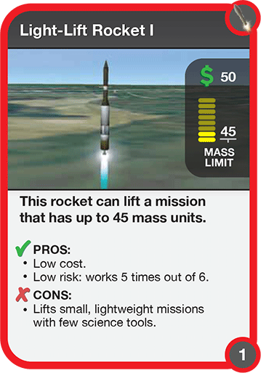
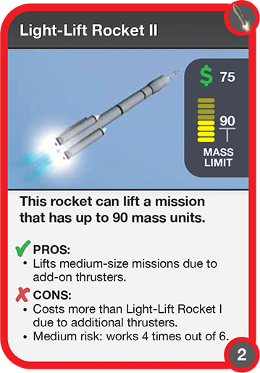
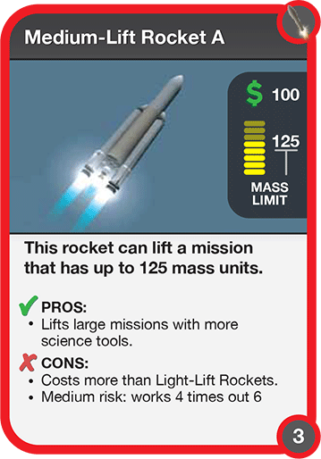
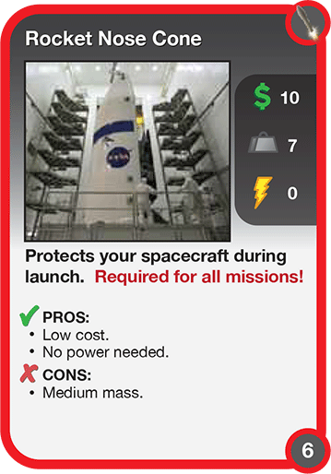
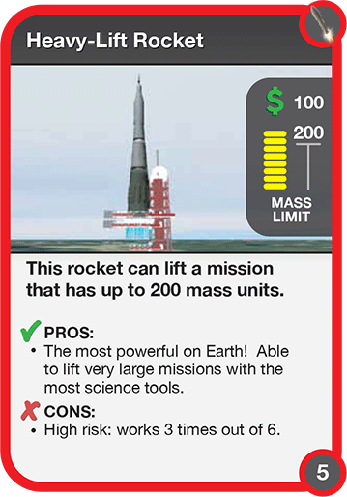
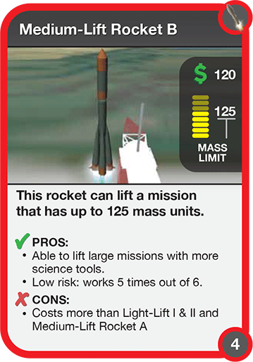

Slide 11
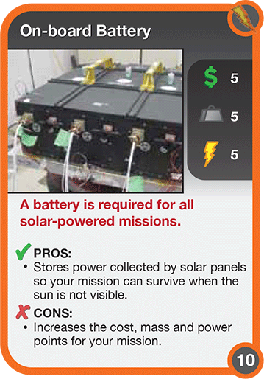

Slide 12
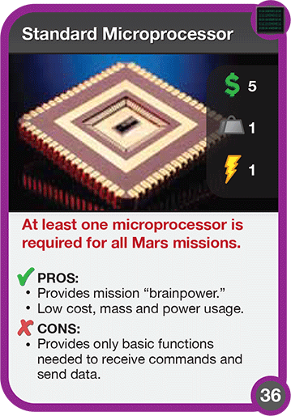
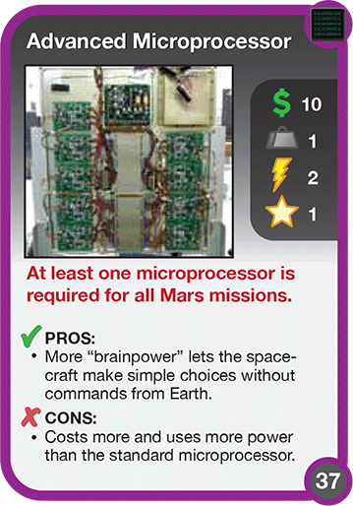
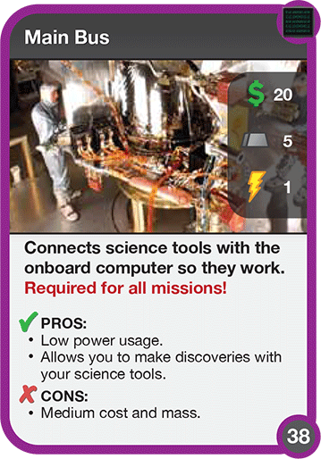
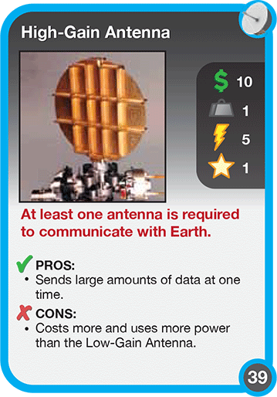
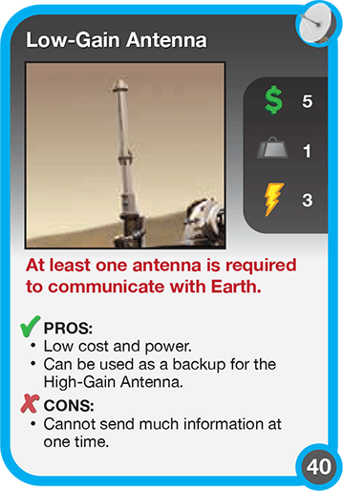
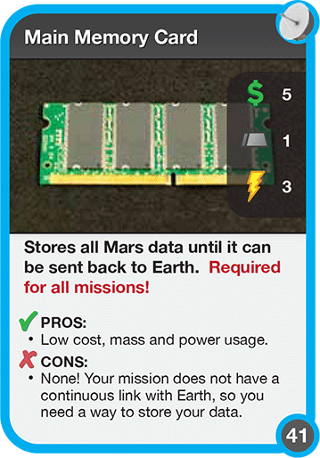

Slide 13
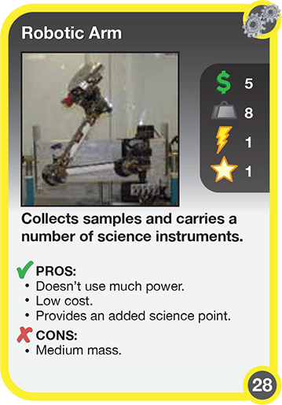
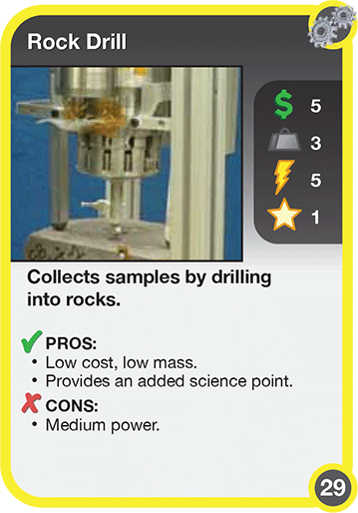
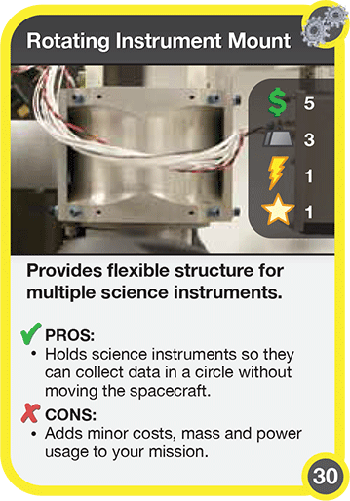
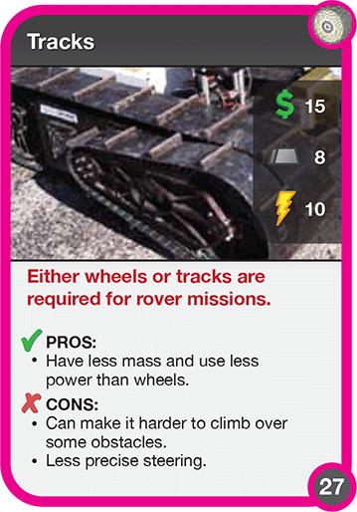
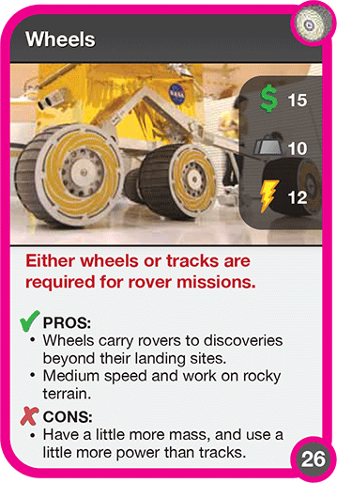

Slide 14
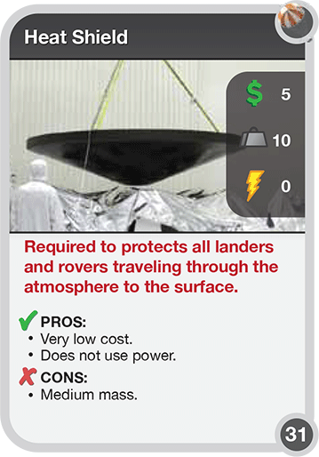
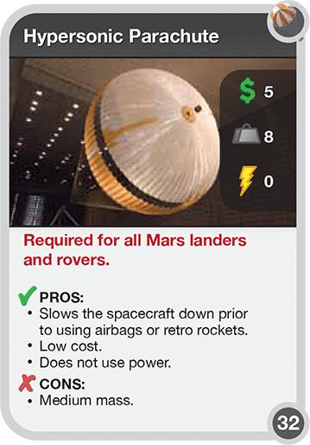
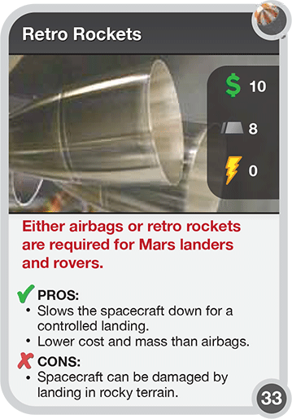
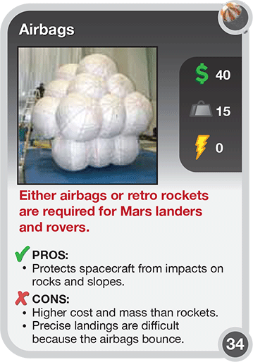
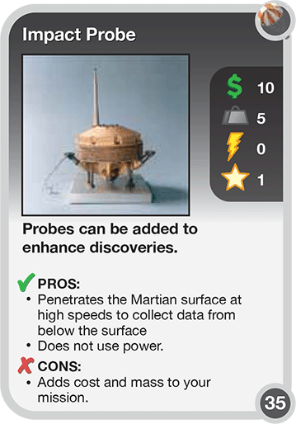

Slide 15
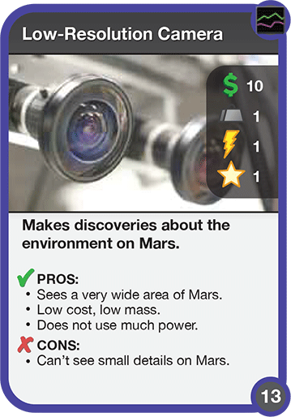
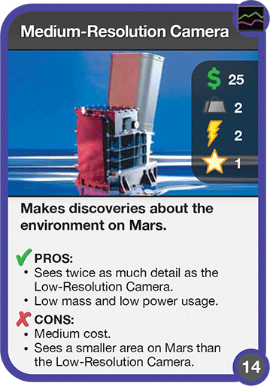
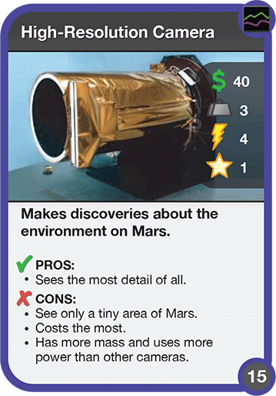
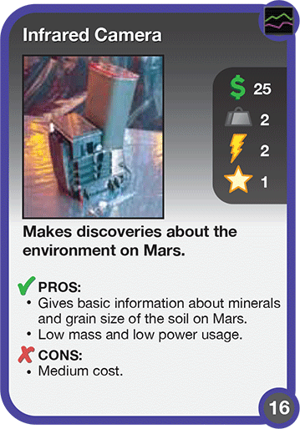
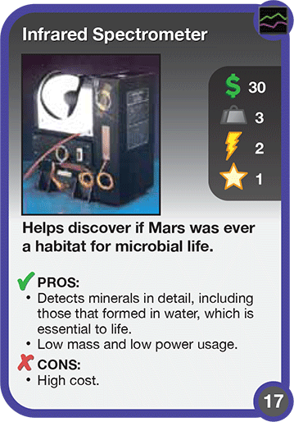
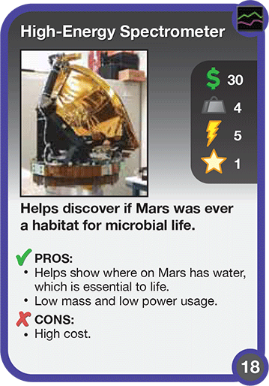

Slide 16
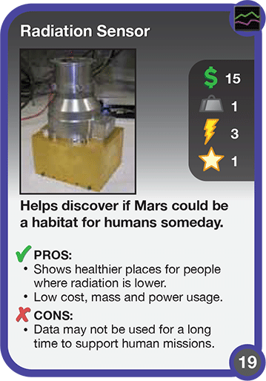
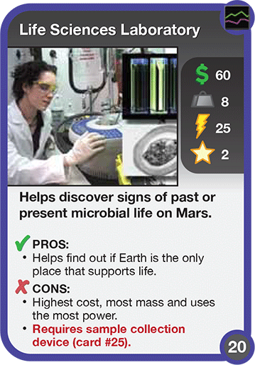
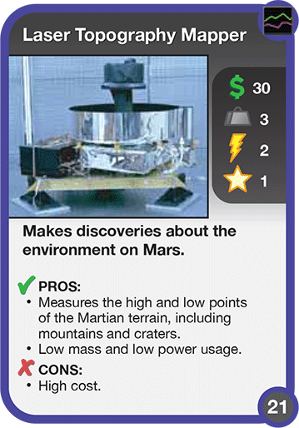
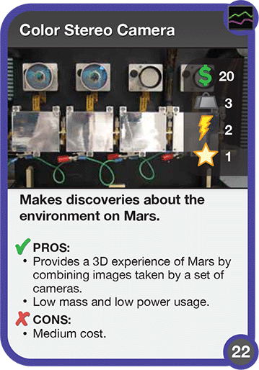
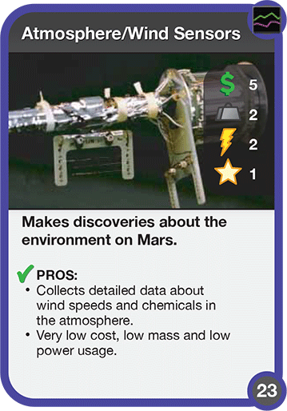
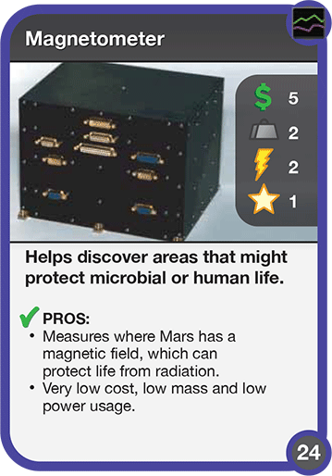
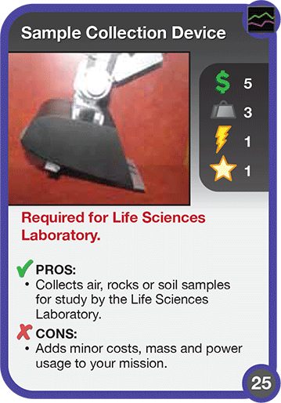

Slide 17
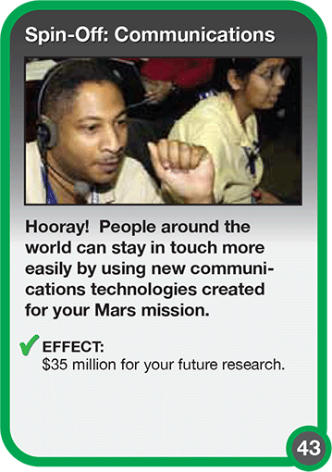
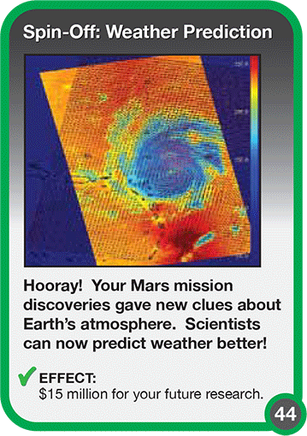
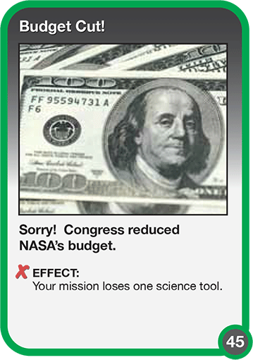
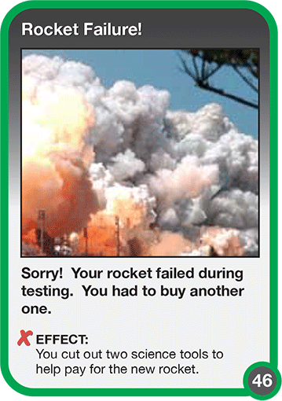
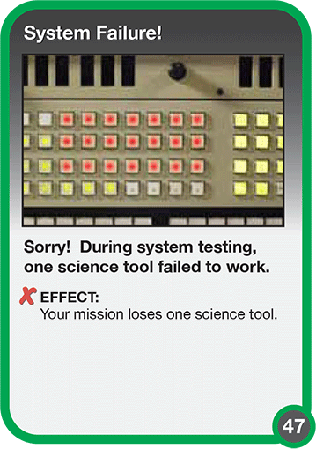
1
2
3
4
5
6
Optional: Teacher rolls a die to choose a special event card for the group based on the number rolled.

Slide 18
Notes:
If a card is “hidden” behind another card, you can right click on a card and choose “Order” from the menu and select “bring forward,” “bring to front,” “send backward,” or “send to back” to make it visible.

