Slide 1
What Causes the Colors You See on Mars?
Notes:
Before showing this slide, ask students what they know about Mars (how big it is, what color it is). Once students have exhausted their knowledge, show this slide. Explain that this is a hill on Mars. Ask what colors they see. Ask if anyone has an idea of what causes the various colors.
https://photojournal.jpl.nasa.gov/catalog/PIA21718
This dark mound, called "Ireson Hill," rises about 16 feet (5 meters) above redder layered outcrop material of the Murray formation on lower Mount Sharp, Mars, near a location where NASA's Curiosity rover examined a linear sand dune in February 2017.
Researchers used the rover's Mast Camera (Mastcam) on Feb. 2, 2017, during the 1,598th Martian day, or sol, of Curiosity's work on Mars, to take the 41 images combined into this scene. The mosaic has been white-balanced so that the colors of the rock and sand materials resemble how they would appear under daytime lighting conditions on Earth. The view extends from west-southwest on the left to north-northwest on the right. The faint horizon in the distance beyond Ireson Hill is part of the rim of Gale Crater. The rover's Sol 1598 location is mapped at https://mars.nasa.gov/multimedia/images/2017/curiositys-traverse-map-through-sol-1598 .

Slide 2
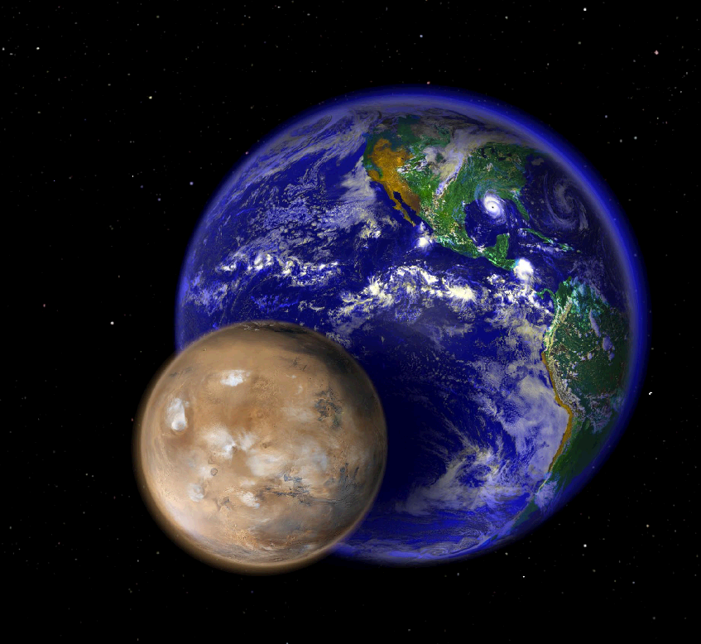
Beyond Earth, Mars is one of the only places in the
solar system where humans could one day live.
In size, Mars is about half the diameter of Earth.
Notes:
Mars is, on average 52 million miles away from Earth.
Ask students: If we want to learn more about Mars, how might we gain more information? Answers might include: read a book, look on the internet. Ask students: Where does the information in a book or on the internet come from? Answers might include: from NASA, from spacecraft, from telescopes.
In order to study Mars, NASA sends spacecraft to orbit, or circle, the planet from above, and to land and rove on the surface. Orbiting spacecraft let us see Mars from a distance, while landers and rovers give us a close-up views of the surface.

Slide 3
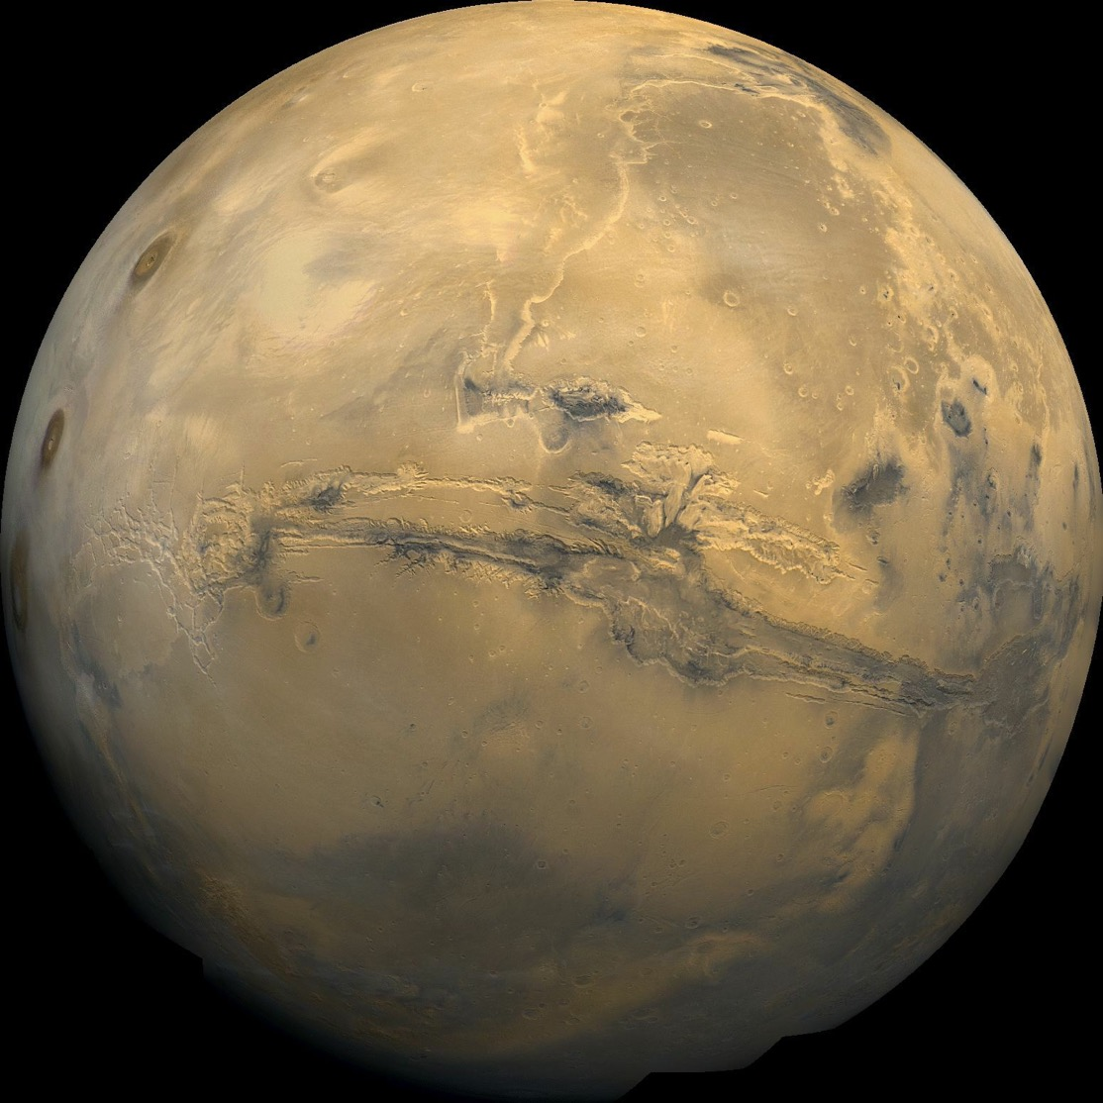
Notes:
A close-up view of Mars shows it has many surface features. Ask students: what do you see on the surface of Mars? Answers might include: the big “crack” or canyon (Valles Marineris) across the middle, the large “dots” or volcanoes along the left side of the image, various ”circles” or craters, light and dark features, squiggly lines.

Slide 4
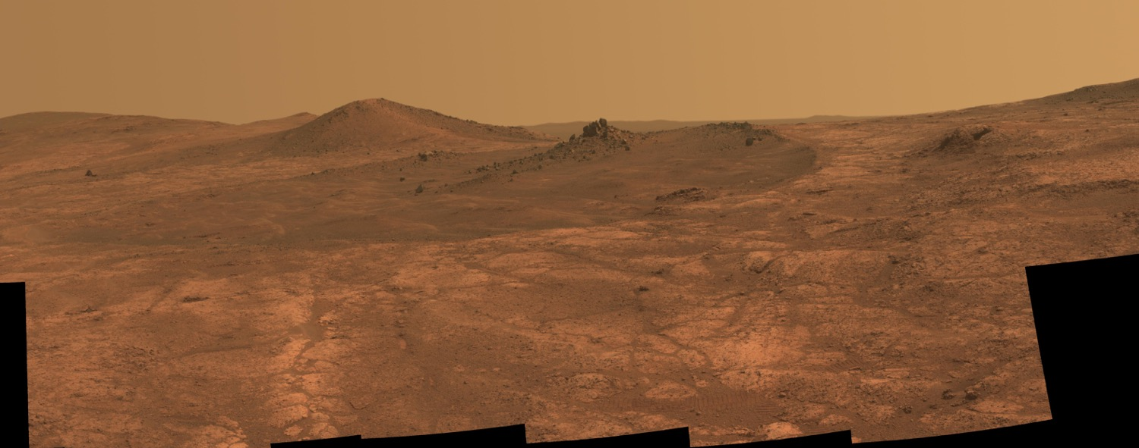
Notes:
Mars is often called the Red Planet because it has a reddish color when seen in the sky using telescopes and close up as in this image taken by one of the Mars rovers. Notice that even the sky is reddish or pink. That is from the surface dust being kicked up in the air by dust storms.

Slide 5
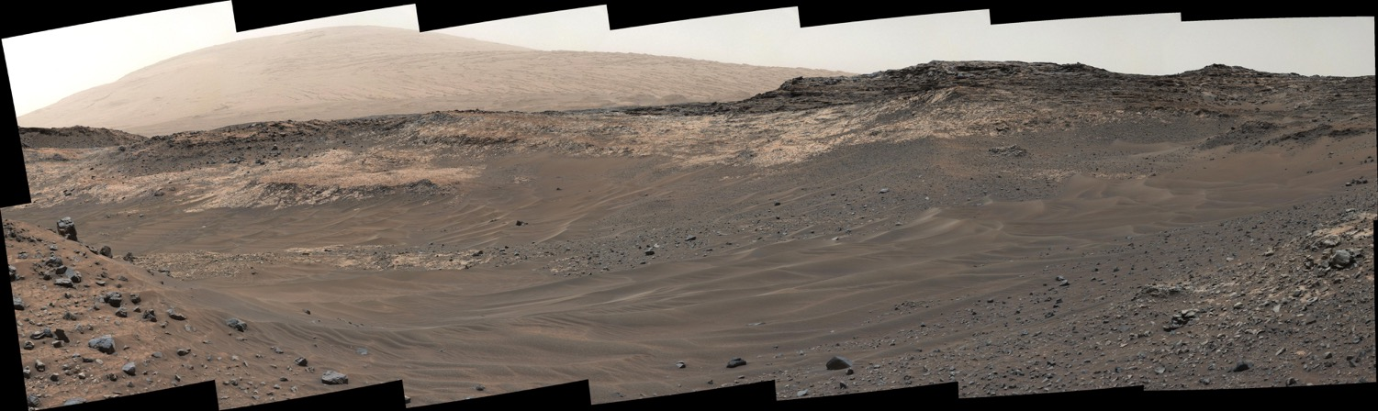
Notes:
Some images of Mars look a little less red because of computer color correction techniques. This image shows what Mars would look like if the lighting were similar to the lighting here on Earth. The surface still looks reddish and the sky still looks pink, but some features stand out more. Have students point out the features and colors they see. Answers might include: rocks and sand in the foreground, light-colored bedrock in the mid-ground, a rough cliff that looks eroded, a hill in the background.

Slide 6
Notes:
Different areas of Mars can look very different. Ask students what features and colors they see in this image. What do you think causes those features and color differences?
https://photojournal.jpl.nasa.gov/catalog/PIA21716
This look ahead from NASA's Curiosity Mars rover includes four geological layers to be examined by the mission, and higher reaches of Mount Sharp beyond the planned study area.
The redder rocks of the foreground are part of the Murray formation. Pale gray rocks in the middle distance of the right half of the image are in the Clay Unit. A band between those terrains is "Vera Rubin Ridge." Rounded brown knobs beyond the Clay Unit are in the Sulfate Unit, beyond which lie higher portions of the mountain.
The view combines six images taken with the rover's Mast Camera (Mastcam) on Jan. 24, 2017, during the 1,589th Martian day, or sol, of Curiosity's work on Mars, when the rover was still more than half a mile (about a kilometer) north of Vera Rubin Ridge. The panorama has been white-balanced so that the colors of the rock and sand materials resemble how they would appear under daytime lighting conditions on Earth. It spans from east-southeast on the left to south on the right. The Sol 1589 location was just north of the waypoint labeled "Ogunquit Beach" on a map of the area that also shows locations of the Murray formation, Vera Rubin Ridge, Clay Unit and Sulfate Unit.
The ridge was informally named in early 2017 in memory of Vera Cooper Rubin (1928-2016), whose astronomical observations provided evidence for the existence of the universe's dark matter.

Slide 7
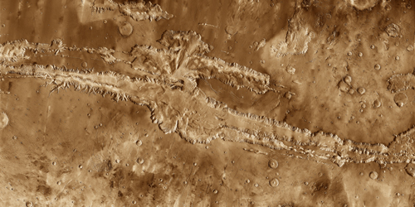
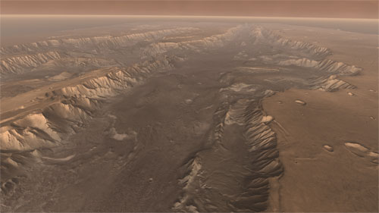
Deep Canyons
Artist’s concept of High View of Melas
Valles Marineris
Notes:
Here is an up-close look at the Grand Canyon of Mars - Valles Marineris. Notice how some features are shadowed. Also, notice how the cracks and disruptions to the surface are differently colored.
Upper left: Valles Marineris, as seen from an orbiting satellite. Notice the different colors on the surface. Where do you see color differences?
Lower right: This is an artist’s concept, using laser altimeter data, of what Valles Marineris would look like if we could fly over it in an airplane. What can you see in this image that might contribute to some of the color differences we observed in the upper left image? (answers might include flat surfaces vs sloped surfaces, rocky areas vs smooth areas, sunlight and shadows)
Upper left image details: This mosaic image of Valles Marineris - colored to resemble the martian surface - comes from the Thermal Emission Imaging System (THEMIS), a visible-light and infrared-sensing camera on NASA's Mars Odyssey orbiter.
Built from more than 500 daytime infrared photos, the mosaic shows the whole valley in more detail than any previous composite photo. Despite the valley's huge extent - including its western extension through Noctis Labyrinthus, it reaches some 3,000 kilometers (2,000 miles) long - the smallest details visible in the image are about the size of a football field: 100 meters (328 feet).
Geologists think Valles Marineris began to open along geological faults about 3.5 billion years ago. The faulting was caused by the tectonic activity that accompanied the growth of the giant volcanoes in Tharsis, lying just to the west. As molten rock (magma) pushed into Tharsis from below, the entire region rose, and the surrounding crustal rocks stretched and broke into faults and fractures.
As cracks opened, the ground sank, much as the keystone in an arch drops when the ends of the arch move apart. The faulting also opened paths for subsurface water to escape, undermining the ground and enlarging the fracture zone. In countless places, the valley's steep, newly exposed walls became unstable, causing landslides that widened the canyon further. It's not clear when the valley's growth stopped - and in places even today small landslides undoubtedly occur. But it appears the main activity came to a halt roughly 2 billion years ago.
Lower right image details: High View of Melas
Soaring high above Valles Marineris, the "Grand Canyon of Mars," viewers look down and catch a sight resembling parts of the desert West of the United States, but on a vastly greater scale. Here the canyon averages over a hundred miles wide, and its floor is heaped with rocks, sediments, and landslide debris. Within the canyon walls lie possibly hundreds of layers filling many pages of Mars' geologic record.
This scene comes from "Flight Into Mariner Valley," an exciting video produced for NASA by the Jet Propulsion Laboratory https://www.jpl.nasa.gov/video/details.php?id=474 . The video takes viewers on a simulated flight into Valles Marineris, where they explore its scenic wonders as their imaginary scout ship dives low over landslides and races through winding canyons.

Slide 8
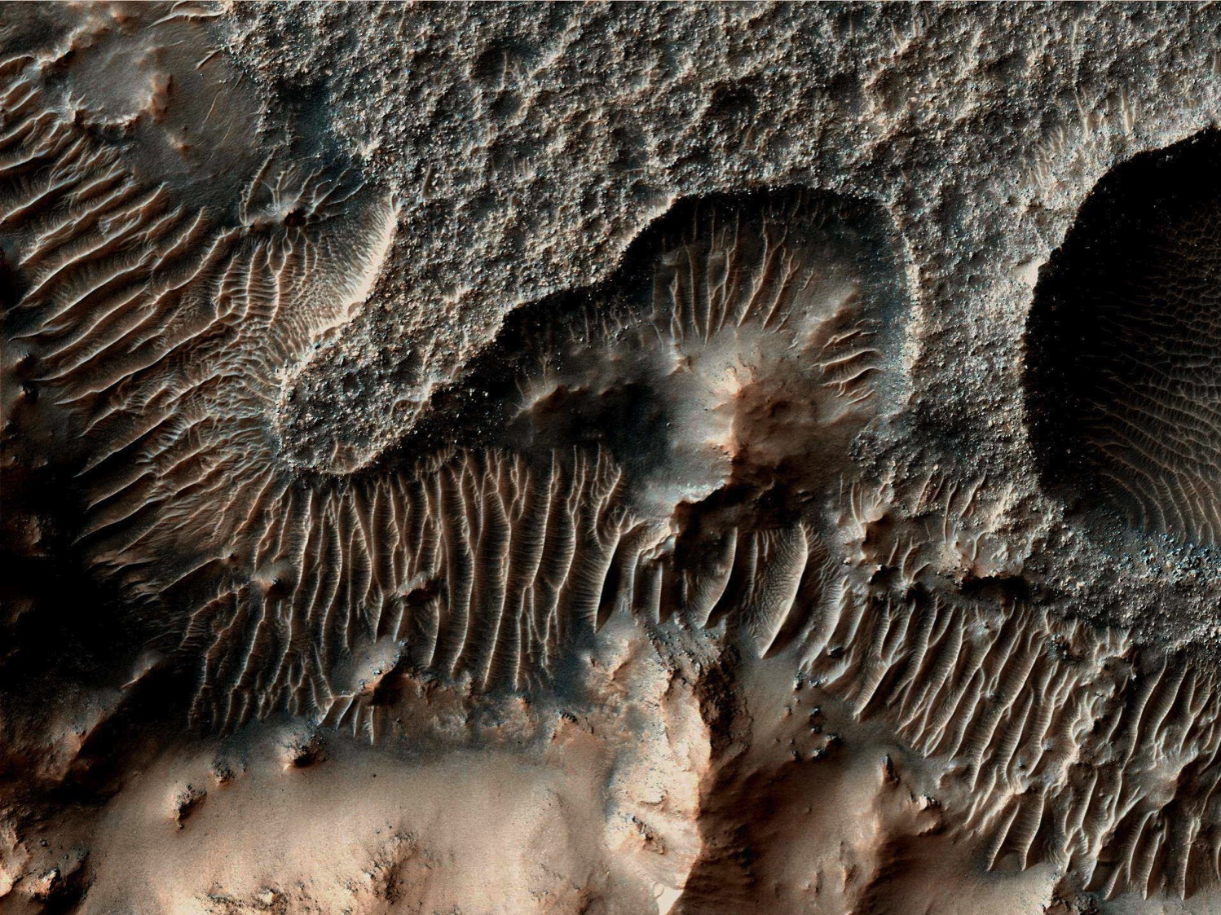
Notes:
This is a close-up of the Mars surface as viewed from an orbiting satellite. What color variations do you see? What do you think causes those variations? (answers might include: shadows in valleys and craters, different surface material, rough vs smooth surfaces)

Slide 9
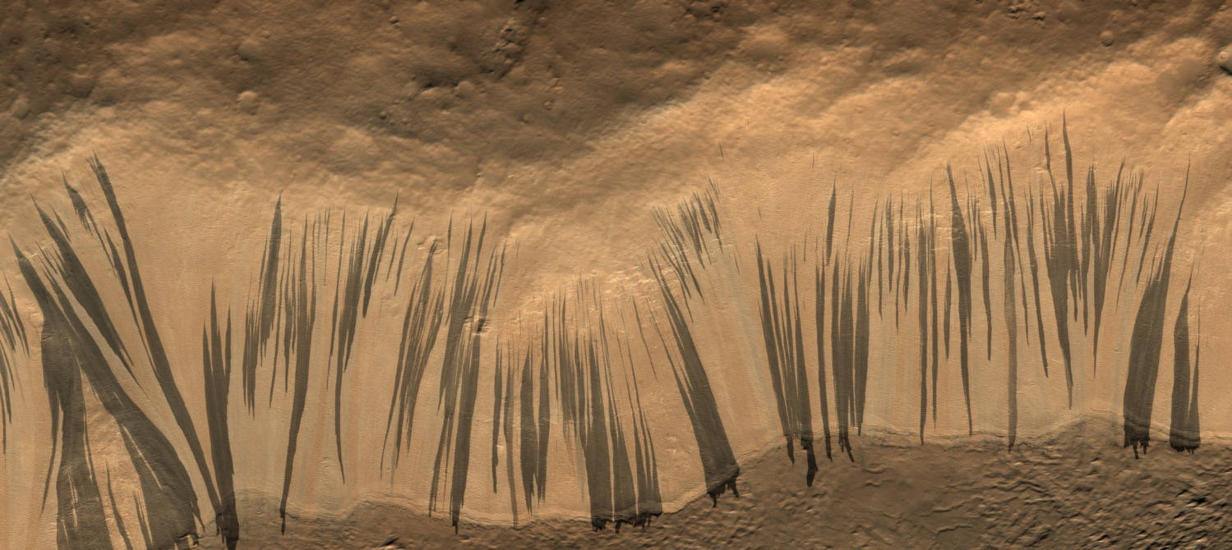
Thousands of New Slope Streaks
Form Every Year
Notes:
Ask students: What do you see in this image? Answers might include: dark “strokes” or lines on a light background. Ask students what might create these features. Answers might include: water flowing, wind, lava flows.

Slide 10
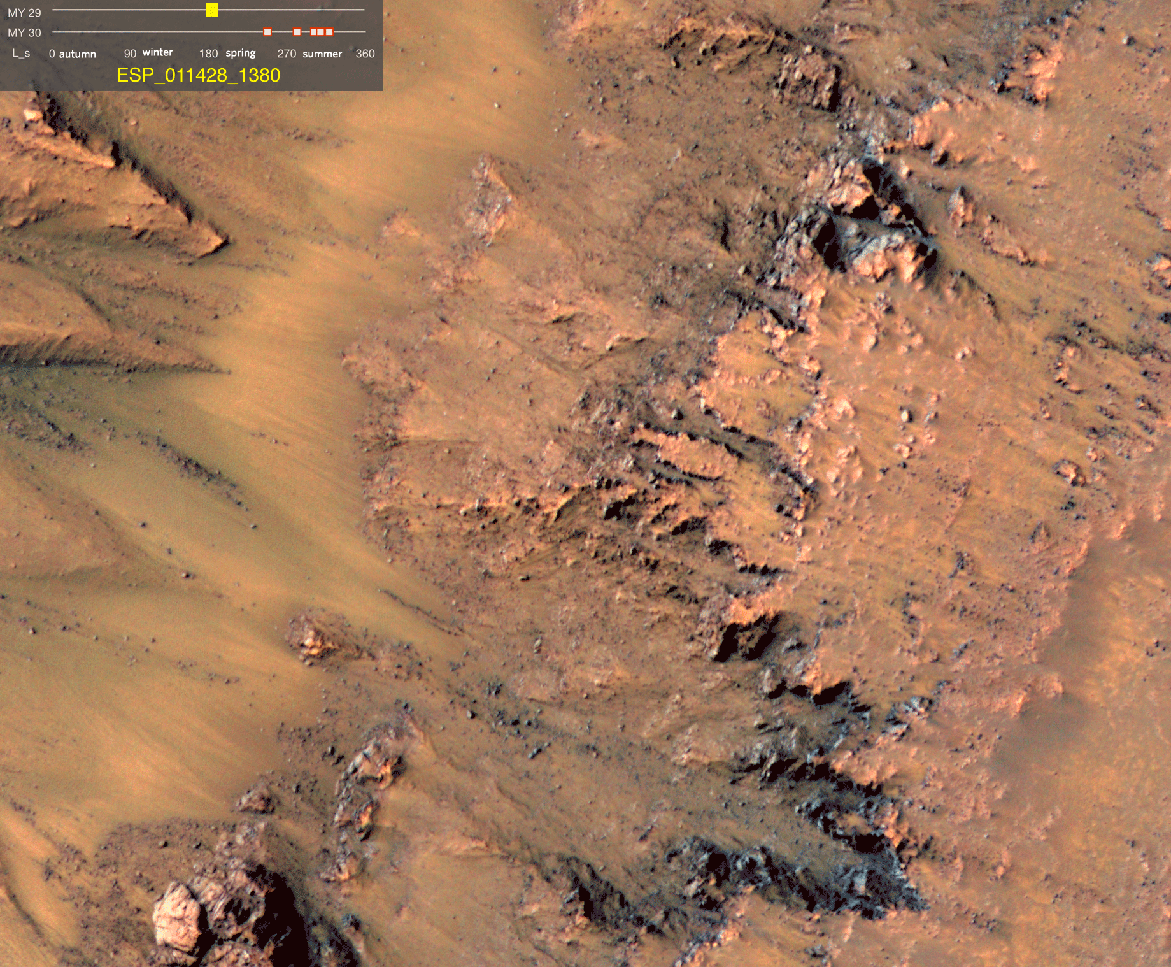
Recurring Slope Lineae
Notes:
Here’s what’s really going on (gif should automatically play showing features appearing where they were not obvious before).
This series of images shows warm-season features that might be evidence of salty liquid water active on Mars today. Repeat imaging by HiRISE shows the features appear and grow during warm seasons and fade in cold seasons.
Ask students: Why are the recurring slope lineae dark? Answer: because they are wet ”dirt.”
More details: This series of images shows warm-season features that might be evidence of salty liquid water active on Mars today. Liquid brines near the surface might explain this activity, but the exact mechanism and source of the water are not understood. The features that extend down the slope during warm seasons are called recurring slope lineae. They are narrow (one-half to five yards or meters wide), relatively dark markings on steep (25 to 40 degree) slopes at several southern hemisphere locations. Repeat imaging by HiRISE shows the features appear and incrementally grow during warm seasons and fade in cold seasons. They extend downslope from bedrock outcrops, often associated with small channels, and hundreds of them form in rare locations. They appear and lengthen in the southern spring and summer from 48 degrees to 32 degrees south latitudes favoring equator-facing slopes.

Slide 11
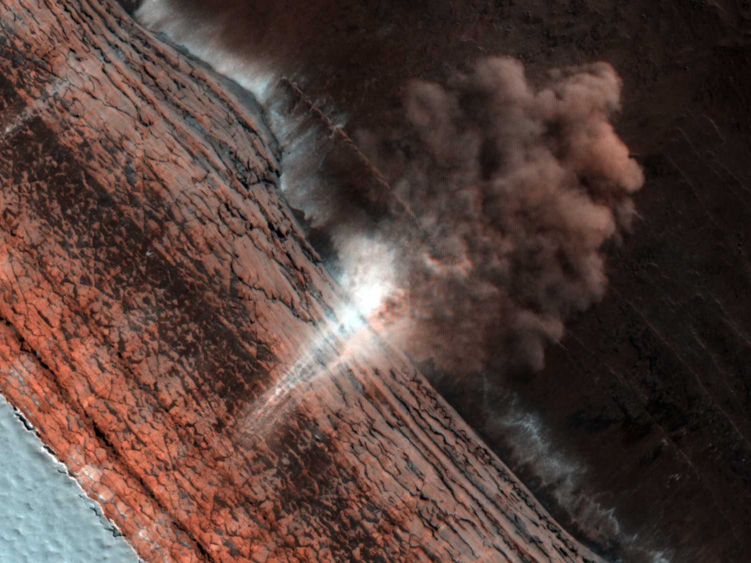
Polar Avalanches
Notes:
Ask students what they see in this image. Ask them to especially note the varying colors and hypothesize about the origin of the colors. Note that the white triangle in the lower left corner of the image is polar ice at the edge of a cliff.
In October 2011 (spring on Mars), the Mars Reconnaissance Orbiter observed an avalanche.
More details:
ESP_016228_2650
A large (approximately 200 meters or 600 feet across) cloud of reddish dust has been kicked up at the base of the scarp. Fine tendrils of bright wisps are visible farther up the cliff face—these may be individual falls of material, before spreading out as the avalanche plummets downward.
This might allow scientists to figure out the exact location of the start of the avalanche; for example, which layer it originally came from and how far it fell. This information will help narrow down what triggers these falls: is it seasonal temperature changes in the ice layers, gusts of wind passing over loosened rocks in steep slopes, or something else entirely?
The upper, steepest section, which appears highly fractured due to blocks pulling away from the wall, is the likely source zone for the falls. The precise trigger mechanism is not yet known, although the disappearance of the carbon dioxide frost, the expansion and contraction of the ice in response to temperature differences, a nearby Mars-quake or meteorite impact, and vibrations caused by the first fall in the area, are all possible contributors.

Slide 12
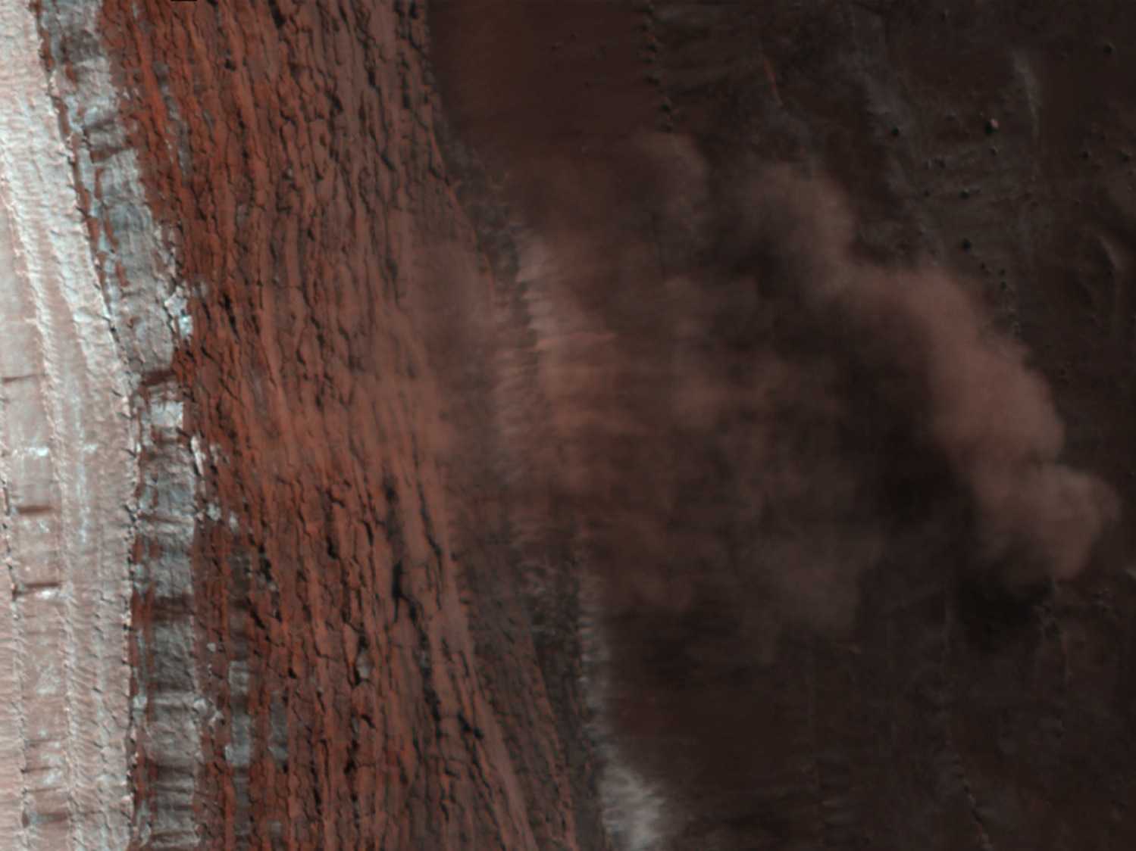
Image width ~0.5 km
Notes:
Another view of the avalanche. Have students note what more they can see in this slide than slide 10. Ask students how big the dust cloud is. Explain that it is about as wide as two football fields placed end-to-end.
More details:
Avalanches in the NPLD – 83.7 N 235.8E PSP_007338_2640
The largest cloud (upper images) traces the path of the debris as it fell down the slope, hit the lower slope, and continues downhill, forming a billowing cloud front. This cloud is about 180 meters (590 feet) across and extends about 190 m (625 ft) from the base of the steep cliff. Shadows to the lower left of each cloud illustrate further that these are three dimensional features hanging in the air in front of the cliff face, and not markings on the ground (sun is from the upper right).

Slide 13
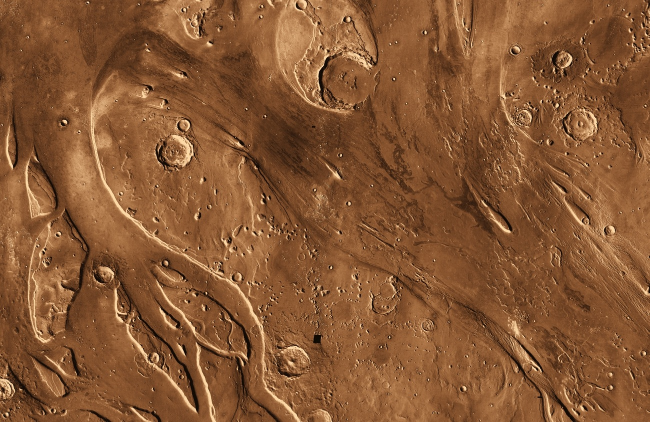
Mars Has a Complex History
Streambeds?
Notes:
Ask students to identify features in this image. Answers might include: craters, curved lines, possible waterways.
Details: Together Ares Vallis and its neighbor to the west, Tiu Vallis, flow northward out of the highlands into the broad depression of Chryse Planitia. Both channels were fed by escaping ground water, though from different sources.
Tiu Vallis, which lies on the left side of the big image, connects upstream to a pair of regions where hills and mesas lie jumbled together. Planetary geologists think such "chaotic terrain" shows where subsurface water escaped in one or more outbursts, and the ground collapsed.
Ares Vallis has several sources, among them Aram Chaos, an old impact crater or basin 500 kilometers (300 miles) in diameter.
Aram has drawn much attention since scientists using the Thermal Emission Spectrometer (TES) on the Mars Global Surveyor orbiter found the mineral hematite within the crater's chaotic deposits. Formed in association with water, the hematite points to at least one wet climatic epoch well after the crater's own formation. A small breach in Aram's eastern rim shows where escaping ground water broke through to Ares Vallis and flowed out.
Yet even these sources are unlikely to be the ultimate one for Ares and Tiu. South from Aram runs a long chain of craters, depressions, and chaotic terrain linked by channels and spillways that extends far into the Arabia highlands. Called the Uzboi-Ladon-Margaritifer system, this lengthy channel reaches to the rim of the Argyre impact basin, about 3,500 km (2,200 mi) south from here.
For Tiu, elevation maps show that floodwaters could have poured out of the east end of Valles Marineris. These floods would be fed by escaping ground water and perhaps the draining of hypothesized lakes within Valles Marineris. These waters would have joined with those from the chaotic terrain that fed Tiu more directly.
The stark difference between today's cold, dry Mars and the clear evidence of floodwaters in the past tells scientists that the Martian climate has seen great changes, probably over repeating cycles. Calculations show that the last several million years have seen repeated swings in climate, in which ice ages deposit water (as snow and ice) even near the equator, recharging aquifers and setting the stage for later outbursts that create floods.
Unraveling the workings of that climate history is one of the major challenges in Mars science.
The image here combines frames taken during daytime at infrared wavelengths by the Thermal Emission Imaging System (THEMIS) on board NASA's Mars Odyssey orbiter.

Slide 14
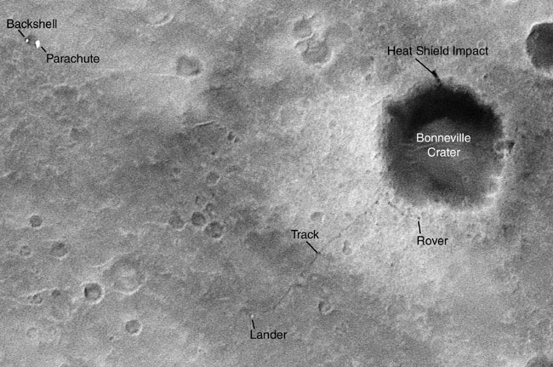
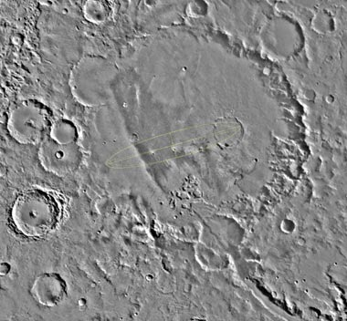
Gusev Crater
Bonneville Crater
Impact Craters
Notes:
Ask students what is different between these images and the previous images. Answer: these are not in color
Ask students if they can still determine some differences in surface materials even without seeing all the colors.
Ask students to point out the circles on the image and explain these are impact craters, caused when rocks from space hit the surface of Mars.
Point out the tracks left by NASA’s Mars Exploration Rover Spirit and ask students to try to identify the rover, its lander, backshell and parachute in the image.
Details:
Rover Tracks Seen from Orbit
Wheel tracks left by NASA's Mars Exploration Rover Spirit, and even the rover itself, are visible in this image from the Mars Orbiter Camera on NASA's Mars Global Surveyor orbiter. North is up in this image. The tracks and rover are in the area south of a crater informally named "Bonneville," which is just southeast of the center of the image. The orbiter captured this image with use of an enhanced-resolution technique called compensated pitch and roll targeted observation. It took the picture on March 30, 2004, 85 martian days, or sols, after Spirit landed on Mars. The rover had driven from its landing site to the rim of Bonneville and was examining materials around the crater's rim.
Gusev-plain
The designated landing site for the first Mars Exploration Rover mission is Gusev Crater, seen here in its geological context from NASA Viking images.

Slide 15
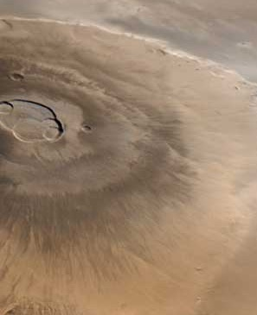
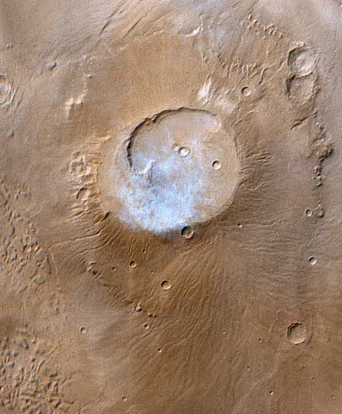
Mars has many landforms that are familiar to people on Earth.
Olympus Mons
Apollinaris Patera
Volcanoes
Notes:
Ask students to describe what a volcano looks like on Earth. Show them these images of Mars volcanoes. The one on the left is the giant Olympus Mons volcano on Mars, the largest volcano in the solar system - larger than the state of Arizona and taller than Mount Everest.
Ask students to note the different colors in the images. Ask: What do you think causes the white color at the top of Apollinaris Patera? Answers might include: snow, ice, clouds. In this case, the white color is from wispy clouds. Sometimes it is hard to tell the difference between snow, ice, or white minerals on the surface and clouds. One clue that clouds are the cause is the appearance of shadows.
Details: Olympus Mons
Olympus Mons, 1998
Olympus Mons is a mountain of mystery. Taller than three Mount Everests and about as wide as the entire Hawaiian Island chain, this giant volcano is nearly as flat as a pancake. That is, its flanks typically only slope 2° to 5°.
The Mars Orbiter Camera (MOC) obtained this spectacular wide-angle view of Olympus Mons on Mars Global Surveyor's 263rd orbit, around 10:40 p.m. PDT on April 25, 1998. In the view presented here, north is to the left and east is up. The spacecraft was traveling from north to south (left to right). Although the camera looks straight down (towards the nadir) and cannot be pointed to the side, the wide angle camera has such a large field of view (it sees from horizon to horizon) that, in effect, it provides side looking views. Unlike some other MOC images, that have had to be warped to provide a view as if seen from a certain direction and altitude, this image shows what the camera saw without additional processing. It is easy to imagine that you are looking out a window at the surface of Mars from about 900 km (560 miles) up.
Apollinaris Patera
This month (April 1999), the Mars Global Surveyor Mars Orbiter Camera (MOC) passed over the Apollinaris Patera volcano and captured a patch of bright clouds hanging over its summit in the early martian afternoon. This ancient volcano is located near the equator and--based on observations from the 1970s Viking Orbiters--is thought to be as much as 5 kilometers (3 miles) high. The caldera--the semi-circular crater at the volcano summit--is about 80 kilometers (50 miles) across.
The color in this picture was derived from the MOC red and blue wide angle camera systems and does not represent true color as it would appear to the human eye (that is, if a human were in a position to be orbiting around the red planet). Illumination is from the upper left.

Slide 16
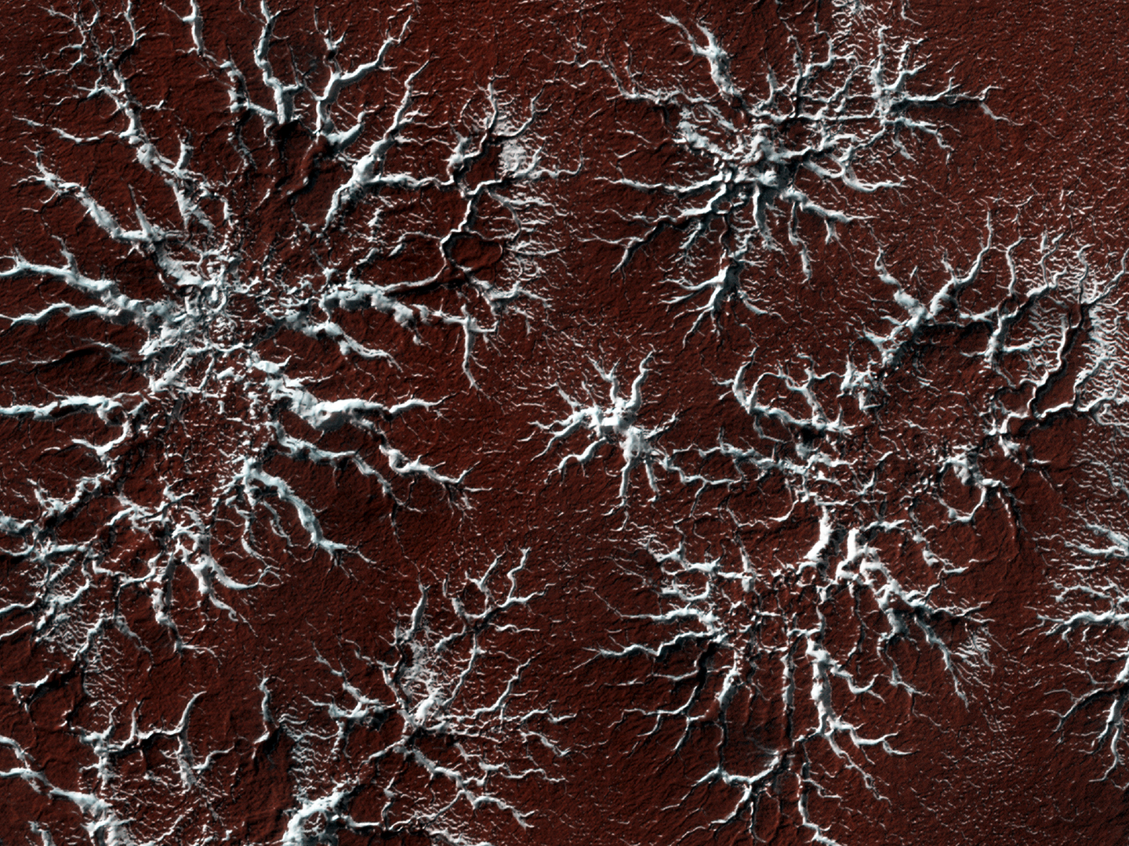
Southern Polar “Spiders”
Notes:
Ask students: What features do you see in this image? What colors do you see? What might have caused these features or color differences? Answers might include: snow, ice, white sand. Older students may be able to rule out clouds because the patterning doesn’t fit usual cloud patterns.
Details: On Mars the seasonal polar caps are composed of dry ice (carbon dioxide). In the springtime as the sun shines on the ice, it turns from solid to gas and causes erosion of the surface. Erosion patterns take on an incredible diversity of forms. Scientists are studying the factors that give us "spiders", "caterpillars", or "starbursts", all colloquial words for what we rigorously name "araneiform" terrain.
This particular example shows eroded channels filled with bright ice, in contrast to the muted red of the underlying ground. In the summer the ice will disappear into the atmosphere, and we will see just the channels of ghostly spiders carved in the surface. This is truly Martian terrain - this type of erosion does not take place anywhere naturally on earth because our climate is too warm.

Slide 17
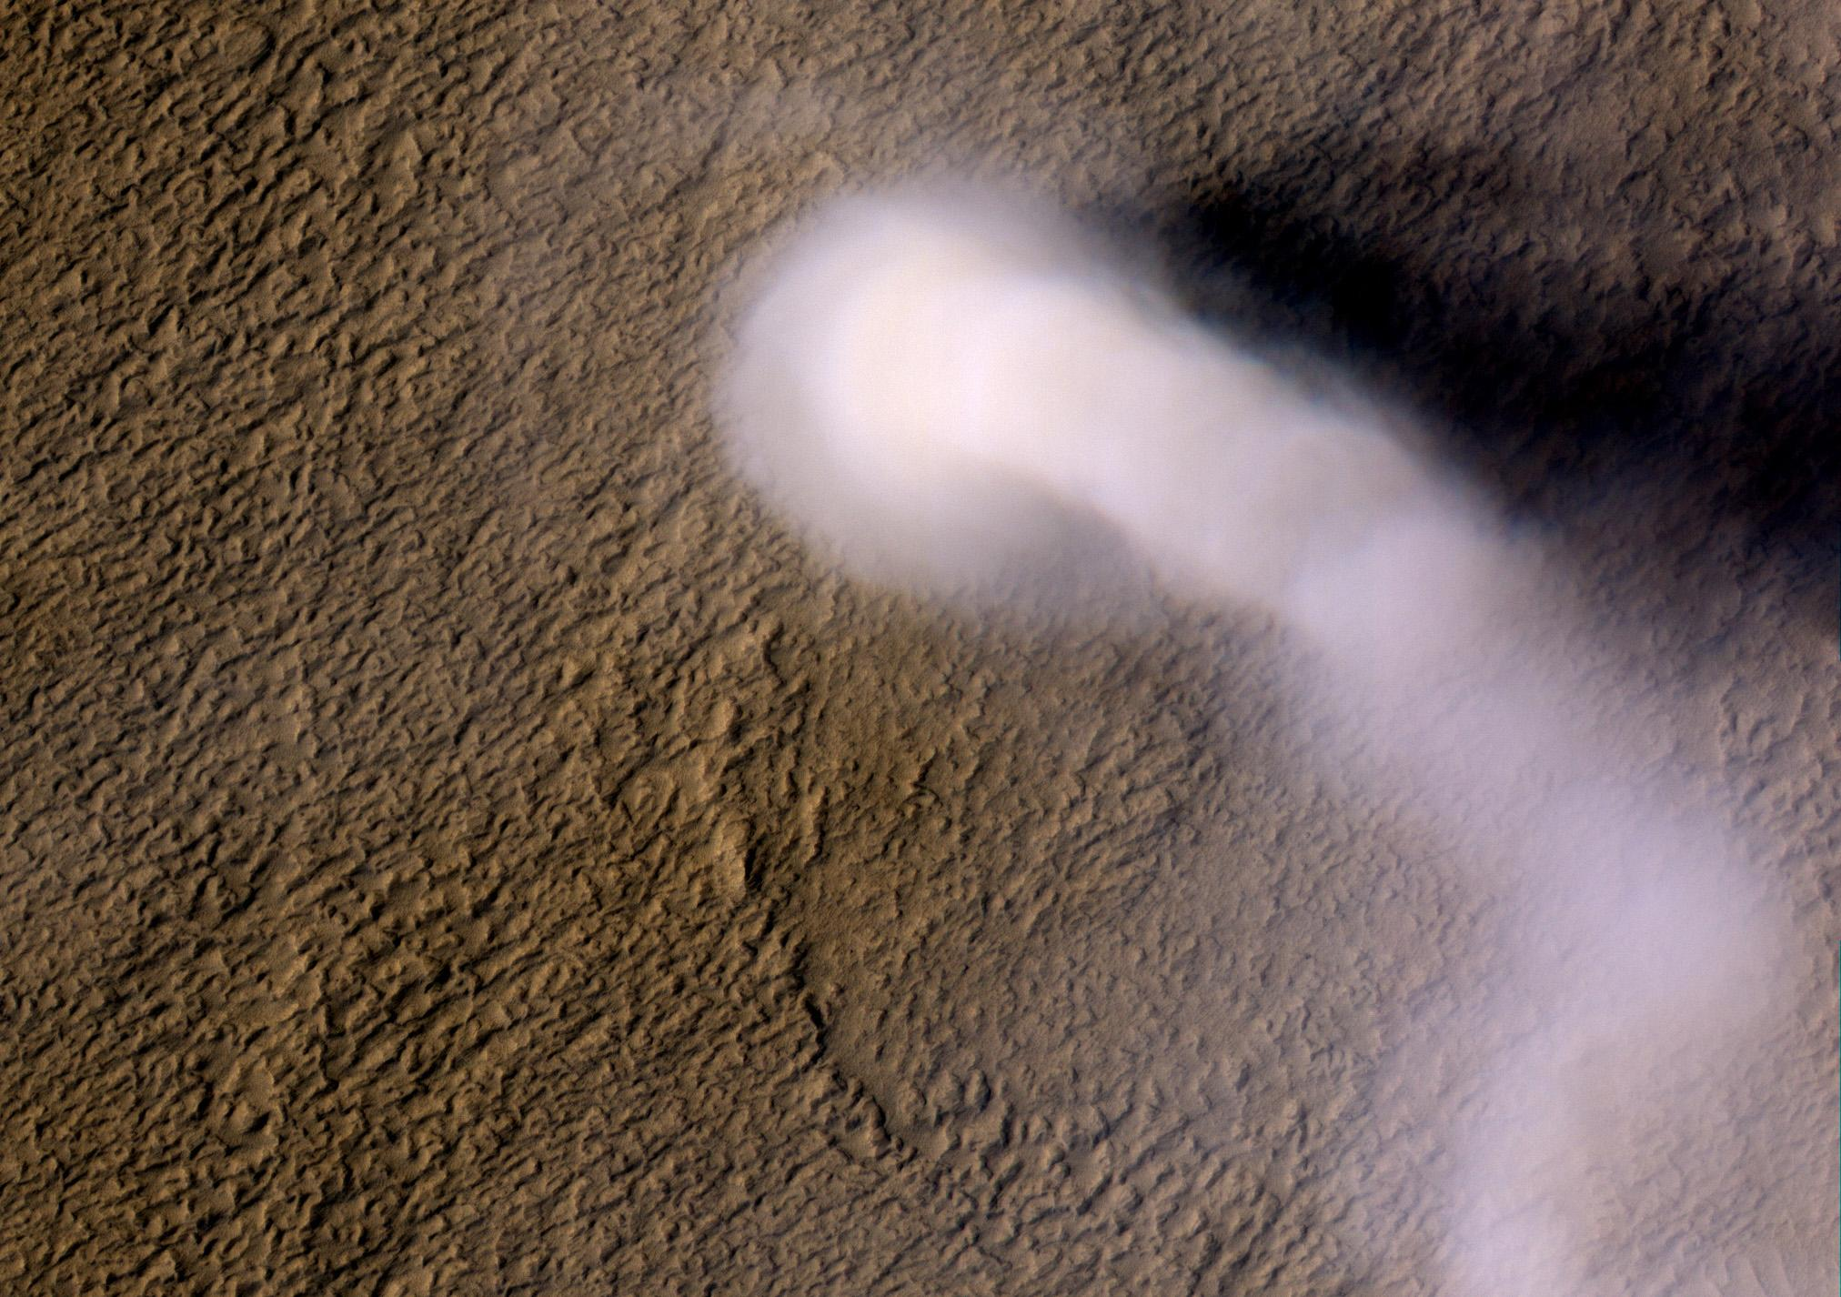
Dust Devil
Notes:
Ask students: What colors do you see in this image? What causes those colors? Answers: reddish brown, white/pink. Students will likely guess that the white/pink is some sort of cloud or smoke. Indeed, it is a dust devil. At this point, students should begin hypothesizing about what causes the varying colors of red and brown on the surface of Mars. Ask students to think about the natural colors they see on Earth and what causes them. Rocks and plants all vary in the color palette. Note that Mars does not currently have plants or trees so we are primarily looking at rocks, dust, “dirt” and formations made of these. Ask: What determines the color of rock or dirt? Younger students may intuitively guess that what they are made of determines their color. Older students may know that different minerals determine color.
http://mars.jpl.nasa.gov/mro/news/whatsnew/index.cfm?FuseAction=ShowNews&NewsID=1213
A Martian dust devil roughly 12 miles high (20 kilometers) was captured whirling its way along the Amazonis Planitia region of Northern Mars.
Despite its height, the plume is little more than three-quarters of a football field wide (70 yards, or 70 meters).
Dust devils occur on Earth as well as on Mars. They are spinning columns of air, made visible by the dust they pull off the ground. Unlike a tornado, a dust devil typically forms on a clear day when the ground is heated by the sun, warming the air just above the ground. As heated air near the surface rises quickly through a small pocket of cooler air above it, the air may begin to rotate, if conditions are just right.
The image was taken during late northern spring, two weeks short of the northern summer solstice, a time when the ground in the northern mid-latitudes is being heated most strongly by the sun.

Slide 18



Notes:
Ask students: What happens when you leave your bike (or anything made of steel) out in the rain? Answer: It gets wet and then can rust.

Slide 19
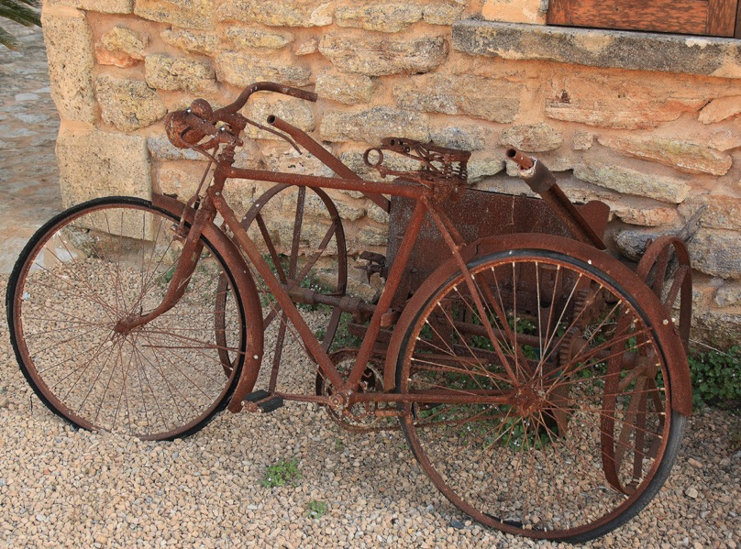


RUST
Iron Oxide
Notes:
What color is rust? Answer: Reddish brown
Mars is the rusty planet. Mars has a lot of a mineral called iron oxide which is another name for rust. Scientists believe that Mars once had a lot of water on the surface. This water caused iron minerals in the surface to rust over time, creating the red/rusty planet we know today.

Slide 20
Iron Oxide
Notes:
Similar colors to those on Mars can be found here on Earth. This image and the next two show mountains in France that are various shades of red, yellow and brown. The pigments red ochre, brown ochre and yellow ochre are different concentrations of iron oxide that make up these colors.

Slide 21
Iron Oxide

Slide 22
Iron Oxide

Slide 23

SAND
SILICA
Notes:
Ask students: What do you see in this image? Answers include: sand, footprints, water/ocean.
Ask students: What planet is this image from? Answer: Earth
Ask students: What colors in this image similar to colors we see on Mars? Answer: yes, brown sand
Ask students what this sand is made of. Answer: a mineral called silica which can be various shades of clear to beige to brown, depending on impurities
Just as white, beige and brown colors here on Earth can be sand or dirt, those same colors on Mars can be sand of various compositions.

Slide 24
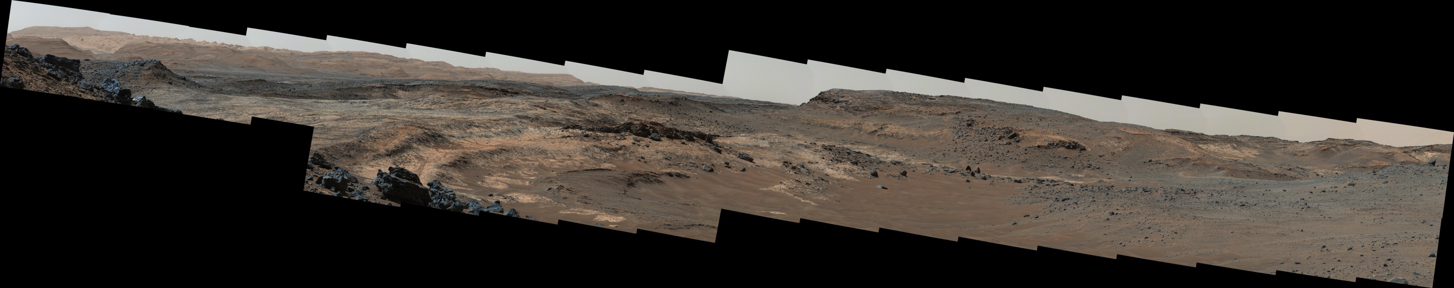
Notes:
Can you see evidence of silica or iron oxides in Mars images? Point to what you can see.
Now it’s time to make your own Mars-scape, a realistic depiction of the colors and features that exist on Mars.

