Slide 1
Mars 2020
Swati Mohan
Jet Propulsion Laboratory, California Institute of Technology
1-14-2021
URS297857

Slide 3
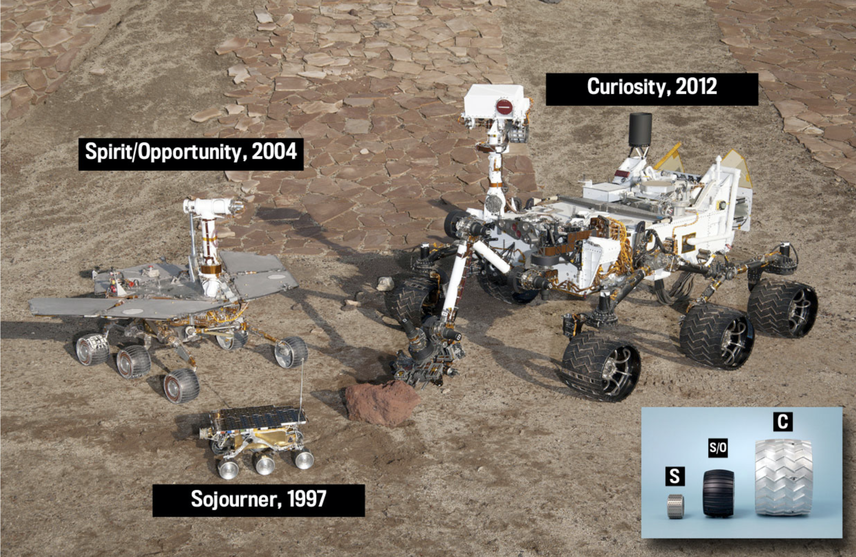

Slide 4
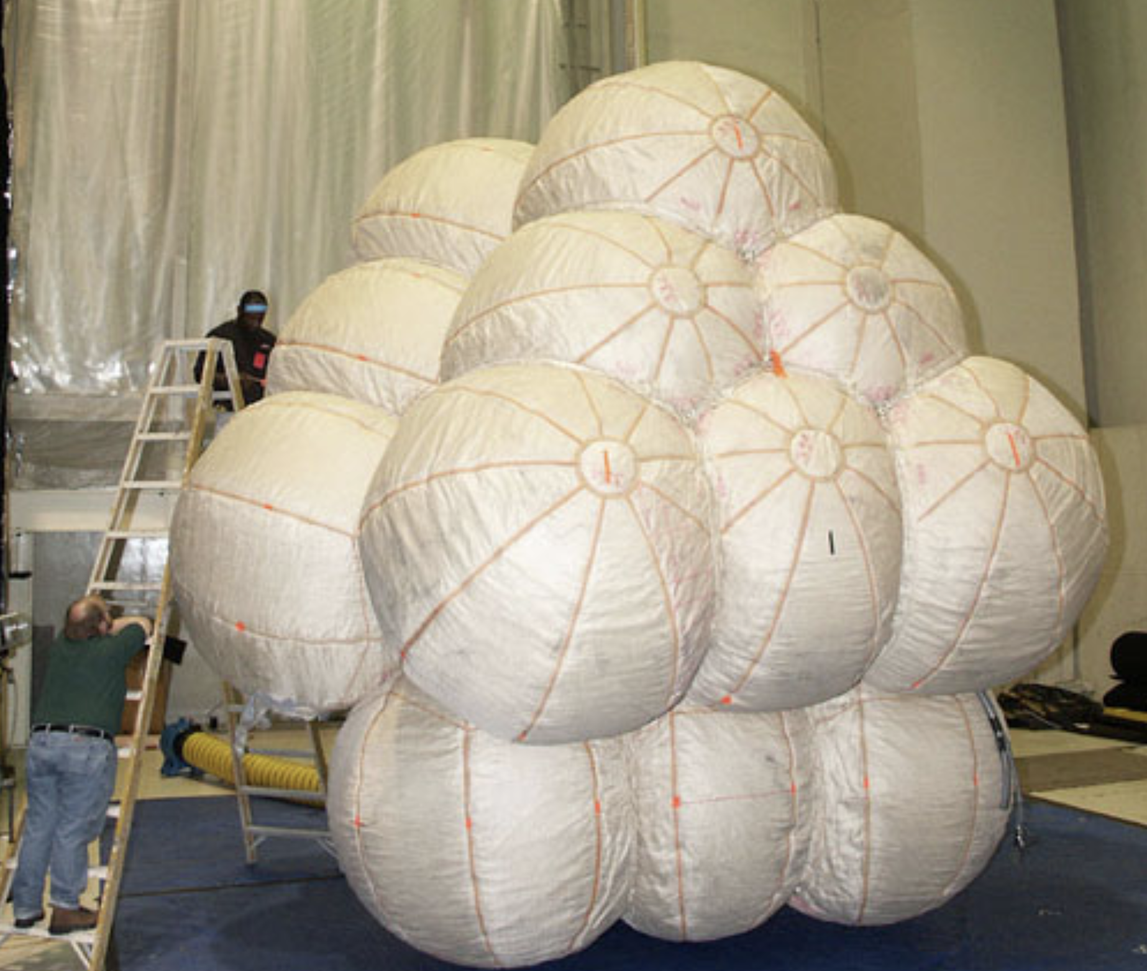
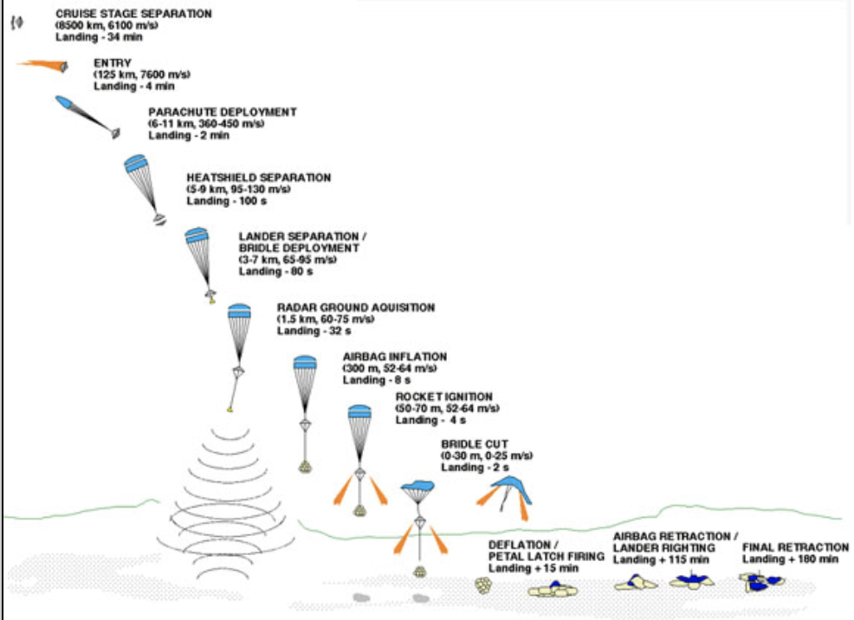

Slide 7
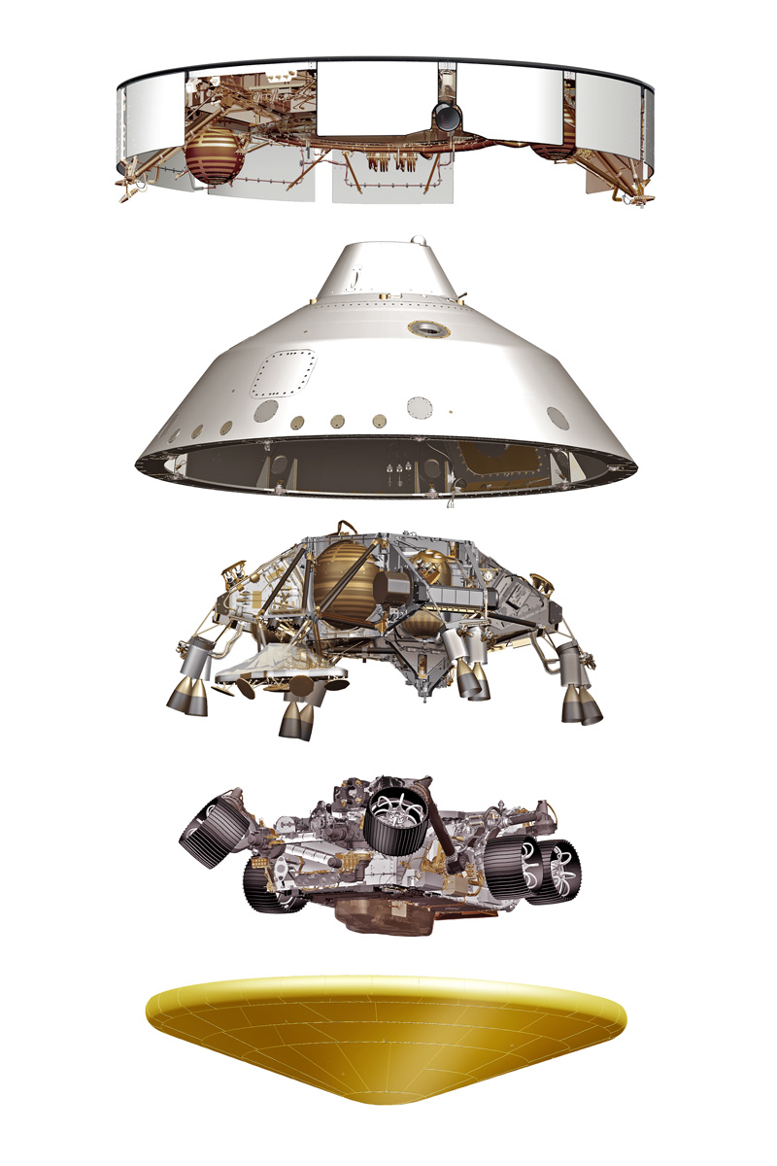
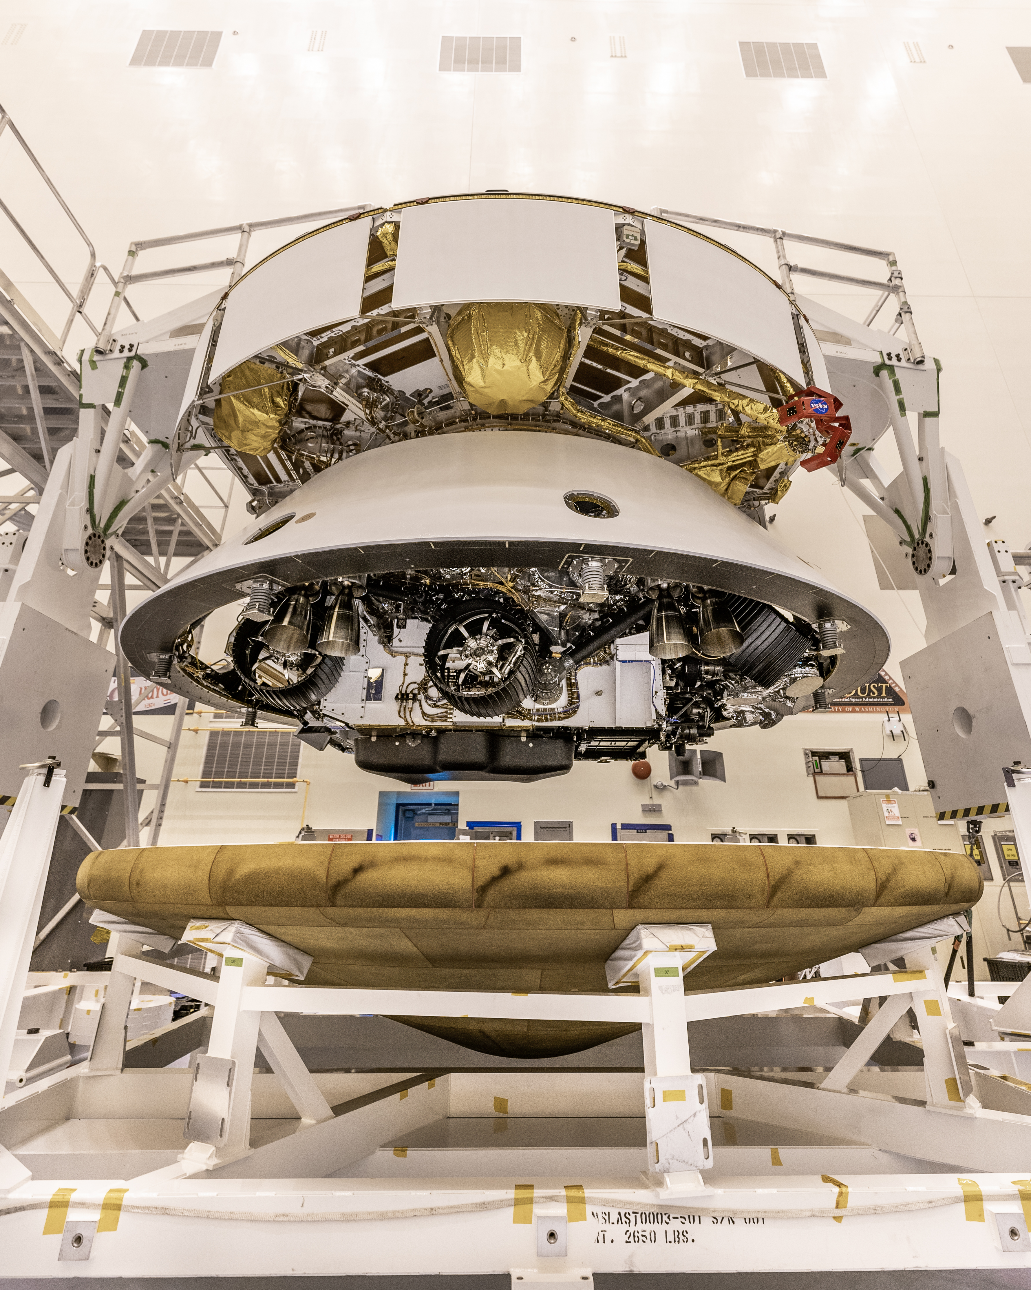

Slide 8
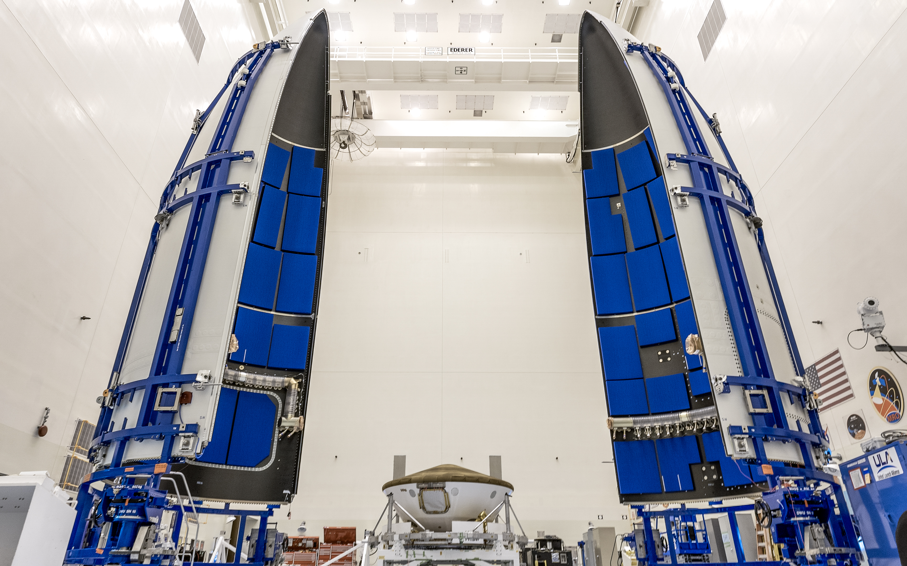

Slide 9
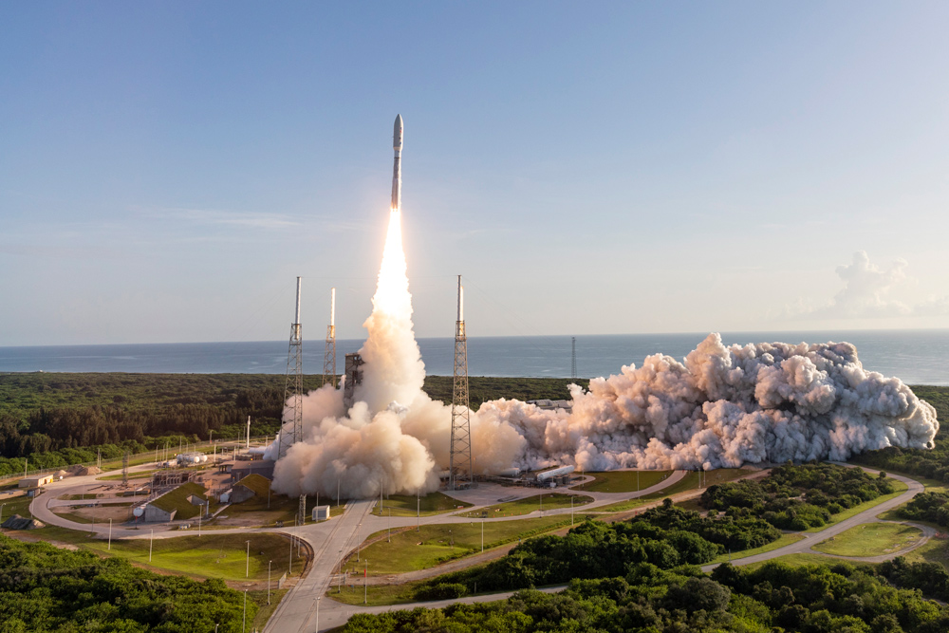

Slide 10
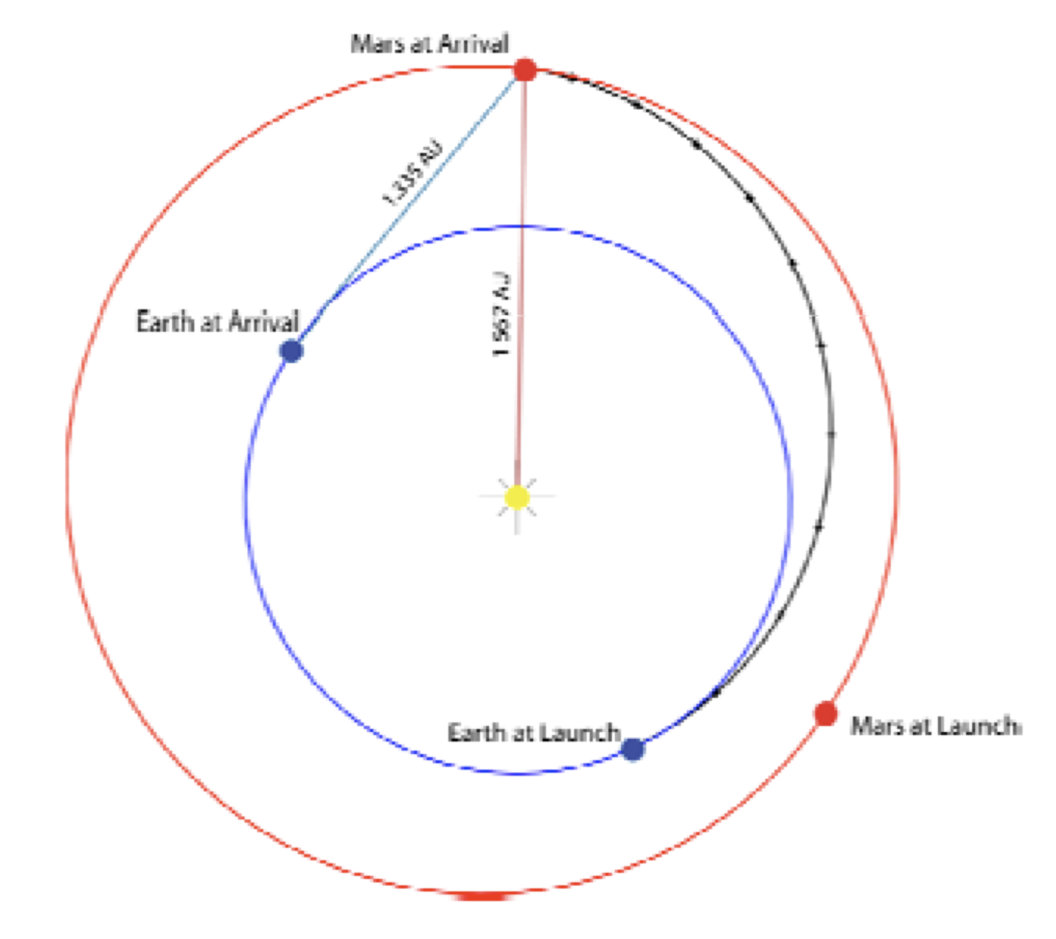

Slide 11
NASA's Mars 2020 Perseverance Rover Landing Animations
https://www.youtube.com/watch?v=rzmd7RouGrM&feature=youtu.be

Slide 12
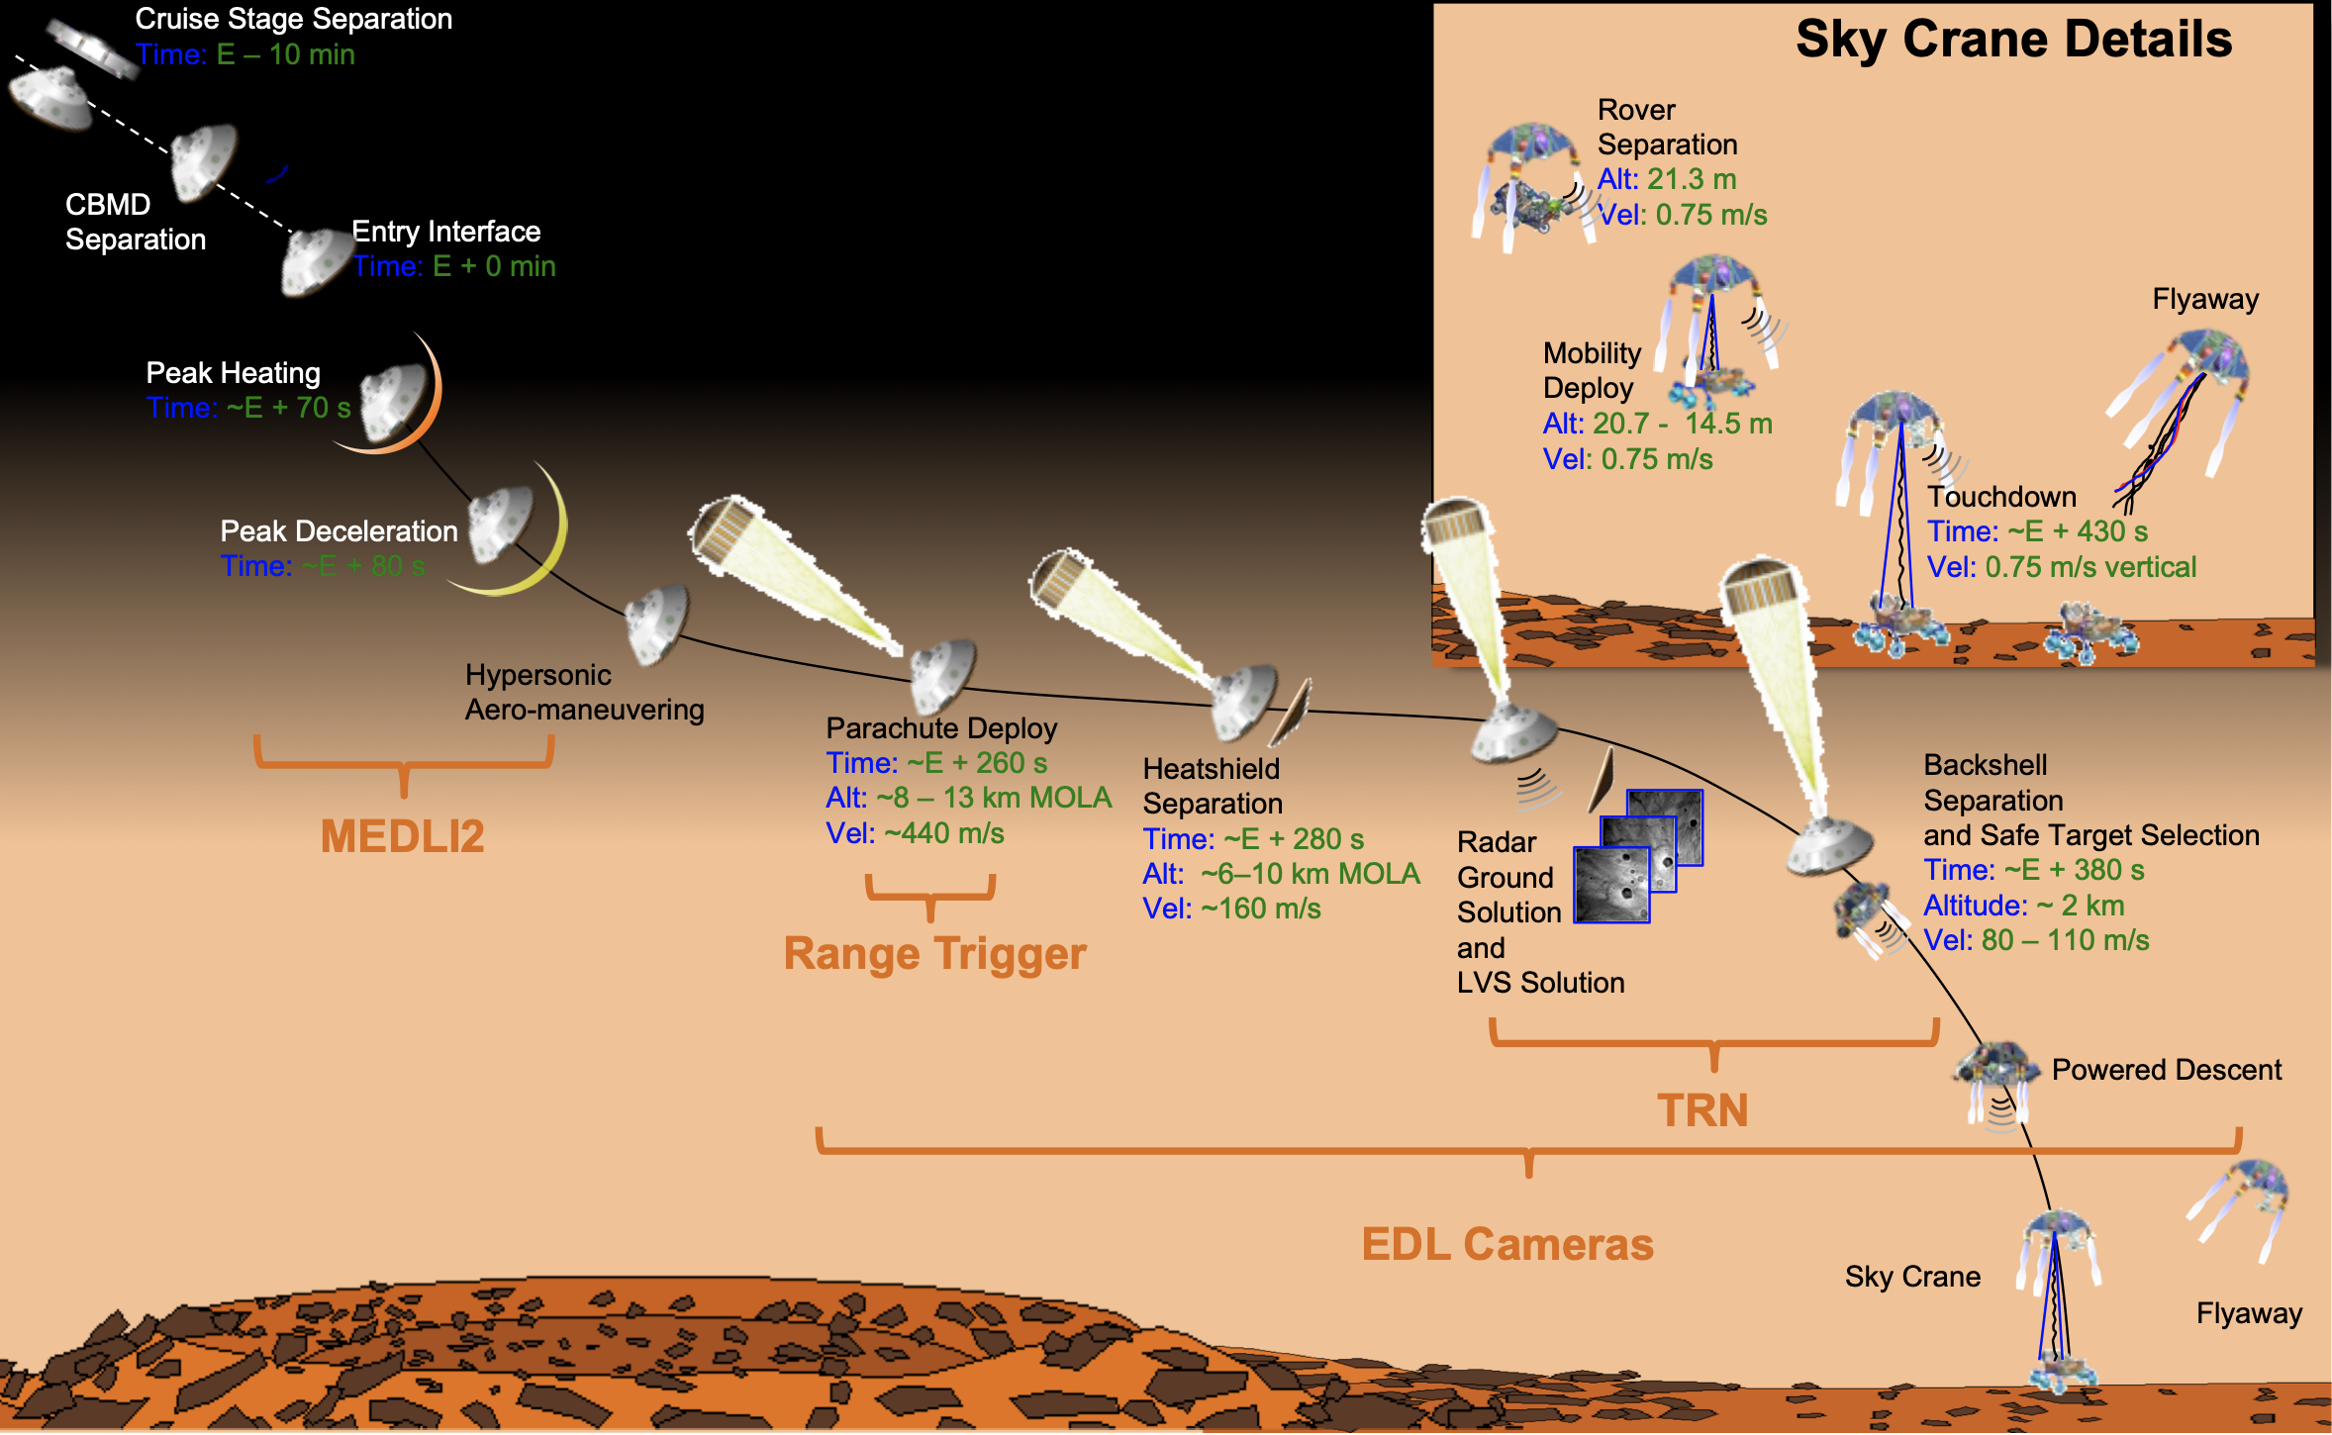

Slide 14
