Slide 1
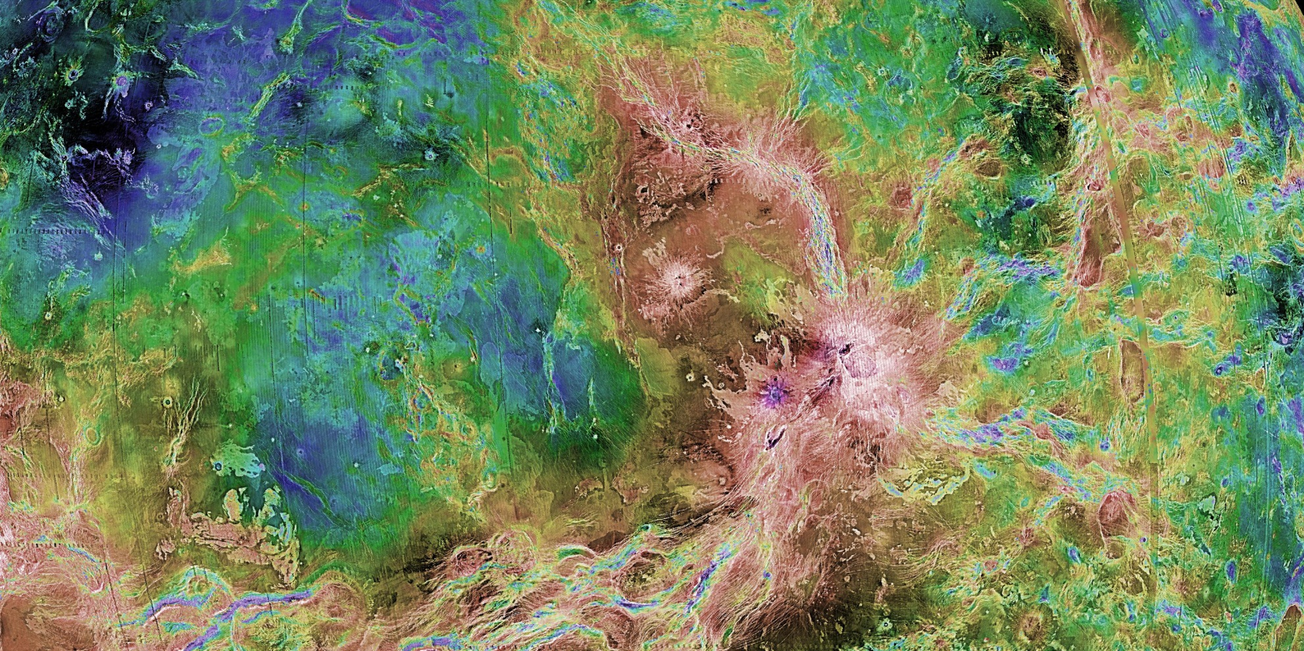
ART & THE COSMIC CONNECTION
Viewing NASA Images Through the Elements of Art
Created by Monica & Tyler Aiello, Planetary Artists and Educators
For NASA’s Discovery and New Frontiers Programs
https://planetarymissions.nasa.gov/art-and-the-cosmic-connection
Notes:
“Art and the Cosmic Connection” is a program that introduces students to the solar system using art concepts. It uses the elements of art to help students understand and analyze beautiful NASA images from space.
The activity was developed by planetary artist and educator Monica Aiello and her husband Tyler Aiello, a sculptor with a background in architecture. Both of the Aiellos are prominent artists whose art is displayed in galleries throughout the west. They also dedicate considerable time to working with students from K through college in schools, afterschool programs and at camp.
The first 13 slides introduce our solar system in its marvelous diversity and the concept of using an artist’s eye to make sense of science (and a scientist’s eye to deepen one’s art!).
PRESENTATION NOTES:
Today we are going to do something a little different.
We’re are going to do art in science class (or science in art class depending on the course this activity is being taught)
We are going to learn about our solar system as artist explorers.
SPECIAL NOTE:
The PowerPoint includes animations that relate to the script and question prompts. These are activated by clicking the forward buttons or arrows. They may also be turned off if not desired.

Slide 2
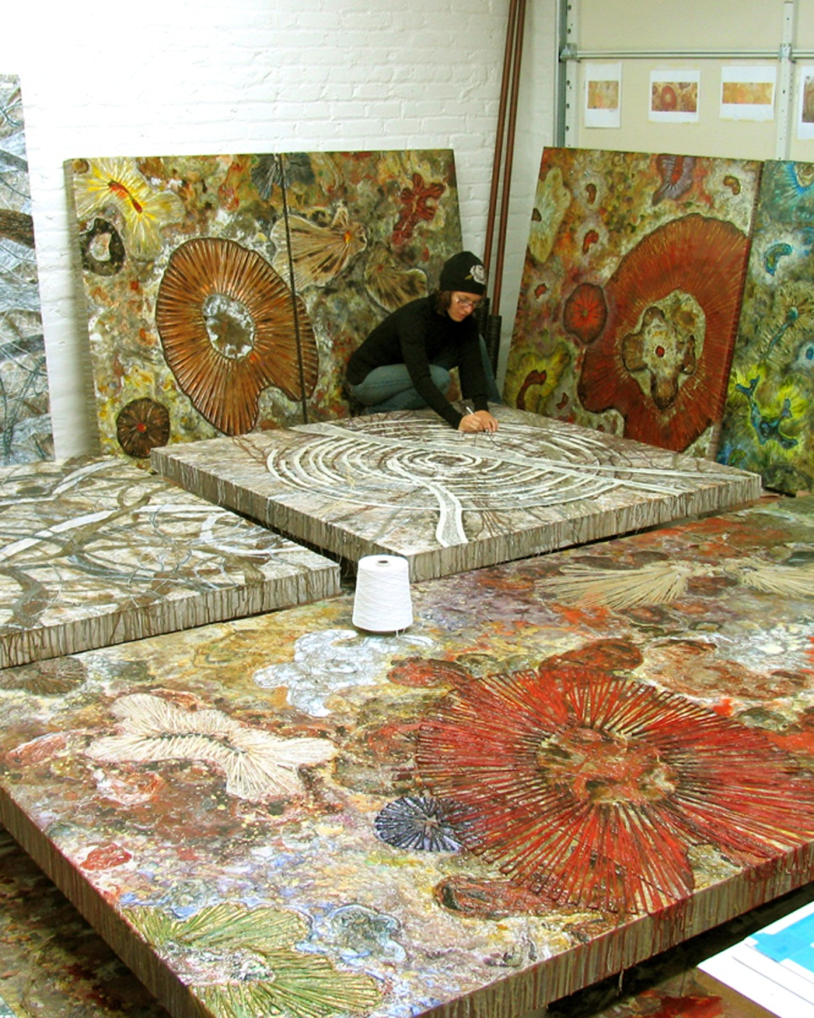
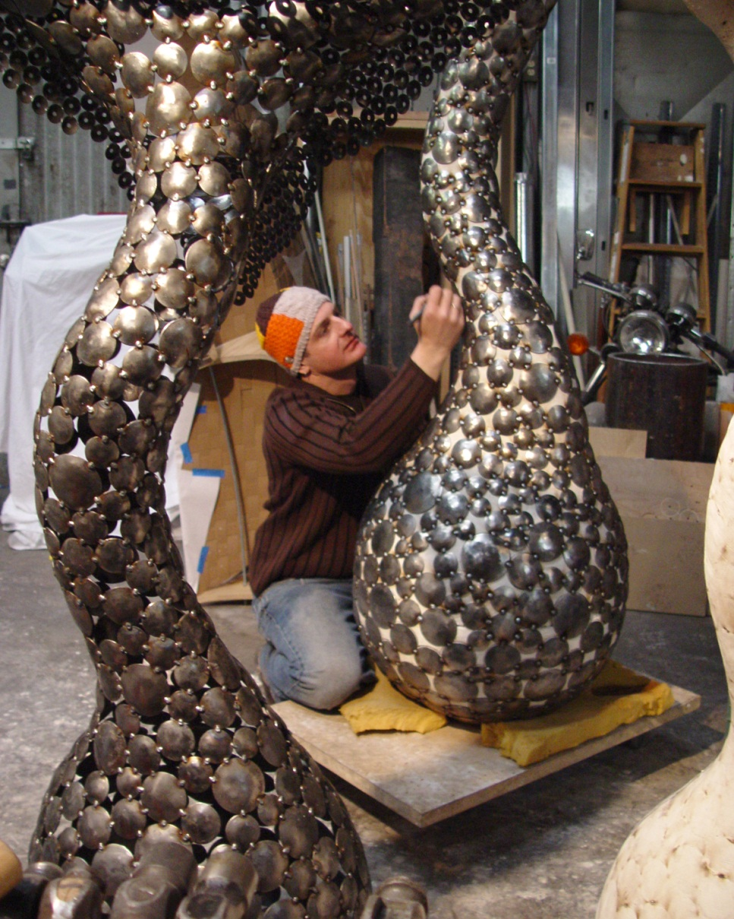
SCIENCE INSPIRES ART
MONICA & TYLER AIELLO
Notes:
PRESENTATION NOTES:
You may think that Art & Science are two very different things.
But the arts & sciences share many things in common
The activity we’ll be doing today was developed by internationally acclaimed artists Monica & Tyler Aiello
Their artwork will inspire your artwork!
They are a married couple who work closely with the scientific community to create artworks and educational programs inspired by science

Slide 3
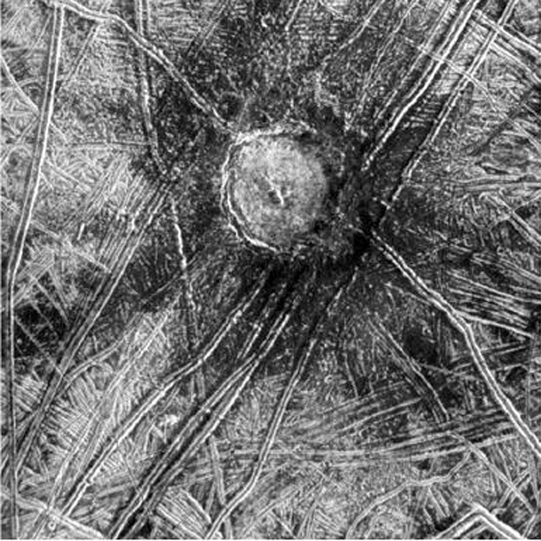
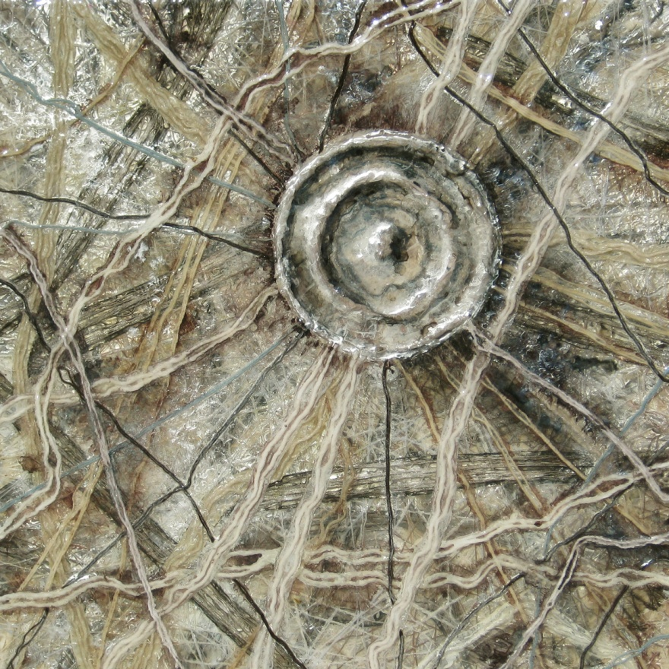
CREDIT: NASA/JPL
Notes:
PRESENTATION NOTES:
Just to give you some brief illustrations of how science inspires art...
The image on the left is of a crater called Cilix on Jupiter’s icy moon Europa. The image on the right is a painting by Monica Aiello of Cilix made with acrylic, ink, yarn, thread and paper.
This is essentially what we will be doing today.
You will be making art inspired by planetary images, and
Your understanding of planet surfaces will deepen by looking at them through art’s lens.

Slide 4
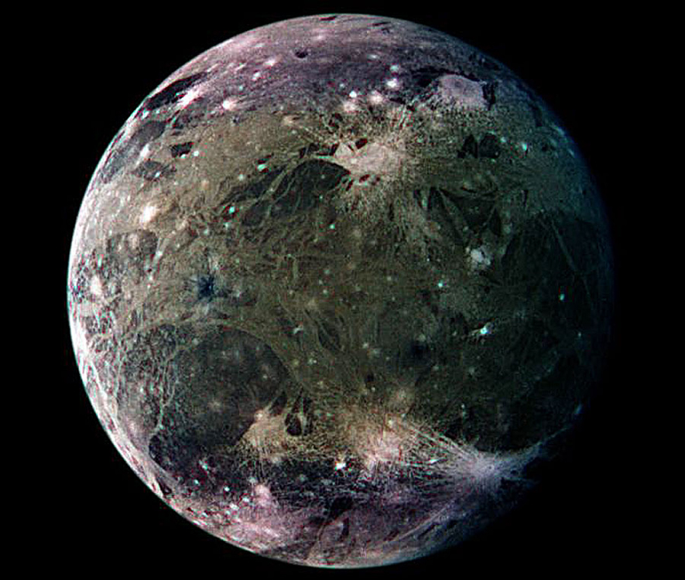
GANYMEDE
CREDIT: NASA/JPL
Notes:
PRESENTATION NOTES:
Another example…This is an image of Ganymede, one of Jupiter’s four big Jovian moons (the largest and most visible from Earth), and the largest moon in the solar system.

Slide 5
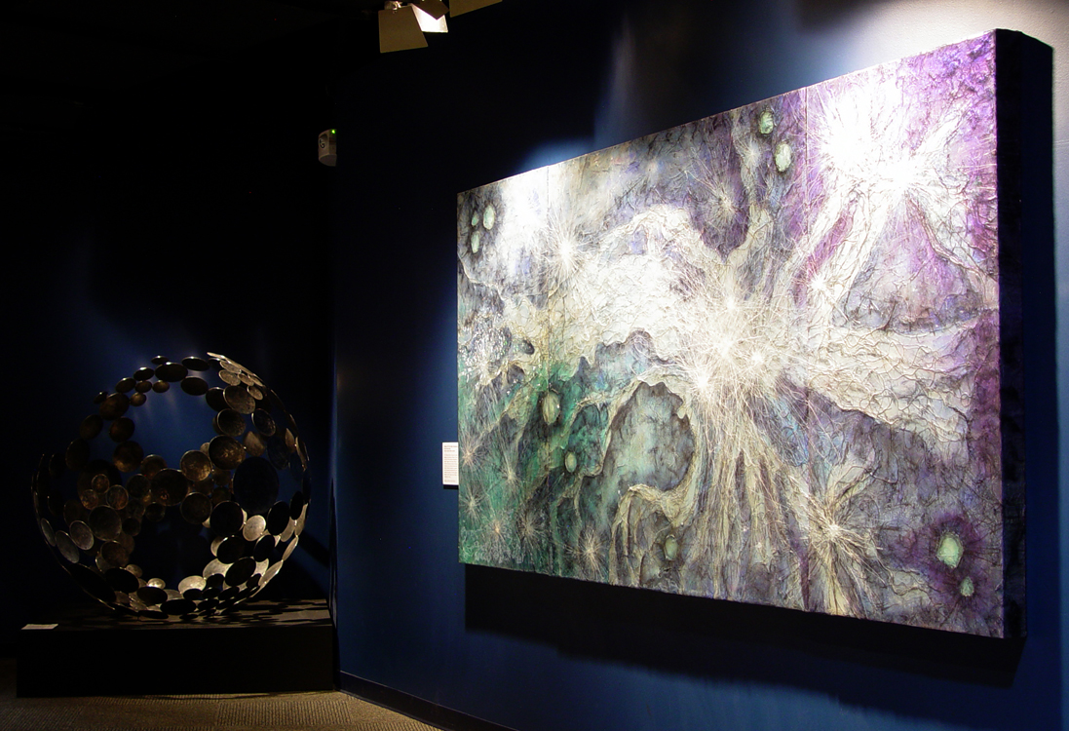
DENVER MUSEUM OF NATURE & SCIENCE - Gates Planetarium
Notes:
PRESENTATION NOTES:
Here are some artworks by the Aiellos inspired by Ganymede at the Denver Museum of Nature & Science. Monica’s painting is 5’x10’ and Tyler’s steel sculpture is 5’ in diameter.
Painting by Monica Aiello:
The Flight of Ganymede
Acrylic, ink, paper, fiber, on panel
5’x10’
Sculpture by Tyler Aiello:
Sphere X
Hand-forged steel
5’ diameter

Slide 6
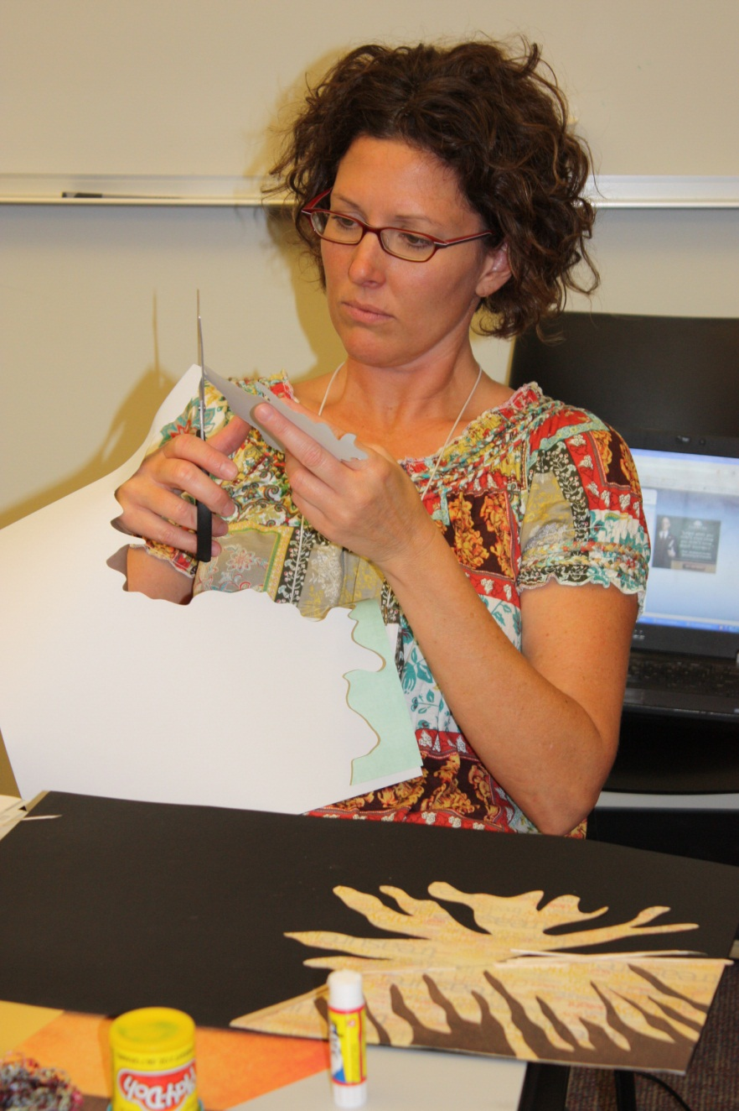
PROGRAM HIGHLIGHTS
- PowerPoint Presentation
- Easy to follow Presentation and Science Notes
- Correlates with current and recent missions
- Scalable for K-12 students…and beyond
- Art Activity to reinforce concepts
- Beautiful NASA images for printing
- 1 or 2 day program
- In-depth Educator Guide
- Works in both art & science class
- Proven success with both youth and adults
Notes:
PRESENTATION NOTES:
In the program package, you will receive a host of tools to implement this program in your classrooms:
PowerPoint Presentation: for in class presentation
Easy to follow presentation notes and science notes: for expanded content
Correlates with current and recent missions: to excite students about space exploration
Scalable for K-12 students…and beyond
Art Activity to reinforce concepts: we will be doing this activity later today
Beautiful NASA images to print: for use with the art activity
1 day or 2 day program: program is flexible for age/time requirements
In-depth Educator Guide: walks teachers through the program/activity
Works in both art & science class: as well as general elementary education
Proven success with both youth and adults: iterations of the program have been taught in schools, universities, & museums

Slide 7
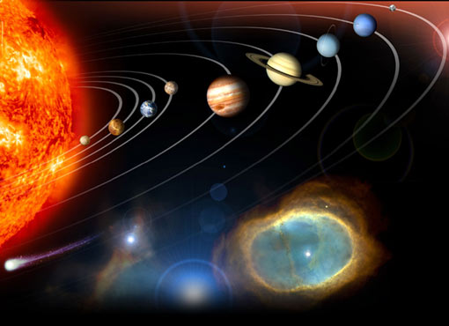
OUR SPACE COMMUNITY
What do you know about the solar system?
Notes:
PRESENTATION NOTES:
Suggestion: On the board or chart paper, record what the students already know about the structure of the solar system to inform you of their background knowledge and promote discussion. A KWL chart can be great here – three columns, what we Know, what we Wonder, what we have Learned. If you have students who are younger or more reticent to speak, having small groups of kids develop their own KWL before opening a larger whole class discussion is an effective way to draw out your students’ background knowledge while engaging them in the activity.
Start by discussing what we already know about our solar system. Recommendation: Leave this portion of the presentation open-ended, building from wherever the students begin. The subsequent slides can be used as cues, and the notes include question prompts to keep students engaged in the discussion. Feel free to adjust the presentation to make it appropriate for your students. Indicators of the answer categories teachers should be looking for are highlighted in red.
Ask students what is at the center of the solar system: The Sun
[Note: The illustration is an artistic interpretation; scale and distance are not accurate.]

Slide 8
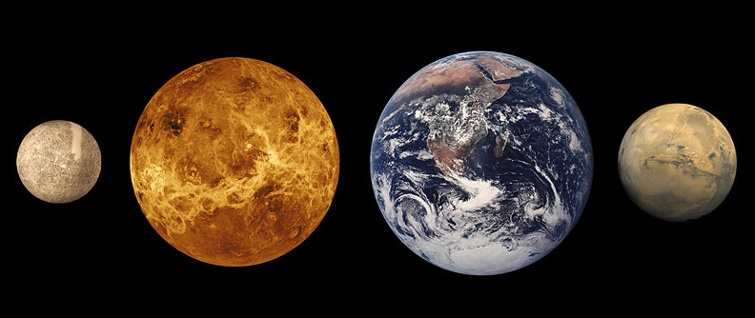
INNER PLANETS
Notes:
PRESENTATION NOTES:
Possible Question Prompts:
Anyone recognize these? Give me a name of one of the inner planets. Mercury, Venus, Earth, Mars
Scientists talk about the inner solar system and the outer solar system – have you heard of that? Where do you think the boundary could be – and why?
Or for older students: What are the inner planets called? Terrestrial Planets
Why are the inner planets called “terrestrial” planets? Because they have rocky surfaces
What does “terrestrial” mean – any ideas? Why might they call it that? Encourage discussion about rocky surfaces and geology
What do you notice about their surfaces? Encourage any answers to get them thinking
Do they have geologic processes we can see on their surfaces? Examples: moving atmosphere, signs of cratering, tectonics – fault lines, etc.

Slide 9
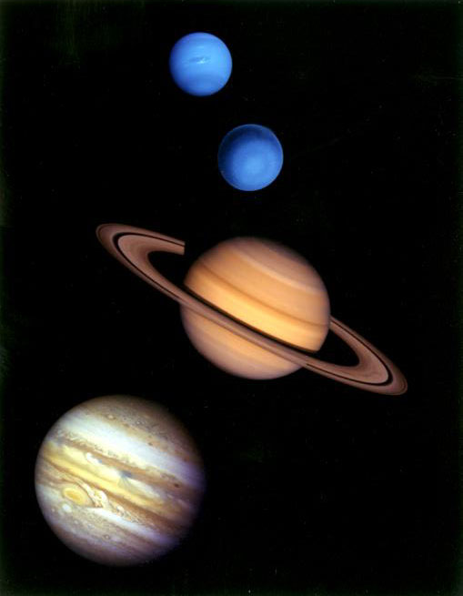
OUTER PLANETS
Notes:
PRESENTATION NOTES:
What are the four large outer planets? Jupiter, Saturn, Uranus, Neptune
Why are these planets called “gas giants”? Because their surfaces are made of thick atmospheres – they may have a dense, molten, core of rocky materials, but they are mostly hydrogen and helium; Neptune and Uranus are sometimes known as ice giants since they are primarily icy worlds made of water, ammonia and methane.
Can we see geologic process at work on their surfaces? No
We are going to be focusing on geologic processes we can see on the surface, so gas giants won’t be much in the picture. However, we will be looking at their marvelous moons!

Slide 10
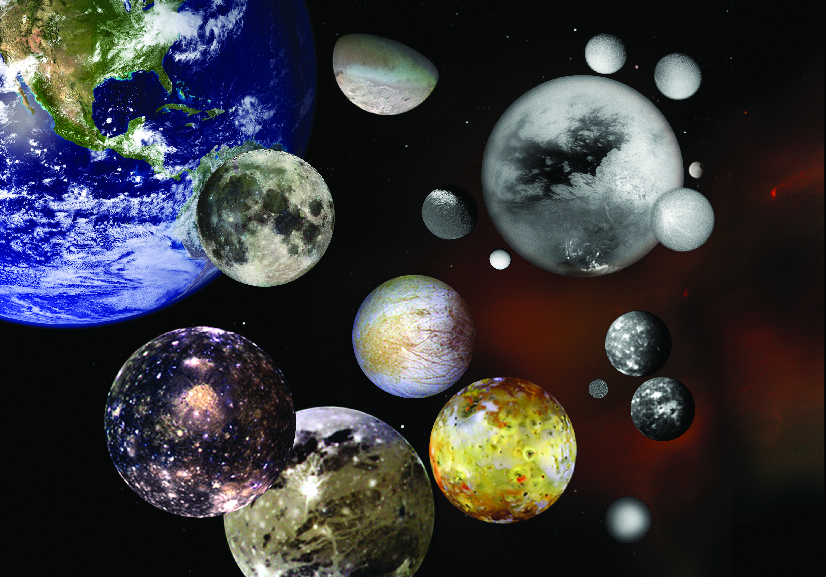
SMALL BODIES: Moons
CREDIT: NASA/JPL
Notes:
PRESENTATION NOTES:
Some of the coolest, weirdest bodies in our solar system are the moons of the outer solar system that orbit the gas giants.
What defines a moon? A body that orbits one of the solar system’s planets
They are like planets, sometimes as large as planets, with fascinating geology.
Do you recognize Earth’s Moon?
Many current and recent NASA missions are focused on these worlds, and hopefully some future ones. There is so much to learn!

Slide 11
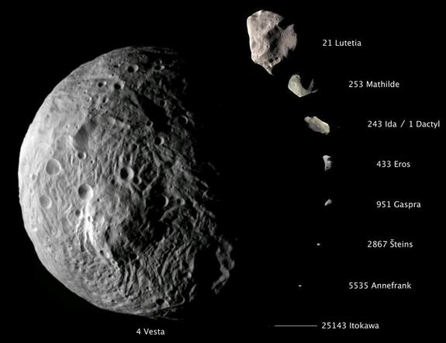
SMALL BODIES: The Asteroid Belt
ooooooo
Notes:
PRESENTATION NOTES:
In addition to the moons of the solar system, there are many other small, interesting bodies to investigate that orbit the Sun, including asteroids, comets and dwarf planets.
What orbits between the inner and outer solar system? The main asteroid belt
An asteroid is a small body in orbit around the Sun made mostly of rock and metal.
They are the subject of exciting current NASA missions and research, including the Dawn mission to Vesta and Ceres and the OSIRIS-REx asteroid sample return mission, to name two
Why is it valuable to study these small bodies?
Understanding their origin helps us understand Earth’s origin – visit an asteroid, and you are often stepping back in solar system time!
Have you heard of the doomsday worries? Well, keeping an eye on asteroids means we can possibly protect Earth from an impact.
SCIENCE NOTES:
Asteroids are small, rocky, airless worlds that orbit our Sun, leftover from the formation of the solar system 4.6 billion years ago. Early in the history of the solar system, the formation of Jupiter brought an end to the development of planetary bodies in the gap between Mars and Jupiter and caused the small bodies that occupied this region to collide with one another, fragmenting them into the asteroids we observe today. This region, called the asteroid belt or simply the main belt, may contain millions of asteroids. Because asteroids have remained mostly unchanged for billions of years, studies of them could tell us a great deal about the early solar system.
The asteroid belt is a vast doughnut-shaped ring between the orbits of Mars and Jupiter. Many asteroids are tiny, but some are quite large. Some are close to planet-size and appear to have “differentiated” as Earth has, with a core, mantle and crust. More than 150 asteroids are known to have one or two moons. Orbits have been determined for more than 300,000 of these space rocks. Asteroids that pass close to Earth are called Near-Earth Objects (NEOs). http://solarsystem.nasa.gov/planets/profile.cfm?Object=Asteroids

Slide 12
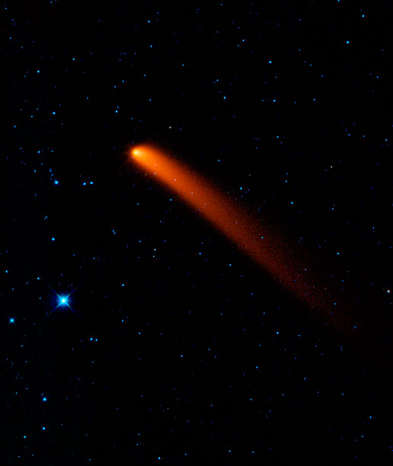
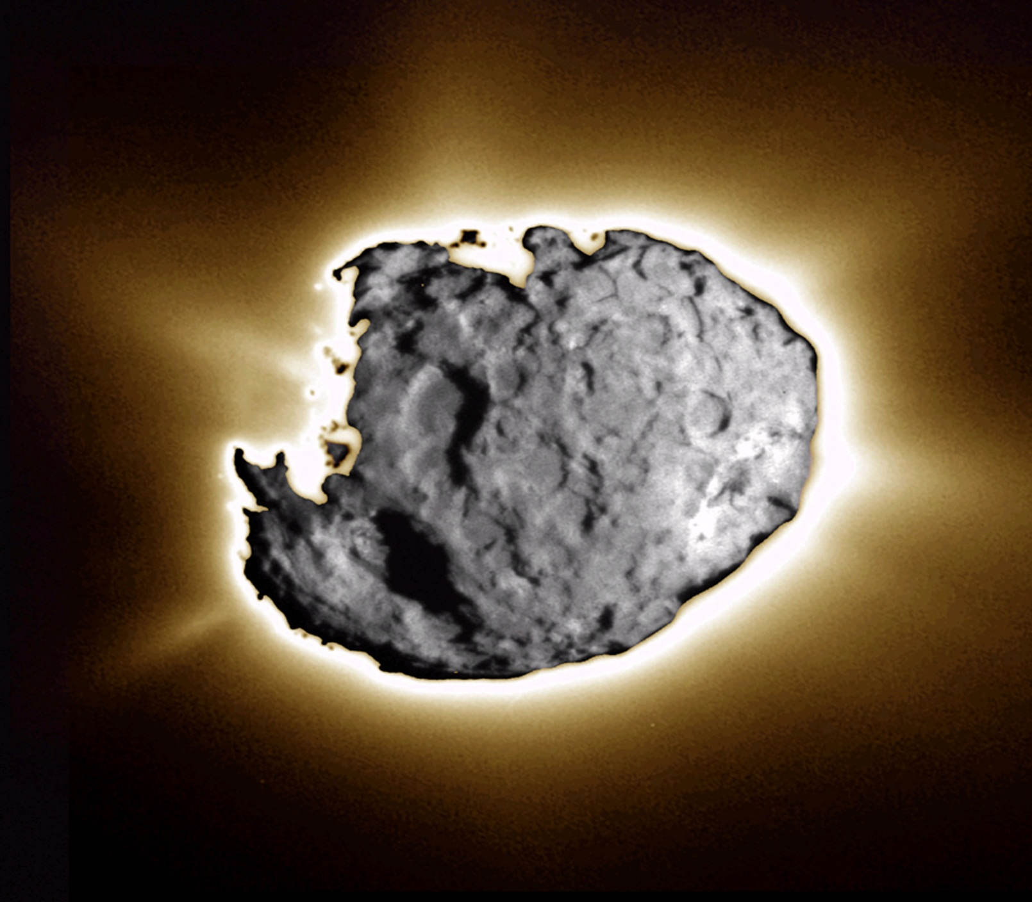
SMALL BODIES: Comets
Nucleus of Comet Wild 2
CREDIT: NASA/JPL-Caltech/Univ. of Washington
WISE infrared telescope image of Comet Sliding Spring
CREDIT: NASA
Notes:
PRESENTATION NOTES:
What’s this? A comet
A comet is a small object made of ice, rocky debris, dust and gas that orbits the Sun. Jets of gas and dust form long tails that can be seen from Earth.
They are sometimes called “dirty snowballs”
Comets are believed to originate in the Kuiper Belt and even more distant Oort Cloud. There are trillions of comets orbiting our Sun!
SCIENCE NOTES:
Comets are part of the solar system. They orbit the Sun, just as planets do, except a comet usually has a very elongated, elliptical orbit. Its orbit starts out very, very far from the Sun but eventually it approaches quite close to the Sun. A comet's nucleus is like a dirty snowball made of ice. As the comet gets closer to the Sun, some of the ice starts to sublimate, going straight from a solid to a gas. The ices sort of explode off the surface of the comet, along with particles of dust. These particles and gases make a cloud around the nucleus, called a coma. The coma is lit by the Sun. The solar wind pushes this material into the beautiful brightly lit tail of the comet. http://spaceplace.nasa.gov/comet-nucleus/redirected/

Slide 13
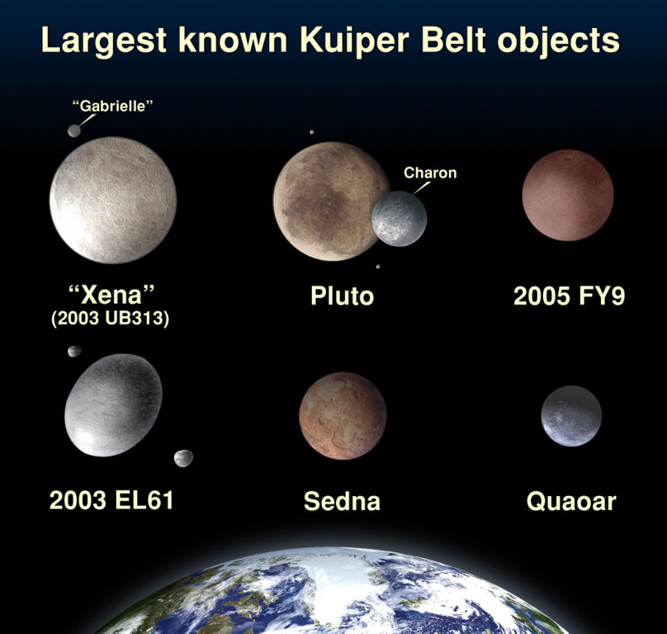
What happened to Pluto?
Eris
Makemake
Notice some have moons - We now know of 5 moons orbiting Pluto!
Haumea
Notes:
PRESENTATION NOTES:
So what happened to Pluto? It was re-classified as a dwarf planet. Scientists learned more, and that made them rethink Pluto’s original classification.
Why do you think this happened?
Generally kids will say because scientists learned new stuff…
That’s right on – we learn new stuff that that makes us reconsider our thinking – here, our classification. Pluto has a lot of odd un-planet like characteristics – an elliptical orbit, an orbit off the planetary plane, and a lot of debris around it, little icy worlds…
Beyond the orbit of Neptune, scientists found a large disc-shaped region they named the Kuiper Belt. Pluto is part of the Kuiper Belt.
The Kuiper Belt has hundreds of thousands of icy bodies larger than 62 miles across orbiting billions of miles from our Sun.
Most objects in the Kuiper Belt are tiny; here are some of the larger, Pluto-sized bodies known so far.
One of the definitions of a planet is that its mass and therefore gravity are great enough to sweep up all the debris in its orbit. Since Pluto has not swept up all the icy debris in its Kuiper Belt orbit, Pluto’s classification changed to “dwarf planet.”

Slide 14
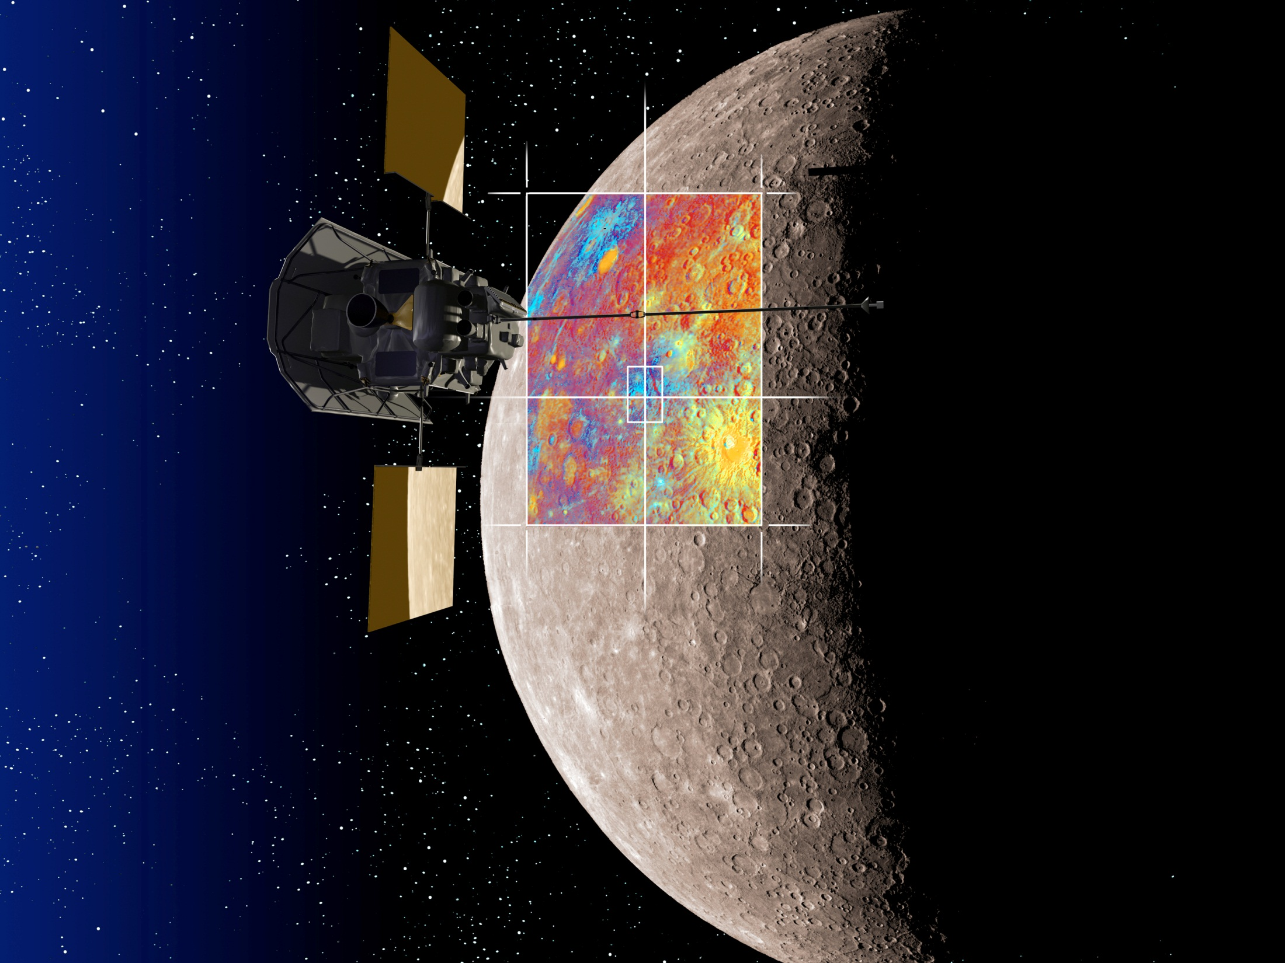
ROBOTIC PHOTOGRAPHERS
CREDIT: NASA/JHUAPL/CIW
Notes:
PRESENTATION NOTES:
So how do we study planets and moons that are very far from Earth?
We use tools like telescopes here on Earth
We also send telescopes into space where the atmosphere doesn’t distort images so much – Hubble Space Telescope, WISE, etc.
And sometimes, We go there!
Can scientists easily travel there themselves?
Not easily – very expensive, much of the technology is not yet developed to support people in such alien (un-Earth-like) environments.
The only planetary body humans have visited is Earth’s moon during the Apollo missions.
Instead scientists and engineers build robotic explorers and send them out into the solar system to take images of planets, moons, asteroids and comets.
They beam back images for us to explore remotely. These are called Remote Sensing Images.
Remote Sensing is the acquisition of information about an object without making physical contact with it. NASA’s spacecraft all carry a variety of science instruments to collect different kinds of data, such as spectrometers, altimeters, magnetometers, and the fabulous cameras and imaging systems that send back these amazing images.
Remote Sensing Images are often taken from a birds-eye or aerial view.
SCIENCE NOTES:
The MESSENGER spacecraft has been orbiting Mercury since March 2011. It carries seven cool scientific instruments, including wide and narrow-angle cameras with CCDs similar to digital devices. MESSENGER is able to gather images in color as well as monochrome! This is an artist’s rendition of the spacecraft over Mercury with a colorized set of images. Scientists often colorize images to help define topographical variations, mineral composition, etc., to help us make better sense of the data.

Slide 15
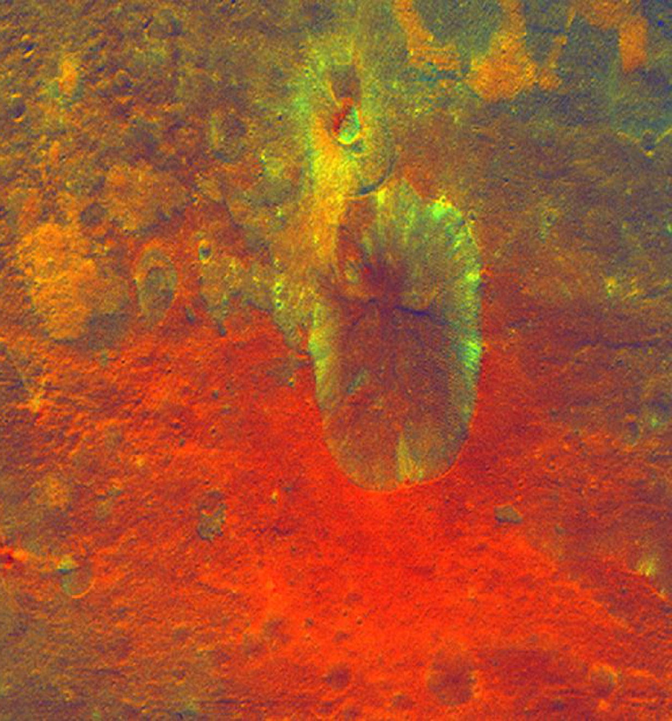
GEOLOGY & THE ELEMENTS OF ART
- LINE
- SHAPE
- COLOR
- VALUE
- TEXTURE
GIANT ASTEROID VESTA
CREDIT: NASA/JPL-Caltech/UCLA/MPS/DLR/IDA
Notes:
PRESENTATION NOTES:
When scientists look at remote sensing images of planets, moons and asteroids, they have to try and understand their surfaces by using their eyes.
The Elements of Art are the foundation artists use to understand visual information.
Does anyone know what the five Elements of Art are? Line, Shape, Color, Value and Texture
[Includes animation which can be turned off]
These art concepts can help us understand the geology of planetary bodies.
This image of the large asteroid Vesta taken by the Dawn spacecraft during the year it spent in orbit uses “translated” color to distinguish the different materials found on the surface around this crater, translating information that instruments capture and making it visible to our eyes.
THE ELEMENTS OF ART (See Educator Guide for more detailed definitions)
If students have not covered concepts in art class, taking them at face value works very well – students will learn as they go!
SCIENCE NOTES:
This translated color image obtained by the Framing Camera on NASA's Dawn spacecraft shows a crater on the giant asteroid Vesta. The reddish coloring below the crater points to material that was hurled from Vesta's interior during an impact or originated from the impactor itself. This image was obtained at an altitude of 1,700 miles altitude above the surface of Vesta. Image resolution is about 260 meters per pixel.
http://www.nasa.gov/mission_pages/dawn/multimedia/pia14709.html

Slide 16
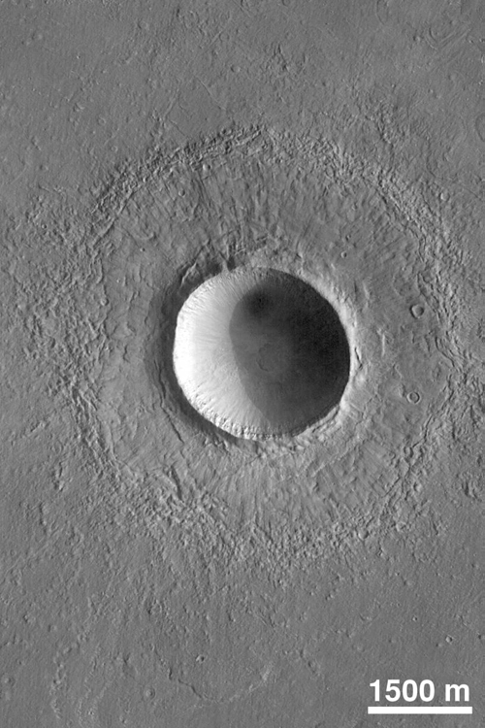
SHAPE
Circle - Craters
MARS
CREDIT: NASA/JPL
Notes:
PRESENTATION NOTES:
Let’s discuss shapes first.
When scientists see circles on the surface of a planet or small body, it often means that there is a crater.
What is a crater? What might cause one? A crater is formed when something impacts a planetary body. Note: Students may not be aware that they are found on Earth as well as the Moon and other planetary objects.
When an object like a meteoroid, asteroid or comet hits the surface of a planet it leaves a mark typically in the shape of the circle.
It also kicks up a lot of debris which is thrown away from the impact site, or “ejected,” around the crater. This is called an ejecta blanket.
This is a beautiful picture of a crater on Mars.
SCIENCE NOTES:
This crater on northern Elysium Planitia is a little more than twice the diameter of the famous Meteor Crater in Arizona. It was formed by the impact and subsequent explosion of a meteorite. The image was taken by the Mars Orbiter Camera aboard the Mars Global Surveyor in July, 1998. http://pds.nasa.gov/planets/captions/mars/crater.htm

Slide 17
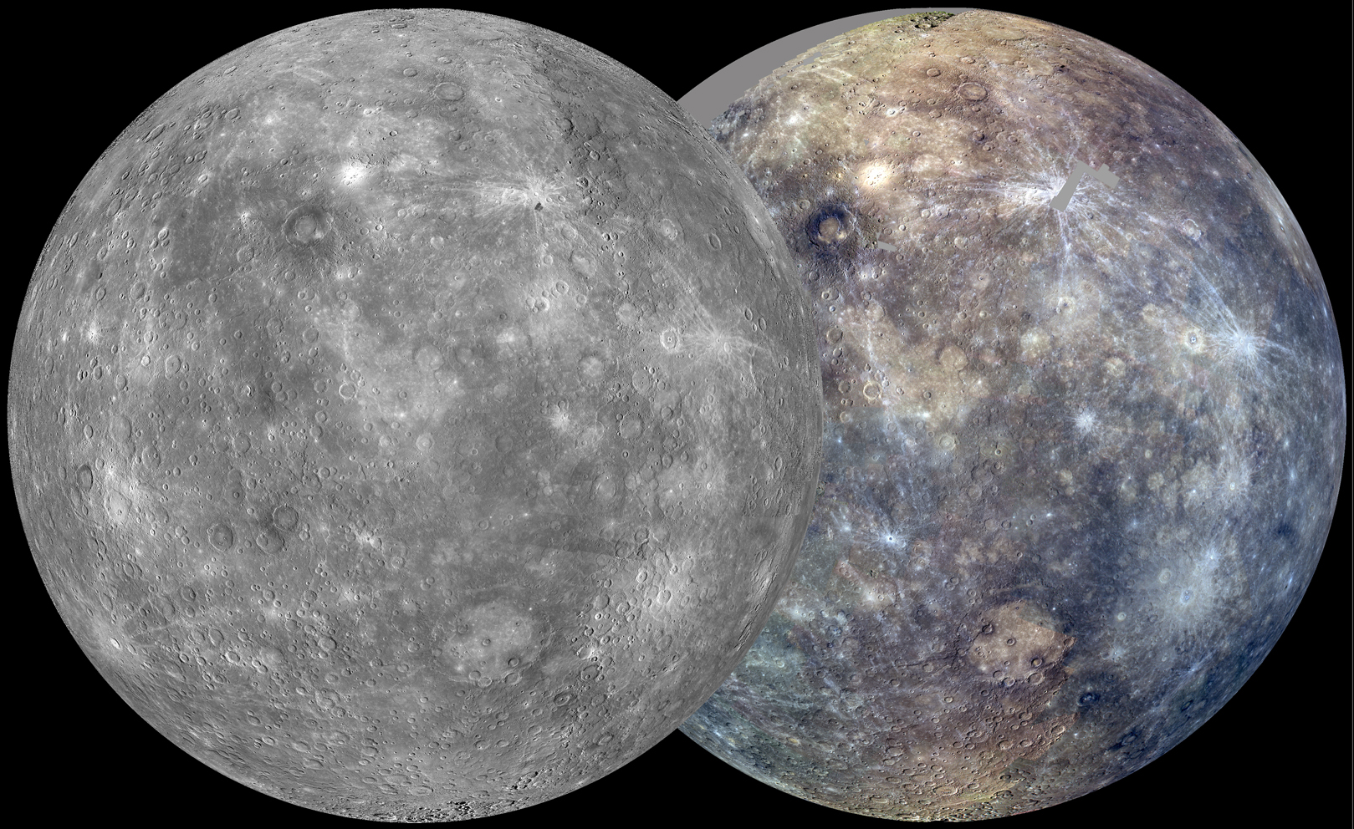
CIRCLES: Mercury
CREDIT: NASA/JHUAPL/CIW
Notes:
PRESENTATION NOTES:
Currently NASA has a mission called MESSENGER orbiting Mercury, the planet nearest our Sun, for the first time.
Here two images of Mercury in monochrome and color.
SCIENCE NOTES:
More on the MESSENGER Mission
After its first Mercury solar day (176 Earth days) in orbit, MESSENGER has nearly completed two of its main global imaging campaigns: a monochrome map at 250 m/pixel and an eight-color, 1-km/pixel color map. Apart from small gaps, which will be filled in during the next solar day, these global maps now provide uniform lighting conditions ideal for assessing the form of Mercury’s surface features as well as the color and compositional variations across the planet.

Slide 18
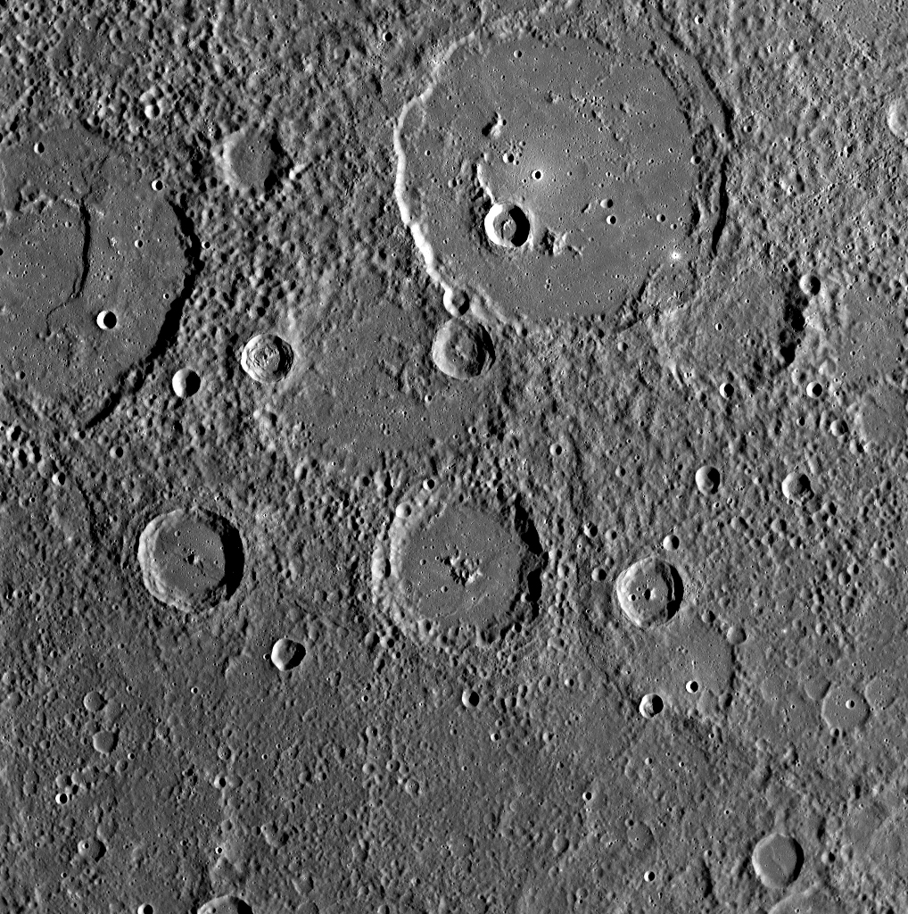
MERCURY
CREDIT: NASA/JHUAPL/CIW
Notes:
PRESENTATION NOTES:
What has MESSENGER found on the surface of Mercury?
Lots of circles which means lots of craters.
You can have students come up and point to craters – urging them to look, notice little ones, eroded ones, craters in craters, etc.
Mercury has been bombarded by many impacts.
SCIENCE NOTES:
The largest impact feature at the top of the image is about 83 miles in diameter and is named Polygnotus, after a Greek painter from the 5th century B.C. This basin has a central peak ring and is embayed with smooth plains material, which is very different in texture from the surrounding terrain. A second, comparably large crater at the top left of the image, named Boethius after the 6th century Roman philosopher, also appears to be almost filled with smooth plains, which were subsequently deformed during the formation of a prominent scarp. http://www.nasa.gov/mission_pages/messenger/multimedia/flyby2_20081007_2.html

Slide 19
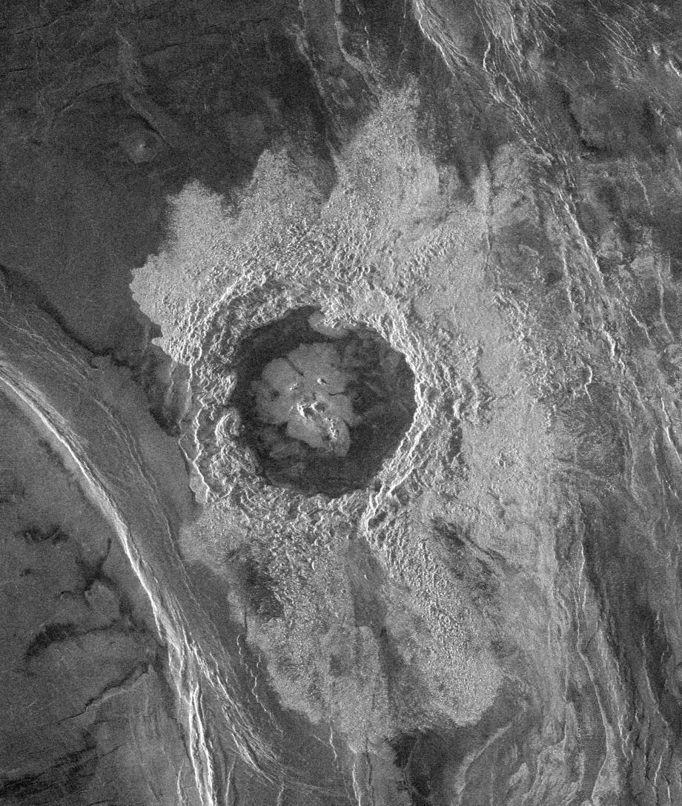
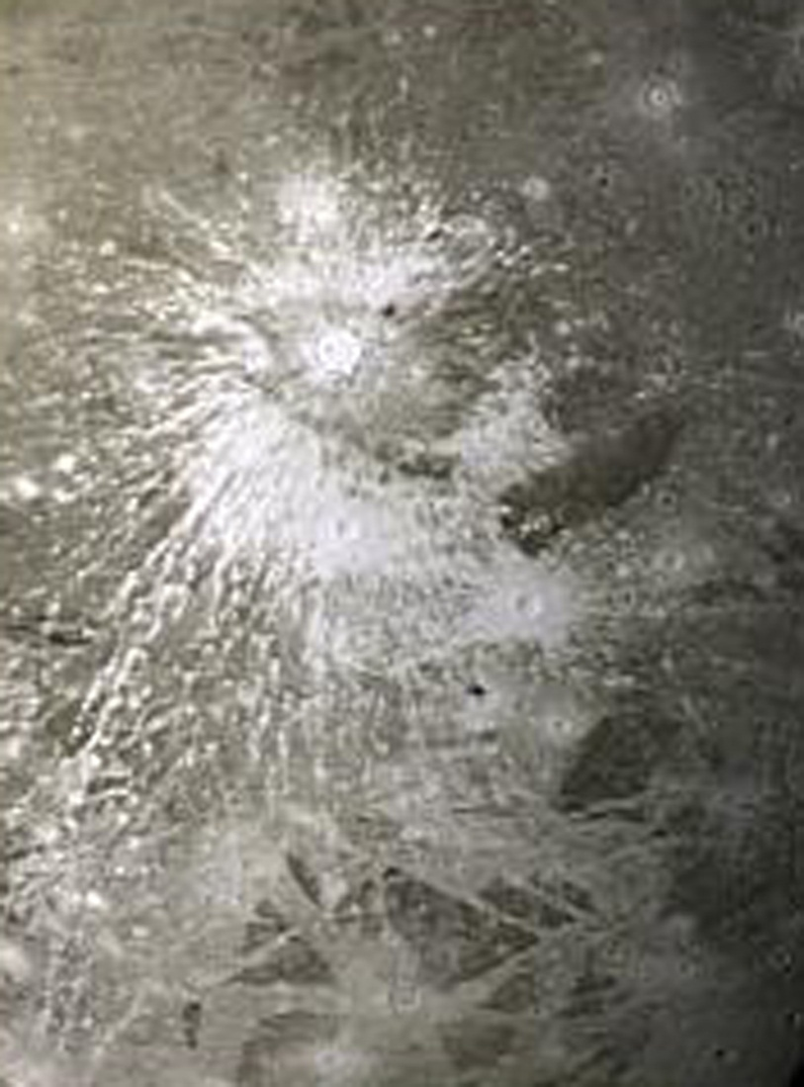
MANY TYPES OF CRATERS: Venus vs. Ganymede
VENUS’s DICKINSON CRATER
CREDIT: NASA/JPL
JUPITER’s MOON, GANYMEDE
CREDIT: NASA/JPL/USGS
Notes:
PRESENTATION NOTES:
Craters come in all shapes and sizes. What do you see?
Students’ observations can lead to additional info, below.
Their ejecta can give clues as to what type of material the surface is made of.
The image on the left is of Venus and the image on the right is of Ganymede, a large moon of Jupiter.
Venus is very hot and rocky and the flows of ejecta may have been melted by the impact.
The Ganymede crater is called a ray crater. It has bright streaks of ejecta which suggest it is a fresh impact on an icy surface
SCIENCE NOTES:
Venus Crater
This Magellan spacecraft image shows Dickinson crater. The crater is complex, characterized by a partial central ring and a floor flooded by radar-dark and radar-bright materials. Hummocky, rough-textured ejecta extend all around the crater, except to the west. Extensive radar-bright flows that emanate from the crater's eastern walls may represent large volumes of impact melt, or they may be the result of volcanic material released from the subsurface during the cratering event. http://photojournal.jpl.nasa.gov/catalog/PIA00479
Ganymede Ray Crater
This image shows a prominent rayed crater on Jupiter's icy moon, Ganymede. The view shows icy ejecta rays splashed out by the impact. http://photojournal.jpl.nasa.gov/catalog/PIA00334

Slide 20
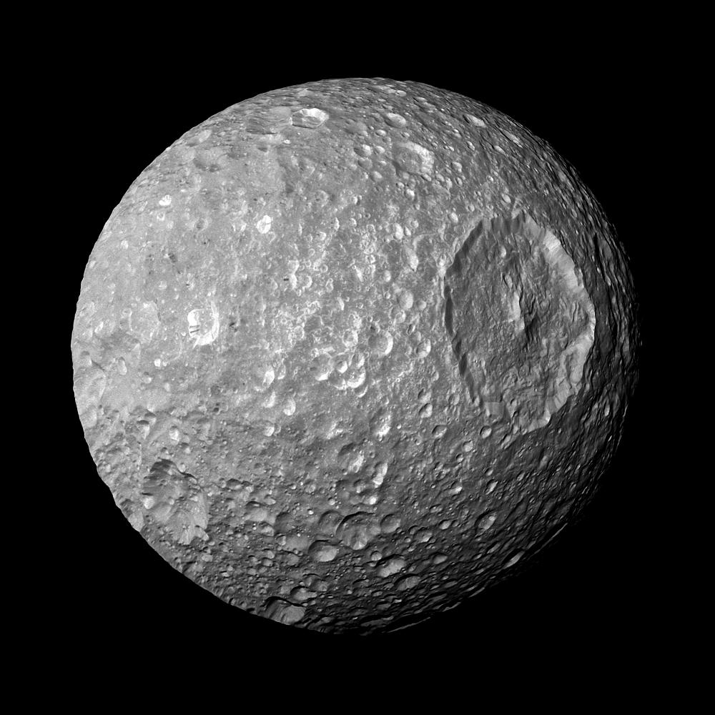
MIMAS: The Death Star Moon
SATURN’s MIMAS
CREDIT: NASA/JPL/SSI
Notes:
PRESENTATION NOTES:
Mimas is a small icy moon of Saturn with a larger crater called Herschel.
What does the size of this circle/crater suggest? That something very large hit the surface of Mimas.
Mimas is often nicknamed the “Death Star” moon because it resembles the fictional moon-sized space station and super weapon from the Star Wars movies.
SCIENCE NOTES:
In this view captured by NASA's Cassini spacecraft on its closest-ever flyby of Saturn's moon Mimas, large Herschel Crater dominates Mimas, making the moon look like the Death Star in the movie "Star Wars.“ http://photojournal.jpl.nasa.gov/catalog/PIA12570

Slide 21
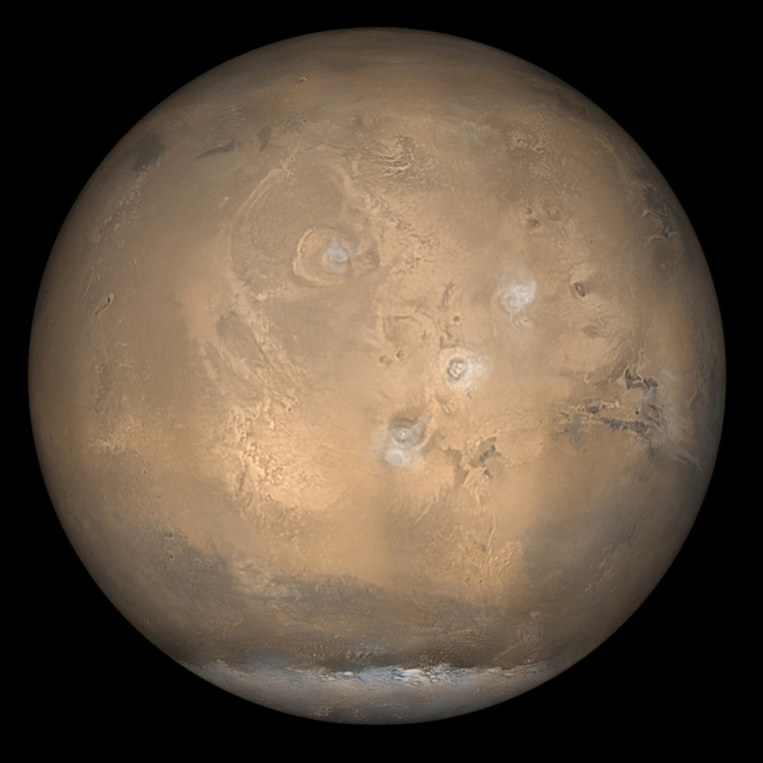
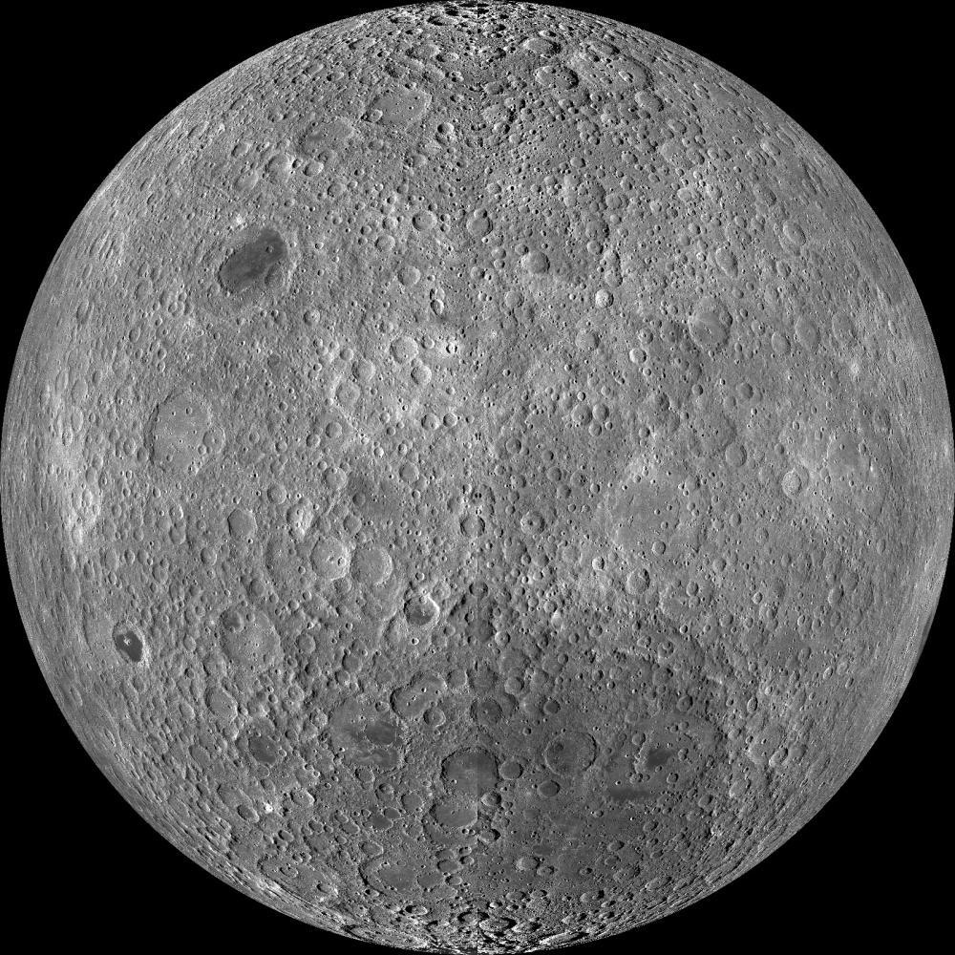
COUNTING CRATERS: The Moon vs. Mars
CREDIT: NASA/GSFC/Arizona State University
CREDIT: NASA/JPL/Malin Space Science Systems
Notes:
PRESENTATION NOTES:
What do you notice when you compare these two bodies? Different numbers of circles/craters
Scientists count the number of craters on a planetary body to help them understand the ages of their surfaces.
What surface do you think is older, the Moons or Mars? The Moon
Why does the Moon’s surface seem older? Because there are more circles/craters
However, we always have to be careful our interpretations, because there are other possible explanations – resolution of the camera. Scientists have to take all these factors into account.
For deeper questioning/thinking if time allows:
What might have happened to craters on Mars? They were erased through geologic process
What kind of geology would erase the craters? Volcanoes, wind erosions, water erosion, tectonic activity.
Active geology covers up craters and means a planetary surface is relatively young.
SCIENCE NOTES:
Lunar Reconnaissance Orbiter
http://lro.gsfc.nasa.gov/
Mars Global Surveyor
http://mars.jpl.nasa.gov/gallery/global/20020418f_g.html

Slide 22
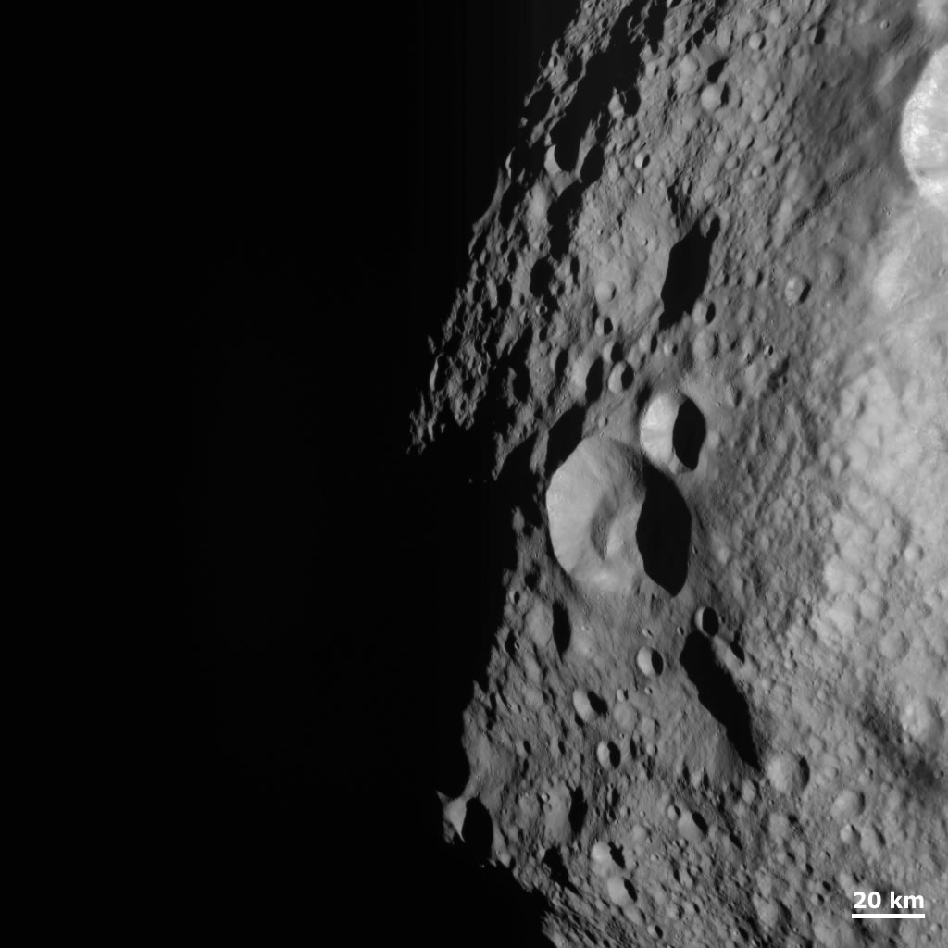
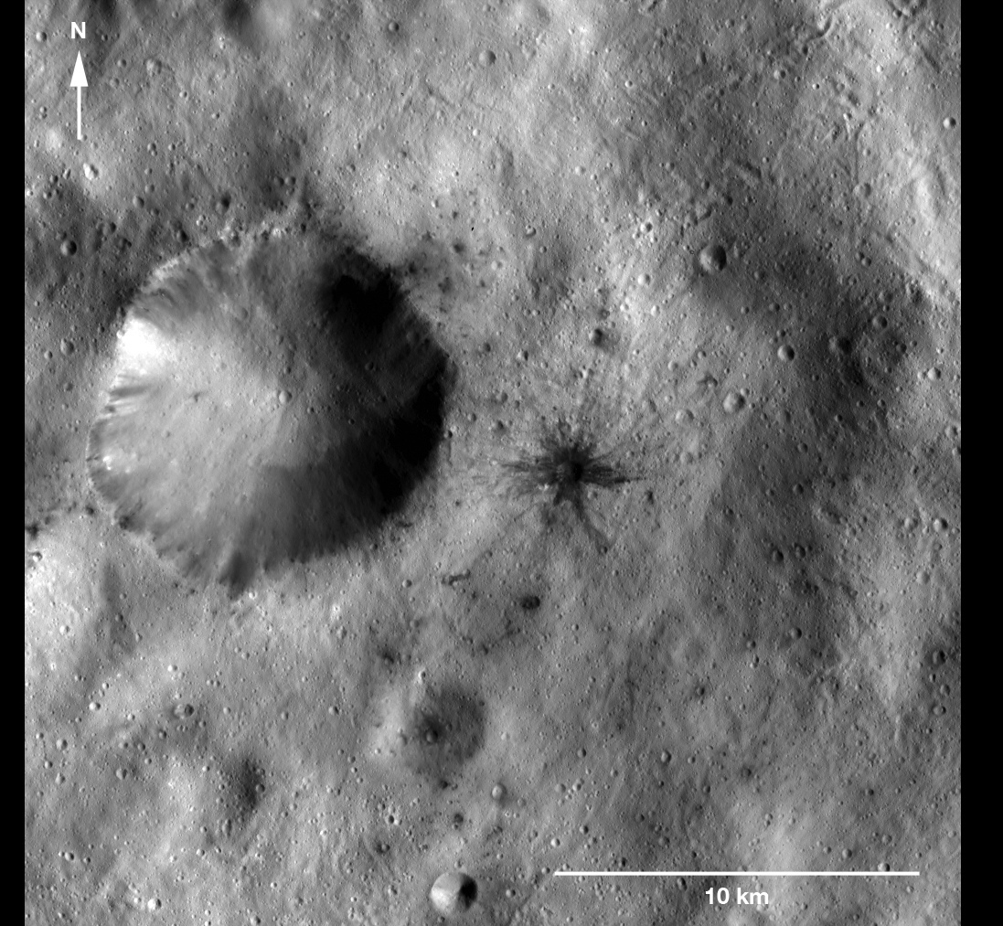
GIANT ASTEROID VESTA
CREDIT: NASA/JPL-Caltech/UCLA/MPS/DLR/IDA
Notes:
PRESENTATION NOTES:
We often think of smaller bodies such as asteroids as causing impacts, and indeed they do, but they are also impacted by other objects as well, as shown in this image of Vesta taken by the Dawn Mission.
What do you see on Vesta’s surface? Circles/Craters
Vesta is the size of Arizona
SCIENCE NOTES:
The image on the left shows a dark-rayed impact crater and several dark spots. The dark materials are located near an older, larger crater in the Sextilia quadrangle of Vesta’s southern hemisphere.
The dark-rayed crater and dark spots may have come from a carbon-rich meteor that broke up and collided with Vesta. Or, the dark-rayed crater could be excavated dark material from under Vesta’s surface. Detection of compositional differences among the examples of dark materials will help scientists determine where they came from.
This image was taken by Dawn’s framing camera on January 8, 2012, during the mission’s low-altitude mapping orbit (on average 130 miles above the surface). This image covers an area of about 200 square miles.
http://dawn.jpl.nasa.gov/multimedia/dark_rayed_crater.asp

Slide 23
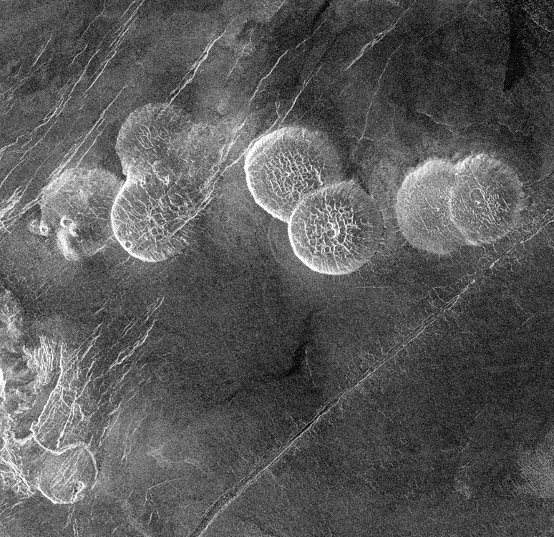
VENUS
CREDIT: NASA/JPL
Notes:
PRESENTATION NOTES:
What do you think this image shows? Circles, craters
There are circles, but they are not craters. What do you think this could be? Encourage any theories
As with many things, there are always exceptions to the rules.
These circular features on Venus are not craters, they are volcanoes.
They are called “Pancake Domes” and are believed to be volcanoes with very thick lava.
How do we know this? Scientists use many other tools to get to the answers.
SCIENCE NOTES:
Seven circular, dome-like hills, averaging 15 miles in diameter with maximum heights of 2,475 feet dominate the scene. These features are interpreted as very thick lava flows that came from an opening on the relatively level ground, which allowed the lava to flow in an even pattern outward from the opening. http://photojournal.jpl.nasa.gov/catalog/PIA00215

Slide 24
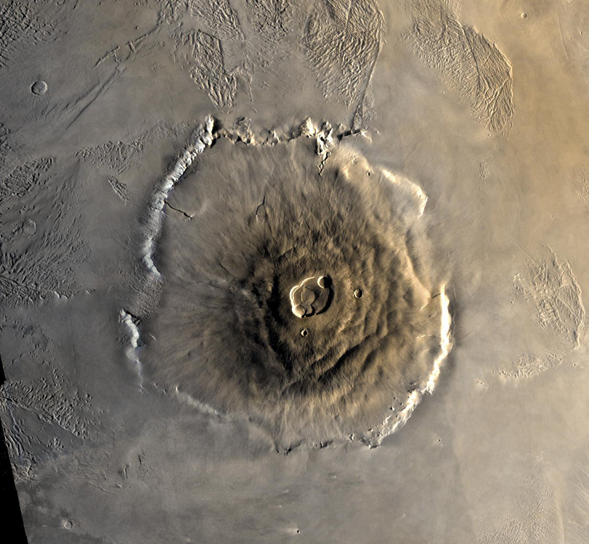
SHAPE
Blobs – Volcanoes (or Lakes)
MAR’s OLYMPUS MONS
CREDIT: NASA/JPL
Notes:
PRESENTATION NOTES:
We have talked about circular shapes meaning craters, now let’s explore organic shapes, or blobs.
When scientists see organic shapes (or blobs) on the surface of a planetary body, it often means they are looking at a volcano.
Recently, that assumption has been expanded by some exciting new discoveries, but we will get to those later.
This is an image of a giant volcano on Mars called Olympus Mons, and it is roughly the size of Arizona, or 3 times the size of Mt. Everest.
SCIENCE NOTES:
The largest of the volcanoes in the Tharsis Montes region, as well as all known volcanoes in the solar system, is Olympus Mons. Olympus Mons is a shield volcano 374 miles in diameter (approximately the same size as the state of Arizona), 16 miles high, and is rimmed by a 4 mile high scarp. A caldera 50 miles wide is located at the summit of Olympus Mons. To compare, the largest volcano on Earth is Mauna Loa. Mauna Loa is a shield volcano 6.3 miles high and 75 miles across. The volume of Olympus Mons is about 100 times larger than that of Mauna Loa. In fact, the entire chain of Hawaiian islands (from Kauai to Hawaii) would fit inside Olympus Mons!
http://marsprogram.jpl.nasa.gov/gallery/atlas/olympus-mons.html

Slide 25
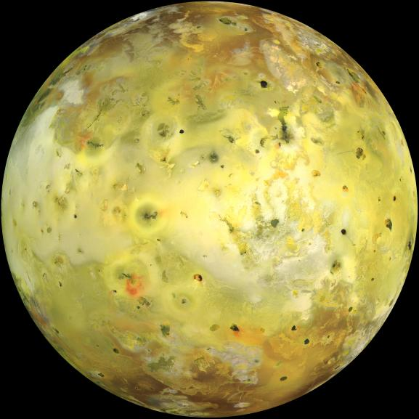
Jupiter’s moon, IO
CREDIT: NASA/JPL-Caltech/Univ. of Arizona
Notes:
PRESENTATION NOTES:
One of the most fascinating places in our solar system is Jupiter’s moon, Io.
This is about what Io looks like with your naked eye.
What do you think all of those blobby shapes are? Volcanoes
SCIENCE NOTES:
NASA's Galileo spacecraft acquired its highest resolution images of Jupiter's moon Io on 3 July 1999 during its closest pass to Io since orbit insertion in late 1995. This color mosaic uses the near-infrared, green and violet filters (slightly more than the visible range) of the spacecraft's camera and approximates what the human eye would see. Most of Io's surface has pastel colors, punctuated by black, brown, green, orange, and red units near the active volcanic centers. http://photojournal.jpl.nasa.gov/catalog/PIA02308

Slide 26
IO
Close…
CREDIT: NASA/JPL/USGS
Notes:
PRESENTATION NOTES:
What do you see on the surface of Io? Lots of blobs
All these blobs and dark spots on Io are volcanos.
Io is the most volcanically active in the solar system.
It is covered with sulphur which makes the amazing colors on the surface.
Io has very active geology—
This extreme geologic activity is the result of tidal heating from friction generated within Io's interior as it is pulled between Jupiter and the other Galilean satellites—Europa, Ganymede and Callisto.
The land on Io actually moves in tides like Earth’s oceans.
SCIENCE NOTES:
Volcanoes erupt massive volumes of silicate lava, sulphur and sulphur dioxide, constantly changing Io's appearance. http://photojournal.jpl.nasa.gov/catalog/PIA09257

Slide 27
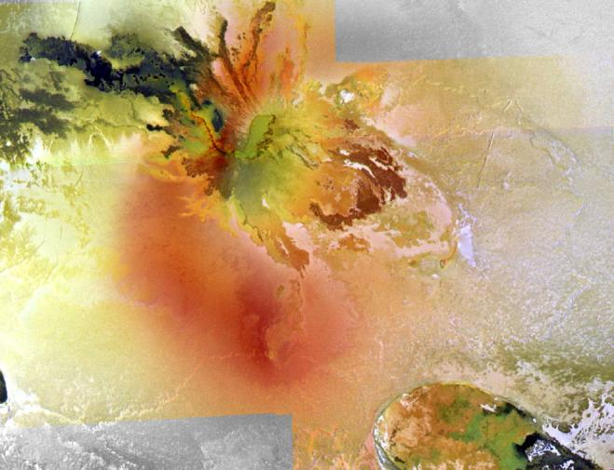
Closer…
CULANN PATERA
CREDIT: NASA/JPL-Caltech/Univ. of Arizona
Notes:
PRESENTATION NOTES:
One of the most colorful volcanic areas on Io is named Culann Patera.
What do you see? Let the audience share their observations
The blobby shapes show the different lava flows coming from the volcanic center.
SCIENCE NOTES:
Culann Patera is the centerpiece of this mosaic of the best high-resolution, color views of Io returned by NASA's Galileo spacecraft. The picture was constructed from images taken through the red, green, and violet filters of the Galileo camera and has been processed to enhance the color variations. The resolution is about 200 per picture element. North is to the top. http://photojournal.jpl.nasa.gov/catalog/PIA02535

Slide 28
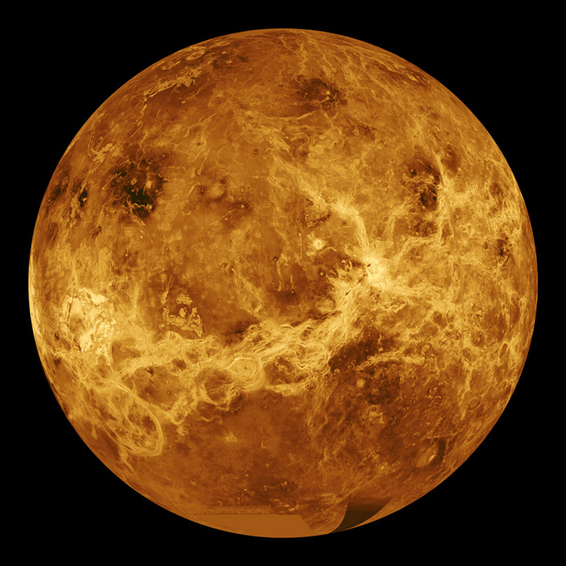
VENUS
CREDIT: NASA/JPL
Notes:
PRESENTATION NOTES:
Another great place to look for blobs or volcanos in the solar system is Venus.
Venus is covered with a thick atmosphere and has experienced a runaway “greenhouse effect,” making the surface temperatures 800 degrees Fahrenheit.
We cannot see through Venus’ clouds so NASA sent a spacecraft to Earth’s neighbor called Magellan which used radar to peer through its thick atmosphere. Another way to see through the clouds would be to use infrared cameras.
SCIENCE NOTES:
For more information on Venus
http://solarsystem.jpl.nasa.gov/planets/profile.cfm?Object=Venus

Slide 29
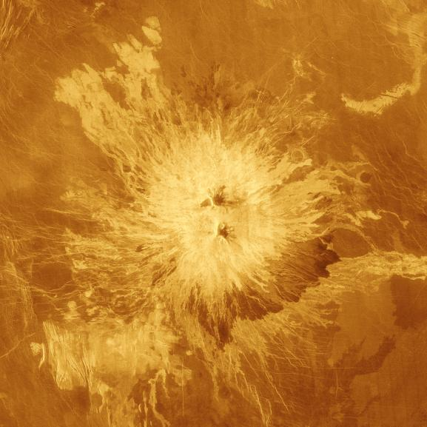
SAPAS MONS on Venus
CREDIT: NASA/JPL
Notes:
PRESENTATION NOTES:
When the Magellan spacecraft imaged Venus with radar, it found lots of blobby, organic shapes, giving scientists clues that Venus has experienced a lot of volcanic activity.
This is an image of a volcano named Sapas Mons.
SCIENCE NOTES:
This translated-color image shows the volcano Sapas Mons, which is located in the broad equatorial rise called Atla Regio. The area shown is approximately 404 miles on a side. Sapas Mons measures about 248 miles across and 0.9 mile high. Its flanks show numerous overlapping lava flows. The dark flows on the lower right are thought to be smoother than the brighter ones near the central part of the volcano. Many of the flows appear to have been erupted along the flanks of the volcano rather than from the summit. This type of flank eruption is common on large volcanoes on Earth, such as the Hawaiian volcanoes. The summit area has two flat-topped mesas, whose smooth tops give a relatively dark appearance in the radar image. http://photojournal.jpl.nasa.gov/catalog/PIA00203

Slide 30
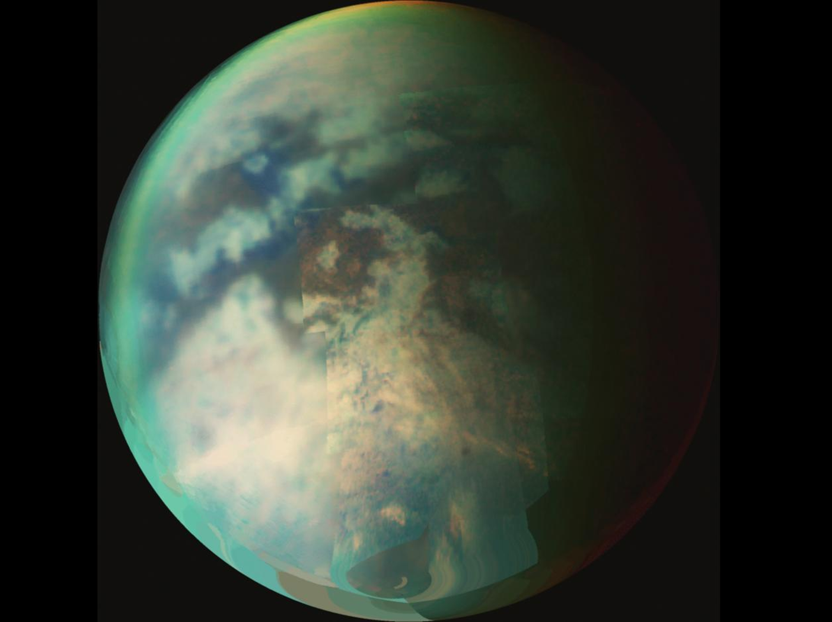
TITAN
CREDIT: NASA/JPL-Caltech/Univ. of Arizona
Notes:
PRESENTATION NOTES:
There is currently a spacecraft in orbit around Saturn named Cassini.
Cassini has been studying a fascinating moon of Saturn’s called Titan. In many respects, Titan is one of the most Earth-like worlds we have found to date. With its thick atmosphere and organic-rich chemistry, Titan resembles a frozen version of Earth from several billion years ago.
Titan is the second largest moon in our solar system and is larger than the planet Mercury.
Titan is covered by a thick atmosphere. Cassini has been studying it using radar and sent a probe called Huygens to its surface in 2005, the first human-made object to land on a body in the outer solar system.
SCIENCE NOTES:
Titan is of great interest to scientists because it is the only moon in the solar system known to have clouds and a mysterious, thick, planet-like atmosphere. Winds sculpt vast regions of dark, hydrocarbon-rich dunes that girdle the moon's equator and low latitudes. http://solarsystem.jpl.nasa.gov/planets/profile.cfm?Object=Sat_Titan

Slide 31
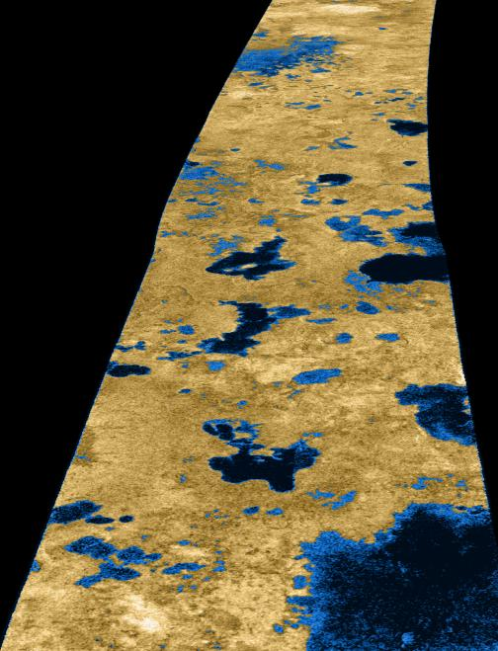
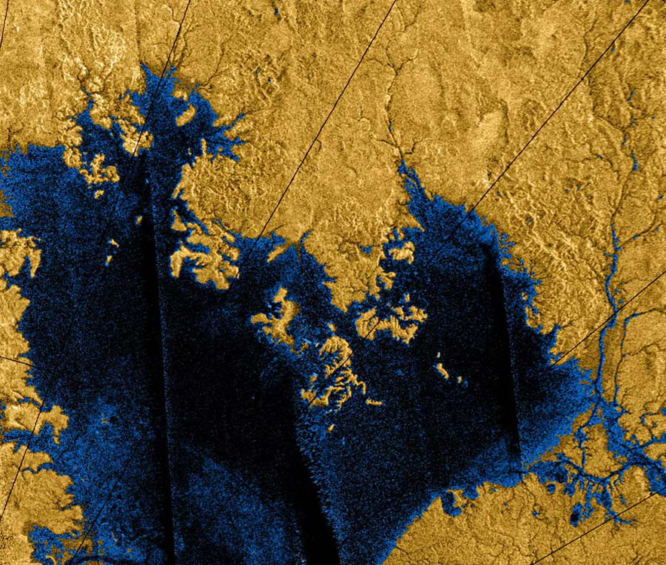
TITAN
CREDIT: NASA/JPL-Caltech/USGS
Notes:
PRESENTATION NOTES:
When scientist saw the surface of Titan, they saw all these blobby shapes.
What could they be? Do they remind you of anything on Earth? Volcanoes perhaps?
This blobby shapes are in fact lakes.
Titan is the only place in the solar system other than Earth where we have found liquid on the surface.
Titan appears to have something like our water cycle with liquid in lakes and streams, clouds and rain.
However, Titan is extremely cold, so can these lakes be filled with water? No, water would be in the form of ice.
In fact, Titan’s lakes, streams, and rain are made of methane!
Cassini has revealed that Titan's surface is shaped by rivers and lakes of liquid ethane and methane (the main component of natural gas), which forms clouds and occasionally rains from the sky as water does on Earth. Volcanism may occur as well, but with liquid water as the lava.
Scientists studying Titan have recently discovered that Titan may have a subsurface ocean!
What we’ve found on Titan has complete revolutionized our thinking about planetary bodies.
SCIENCE NOTES:
The existence of oceans or lakes of liquid methane on Saturn's moon Titan was suggested in 1980 from data returned by the Voyager 1 spacecraft. With a dense haze preventing a closer look, it was not possible at the time to confirm their presence. Data from the Hubble Space Telescope in 1995 offered direct evidence of liquid methane on Titan. Observations from the Cassini mission of the northern latitudes showed smooth dark patches dotting the surface near the pole. Based on these observations, scientists announced definitive evidence of of lakes filled with methane on Saturn’s moon Titan in 2007. http://photojournal.jpl.nasa.gov/catalog/PIA09102

Slide 32
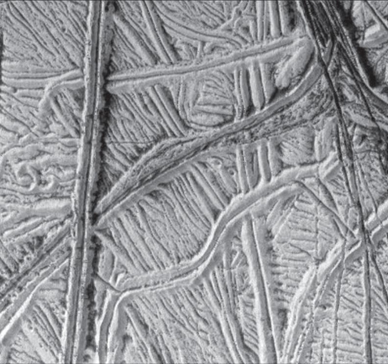
LINE
Straight lines - tectonic activity
JUPITER’s MOON, EUROPA
CREDIT: NASA/JPL
Notes:
PRESENTATION NOTES:
We’ve explored shapes, so now let’s move on to line.
When scientists see relatively straight lines on a planetary body, it often means there has been some type of tectonic activity.
Have you heard of that? What do we know? What are some tectonic processes? Encourage discussion
Tectonic activity can include fractures, cracks, faults, ridges, mountain building.
This image of a moon of Jupiter called Europa shows numerous ridges, cracks and fractures.

Slide 33
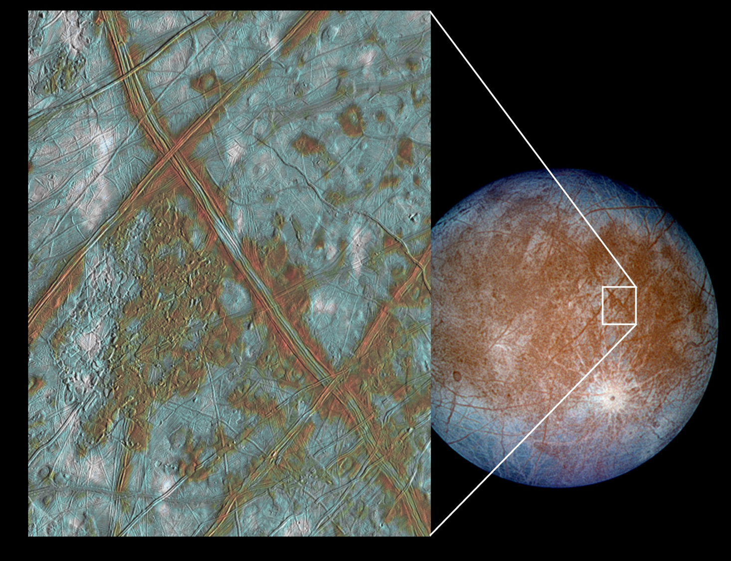
EUROPA
CREDIT: NASA/JPL-Caltech/Univ. of Arizona
Notes:
PRESENTATION NOTES:
Indeed, one of the best places to look for straight lines and study tectonic activity in the solar system is Europa.
Icy Europa is one of Jupiter's 4 large moons
It is covered in a shell of ice, and scientists think that below the ice is a global ocean.
Like Io, Europa is affected by Jupiter’s intense gravity and the tidal forces continually re-shape the moon.
Europa’s surface is covered in cracks, bands and fractures.
Europa is very exciting to scientists who think it might be one of the best candidates in the solar system to explore to find life in its oceans.
If we wanted to find out about how ice behaves here on Earth, where could we go?
Arctic, mountains, Antarctica – and indeed, scientists study these places, especially Antarctica, to help them understand icy worlds in our solar system like Europa and dwarf planet Ceres.
SCIENCE NOTES:
The image on the left shows a region of Europa's crust made up of blocks which are thought to have broken apart and "rafted" into new positions. These features are the best geologic evidence to date that Europa may have had a subsurface ocean at some time in its past. Combined with the geologic data, the presence of a magnetic field leads scientists to believe an ocean is most likely present at Europa today. http://photojournal.jpl.nasa.gov/catalog/PIA03002

Slide 34
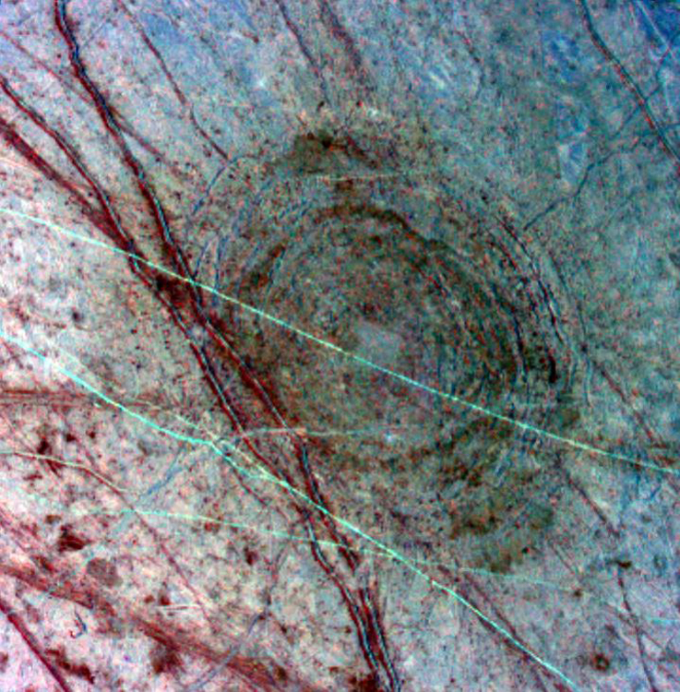
EUROPA: Geology & Storytelling
CREDIT: NASA/JPL-Caltech/Univ. of Arizona
Notes:
PRESENTATION NOTES:
The geology on a planetary surface can help us understand its unique and individual story.
Now that you have learned some of the basic tools, you can start to piece together the art elements you see to understand a planetary body’s history.
For instance, what is the big feature you see here? A circle or crater
Tell me what else you observe.
This circular feature is the impact crater called Tyre Macula on Europa.
What do you see going across the impact crater? Lines or cracks
The lines and cracks show that the surface also has tectonic activity present.
What came first, the crater or cracks? Some cracks are under the crater and came first, then there was an impact that left the large circular feature. Then there are clearly cracks and bands on top of the feature which happened last.
So you can use the layers of the art elements you see to uncover the geologic history of a planetary body.
ADDITIONAL SCIENCE NOTES:
The "bulls-eye" pattern appears to be an 86-mile-wide impact scar (about the size of the island of Hawaii) which formed as the surface fractured minutes after a mountain-sized asteroid or comet slammed into the satellite. This approximately 132-mile wide picture is the product of three images which have been processed in false color to enhance shapes and compositions. http://photojournal.jpl.nasa.gov/catalog/PIA00702

Slide 35
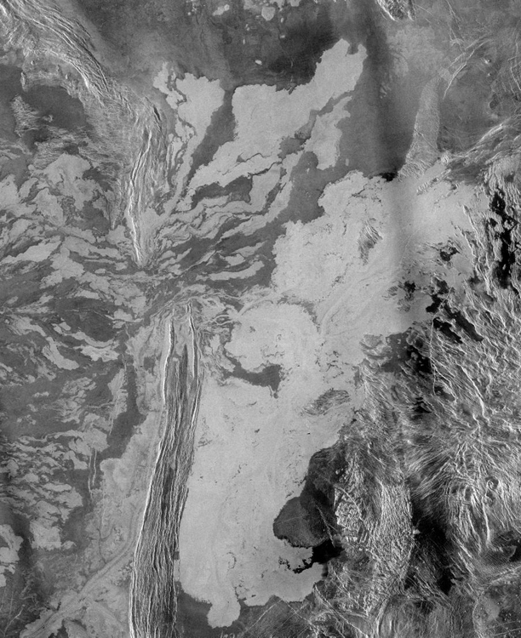
VENUS:
Geology & Storytelling
CREDIT: NASA/JPL
Notes:
PRESENTATION NOTES:
Let’s try it again with this image of Venus.
What do you see in this image? Blobs and straight lines
This probably means there has been both volcanic and tectonic activity.
Could the blobs be lakes? No, because the surface of Venus is too hot for liquid water, so the blobs most likely indicate“frozen” (solidified) lava.
Do you see the break in the straight lines? Yes
Scientists have interpreted this image to mean there was a range of ridges on the left side of the image and the lava broke through to flow to the plains on the right.
SCIENCE NOTES:
The mosaic shows a system of east-trending radar-bright and dark lava flows encountering and breaching a north-trending ridge belt (left of center). Upon breaching the ridge belt, the lavas pool in a vast, radar-bright deposit (covering approximately 62,000 square miles [right side of image]). The source caldera for the lava flows, named Ammavaru, lies approximately 186 miles west of the scene. http://photojournal.jpl.nasa.gov/catalog/PIA00486

Slide 36
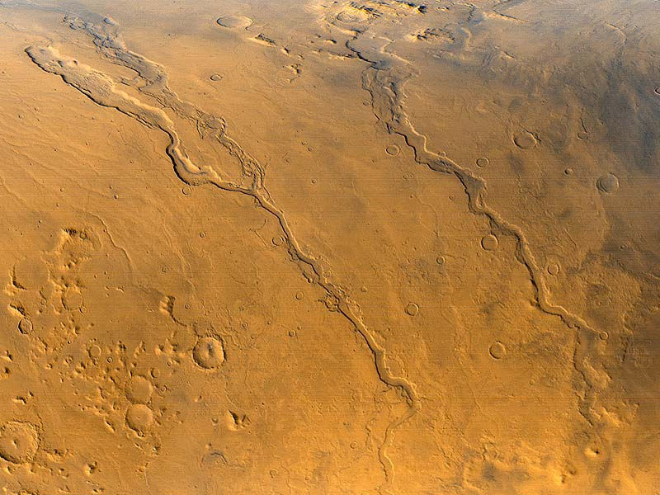
LINE
Squiggly lines - erosion (liquid & wind)
CREDIT: NASA/JPL
Notes:
PRESENTATION NOTES:
We’ve discussed straight lines, but scientists also see squiggly lines on the surface of planetary bodies.
Hmm, what does this remind you of, if you saw this on Earth…?
Squiggly lines often means the surface has experienced erosion… which is most often caused by what? liquid or wind
What type of liquid could cause erosions? Liquid water as on Earth and Mars, liquid methane on Titan, liquid lava rivers on Venus, Earth, Io
Can anyone guess what planet this is an image of? Mars

Slide 37
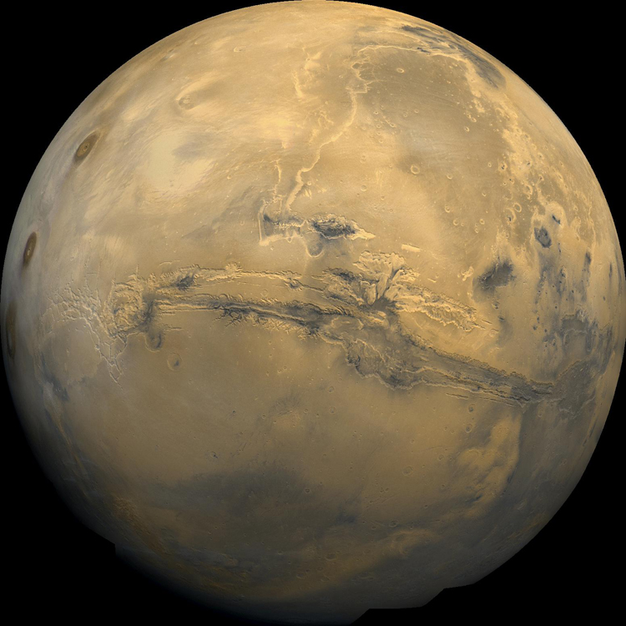
MARS
CREDIT: NASA/JPL
Notes:
PRESENTATION NOTES:
One of the reasons scientists have been so excited to study Mars is that they see lots of evidence that there has been water on the surface. There are lots of squiggly lines.
Scientists have not found obvious signs of liquid water currently on Mars, as it is so cold and dry. But they have found lots of clues that it existed in the past.
What do you see in the center of this image? A large collection of squiggly lines.
Indeed this is a huge canyon system called Valles Marineris, which is 3 times the size of the Grand Canyon on Earth.
In the 1970’s scientists believed this huge canyon was formed by flowing water. But with additional studies, most agree today that Valles Marineris was formed by tectonic activity - rift faults that were made bigger by erosion and collapsing of the rift walls. More than one process likely formed many of the features we are looking at.
SCIENCE NOTES:
More About Mars
http://www.nasa.gov/mission_pages/mars/main/index.html

Slide 38
MARS
CREDIT: NASA/JPL-Caltech/Univ. of Arizona
Notes:
PRESENTATION NOTES:
This is a series of images captured in 2011 that has led some scientists to believe that seasonal flows on Mars today may in fact be caused by liquid water. They think that melting and subsequent evaporation of frozen salty water might be the cause of intriguing dark streaks that were observed in images taken during spring and summer on a slope inside Mars’ Newton Crater.
SCIENCE NOTES:
Evidence for the interpretation that this may be an indication of liquid water flowing on Mars today is presented in a report by McEwen et al. in the Aug. 5, 2011, edition of Science. These images were taken by the High Resolution Imaging Science Experiment (HiRISE) camera on NASA's Mars Reconnaissance Orbiter.
The features that extend down the slope during warm seasons are called recurring slope lineae. They are narrow (one-half to five meters wide), relatively dark markings on steep slopes at several southern hemisphere locations. Repeat imaging by HiRISE shows the features appear and incrementally grow during warm seasons and fade in cold seasons. They extend downslope from bedrock outcrops, often associated with small channels, and hundreds of them form in rare locations. Liquid brines near the surface might explain this activity, but the exact mechanism and source of the water are not understood. http://photojournal.jpl.nasa.gov/catalog/PIA14472

Slide 39
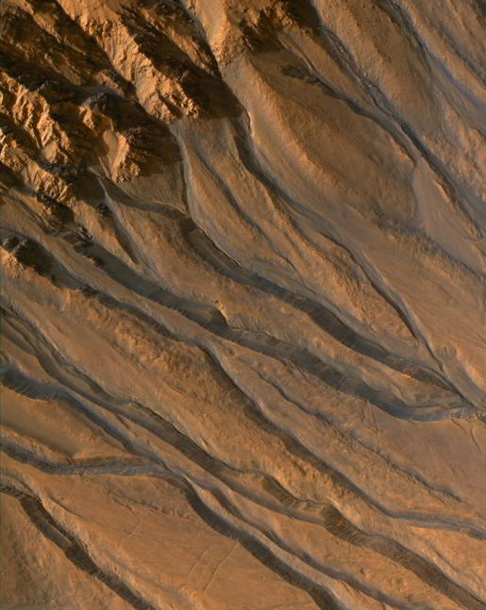
FOLLOW THE WATER: Mars
CREDIT: NASA/JPL-Caltech/Univ. of Arizona
Notes:
PRESENTATION NOTES:
This image shows squiggly lines coming from a crater rim.
Scientists believe these are gullies that have been carved into Mar’s surface by water.
Scientists have a saying, “follow the water”. What does this refer to? They are interested in water because it seems to be necessary for life as we know it.
SCIENCE NOTES:
This image shows gully channels in a crater in the southern highlands of Mars, taken by the High Resolution Imaging Science Experiment (HiRISE) camera on the Mars Reconnaissance Orbiter. The gullies emanating from the rocky cliffs near the crater's rim (upper left) show meandering and braided patterns typical of water-carved channels. http://photojournal.jpl.nasa.gov/catalog/PIA10001

Slide 40
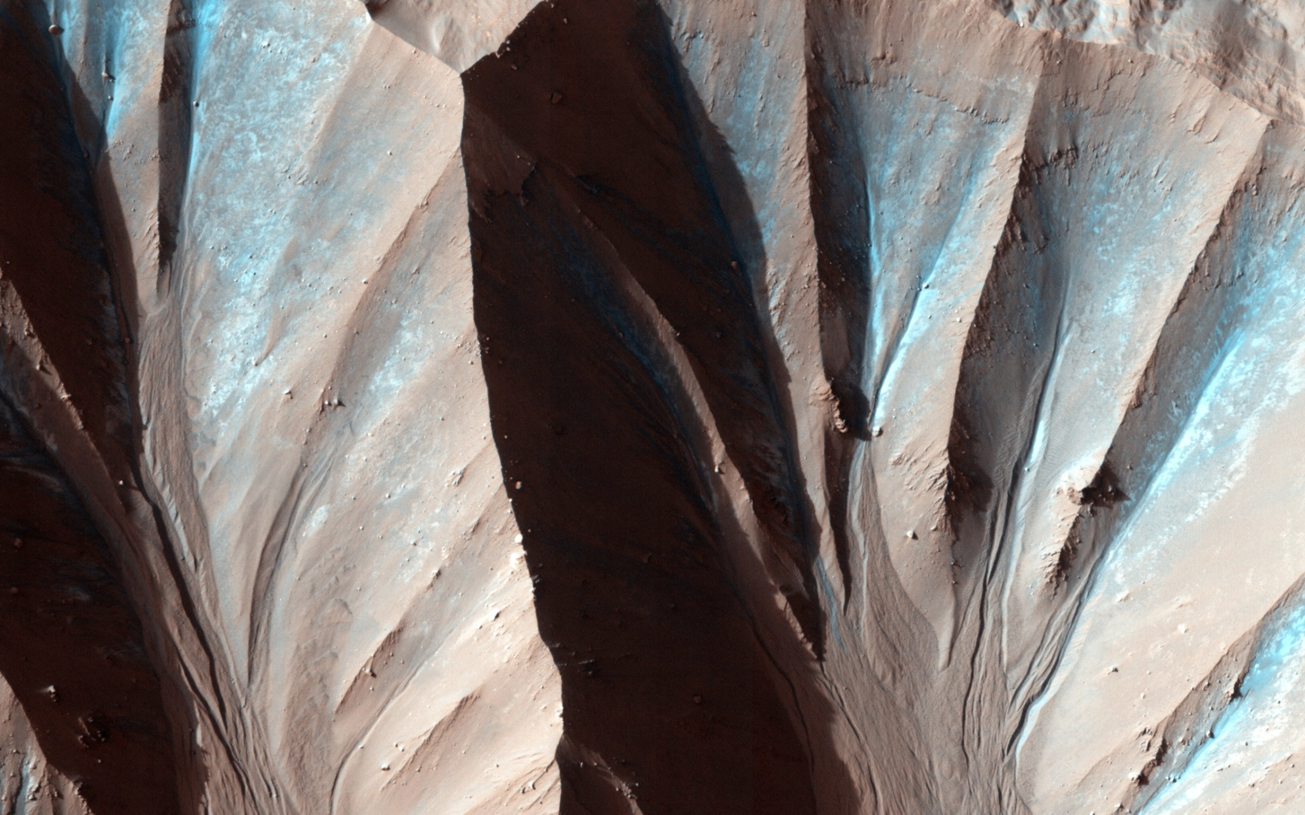
MARS
CREDIT: NASA/JPL-Caltech/Univ. of Arizona
Notes:
PRESENTATION NOTES:
Gully landforms like those in this image are found in many craters in the mid-latitudes of Mars. Changes in gullies were first seen in images from the Mars Orbiter Camera in 2006.
Current gully activity appears to be concentrated in winter and early spring, and may be caused by the seasonal carbon dioxide frost that is visible in gully alcoves in the winter.
SCIENCE NOTES:
This image of landforms on Mars was taken by the High Resolution Imaging Science Experiment (HiRISE) flying onboard the Mars Reconnaissance Orbiter (MRO) mission.
Learn more about what MRO is finding out about possible water flows on Mars at http://mars.jpl.nasa.gov/mro/.

Slide 41
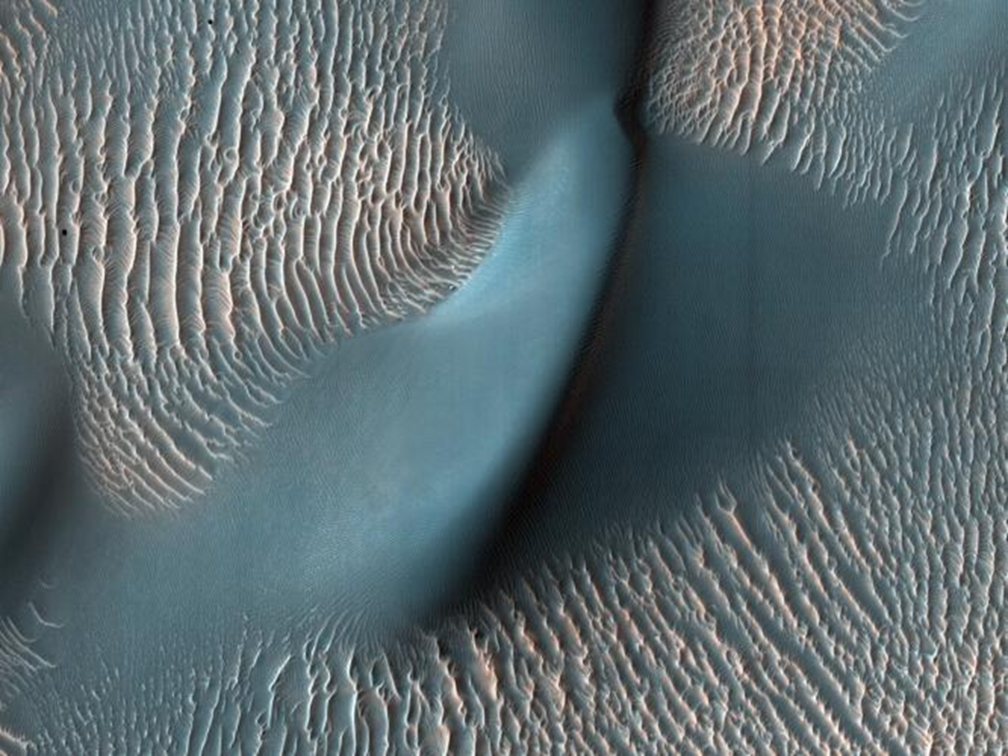
MARS
CREDIT: NASA/JPL-Caltech/Univ. of Arizona
Notes:
PRESENTATION NOTES:
Squiggly lines don’t just mean erosion by liquid. What other process can cause erosion? Wind erosion
Indeed, Mars hasn’t just had erosion due to liquid water, it also has a lot of wind.
What do you think this is an image of (think of the desert)? This is an image of sand dunes.
SCIENCE NOTES:
This view from the High Resolution Imaging Science Experiment (HiRISE) camera on NASA's Mars Reconnaissance Orbiter shows two classes of aeolian bedforms within Proctor Crater. The relatively bright, small ridges are ripples. From their study on Earth and close-up examination by the Mars Exploration Rovers (roving elsewhere on Mars), we know that ripples are composed of fine sand (less than 200 microns in diameter) or fine sand coated with coarser sand and granules. http://photojournal.jpl.nasa.gov/catalog/PIA11833

Slide 42
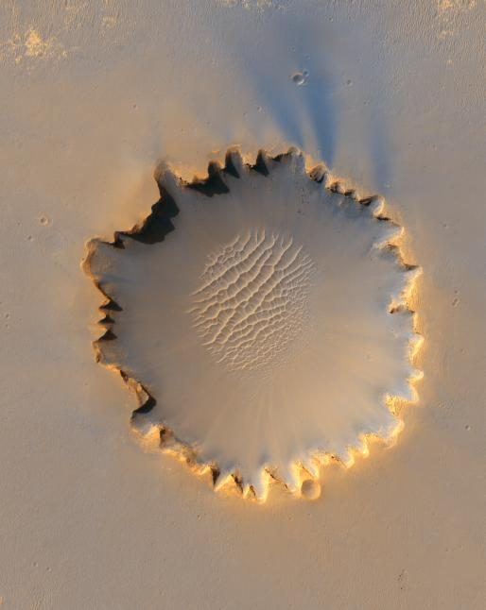
What’s the Story?
Victoria Crater on Mars
CREDIT: NASA/JPL-Caltech/Univ. of Arizona/Cornell/Ohio State Univ.
Notes:
PRESENTATION NOTES:
We’ve talked about how shapes and lines can tell the story of a surface.
What do you see here? Circles and squiggly lines
Yes, but the circle has a squiggly edge so what has happened? They have been eroded
The circle is a crater called Victoria Crater. Its edges have been eroded and are now irregular. There are sand dunes at the bottom of the crater.
Do you see the small circles around Victoria crater? Yes
Do you think those are older or younger than the big crater? They are younger because they are very circular and have not been eroded
SCIENCE NOTES:
"Victoria Crater," about one-half mile in diameter, was home ground for NASA's Mars Exploration Rover Opportunity for more than 14 of the rover's first 46 months on Mars. http://photojournal.jpl.nasa.gov/catalog/PIA08813

Slide 43
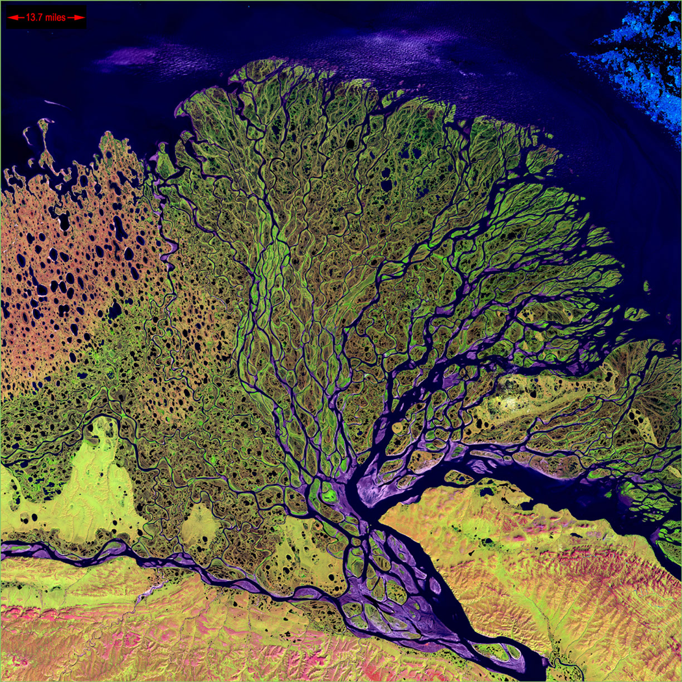
EARTH
CREDIT: NASA Earth Observatory
Notes:
PRESENTATION NOTES:
One of the most exciting and beautiful places to look for squiggly lines and erosion is our own planet Earth.
Earth is the ONLY planet in the solar system known to have liquid water currently present on the surface.
We also have a thick, wet, windy atmosphere so there has been a lot of erosion on the surface of Earth.
This image is of the Lena River Delta in Russia taken from space.
As a reminder, where is the only other solar system body that we know has liquid on the surface? Saturn’s moon, Titan

Slide 44
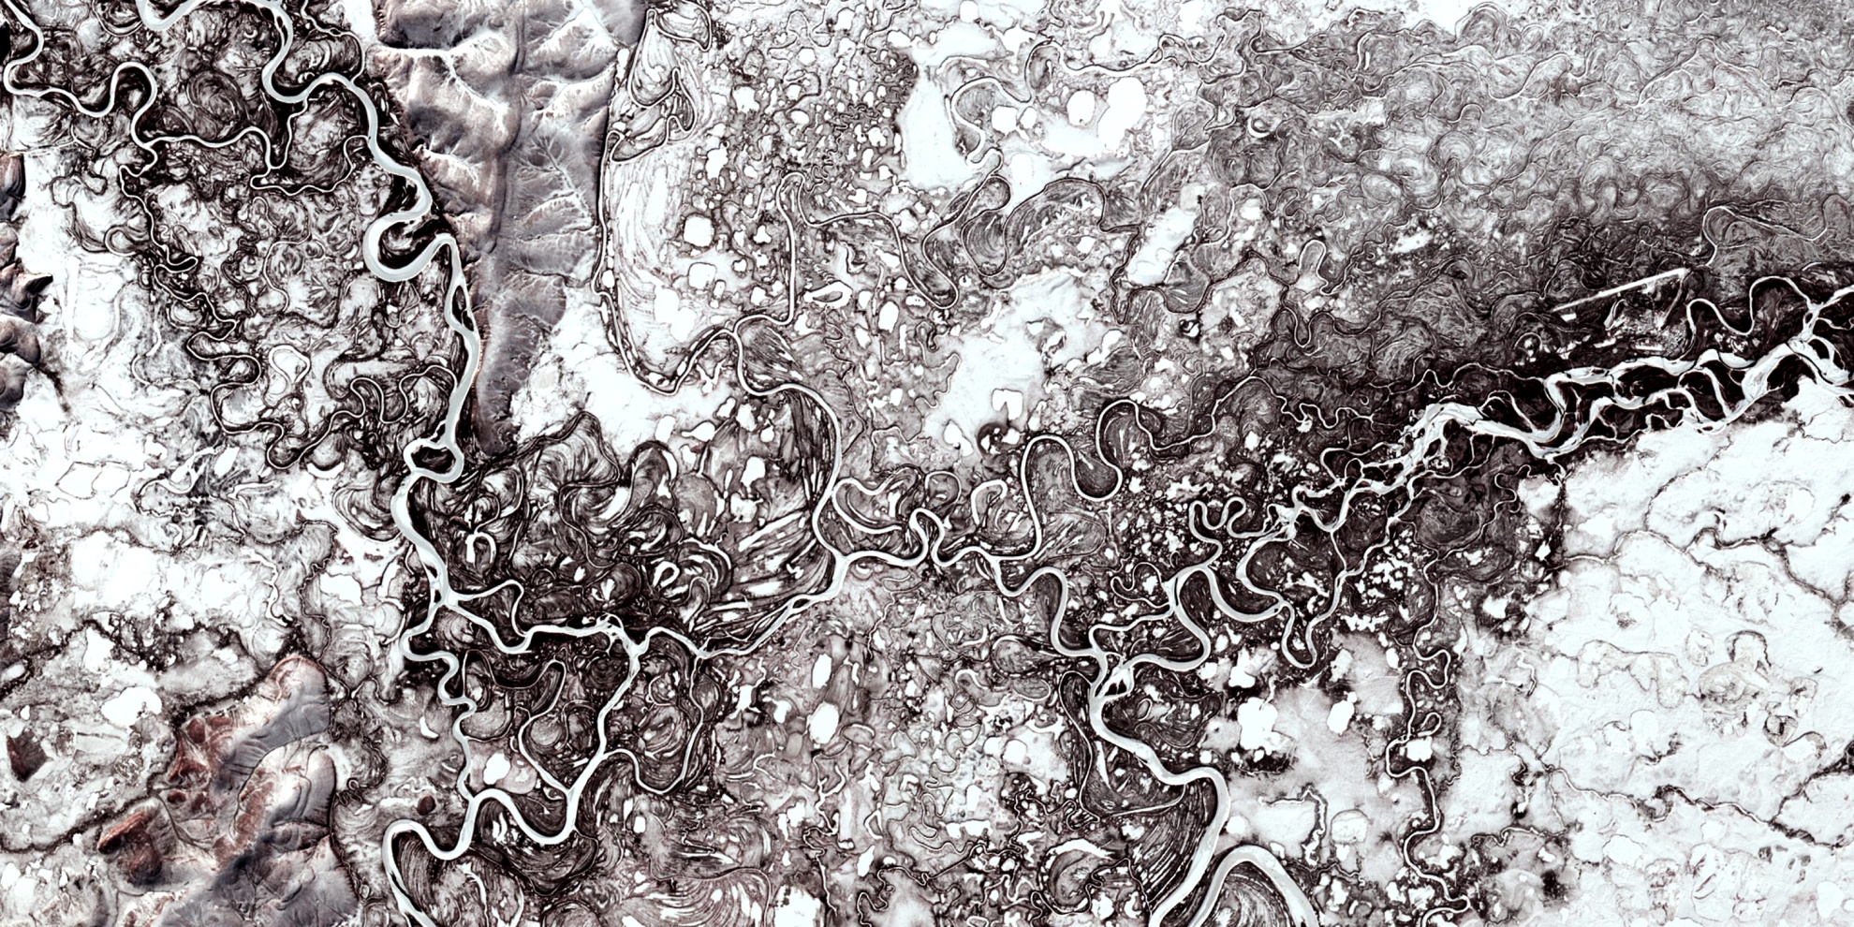
EARTH
CREDIT: NASA Earth Observatory
Notes:
PRESENTATION NOTES:
This is another beautiful image of streams and rivers in Siberia in winter.
Do you see all the squiggly lines? Yes
What are they? Rivers and streams covered with snow and ice.

Slide 45
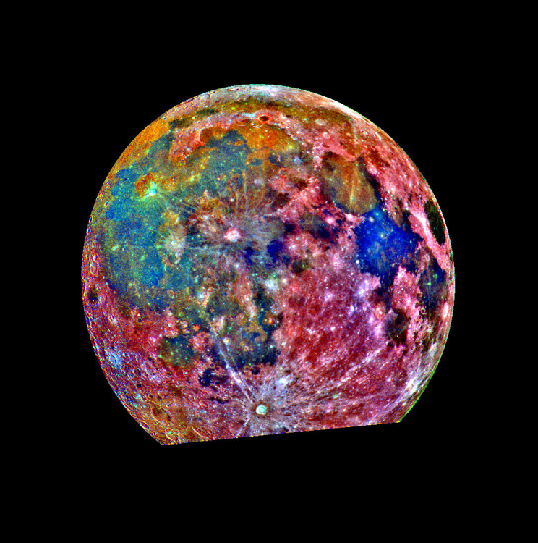
COLOR
MOON
Color – true and added
CREDIT: NASA/JPL
Notes:
PRESENTATION NOTES:
Do you think all the images we’ve looked at are in “true-color,” meaning what your eyes see? No
Scientists use color as an important tool to understand planetary surfaces.
Sometimes they use different types of light, such as infrared or ultraviolet, to take images.
Sometimes they use various filters or color schematics to highlight certain features.
The image of the Moon on the left is in black and white. The image on the right has been colorized to show the differences in surface composition.
One way to think about this is to call it “translated” color - translated into visible colors that we can see. What else is often translated? Languages
SCIENCE NOTES:
The translated color processing used to create this lunar image is helpful for interpreting the surface soil composition. Areas appearing red generally correspond to the lunar highlands, while blue to orange shades indicate the ancient volcanic lava flow of a mare, or lunar sea. Bluer mare areas contain more titanium than do the orange regions. Mare Tranquillitatis, seen as a deep blue patch on the right, is richer in titanium than Mare Serenitatis, a slightly smaller circular area immediately adjacent to the upper left of Mare Tranquillitatis. Blue and orange areas covering much of the left side of the Moon in this view represent many separate lava flows in Oceanus Procellarum. The small purple areas found near the center are pyroclastic deposits formed by explosive volcanic eruptions. http://photojournal.jpl.nasa.gov/catalog/PIA00132

Slide 46
VESTA
CREDIT: NASA/JPL-Caltech/UCLA/MPS/DLR/IDA
Notes:
PRESENTATION NOTES:
Here are two recent images the Dawn spacecraft took of the large asteroid Vesta.
The image on the left uses infrared filters and the image on the right uses color to represent different types of rock and minerals present.
What does color help us see when comparing these two images? Encourage discussion
Scientists are using color to better understand the surface.
SCIENCE NOTES:
This image combines two separate views of the giant asteroid Vesta obtained by NASA's Dawn spacecraft. The images were taken by Dawn's framing camera. The far-left image uses near-infrared filters where red is used to represent 750 nanometers, green represents 920 nanometers and blue represents 980 nanometers. The image on the right is an image with colors assigned by scientists, representing different rock or mineral types on Vesta. The data reveal a world of many varied, well-separated layers and ingredients. The reddish color suggests a steep visible spectral slope, and areas of fresh landslides in the inner walls of the crater show deeper green colors.

Slide 47
VESTA: Cornelia Crater
CREDIT: NASA/JPL-Caltech/UCLA/MPS/DLR/IDA
Notes:
PRESENTATION NOTES:
In this case, the color represents minerals. The pitted terrain in the bottom of the crater contains hydrated, carbon-rich minerals - evidence that water once existed on the giant asteroid!
SCIENCE NOTES:
This enhanced-color view from NASA's Dawn mission shows an unusual "pitted terrain" on the floor of Cornelia crater on the giant asteroid Vesta. A comparison with other craters shows that the physical properties or composition of the material in which these pits form is different from crater to crater.
Scientists think low-speed collisions with carbon-rich asteroids and meteoroids left hydrated minerals on Vesta's surface. It is thought that heat generated during later, high-speed collisions with asteroid belt rocks released water that was previously bound within the hydrated minerals. This water is thought to have explosively degassed into space, leaving behind pothole-like depressions as it escaped.
http://dawn.jpl.nasa.gov/multimedia/pitted_terrain_in_color.asp

Slide 48
VENUS
CREDIT: NASA/JPL/USGS
Notes:
PRESENTATION NOTES:
Here is an image of Venus that has been color-coded to represent the elevation of different parts of the surface.
SCIENCE NOTES:
The composite image was processed to improve contrast and to emphasize small features, and was color-coded to represent elevation.
http://photojournal.jpl.nasa.gov/catalog/PIA00159

Slide 49
VALUE / ALBEDO
Saturn’s moon, IAPETUS
Value – light and dark, shade and highlight
CREDIT: NASA/JPL/SSI
Notes:
PRESENTATION NOTES:
Can anyone give me a definition of Value? Value means the contrast between light and dark.
Scientists use a similar concept called “albedo,” which is the measure of the reflectivity of a surface.
These two images are details of the surface of Iapetus, a strange icy moon of Saturn.
SCIENCE NOTES:
Left Image
Dark material splatters the walls and floors of craters in the surreal, frozen wastelands of Iapetus. This image shows terrain in the transition region between the moon's dark leading hemisphere and its bright trailing hemisphere. The view was acquired during Cassini's only close flyby of the two-toned Saturn moon. http://photojournal.jpl.nasa.gov/catalog/PIA08374
Right image
Cassini surveys a bright landscape coated by dark material on Iapetus. This image shows terrain in the transition region between the moon's dark leading hemisphere and its bright trailing hemisphere. The view was acquired during Cassini's only close flyby of the two-toned Saturn moon. http://photojournal.jpl.nasa.gov/catalog/PIA08373

Slide 50
IAPETUS: The Yin-Yang Moon
CREDIT: NASA/JPL/SSI
Notes:
PRESENTATION NOTES:
Iapetus has the most intense value contrast in the solar system.
Half of its surface is bright white the other half is as dark as black velvet.
Things that are bright white are very reflective; this often means they are composed of ice.
Iapetus is still a mystery, and scientists are currently studying it and developing theories to explain its unusual terrain.
What else do you see in Iapetus’ southern hemisphere? A large circle/crater meaning a large impact
SCIENCE NOTES:
In many places, the dark material--thought to be composed of nitrogen-bearing organic compounds called cyanides, hydrated minerals and other carbonaceous minerals--appears to coat equator-facing slopes and crater floors. The distribution of this material and variations in the color of the bright material across the trailing hemisphere will be crucial clues to understanding the origin of Iapetus' peculiar bright-dark dual personality. http://photojournal.jpl.nasa.gov/catalog/PIA08384

Slide 51
ENCELADUS
CREDIT: NASA/JPL/SSI
Notes:
PRESENTATION NOTES:
Enceladus is a small icy satellite of Saturn. It is the brightest body in our solar system other than the Sun.
It is bright white, so what do you think its surface is made of? Ice
Yes, It is made of almost pure water ice.
What else do you see at the bottom of Enceladus? Lines or cracks, tectonic features
These are tectonic features called Tiger Strips. They are faults from which water geysers are erupting.
SCIENCE NOTES:
A masterpiece of deep time and wrenching gravity, the tortured surface of Saturn's moon Enceladus and its fascinating ongoing geologic activity tell the story of the ancient and present struggles of one tiny world. The enhanced color view of Enceladus seen here is largely of the southern hemisphere and includes the south polar terrain at the bottom of the image. Ancient craters remain somewhat pristine in some locales, but have clearly relaxed in others. Northward-trending fractures, likely caused by a change in the moon's rate of rotation and the consequent flattening of the moon's shape, rip across the southern hemisphere. The south polar terrain is marked by a striking set of `blue' fractures and encircled by a conspicuous and continuous chain of folds and ridges, testament to the forces within Enceladus that have yet to be silenced. http://photojournal.jpl.nasa.gov/catalog/PIA07800

Slide 52
TEXTURE
TRITON
Texture – the quality of the surface
CREDIT: NASA/JPL/USGS
Notes:
PRESENTATION NOTES:
Looking at the texture of a planetary surface can give scientists clues as to its geologic story.
This is Triton, an icy moon of Neptune, the seventh largest in the solar system.
Scientists figured something this far from the Sun and so cold would not have a lot of geologic activity.
However, when they got images of Triton they saw this weird texture.
What does Triton remind you of? A cantaloupe
The presence of this weird “cantaloupe” terrain, combined with a lack of craters, suggested that Triton was geologically active.
And indeed scientists have found evidence of geysers and cryo-volcanoes -- ice volcanoes!
SCIENCE NOTES:
The surface of Triton is very rugged, scarred by rising blobs of ice, faults and volcanic pits and lava flows composed of water and other ices. The surface is also extremely young and sparsely cratered and could be geologically active today. http://photojournal.jpl.nasa.gov/catalog/PIA12186
The pinkish deposits constitute a vast south polar cap believed to contain methane ice, which would have reacted under sunlight to form pink or red compounds. The dark streaks overlying these pink ices are believed to be an icy and perhaps carbonaceous dust deposited from huge geyser-like plumes, some of which were found to be active during the Voyager 2 flyby. http://photojournal.jpl.nasa.gov/catalog/PIA00317

Slide 53
MIRANDA
Uranus Moon
NASA/JPL-Caltech/Univ. of Arizona
Notes:
PRESENTATION NOTES:
One of the strangest most varied surfaces in all of the solar system is present on Uranus’ small moon Miranda.
What do you see in the bottom of this image? Huge straight lines, cracks, tectonics
Scientists think Miranda was smashed apart in some collision and then came back together.
SCIENCE NOTES:
Like Frankenstein's monster, Miranda looks like it was pieced together from parts that didn't quite merge properly. At about 500 km in diameter, it's only one-seventh as large as Earth's moon, a size that seems unlikely to support much tectonic activity. Yet Miranda sports one of the strangest and most varied landscapes among extraterrestrial bodies, including three large features known as "coronae," which are unique among known objects in our solar system. They are lightly cratered collections of ridges and valleys, separated from the more heavily cratered (and presumably older) terrain by sharp boundaries like mismatched patches on a moth-eaten coat. Miranda's giant fault canyons are as much as 12 times as deep as the Grand Canyon. Due to Miranda's low gravity and large cliffs, a rock dropped off the edge of the highest cliff would take a full 10 minutes to reach the foot of the cliff.
http://solarsystem.nasa.gov/planets/profile.cfm?Object=Miranda

Slide 54
COMET NUCLEI
CREDIT: NASA/JPL-Caltech/UMD
Notes:
PRESENTATION NOTES:
Recent and ongoing NASA missions have given us a close up look at the nucleus of comets.
The surfaces of comets are fascinating and constantly changing. As they approach the Sun, they heat up and shoot jets of ice, dust, and gases from their surfaces.
SCIENCE NOTES:
The Deep Impact/EPOXI Mission
This image shows the nuclei of comets Tempel 1 and Hartley 2, both imaged by NASA's Deep Impact spacecraft. After its primary mission to impact Tempel 1, the spacecraft continued on to Hartley 2 as part of an extended mission known as EPOXI.
http://www.nasa.gov/mission_pages/epoxi/index.html

Slide 55
HYPERION
SATURN’s MOON
CREDIT: NASA/JPL/SSI
Notes:
PRESENTATION NOTES:
A moon with one of the strangest textures in the solar system is Saturn’s small icy moon Hyperion.
What does it look like to you? A sponge, loofa
Finding unusual things helps scientists to develop new theories as to how a world is formed. Scientists are still trying to understand Hyperion.
Why is Hyperion lumpy and not shaped like a ball? It does not have enough mass to pull itself into a spherical shape.
SCIENCE NOTES:
Cassini mission scientists think that Hyperion’s unusual appearance can be attributed to the fact that it has an unusually low density for such a large object, giving it weak surface gravity and high porosity. These characteristics help preserve the original shapes of Hyperion’s craters by limiting the amount of impact ejecta coating the moon’s surface. Impactors tend to make craters by compressing the surface material, rather than blasting it out. Further, Hyperion’s weak gravity, and correspondingly low escape velocity, means that what little ejecta is produced has a good chance of escaping the moon altogether. http://photojournal.jpl.nasa.gov/catalog/PIA07740

Slide 56
DECIPHERING GEOLOGIC STORIES: Circles, Lines & Blobs
CREDIT: NASA/JHUAPL/CIW
Notes:
PRESENTATION NOTES:
We can combine what we know about the Elements of Art to start to understand complex geologic stories.
What do you see here? Encourage all discussion
Lots of impact craters, some old, some newer, as indicated by what is on top and bottom.
Large blobby shape in the middle of the image is an old volcanic basin. You know it’s older because it is covered in subsequent craters.
Young ray craters have fresh bright ejecta.
Lines on the image indicate tectonic activity. These are scarps or cliffs that formed when Mercury’s interior shrank in its past and its surface buckled.
SCIENCE NOTES:
During MESSENGER's second flyby of Mercury, the Mercury Dual Imaging System acquired a strip of high-resolution images using each of the Wide Angle Camera's 11 different color filters. There is a detailed graphic and key located on the NASA site: http://photojournal.jpl.nasa.gov/catalog/PIA13823

Slide 57
MYSTERIOUS LANDSCAPE: What happened here…?
ONE
CRATER CHAIN…
TWO CRATER CHAINS…
MERCURY
CREDIT: NASA/JHUAPL/CIW
Notes:
PRESENTATION NOTES:
Indeed, the thing that propels science and makes it so exciting are the things we DON’T know.
For instance, what do you see in this image? A cross of circles
What could have caused this? Encourage discussion even if theories are wrong
Scientists do exactly what you just did. When they see something they don’t understand, they come up with ideas and hypotheses to explain what they are seeing. Many ideas end up being tossed aside as new evidence arises, but it is through the process of asking questions that we come up with answers.
This image, a close-up of Stevenson crater, is known for the distinct X-shape made by the secondary crater chains crisscrossing its floor, the result of falling ejecta from two primary impacts outside the field of view.
SCIENCE NOTES:
X Marks the Spot
This image was taken using the Mercury Dual Imaging System (MDIS) pivot and Narrow Angle Camera (NAC) on April 24, 2011.
http://www.nasa.gov/mission_pages/messenger/multimedia/messenger_orbit_image20110428_1.html

Slide 58
Learn more
NASA’s Discovery Program
https://planetarymissions.nasa.gov/art-and-the-cosmic-connection

