Slide 1
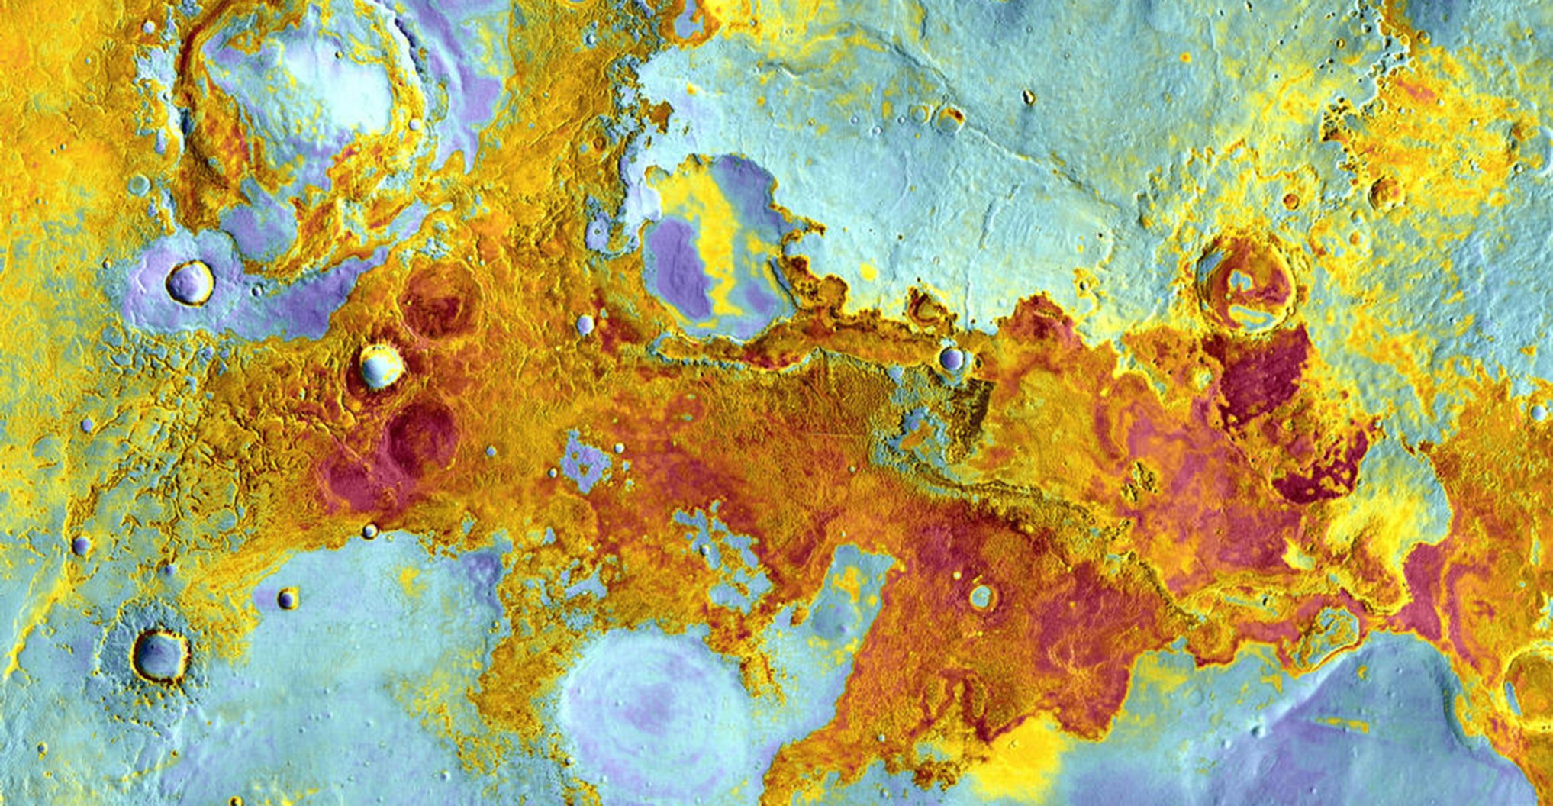
ART & THE COSMIC CONNECTION
The Elements of Art & Planetary Image Analysis
THE MARS EDITION
Notes:
INTRODUCTION
“Art and the Cosmic Connection” is a program that introduces students to the solar system, using the elements of art to help students understand and analyze beautiful NASA images from space. The Mars Edition takes a closer look at the red planet, our cosmic neighbor and the exciting destination of new and ongoing NASA missions including the Mars Science Lab and Curiosity, MAVEN, Mars Exploration Rovers, Mars Global Surveyor and Mars Reconnaissance Orbiter.
The activity was developed by planetary artist and educator Monica Aiello and her husband Tyler Aiello, a sculptor with a background in architecture. Both of the Aiellos are prominent artists whose work is displayed in galleries throughout the west. They also dedicate considerable time to working with students from K through college in schools, afterschool programs and at camp through their organization, Da Vinci Club.
Cover image - Meridiani Planum
When the Mars Exploration Rover, Opportunity, landed on Meridiani Planum in January 2004, it quickly found what it was looking for: evidence of liquid water in the Martian past. Earlier remote sensing from orbit showed that portions of Meridiani contain up to 20 percent gray crystalline hematite at the surface. On Earth, the gray crystalline hematite forms mostly in association with liquid water.
Image Credit: NASA/JPL-Caltech/Arizona State University
http://mars.nasa.gov/multimedia/marsasart/?ImageID=5260

Slide 2
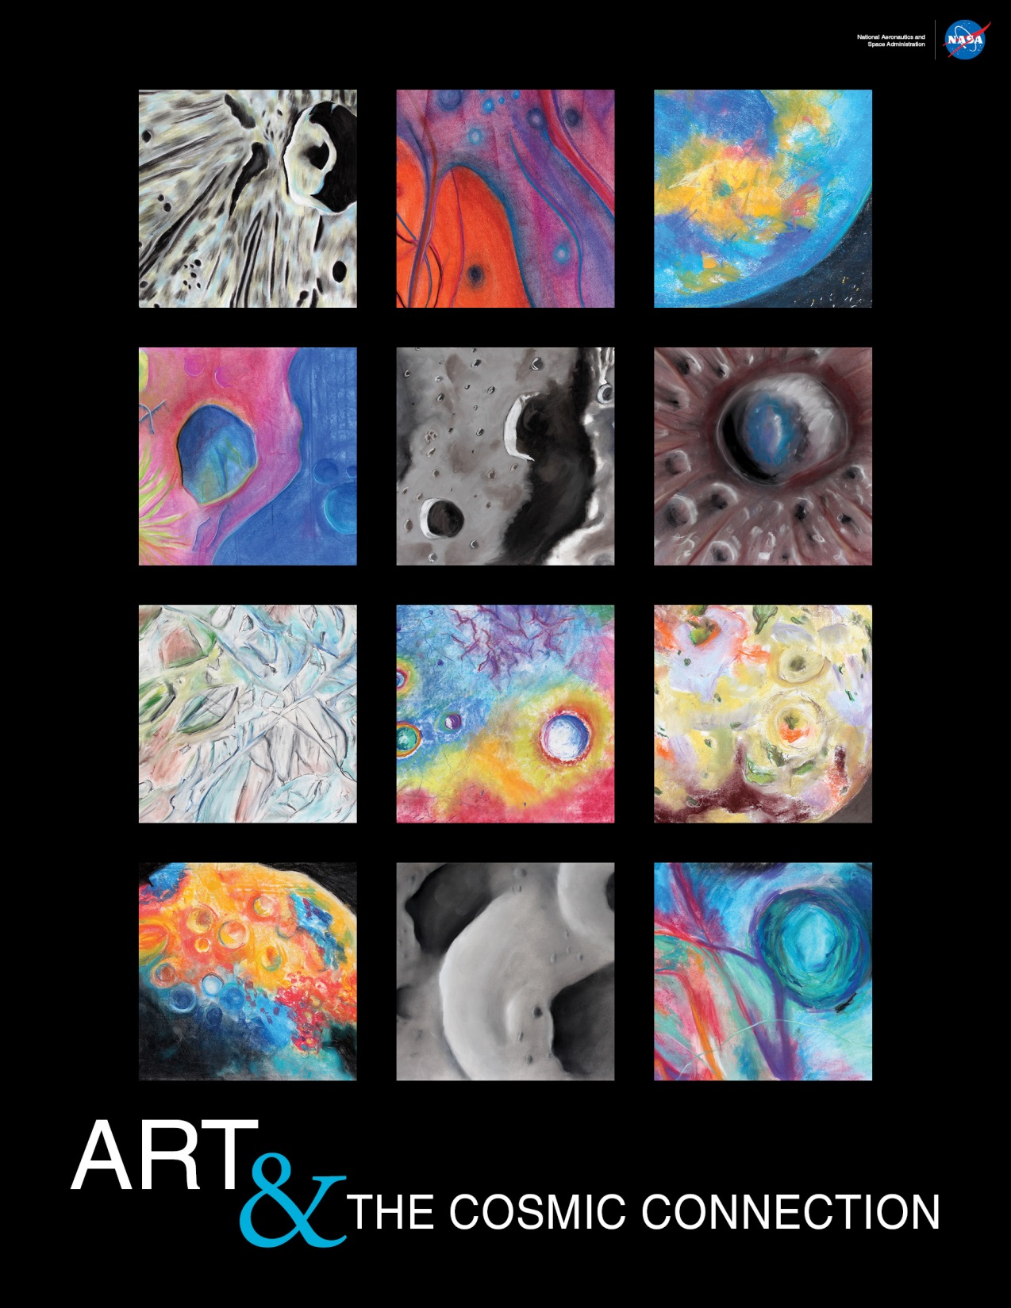
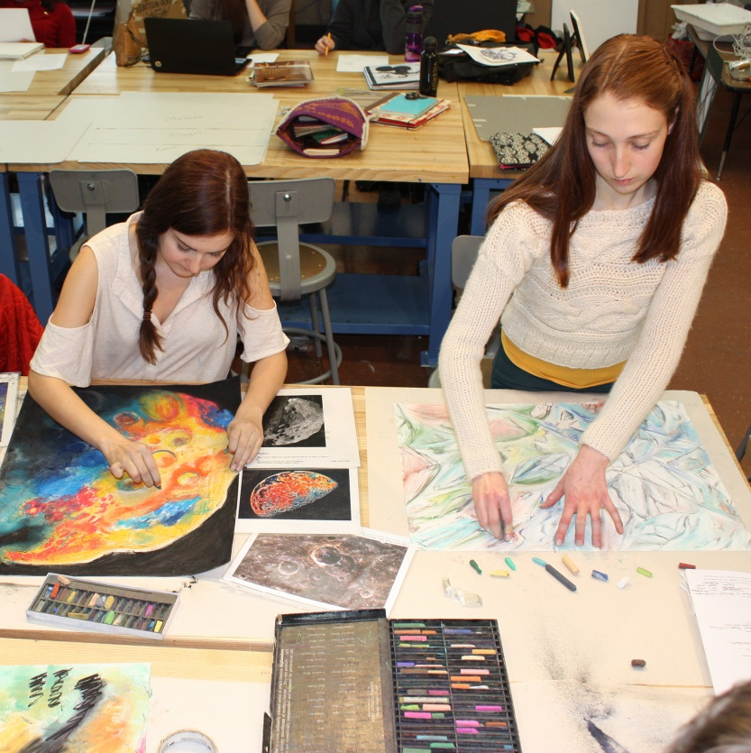
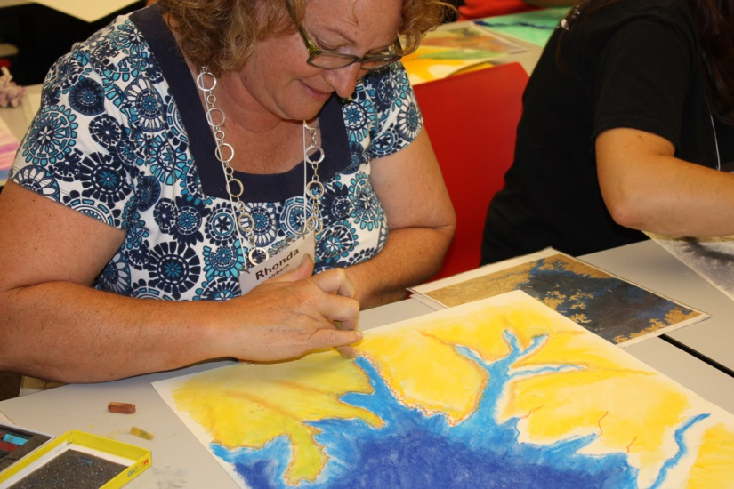
http://discovery.nasa.gov/art/
Notes:
•Robust STEAM program: Utilizing visual art as a vehicle to explore STEAM subjects – Science, Technology, Engineering, Arts & Math.
•Scalable for lifelong learning, K-retirement: Successful implementation in K-12 classes, summer camps, after school enrichment, family programs, college courses, continuing education classes, educator and adult workshops, public programs.
•Proven success in many formal & informal settings: Exciting for all ages in many environments, including traditional classrooms, science museums, art museums, art schools, science centers, libraries, colleges, universities and communities centers.
•Free, easy-to-use tools for implementation: Anyone can teach the program with the easy-to-use educator materials, including a beautiful printed & interactive web poster, PowerPoint presentation, extensive presentation & science notes, educator guide, instructional & student videos, NASA prints, and student art gallery.
•Correlates with current and recent missions: To excite students about space exploration!
•Engaging lesson & fun art activity to reinforce concepts: Program includes rich science content and exciting, creative, hands-on projects.

Slide 3
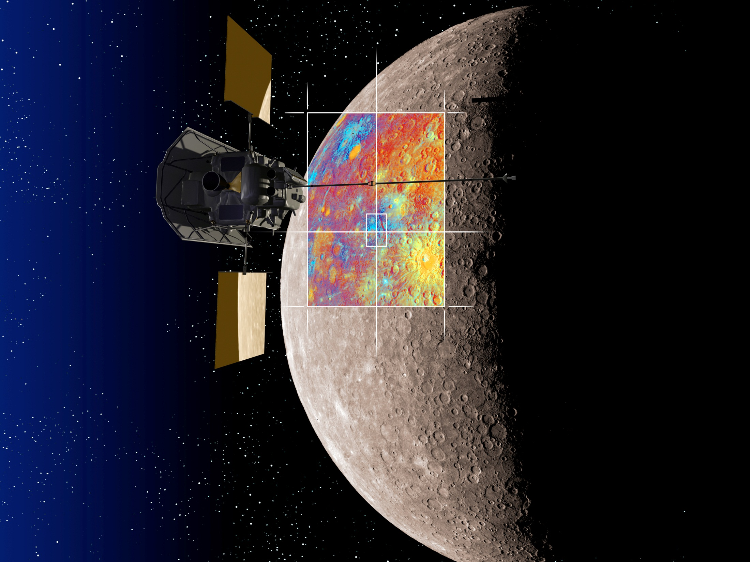
ROBOTIC PHOTOGRAPHERS
CREDIT: NASA/JHUAPL/CIW
Notes:
PRESENTATION NOTES:
How do we study planets, moons and small bodies such as asteroids and comets?
We use tools like telescopes here on Earth.
We also send telescopes into space where the atmosphere doesn’t distort images so much – Hubble, WISE, etc.
And sometimes, We go there!
Can scientists easily travel there themselves? Not easily – very expensive.
The only planetary body humans have visited is Earth’s moon during the Apollo missions.
Instead scientists and engineers build robotic explorers and send them out into the solar system to take images of planets, moons, asteroids and comets.
They beam back their images for us to explore remotely.
Remote Sensing Images are often taken from a bird’s-eye or aerial view.
SCIENCE NOTES:
Artist’s rendition of the MESSENGER spacecraft in orbit above Mercury. MESSENGER has been orbiting Mercury since March 2011. It carries seven miniaturized scientific instruments, including wide and narrow-angle cameras. MESSENGER is able to gather images in color as well as monochrome! This is an artist’s rendition of the spacecraft over Mercury with a colorized set of images. Scientists often colorize images to help define topographical variations, mineral composition, and more, to help us make better sense of the data.

Slide 4
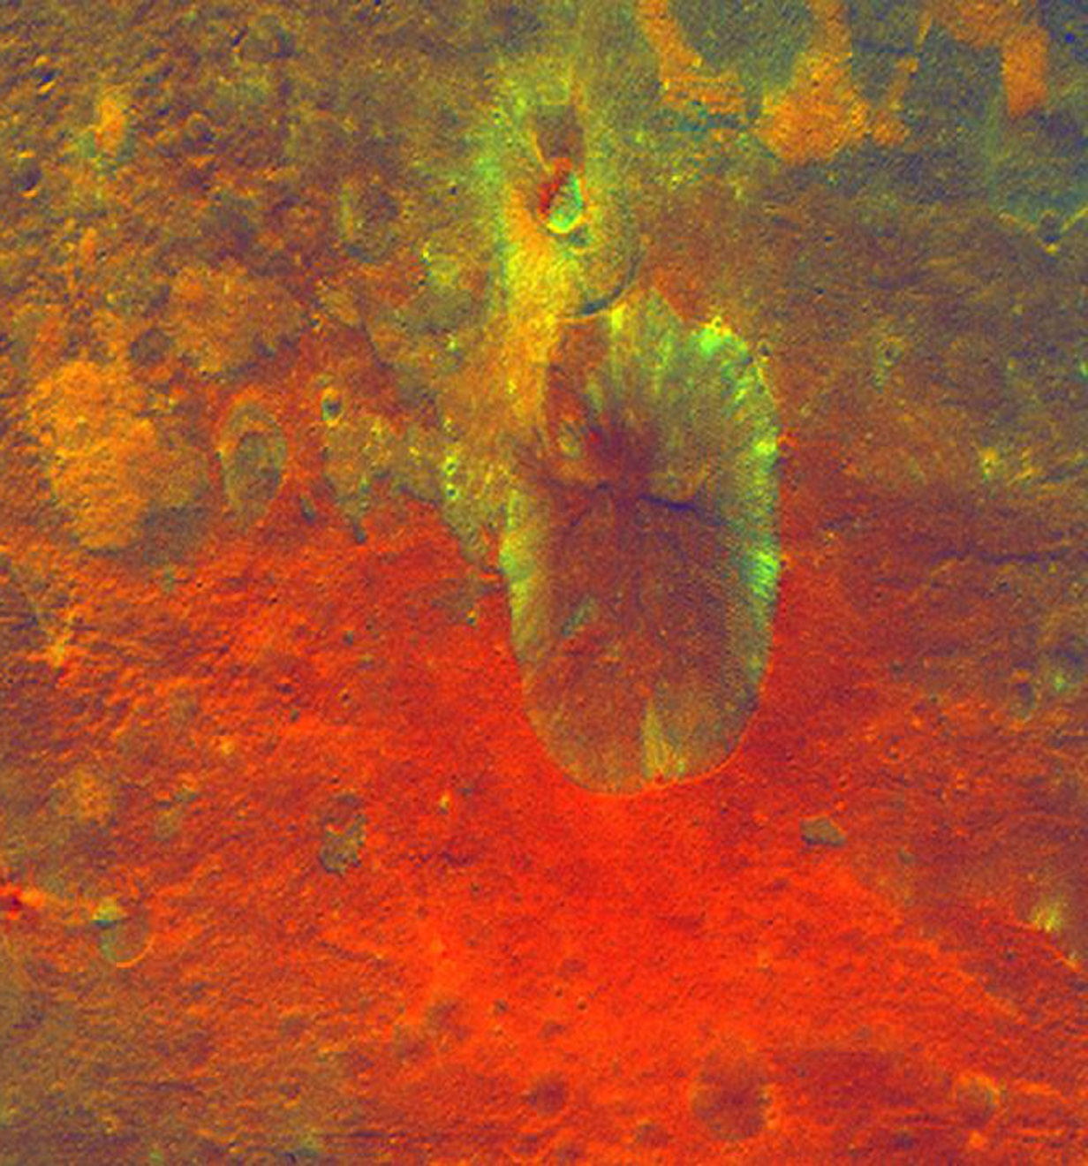
ELEMENTS OF ART & PLANETARY IMAGE ANALYSIS
LINE
-SHAPE
-COLOR
-VALUE
-TEXTURE
CREDIT: NASA/JPL-Caltech/UCLA/MPS/DLR/IDA
Notes:
PRESENTATION NOTES:
When scientists look at remote sensing images of planets, moons and other small bodies, they learn to understand their surfaces by examining them with their eyes.
The Elements of Art are the foundation artists use to understand visual information.
These are Line, Shape, Color, Value and Texture
These art concepts can help us understand the geology of planetary bodies.
This is a colorized image of the large asteroid Vesta taken by the Dawn spacecraft.
THE ELEMENTS OF ART (See Educator Guide)
Teacher may ask for definitions if students have not covered concepts in art class.
SCIENCE NOTES:
This colorized image obtained by NASA's Dawn spacecraft shows a crater on the giant asteroid Vesta. Added color is used to represent different rock or mineral types. The reddish coloring below the crater points to material that was hurled from Vesta's interior during an impact or it could have originated from the impactor itself. This image was obtained at an altitude of 2,700 kilometers (1,700 miles) altitude above the surface of Vesta. Image resolution is about 260 meters per pixel. Dawn spent a full year in orbit around Vesta and obtained hundreds of amazing, detailed images.
http://www.nasa.gov/mission_pages/dawn/multimedia/pia14709.html

Slide 5
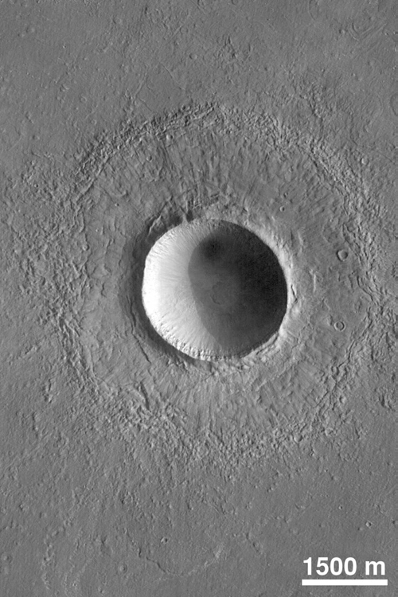
SHAPE
Circle - Craters
CREDIT: NASA/JPL
Notes:
PRESENTATION NOTES:
Let’s discuss shapes first.
When scientists see circles on the surface of a planet, moon or small body, it often means that there is a crater.
What is a crater? What might cause one? A crater is formed when something impacts a planetary body. (Note: Students may not be aware that craters are found on Earth as well as the Moon, etc.)
When an object like a meteor, asteroid or comet hits the surface of a planet, it leaves a mark typically in the shape of the circle.
It also kicks up a lot of debris which is thrown onto the surface around the crater. This is called an ejecta blanket.
This is a beautiful picture of a crater on Mars.
SCIENCE NOTES:
This crater on northern Elysium Planitia is a little more than twice the diameter of the famous Meteor Crater in Arizona. It was formed by the impact and subsequent explosion of a meteorite. The image was taken by the Mars Orbiter Camera aboard the Mars Global Surveyor in July, 1998. http://pds.nasa.gov/planets/captions/mars/crater.htm

Slide 6
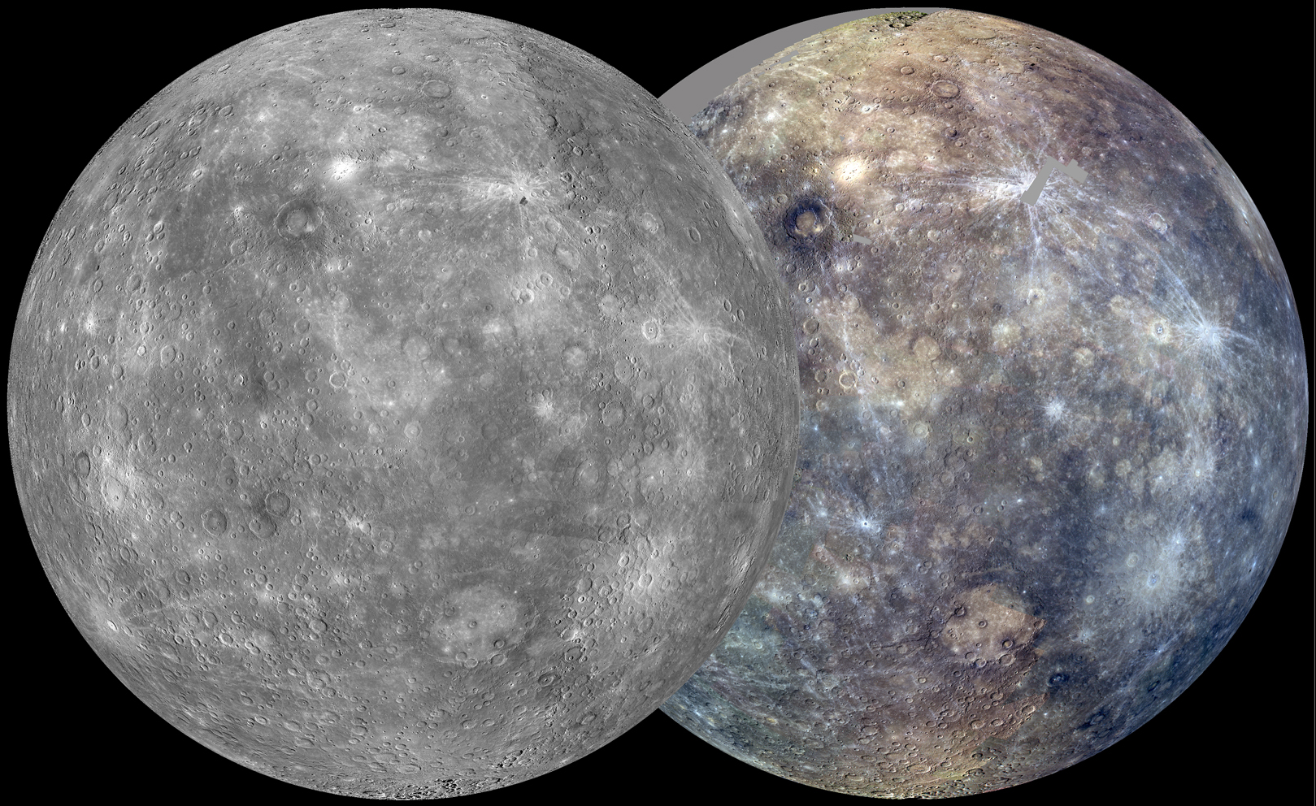
MERCURY
CREDIT: NASA/JHUAPL/CIW
Notes:
Mercury is one of the best places to look at craters and circles. The surface is covered with circles of all different shapes and sizes, suggesting it has been hit many times.
PRESENTATION NOTES:
Currently NASA has a mission called MESSENGER in orbit around Mercury, the planet nearest our Sun.
Here are two images of Mercury, in monochrome and color.
SCIENCE NOTES:
After its first Mercury solar day (176 Earth days) in orbit, MESSENGER nearly completed two of its main global imaging campaigns: a monochrome map at 250 m/pixel and an eight-color, 1-km/pixel color map. Apart from small gaps, which were filled in during the next solar day, these global maps now provide uniform lighting conditions ideal for assessing the form of Mercury’s surface features as well as the color and compositional variations across the planet.
http://messenger.jhuapl.edu/gallery/sciencePhotos/image.php?page=9&gallery_id=2&image_id=658

Slide 7
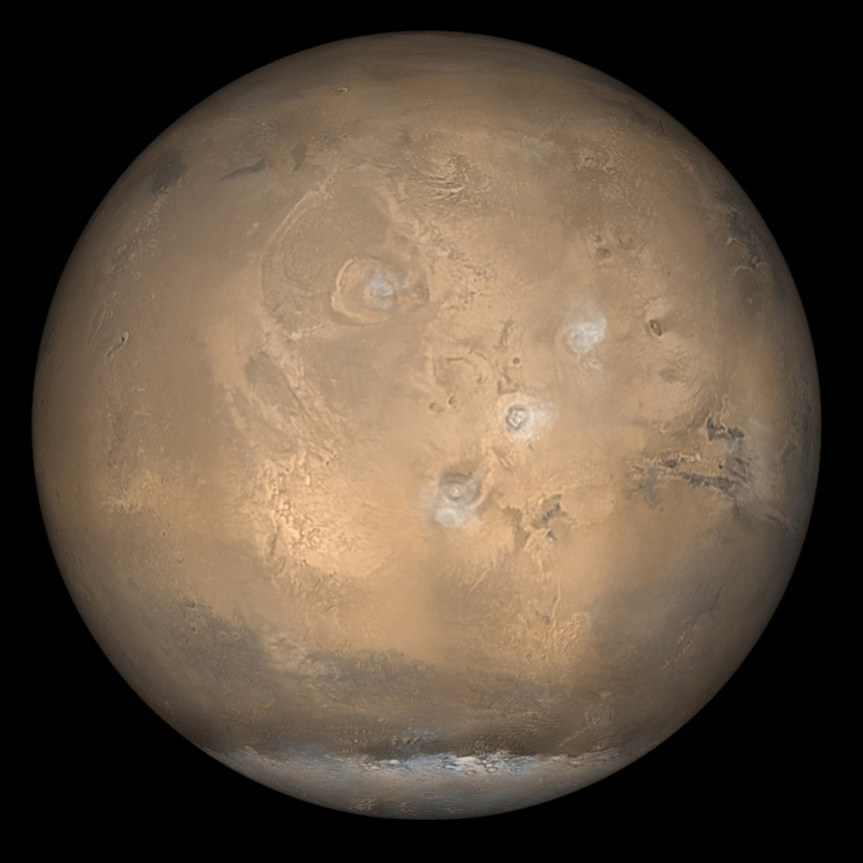
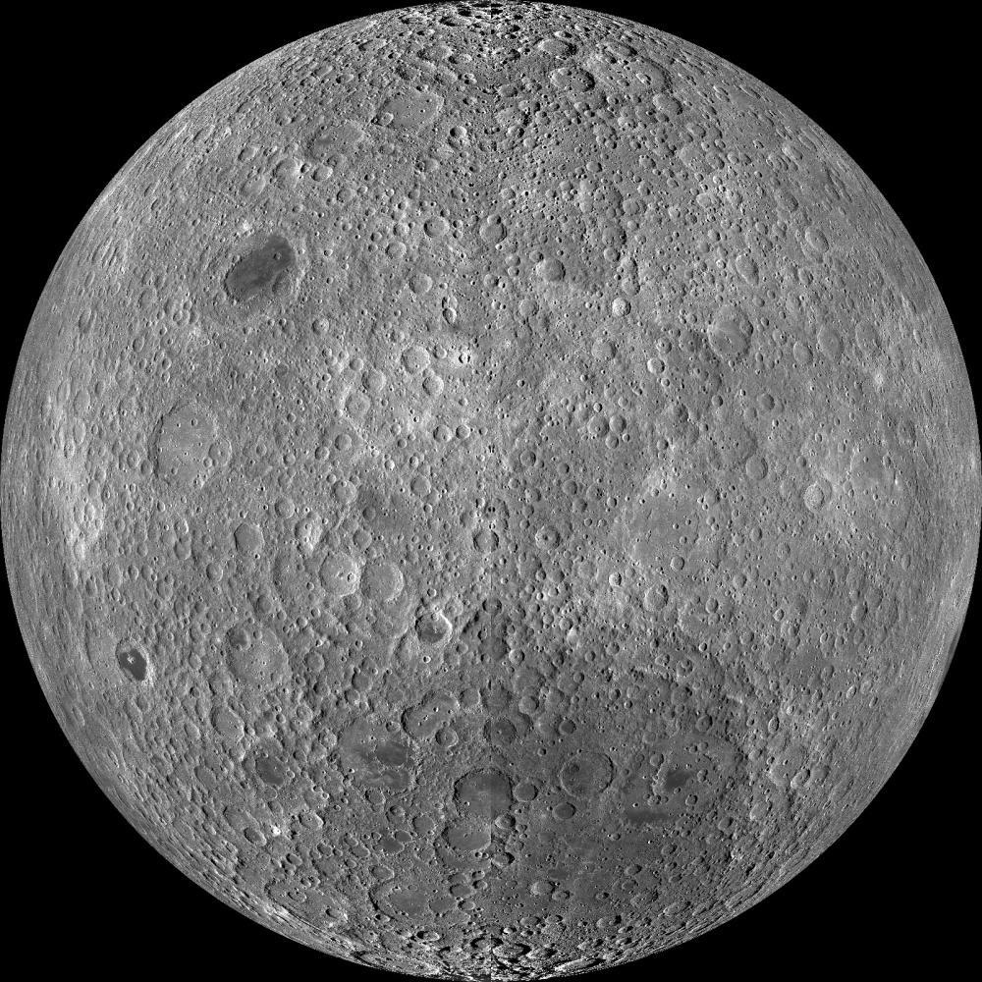
COUNTING CRATERS: The Moon vs. Mars
CREDIT: NASA/GSFC/Arizona State University
CREDIT: NASA/JPL/Malin Space Science Systems
Notes:
Our Moon is also covered with craters and circles. It looks quite different than the surface of Mars, which has many fewer craters. What does that tell us? Scientist think that all planets in the solar system have been hit about the same amount. But something has happened to erase the craters on Mars – geologic processes. Bodies with fewer craters are considered to have younger surfaces.
PRESENTATION NOTES:
What do you notice when you compare these two bodies? Different numbers of circles/craters.
Scientists count the number of craters on a planetary body to help them understand the ages of their surfaces.
What surface do you think is older, the Moons or Mars? The Moon.
Why does the Moon’s surface seem older? Because there are more circles/craters.
However, we always have to be careful with our interpretations because there are other possible explanations such as resolution of the camera. Scientists have to take many factors into account.
For deeper questioning/thinking if time allows:
What might have happened to craters on Mars? They were erased through geologic processes.
What kind of geology would erase the craters? Volcanoes, wind erosions, water erosion, tectonic activity.
Active geology covers up craters and means a planetary surface is relatively young.

Slide 8
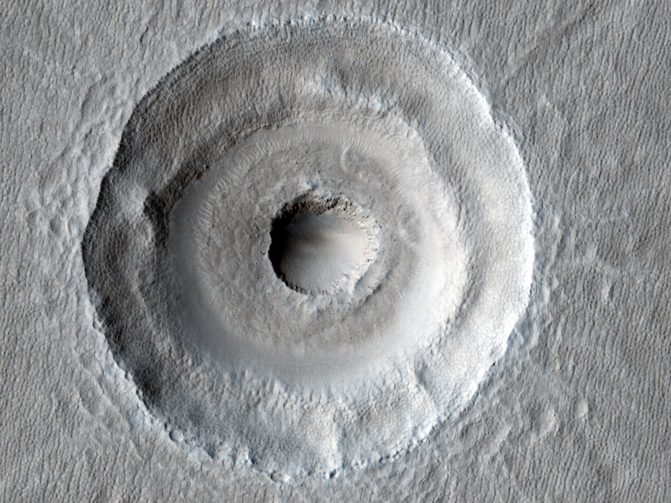
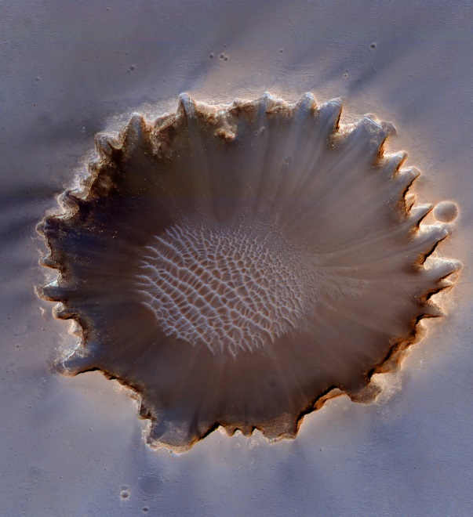
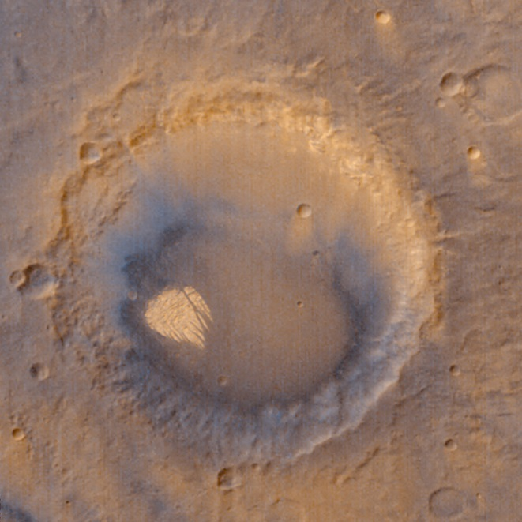
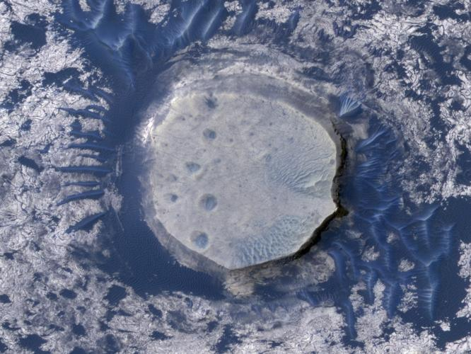
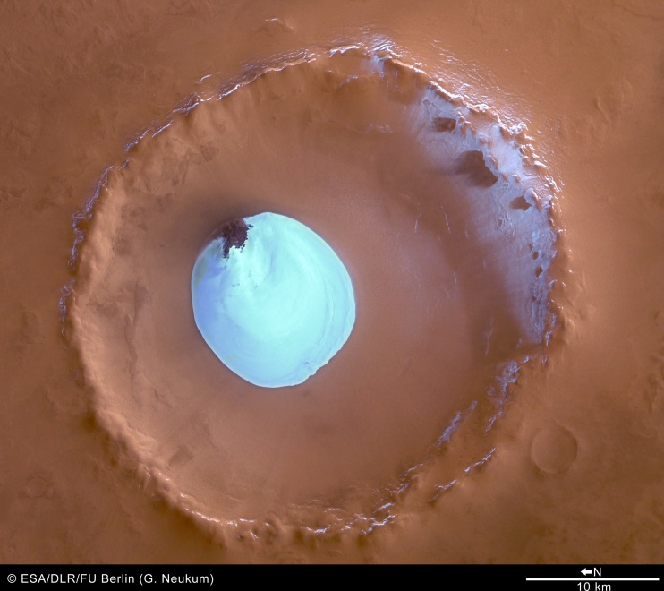
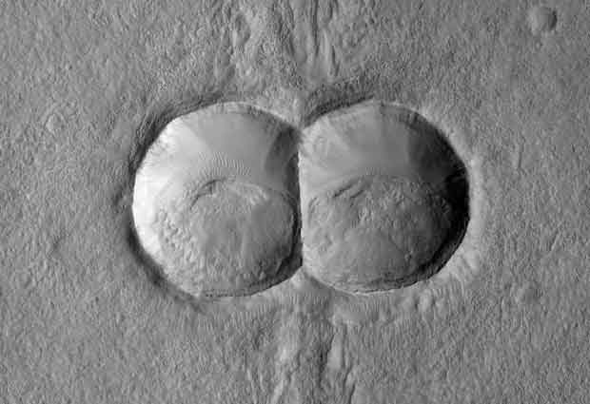
MARS CRATERS
CREDIT: NASA/JPL/University of Arizona or Malin Space Science Systems
Notes:
PRESENTATION NOTES:
Mars has lots of different types of craters. Their size and shape and the shape of the ejecta blanket give scientists clues as to the nature of the surface of the planet.
SCIENCE NOTES:
Learn more about these craters:
-Bull’s Eye Crater: http://www.uahirise.org/ESP_018_2270
-Victoria Crater: http://photojournal.jpl.nasa.gov/catalog/PIA12167
-Pollack Crater: http://www.msss.com/mars_images/moc/dec00_seds/pollack
-Inverted Crater: http://photojournal.jpl.nasa.gov/catalog/PIA12862
-Ice Crater: http://www.esa.int/Our_Activities/Space_Science/Mars_Express/Water_ice_in_crater_at_Martian_north_pole
-Double crater: http://hirise.lpl.arizona.edu/ESP_020894_1395

Slide 9
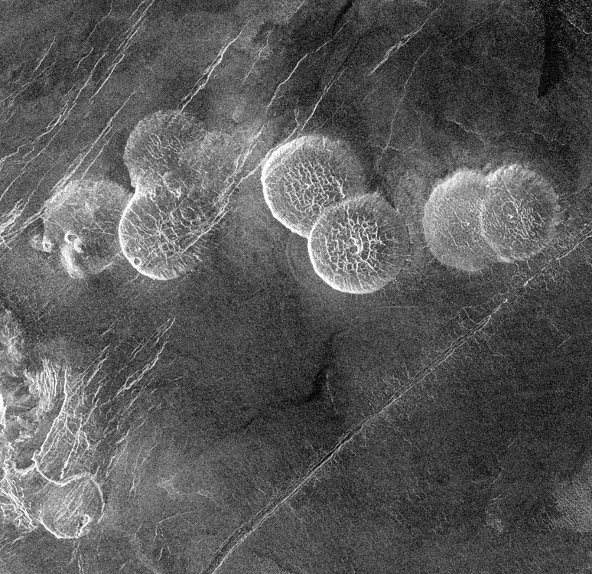
VENUS
CREDIT: NASA/JPL
Notes:
PRESENTATION NOTES:
What do you think this image shows? Circles, craters.
There are circles, but they are not craters. What do you think this could be? Encourage any theories.
As with many things, there are always exceptions to the rules.
These circular features on Venus are not craters, they are volcanoes.
They are called “Pancake Domes” and are believed to be volcanoes with very thick lava.
How do we know this? Scientists use many other tools to get to the answers.
SCIENCE NOTES:
Seven circular, dome-like hills, averaging 25 kilometers (15 miles) in diameter with maximum heights of 750 meters (2,475 feet) dominate the scene. These features are interpreted as very thick lava flows that came from an opening on the relatively level ground, which allowed the lava to flow in an even pattern outward from the opening.
http://photojournal.jpl.nasa.gov/catalog/PIA00215

Slide 10
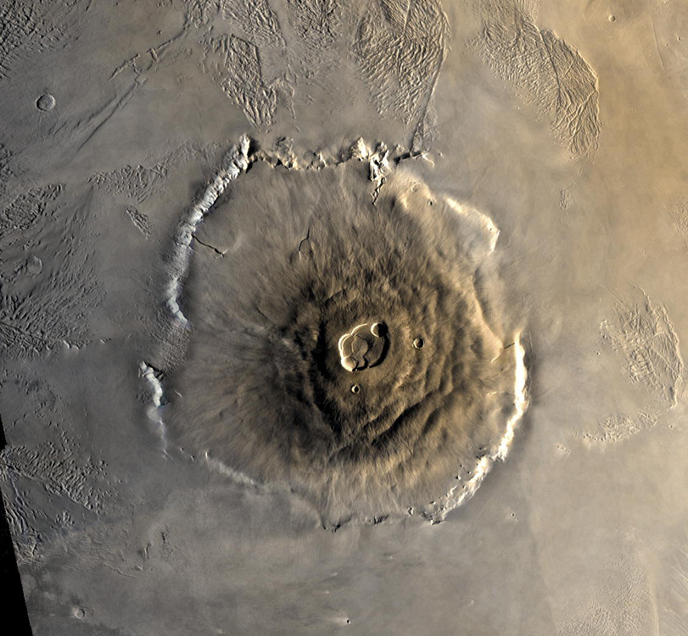
SHAPE
Blobs – Volcanoes (or Lakes)
CREDIT: NASA/JPL
Notes:
PRESENTATION NOTES:
We have talked about circular shapes meaning craters, now let’s explore organic shapes, or blobs.
When scientists see organic shapes (or blobs) on the surface of a planetary body, it often means they are looking at a volcano.
Recently, that assumption has been expanded by some exciting new discoveries, but we will get to those later.
This is an image of a giant volcano on Mars called Olympus Mons and it is roughly the size of Arizona, or 3 times the size of Mt. Everest.
SCIENCE NOTES:
The largest of the volcanoes in the Tharsis Montes region on Mars, as well as all known volcanoes in the solar system, is Olympus Mons. Olympus Mons is a shield volcano 624 km (374 mi) in diameter (approximately the same size as the state of Arizona), 25 km (16 mi) high, and is rimmed by a 6 km (4 mi) high scarp. A caldera 80 km (50 mi) wide is located at the summit of Olympus Mons. To compare, the largest volcano on Earth is Mauna Loa. Mauna Loa is a shield volcano 10 km (6.3 mi) high and 120 km (75 mi) across. The volume of Olympus Mons is about 100 times larger than that of Mauna Loa. In fact, the entire chain of Hawaiian islands (from Kauai to Hawaii) would fit inside Olympus Mons!
http://marsprogram.jpl.nasa.gov/gallery/atlas/olympus-mons.html

Slide 11
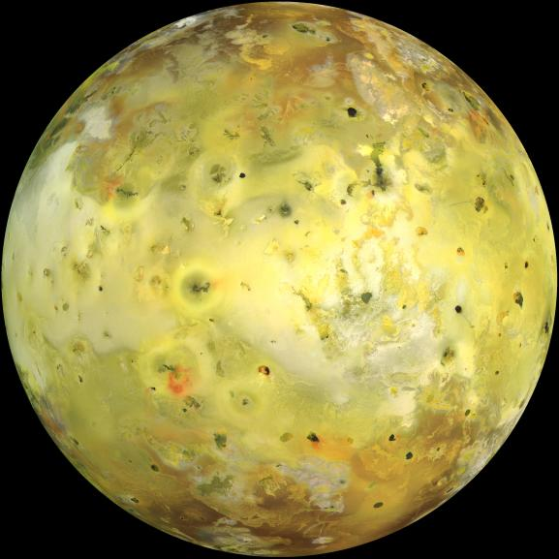
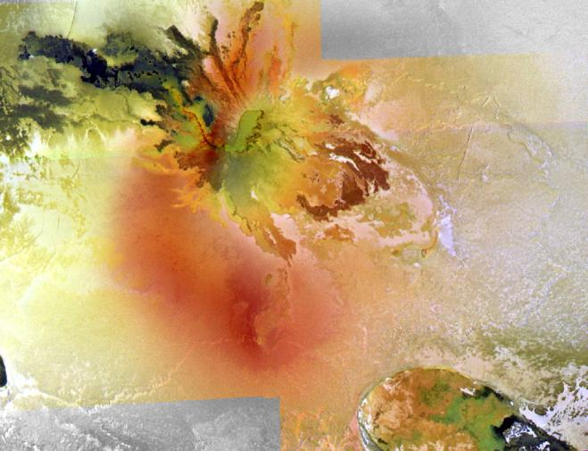
IO
CREDIT: NASA/JPL/University of Arizona
Notes:
PRESENTATION NOTES:
One of the most fascinating places in our solar system is Jupiter’s moon Io, the fourth largest moon in the solar system.
This is about what Io looks like with your naked eye.
What do you think all of those blobby shapes are? Volcanoes
SCIENCE NOTES:
NASA's Galileo spacecraft acquired its highest resolution images of Jupiter's moon Io on 3 July 1999 during its closest pass to Io since orbit insertion in late 1995. This color mosaic uses the near-infrared, green and violet filters (slightly more than the visible range) of the spacecraft's camera and approximates what the human eye would see. Most of Io's surface has pastel colors, punctuated by black, brown, green, orange, and red units near the active volcanic centers.
http://photojournal.jpl.nasa.gov/catalog/PIA02308

Slide 12
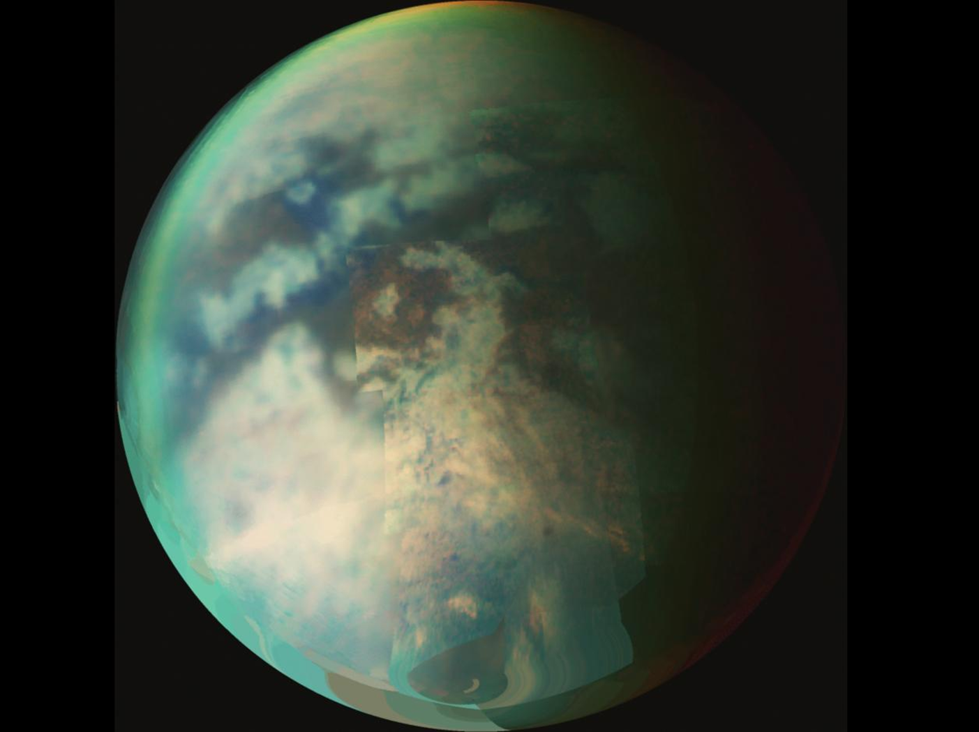
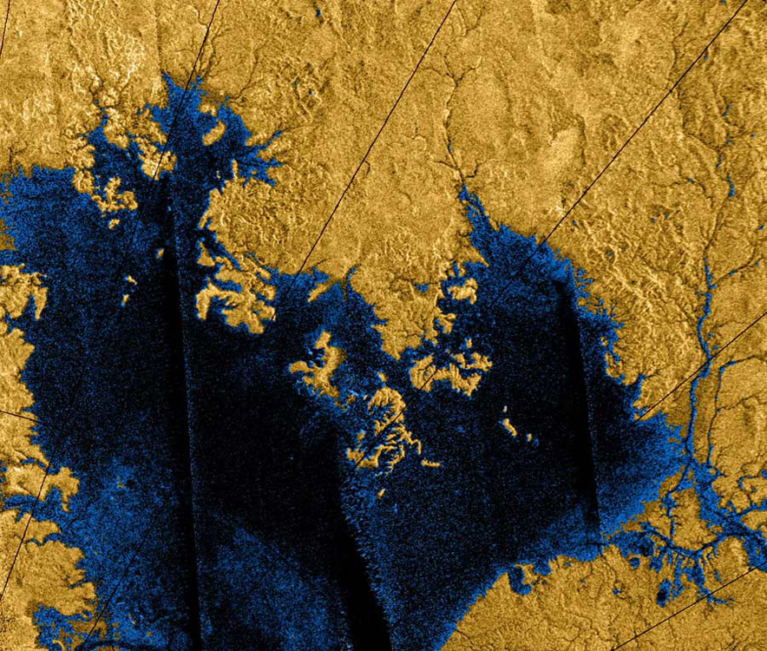
TITAN
CREDIT: NASA/JPL/University of Arizona
CREDIT: NASA/JPL/USGS
Notes:
PRESENTATION NOTES:
When scientists saw the surface of Saturn’s moon Titan, they saw all these blobby shapes.
What could they be? Do they remind you of anything on Earth? Maybe volcanoes?
These blobby shapes are in fact lakes.
Titan is the only place in the solar system other than Earth where we have found liquid on the surface.
Titan appears to have something like our water cycle with liquid in lakes and streams, clouds and rain.
However Titan is extremely cold, so can these lakes be filled with water? No, water would be in the form of ice.
In fact, Titan’s lakes, streams, and rain are made of methane!
Titan has completely revolutionized the way we think about planetary bodies.
SCIENCE NOTES:
The existence of oceans or lakes of liquid methane on Saturn's moon Titan was predicted more than 20 years ago but with a dense haze preventing a closer look, their presence was not confirmed until the Cassini flyby in July 2006. Titan is of great interest to scientists because it is the only moon in the solar system known to have clouds and a mysterious, thick, planet-like atmosphere.
http://photojournal.jpl.nasa.gov/catalog/PIA09034
http://solarsystem.jpl.nasa.gov/planets/profile.cfm?Object=Sat_Titan

Slide 13
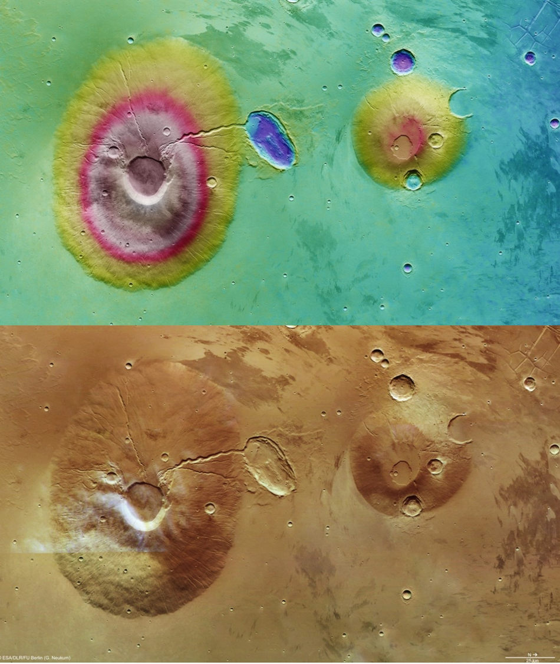
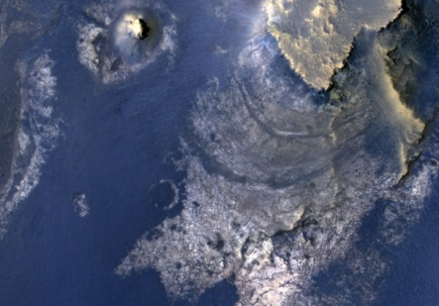
MARS: Volcanoes & Lakes!
CREDIT: NASA/JPL-Caltech/Univ. of Arizona
CREDIT: ESA/DLR/FU
Notes:
PRESENTATION NOTES:
Mars has some of the largest volcanoes in the solar system and evidence of ancient lakes.
Scientific instruments on the spacecraft are like detectives, uncovering what happened thousands of years ago on these fascinating surfaces.
SCIENCE NOTES:
McLaughlin Crater, at left, has sedimentary rocks that contain spectroscopic evidence for minerals formed through interaction with water.
A combination of clues suggests this 2.2-kilometer (1.4-mile)-deep) crater once held a lake fed by groundwater. Part of the evidence is identification of clay and carbonate minerals within layers visible near the center.
The scene covers an area about about 550 meters (one-third of a mile) across.
http://photojournal.jpl.nasa.gov/catalog/PIA16710
The images on the right show two volcanoes in the Tharsis region of Mars. Ceraunius Tholus is 130 km (81 mi) across and rises 5.5 km (3.4 mi) above its surroundings. Its neighbor, Uranius Tholus, is a smaller volcano with a base diameter of 62 km (38 mi) and a height of 4.5 km (2.8 mi).
Purple indicates the lowest lying regions and grey the highest.
http://www.esa.int/spaceinimages/Images/2011/03/Elevation_of_Ceraunius_Tholus_and_Uranius_Tholus

Slide 14
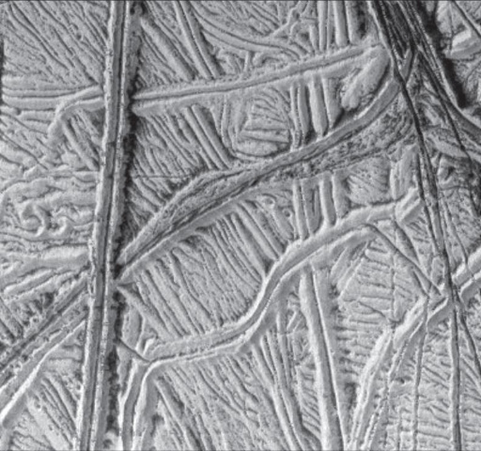
LINE
Straight lines - tectonic activity
CREDIT: NASA/JPL
Notes:
PRESENTATION NOTES:
We’ve explored shapes, so now let’s move on to lines.
When scientists see relatively straight lines on a planetary body, it often means there has been some type of tectonic activity.
Have you heard of that? What do we know? What are some tectonic process? Encourage discussion.
This can include fractures, cracks, faults, ridges, mountain building.
This image is a moon of Jupiter called Europa and shows numerous ridges, cracks and fractures.

Slide 15
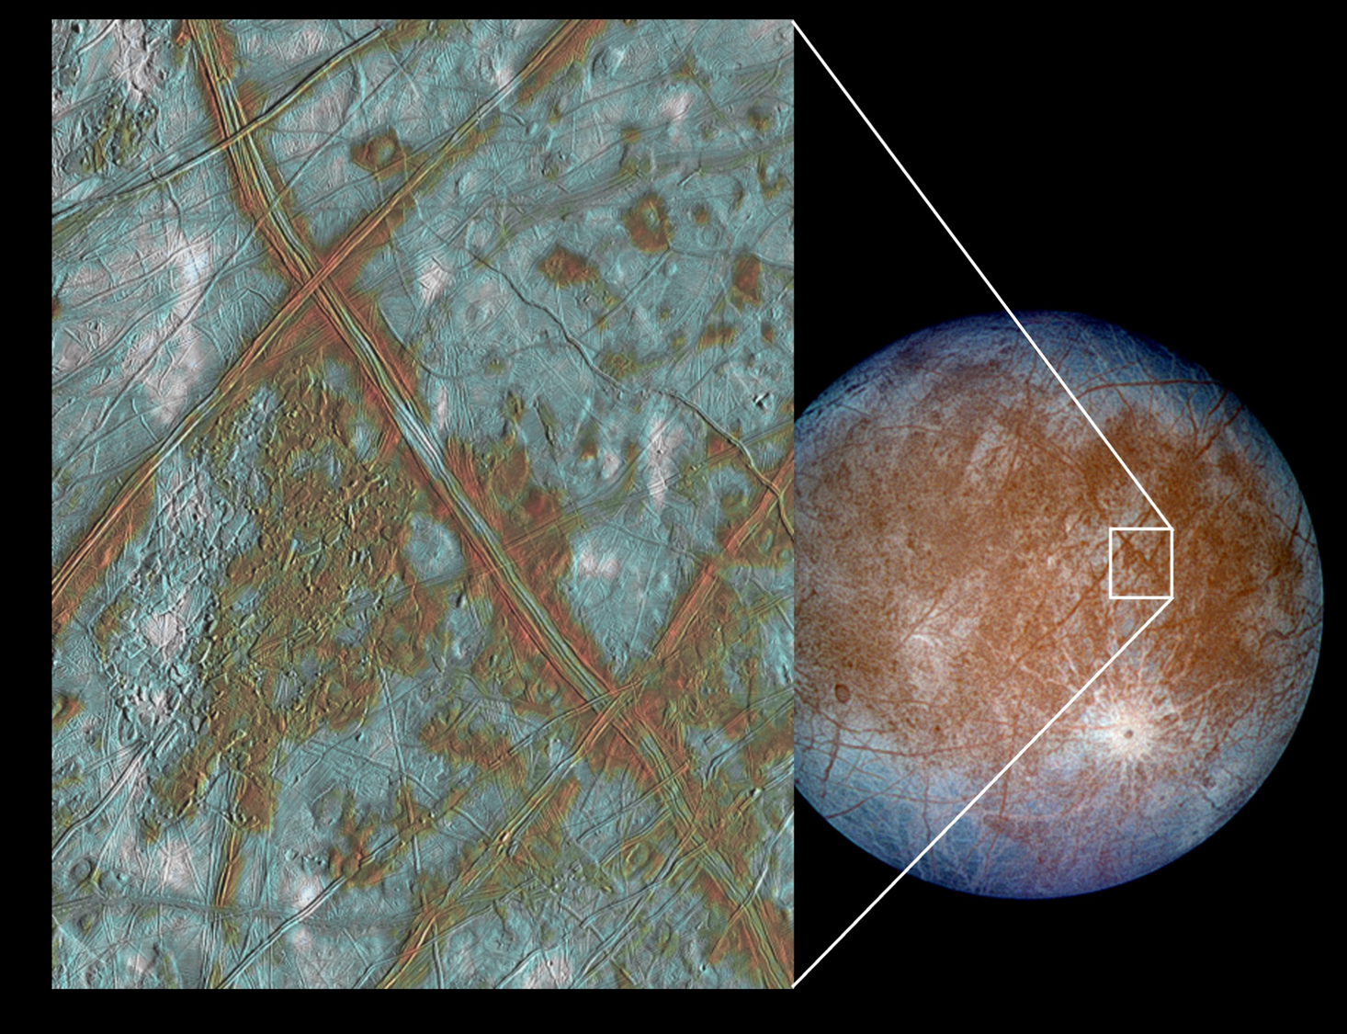
EUROPA
CREDIT: NASA/JPL/University of Arizona
Notes:
PRESENTATION NOTES:
Indeed, one of the best places to look for straight lines and study tectonic activity in the solar system is Europa.
Icy Europa is one of Jupiter's 4 large moons
Europa’s surface is covered in cracks, bands, fractures and a shell of ice.
Scientists think that below the ice is a global ocean.
Like Io, Europa is affected by Jupiter’s intense gravity. The tidal forces continually re-shape the moon.
Europa is very exciting to scientists who think it might be one of the best candidates in the solar system to explore to find life in its oceans.
If we wanted to find out about how ice behaves here on Earth, where could we go?
Arctic, mountains, Antarctica – and indeed, scientists study these places, especially Antartica, to help them understand icy worlds in our solar system like Europa and the dwarf planet Ceres.
SCIENCE NOTES:
The image on the left shows a region of Europa's crust made up of blocks which are thought to have broken apart and "rafted" into new positions. These features are the best geologic evidence to date that Europa may have had a subsurface ocean at some time in its past. Combined with the geologic data, the presence of a magnetic field leads scientists to believe an ocean is most likely present at Europa today.
http://photojournal.jpl.nasa.gov/catalog/PIA03002

Slide 16
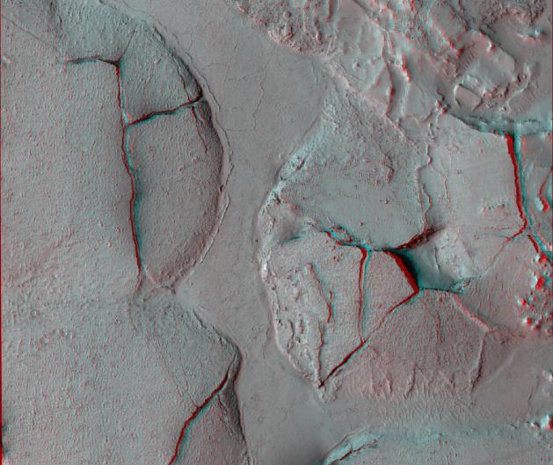
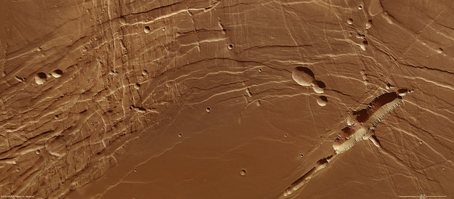
MARS: Fractures & Faults
CREDIT: NASA/JPL/University of Arizona
CREDIT: ESA/Mars Express
Notes:
PRESENTATION NOTES:
Mars has lots of straight lines and shows evidence of tectonic activity, visible in these images of fractures and faults.
SCIENCE NOTES:
The stereo view on the top left shows fractured mounds on the southern edge of Elysium Planitia on Mars. It combines two images taken by the High Resolution Imaging Science Experiment (HiRISE) camera on NASA's Mars Reconnaissance Orbiter. When seen through red-blue glasses, the view appears three dimensional.
This view spans an area about 6 kilometers (3.7 miles) wide. The mounds on the southern edge of Elysium Planitia are typically a few kilometers in diameter and about 60 meters (200 feet) tall. Evidence suggests they were pushed up from below. The mounds are probably composed of solidified lava.
http://photojournal.jpl.nasa.gov/catalog/PIA11446
The image on the lower right shows complex fault lines in Mars’ Phoenix Lake region that have resulted in terrain with a distinctly contrasting appearance. Nineteenth-century astronomers identified this area as a dark spot and thought it resembled a sea. Now we know that it is not a body of water but the southwestern extension of the complex Noctis Labyrinthus, the Labyrinth of Night, system, which stretches away from the giant volcanoes of Mars’s Tharsis region.
http://www.esa.int/Our_Activities/Space_Science/Mars_Express/Light_and_dark_in_the_Phoenix_Lake

Slide 17
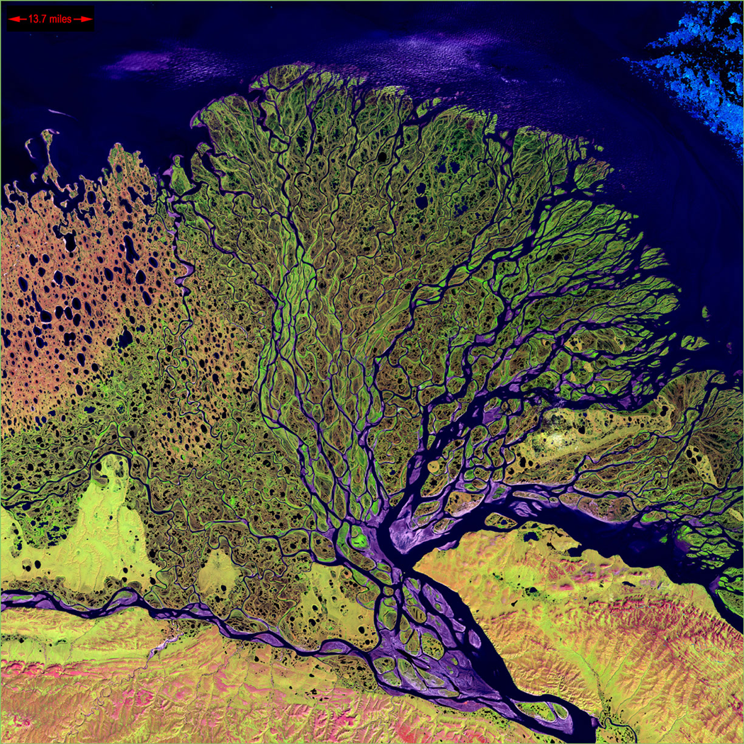
LINE
Squiggly lines - erosion (liquid & wind)
CREDIT: NASA Earth Observatory
Notes:
PRESENTATION NOTES:
We’ve discussed straight lines, but scientists also see squiggly lines on the surface of planetary bodies.
Squiggly lines often indicate the presence of erosion, which is most often caused by what? Liquid or wind.
What type of liquid could cause erosion? Liquid water as on Earth and Mars, liquid methane on Titan, liquid lava rivers on Venus.
One of the most exciting and beautiful places to look for squiggly lines and erosion is our own planet Earth.
Earth is the ONLY planet in the solar system known to have liquid water on the surface.
We also have a thick, wet, windy atmosphere. There has been a lot of erosion on the surface of Earth.
This image is of the Lena River Delta in Russia, taken from space.
As a reminder, where is the only other solar system body that we know has liquid on the surface? Saturn’s moon, Titan.

Slide 18
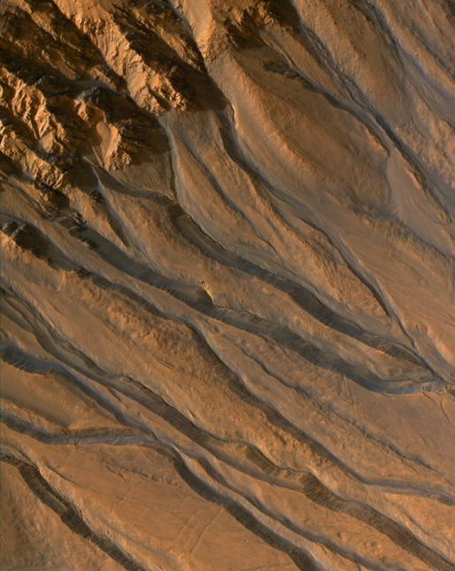
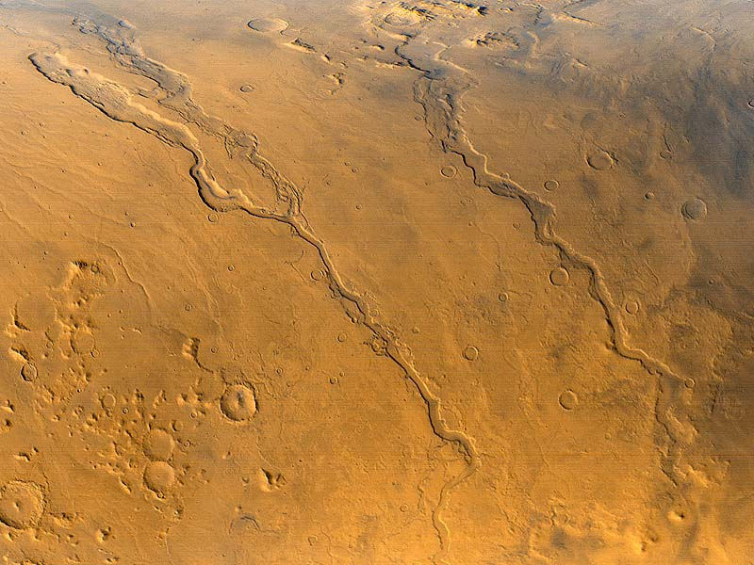
MARS: Follow the Water?
CREDIT: NASA/JPL/UNIVERSITY OF ARIZONA
Notes:
PRESENTATION NOTES:
Mars has lots of squiggly lines. This image shows squiggly lines coming from a crater rim.
Scientists believe these are gullies that have been carved into Mar’s surface by water.
There is a lot of evidence that there was water flowing on Mars’ surface in the distant past.
Scientists have a saying, “follow the water.” What does this refer to? They are interested in water because it seems to be necessary for the development of life as we know it.
SCIENCE NOTES:
This image shows gully channels in a crater in the southern highlands of Mars, taken by the High Resolution Imaging Science Experiment (HiRISE) camera on the Mars Reconnaissance Orbiter. The gullies emanating from the rocky cliffs near the crater's rim (upper left) show meandering and braided patterns typical of water-carved channels.
http://photojournal.jpl.nasa.gov/catalog/PIA10001

Slide 19
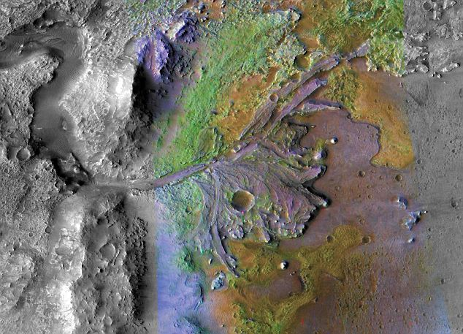
MARS
CREDIT: NASA/JPL/JHUAPL/MSSS/Brown University
Notes:
PRESENTATION NOTES:
This beautiful colorized image shows a river delta on Mars in Jezero Crater which once held a lake.
Does Mars currently have water? No, none has been found.
Think of this image as a “fossil” river delta. We see structures like this in the Atacama desert on Earth.
SCIENCE NOTES:
Researchers have found that ancient rivers ferried clay-like minerals (shown in green) into the lake, forming the delta. Clays tend to trap and preserve organic matter, making the delta a good place to look for signs of ancient life.
http://www.nasa.gov/mission_pages/MRO/multimedia/jezero-20080716.html

Slide 20
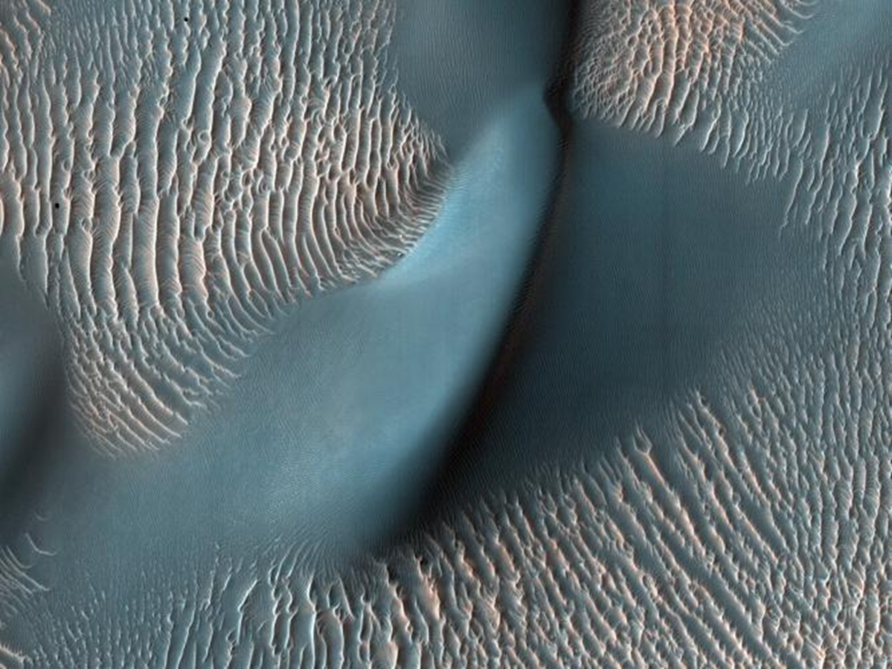
MARS
CREDIT: NASA/JPL-Caltech/University of Arizona
Notes:
PRESENTATION NOTES:
Squiggly lines don’t just mean erosion by liquid, what other process can cause erosion? Wind erosion
The surface of Mars has not only been shaped by water erosion, it has also been shaped by wind erosion.
What do you think this is an image of? Think of the desert. This is an image of sand dunes.
SCIENCE NOTES:
This view from the High Resolution Imaging Science Experiment (HiRISE) camera on NASA's Mars Reconnaissance Orbiter shows two classes of aeolian bedforms within Proctor Crater. The relatively bright, small ridges are ripples. From their study on Earth, and close-up examination by the MER rovers (roving elsewhere on Mars), we know that ripples are composed of fine sand (less than 200 microns in diameter) or fine sand coated with coarser sand and granules.
The larger, darker bedforms are dunes composed of sand, most likely of fine size. Ripples tend to move slower than dunes. Because of this, over time, ripples get covered with dust, possibly explaining the bright tone visible here. The dunes are dark probably because they are composed of basaltic sand (derived from dark, volcanic rock) that is blown by the wind enough that dust does not sufficiently accumulate to change their color.
http://photojournal.jpl.nasa.gov/catalog/PIA11833

Slide 21
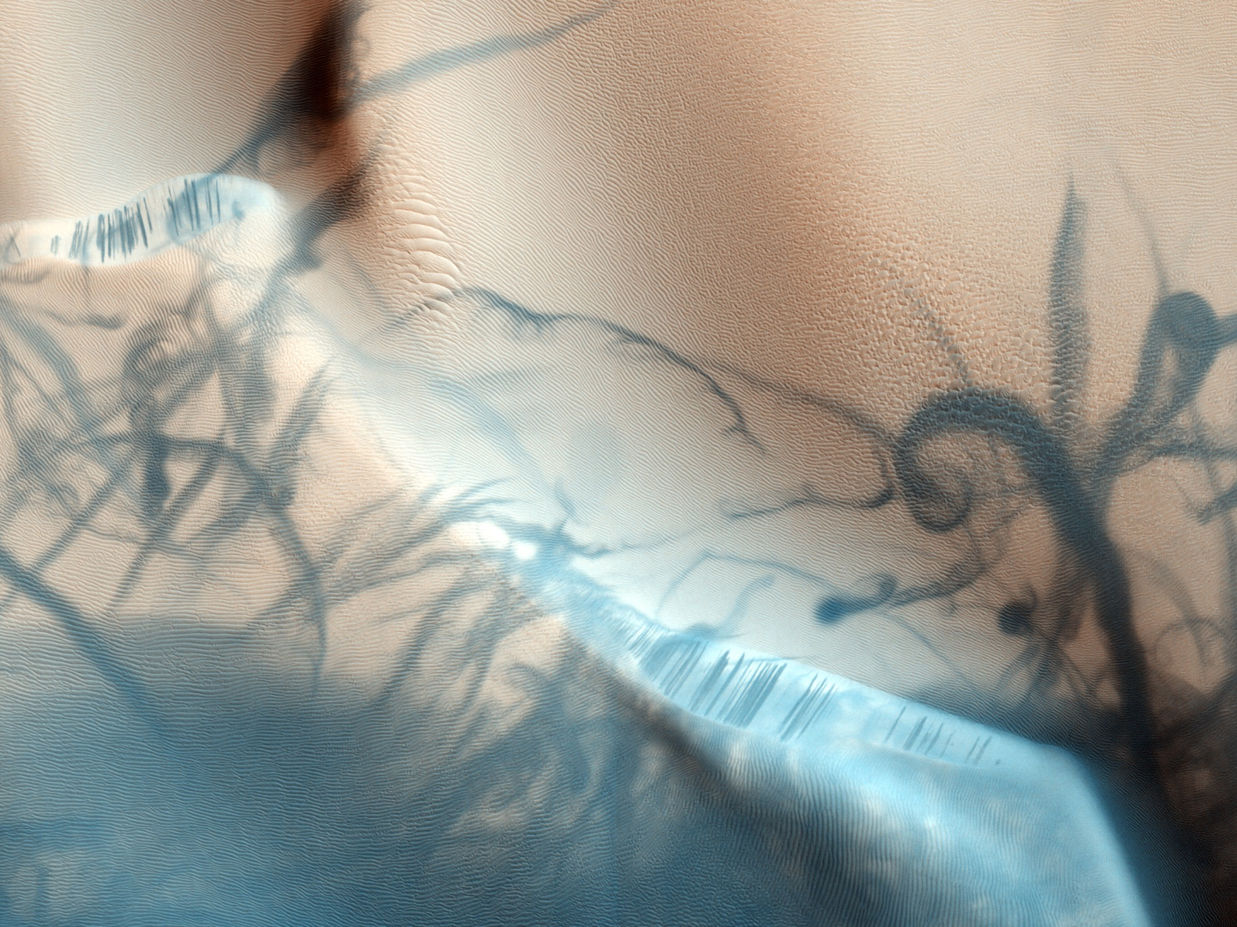
MARS
CREDIT: NASA / JPL / University of Arizona
Notes:
PRESENTATION NOTES:
This mysterious image shows sand dunes and dark serpentine lines that were created by dust devils leaving trails.
What is a dust devil? A small whirlwind of dust and debris. Have you ever seen one?
SCIENCE NOTES:
This portion of an image from the HiRISE camera on board the Mars Reconnaissance Orbiter shows twisting dark trails crisscrossing light colored terrain on the Martian surface. Newly formed trails like these initially presented researchers with a tantalizing Martian mystery, but they are now known to be the work of miniature wind vortices known to occur on the red planet - Martian dust devils. These spinning columns of rising air heated by the warm surface are also common in dry and desert areas on Earth. Typically lasting only a few minutes, dust devils become visible as they pick up loose red-colored dust, leaving the darker and heavier sand beneath intact. On Mars, dust devils can be up to 8 kilometers (4.8 mi) high.
Dust devils have been credited with unexpected cleaning of the solar panels on the Mars rovers.
http://apod.nasa.gov/apod/ap091021.html

Slide 22
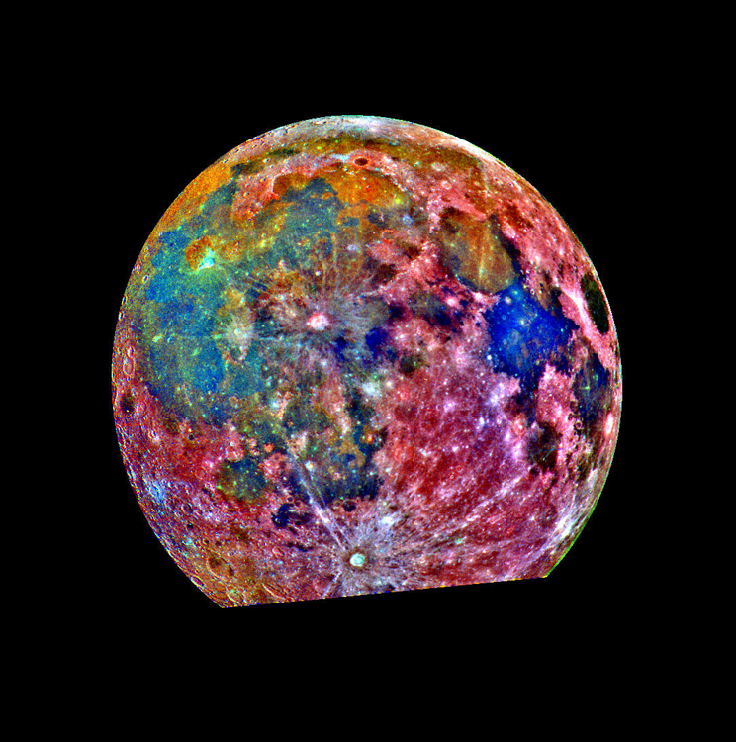
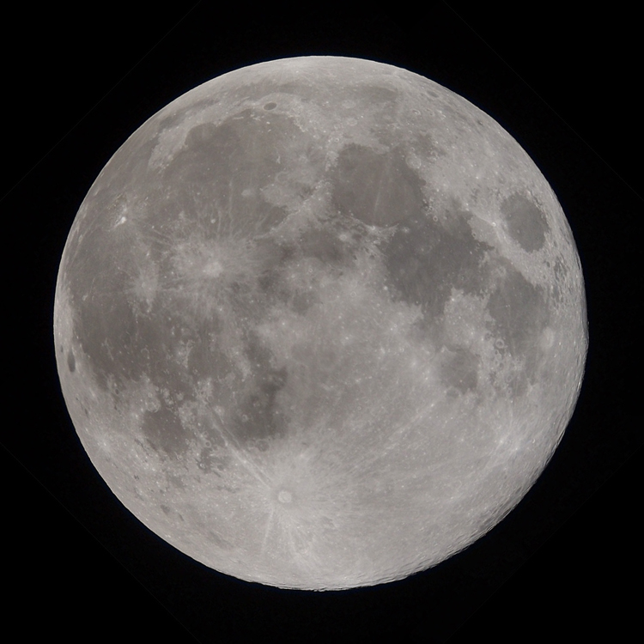
COLOR
MOON
Color – true and added
CREDIT: NASA/JPL
Notes:
PRESENTATION NOTES:
Do you think all the images we’ve looked at are in “true-color,” meaning what your eyes see? No
Scientists use color as an important tool to understand planetary surfaces.
Sometimes they use different types of light such as infrared or ultraviolet to take images.
Sometimes they use various filters or color schematics to highlight certain features.
The image on the right has been colorized to emphasize surface composition.
SCIENCE NOTES:
The false-color processing used to create this lunar image is helpful for interpreting the surface soil composition. It is a composite of 15 images taken through 3 color filters by the Galileo spacecraft. Areas appearing red generally correspond to the lunar highlands, while blue to orange shades indicate the ancient volcanic lava flow of a mare, or lunar sea. Bluer mare areas contain more titanium than do the orange regions. Mare Tranquillitatis, seen as a deep blue patch on the right, is richer in titanium than Mare Serenitatis, a slightly smaller circular area at its the upper left. Blue and orange areas covering much of the left side of the Moon in this view represent many separate lava flows in Oceanus Procellarum. The small purple areas found near the center are pyroclastic deposits formed by explosive volcanic eruptions.
http://photojournal.jpl.nasa.gov/catalog/PIA00132

Slide 23
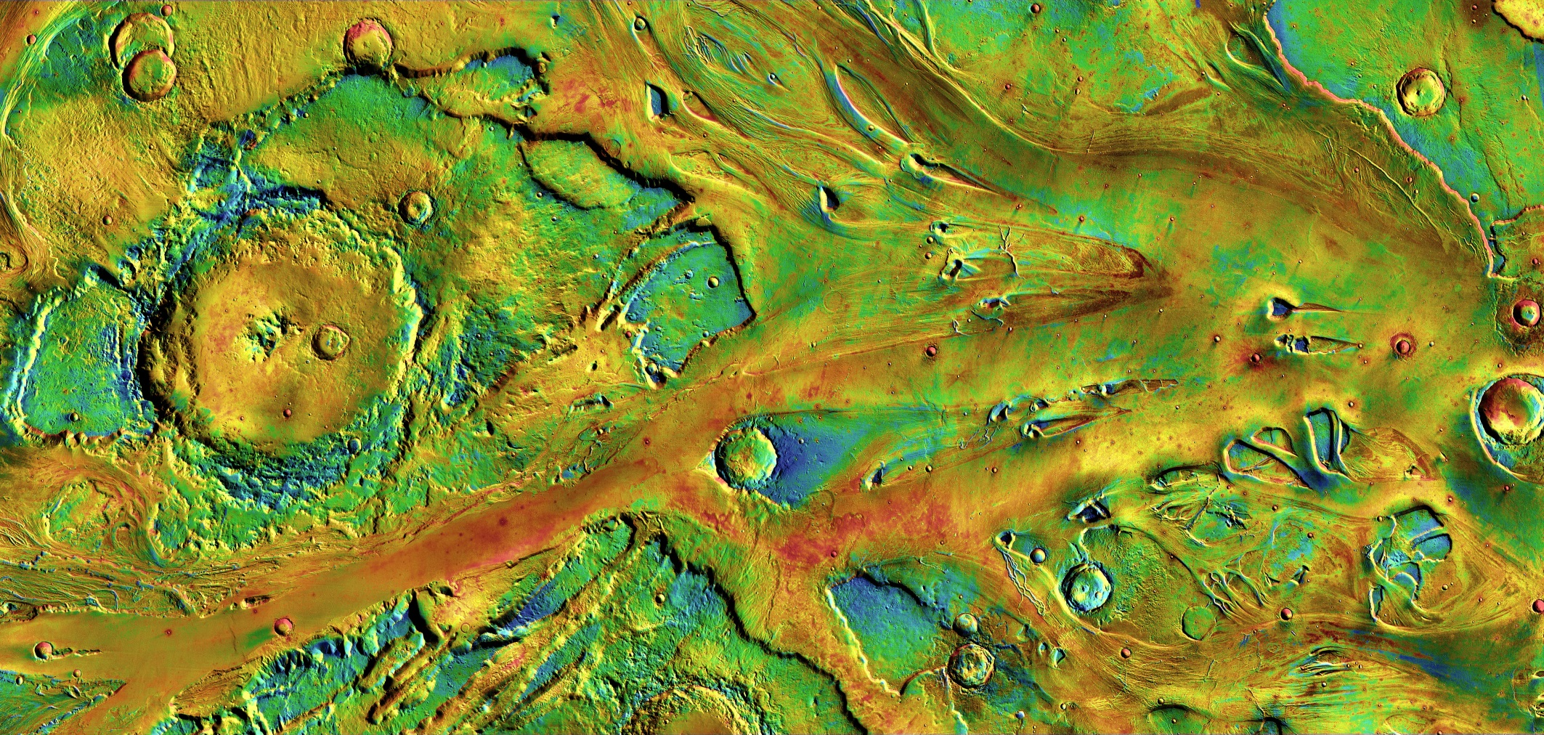
MARS
CREDIT: NASA/JPL-Caltech/University of Arizona/HI-RISE
Notes:
PRESENTATION NOTES:
This stunning enhanced color image shows the nature of the ground surface. You can almost envision water flowing across the surface in the distant past.
The enhanced color really emphasized the “texture” of the surface.
SCIENCE NOTES:
Billions of years ago, floodwaters emerged from Echus Chasma on the northern side of Valles Marineris, the "Grand Canyon" of Mars. The waters then poured across the landscape as they headed for the northern lowlands, carving a giant channel named Kasei Valles. In the scene here, the floodwaters moved generally left to right, dividing and merging to erode a network of linked channels. Where the floods encountered hills and craters in their path, they often left a streamlined mesa behind the feature, pointing like a pennant downstream. Areas in cool tints have more fine-grain materials (such as sand and dust) at the surface, while redder tints indicate areas with harder sediments and outcrops of rock.
http://mars.nasa.gov/multimedia/marsasart/?ImageID=5262

Slide 24
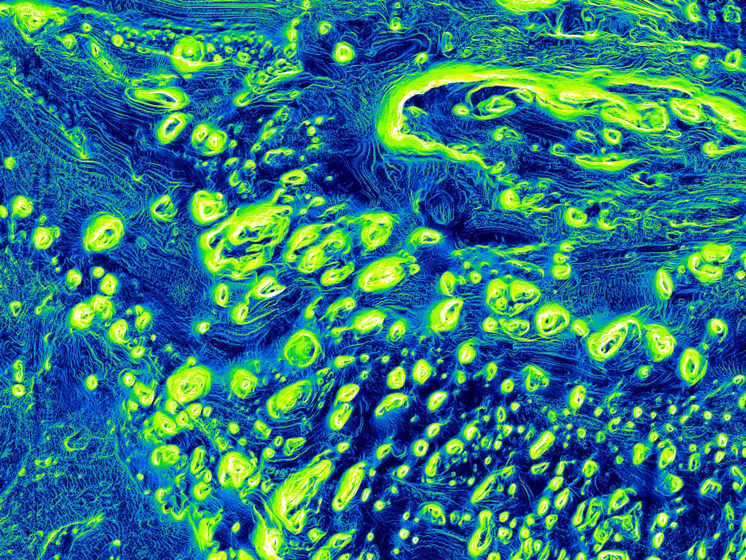
MARS
CREDIT: NASA/JPL-Caltech/University of Arizona
Notes:
PRESENTATION NOTES:
This compelling image shows Mars in infrared light.
SCIENCE NOTES:
This mosaic was made from images taken at infrared wavelengths in daytime and nighttime by the Thermal Emission Imaging System (THEMIS) on the Mars Odyssey orbiter. THEMIS is a special camera whose main tasks are mapping rock mineralogies and detecting heat, which yields information on the physical and thermal properties of the Martian surface. Its chief science goals are to look for rocks altered by water, study geologic details and hunt for "hot spots" indicating underground hydrothermal systems.
The largest crater visible (left) is Sharonov Crater, 100 kilometers (62 miles) wide.
http://mars.nasa.gov/multimedia/marsasart/?ImageID=5259

Slide 25
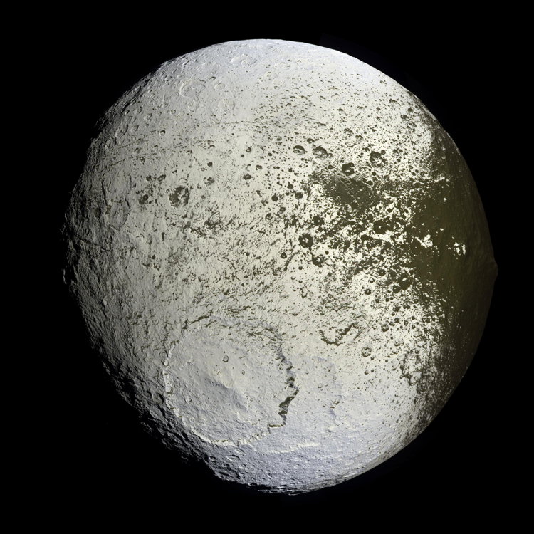
VALUE / ALBEDO
IAPETUS
Value – light and dark, shade and highlight
CREDIT: NASA/JPL/Space Science Institute
Notes:
PRESENTATION NOTES:
Can anyone give me a definition of Value? Value means the contrast between light and dark.
Scientists use a similar concept called “albedo” which is the measure of the reflectivity of a surface.
Iapetus has the most intense value contrast in the solar system.
Half of its surface is bright white while the other half is as dark as black velvet.
Things that are bright white are very reflective; this often means they are composed of ice.
Iapetus is still a mystery. Scientists are currently studying it and developing theories to explain its unusual terrain.
What else do you see in Iapetus’ southern hemisphere? A large circle/crater, meaning a large impact.
SCIENCE NOTES:
The Cassini spacecraft captured the first high-resolution view of the bright trailing hemisphere of Saturn's moon Iapetus in 2007. This image reveals the complicated transition region between the dark leading and bright trailing hemispheres.
The most prominent topographic feature is the huge impact basin seen at the bottom, one of at least nine such large basins on Iapetus.
This basin overlaps an older, similar-sized impact basin to its southeast.
http://photojournal.jpl.nasa.gov/catalog/PIA08384

Slide 26
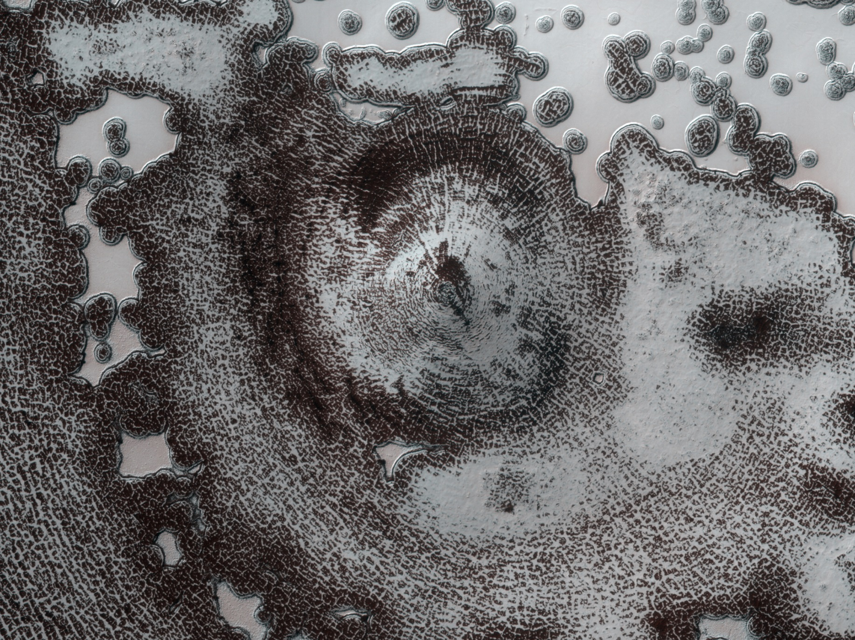
MARS
CREDIT: NASA/JPL-Caltech/University of Arizona
Notes:
PRESENTATION NOTES:
The polar regions of Mars are fascinating. The poles have an interesting process going on with water and carbon dioxide ice and sublimation which produces captivating images of light and dark.
The image looks like it could be of something biological found under a microscope.
SCIENCE NOTES:
This 4 km (2.4 mi) diameter feature near the edge of the south polar residual cap was first viewed in Mariner 9 and Viking Orbiter images taken in the 1970s, but its origin could not be inferred. It was therefore targeted for stereo imaging using the Mars Reconnaissance Orbiter’s HiRISE instrument.
The bright areas in this image are covered by carbon dioxide frost, and the "swiss cheese" terrain, typical of the south polar residual cap, covers much of the imaged area. The dark walls of the circular depression do not have as much frost on them and are fractured in a polygonal pattern. The surface of the walls appears to have been extensively modified by thermal expansion and contraction of water ice.
http://photojournal.jpl.nasa.gov/catalog/PIA13727

Slide 27
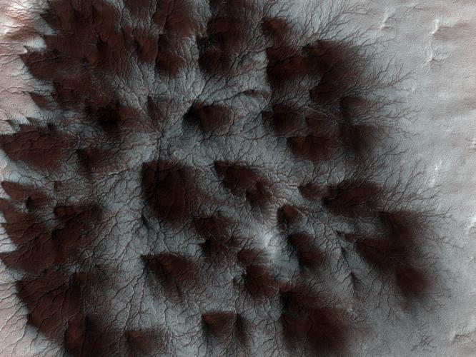
MARS
CREDIT: NASA/JPL-Caltech/University of Arizona
Notes:
PRESENTATION NOTES:
This is an intriguing image of the Martian pole with dark spider-like shapes.
SCIENCE NOTES:
Mars' seasonal cap of carbon dioxide ice has eroded many beautiful terrains as it sublimates (goes directly from ice to vapor) every spring. In the region where the HiRISE camera on NASA's Mars Reconnaissance Orbiter took this image, we see troughs that form a starburst pattern. In other areas these radial troughs have been referred to as spiders because of their shape. In this region the pattern looks more dendritic as channels branch out numerous times as they get further from the center.
The troughs are believed to be formed by gas flowing beneath the seasonal ice to openings where the gas escapes, carrying along dust from the surface below. The dust falls to the surface of the ice in fan-shaped deposits.
http://photojournal.jpl.nasa.gov/catalog/PIA11858

Slide 28
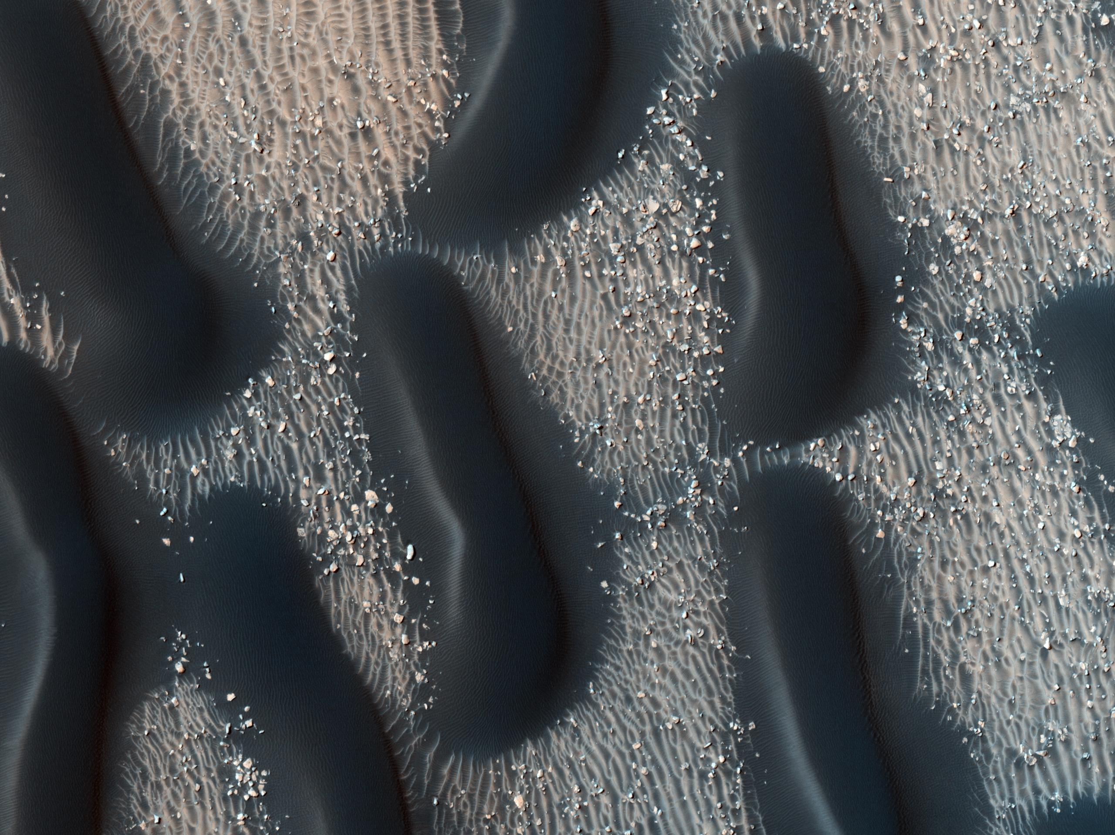
MARS
CREDIT: NASA/JPL-Caltech/University of Arizona
Notes:
PRESENTATION NOTES:
Here’s an very bizarre and interesting image of dark sand dunes.
This one also has a biological appearance.
SCIENCE NOTES:
This observation shows the edge of a dark dune field on the floor of Proctor Crater, a 150-km (90-mi)-diameter crater in the southern highlands of Mars. The dark dunes are composed of basaltic sand that have collected on the bottom of the crater. The dark steeper sides of the dunes are believed to have formed in response to fall and winter westerly winds caused by geostrophic forces (winds balanced by Coriolis and pressure gradient forces). Superimposed on their surface are smaller secondary dunes that are commonly seen on terrestrial dunes of this size.
Many smaller and brighter bed forms, most likely small dunes or granule ripples, cover the substrate between the larger dark dunes as well as most of the floor of Proctor Crater. The dark dunes overlie the small bright bedforms, indicating that they formed more recently. In several areas the dark dunes appear to influence the orientation of the small bright dunes, possibly by wind flowing around the larger ones, suggesting that both dark and bright bedforms were formed about the same time. The dunes in Proctor Crater may be active today, moving in response to Martian winds.
http://photojournal.jpl.nasa.gov/catalog/PIA13613

Slide 29
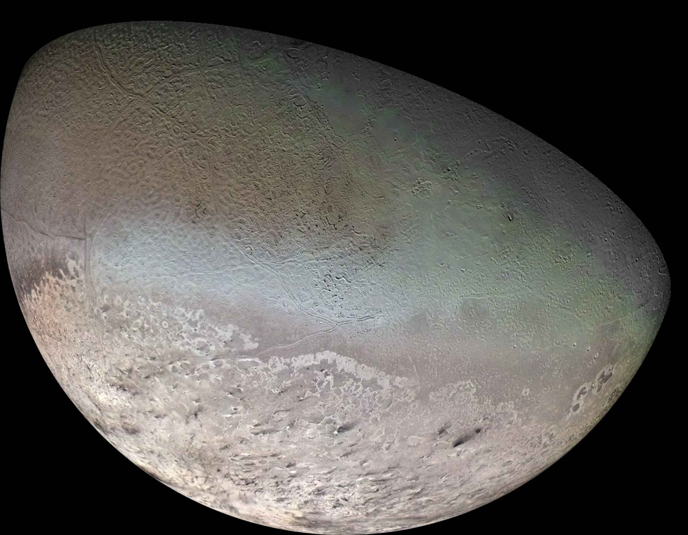
TEXTURE
Texture – the quality of the surface
CREDIT: NASA/JPL-Caltech/University of Arizona
Notes:
PRESENTATION NOTES:
Looking at the texture of a planetary surface can give scientists clues as to its geologic story. This unusual texture is on Triton, a small icy moon of Neptune.
What does Triton remind you of? A cantaloupe.
Scientists figured something this far from the Sun and so cold would not have a lot of geologic activity.
This weird terrain, combined with a lack of craters, suggests that Triton was geologically active. And indeed, scientists have found evidence of geysers and cryo-volcanoes -- ice volcanoes!
SCIENCE NOTES:
The surface of Triton is very rugged, scarred by rising blobs of ice, faults and volcanic pits and lava flows composed of water and other ices. The surface is also extremely young and sparsely cratered, and could still be geologically active. http://photojournal.jpl.nasa.gov/catalog/PIA12186
Triton is one of only three objects in the solar system known to have a nitrogen-dominated atmosphere (the others are Earth and Saturn's giant moon, Titan). Triton has the coldest surface known anywhere in the solar system (about -391º F); it is so cold that most of Triton's nitrogen is condensed as frost, making it the only satellite in the solar system known to have a surface made mainly of nitrogen ice.

Slide 30
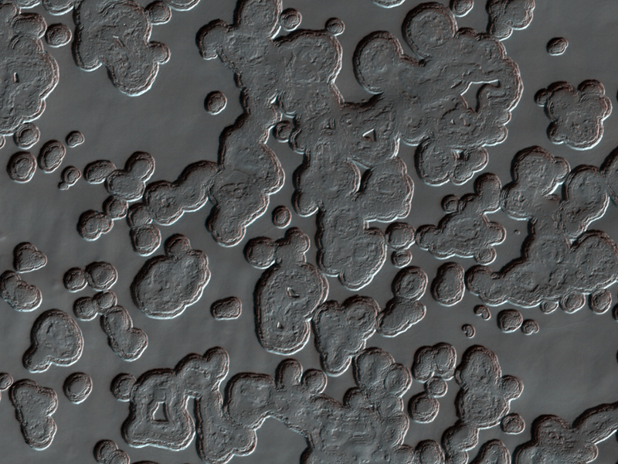
MARS
CREDIT: NASA / JPL / University of Arizona
Notes:
PRESENTATION NOTES:
This is another image of Mars’ south pole with pitted texture called swiss-cheese terrain that hints at sublimation of underground carbon dioxide.
SCIENCE NOTES:
The Mars Reconnaissance Orbiter’s ground-penetrating Shallow Radar identified a subsurface deposit of carbon dioxide . As the polar surface warms during the Martian spring, underground CO2 deposits evaporate, leaving behind round depressions in the frozen ground. This has been aptly dubbed “swiss cheese terrain” by researchers on the HiRISE imaging team.)
While scientists were aware of seasonal CO2 ice layers atop the water ice, this discovery brings to light nearly 30 times more frozen CO2 than was previously believed to exist. This deposit alone contains 80% of the amount of CO2 currently present in the planet’s entire atmosphere.
The importance of this finding is how the carbon dioxide ultimately affects the global Martian climate as it freezes and thaws. When the CO2 is frozen and locked away in subsurface deposits like this, it’s not free to enter the atmosphere and do what CO2 does best: warm the planet, as well as increase atmospheric pressure. This means that liquid water cannot last as readily on the surface since it will either freeze or boil away. Also with less air pressure the strength of wind is decreased, so dust storms are less frequent and less severe.
http://www.uahirise.org/ESP_012271_0940

Slide 31
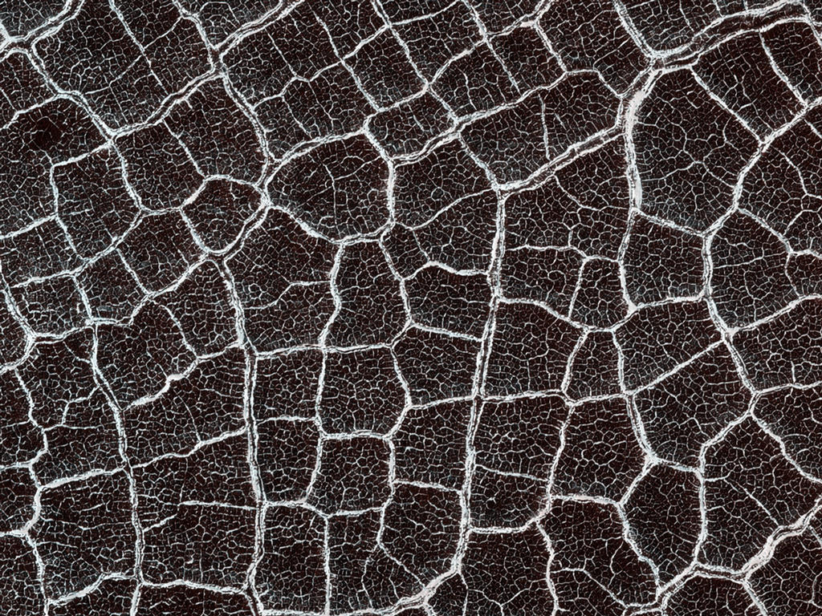
MARS: Polygons?
CREDIT: NASA/JPL-Caltech/University of Arizona
Notes:
PRESENTATION NOTES:
Look at this unusual texture and the curious polygon shapes.
The polygons in this "patterned ground" are easy to see because their edges are bound by ridges covered with bright frost in contrast with their darker, frost-free interiors.
SCIENCE NOTES:
From a distance, the floor of this crater looks like a giant honeycomb or spider web. The intersecting shapes, or polygons, commonly occur in the northern lowlands of Mars.
Patterned ground on Mars is thought to form as the result of cyclic thermal contraction cracking in the permanently frozen ground.
Scientists study these polygons to help us understand the recent and past distribution of ice (frozen water) in the shallow subsurface. These features also provide clues about climate conditions.
http://www.uahirise.org/ESP_016641_2500

Slide 32
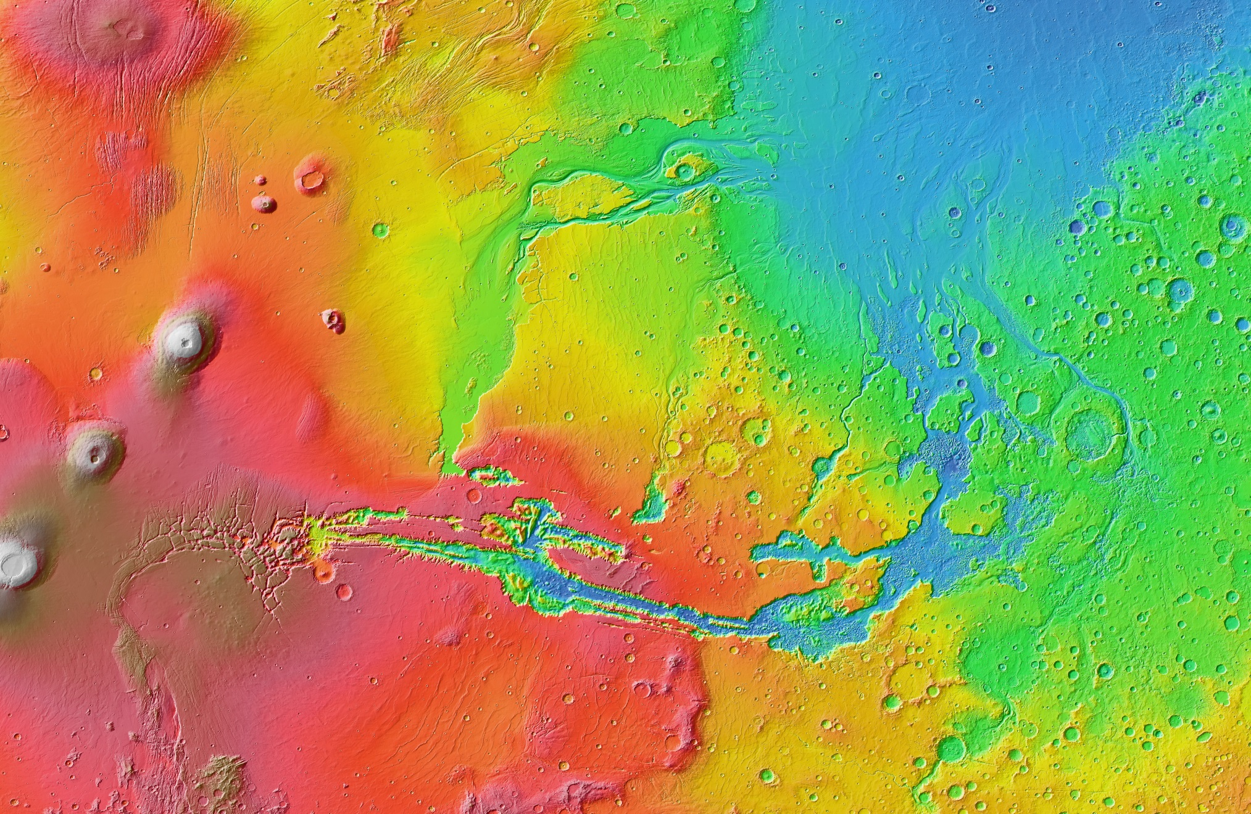
GEOLOGIC STORIES: Circles, Lines, Blobs & Color
CREDIT: NASA/JPL-Caltech/Arizona State University
Notes:
PRESENTATION NOTES:
We can combine what we know about the Elements of Art to start to read complex geologic stories.
What do you see here on this image of Mars? Encourage all discussion.
The circles are craters.
The three grey blobby shapes on the left are huge shield volcanoes in the Tharsis Montes region.
The big blue blobby shape on the top right is an ancient lake or ocean bed.
The squiggly lines are ancient river channels.
The straight lines near the middle-left of the image are tectonic faults. These lead into a big blue series of lines of a giant canyon system created by erosion and tectonic activity called Valles Marineris.
The enhanced color indicates topography, how high and low the surface is. What parts do you think are the lowest? Blue regions.
You can almost imagine what Mars looked like in the ancient past, with liquid water flowing on the surface!
SCIENCE NOTES:
This image was taken by the Mars Orbiter Laser Altimeter on the Mars Global Surveyor spacecraft showing the Tharsis province which includes the major volcanoes, the Valles Marineris, and the Chryse outflow regions. http://photojournal.jpl.nasa.gov/catalog/PIA17607

Slide 33
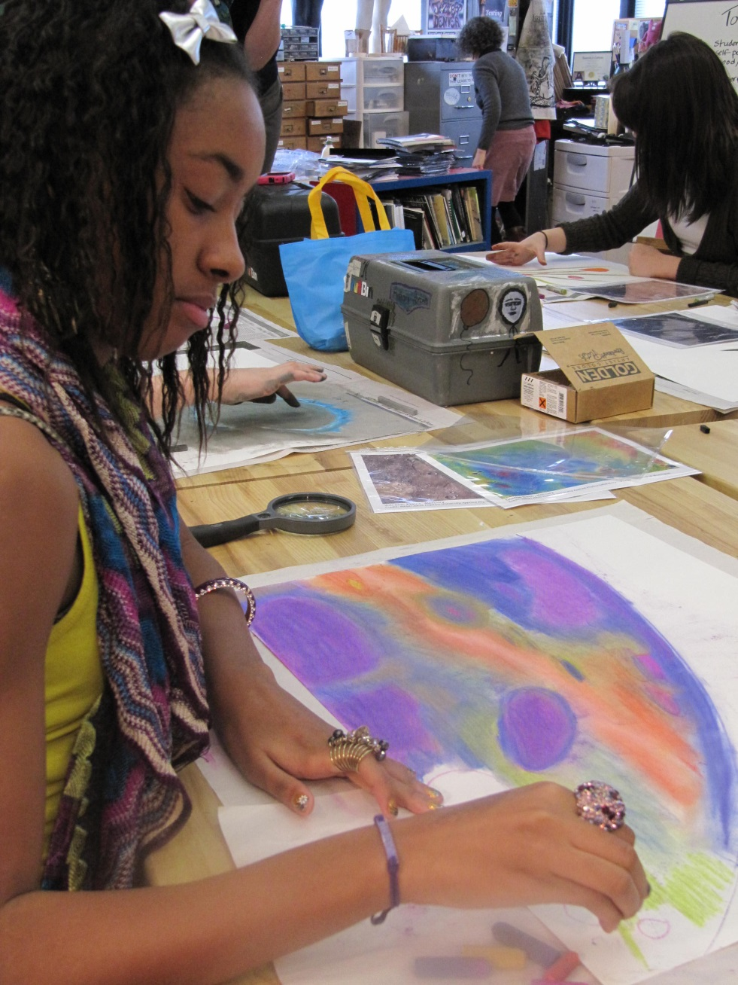
Learn more
NASA’s Discovery Program
https://planetarymissions.nasa.gov/art-and-the-cosmic-connection

