Slide 1
The High Definition Space Telescope
Lessons Learned
Marc Postman
Space Telescope Science Institute

Slide 2
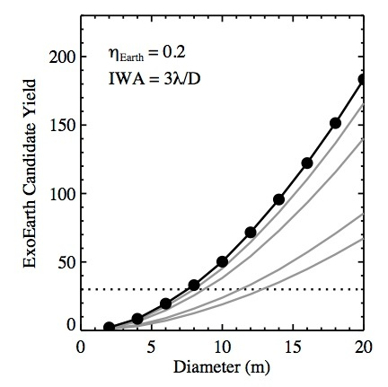
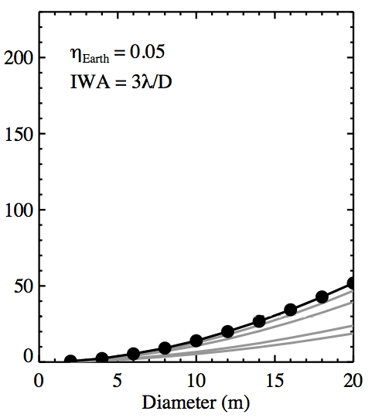
ExoEarth Yield Results
(see Stark et al. 2014; 2015)
η_{Earth} = 0.2
IWA = 3λ/D
Optimistic
η_{Earth} = 0.05
IWA = 3λ/D
Pessimistic
n_{exozodis}= 3
5
10
50
100
A 12-meter telescope can detect and study 20 - 70 Earth-like planets: this is enough to detect or significantly constrain the incidence of biomarker molecules.

Slide 3
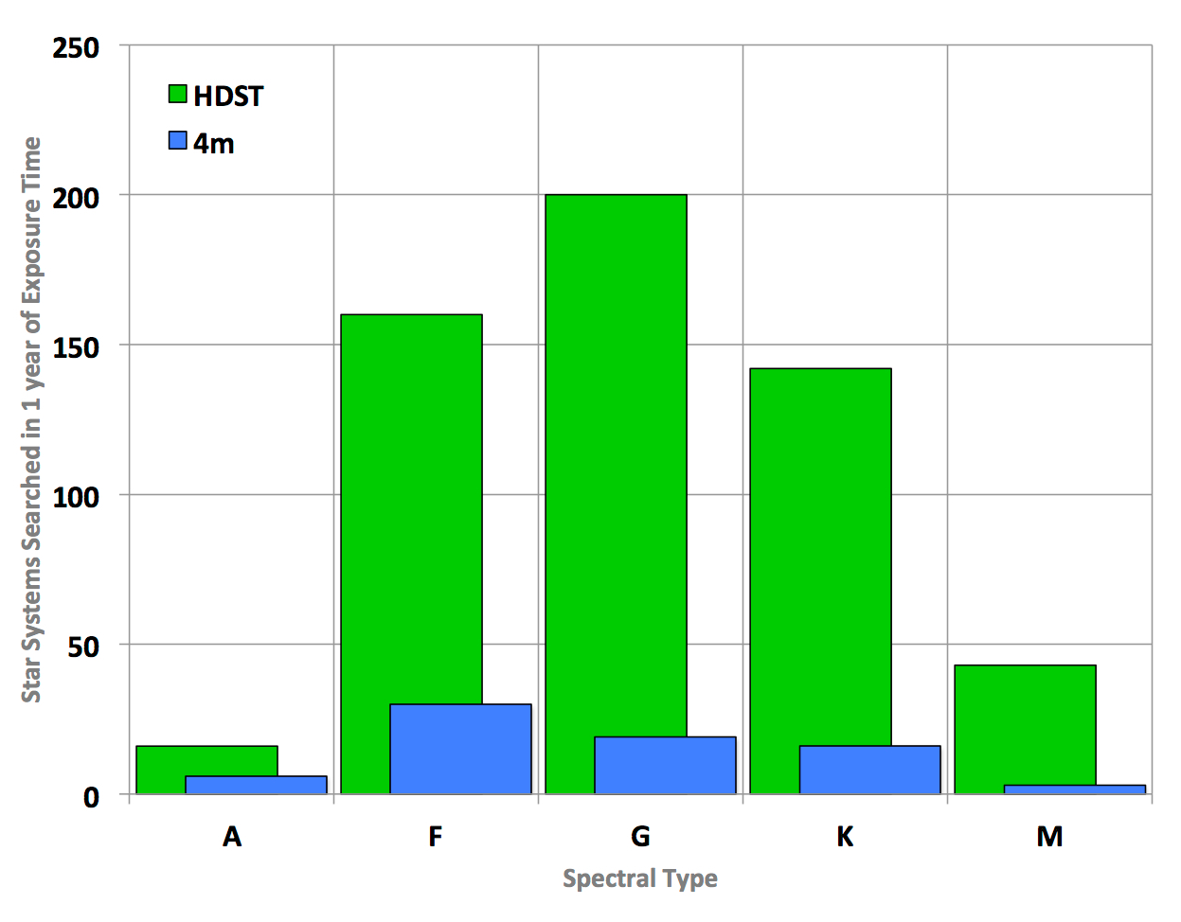
HDST surveys a broad range of stars
The distribution of stellar spectral types in the design reference mission (DRM) for a 12 m HDST (green) and for a 4 m exoplanet mission (blue). The histograms show the number of stars in each spectral type surveyed with a survey integration time of 1 year (which includes spectroscopic characterization of Earth-like planets). HDST surveys a total of 561 stars. The 4 m space telescope surveys 74 stars. The Stark et al. (2015) altruistic yield optimization algorithm is used in these DRMs.

Slide 4
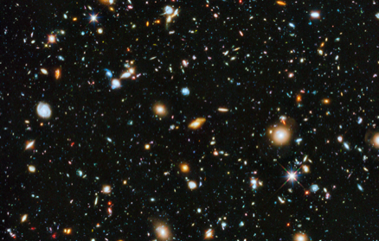
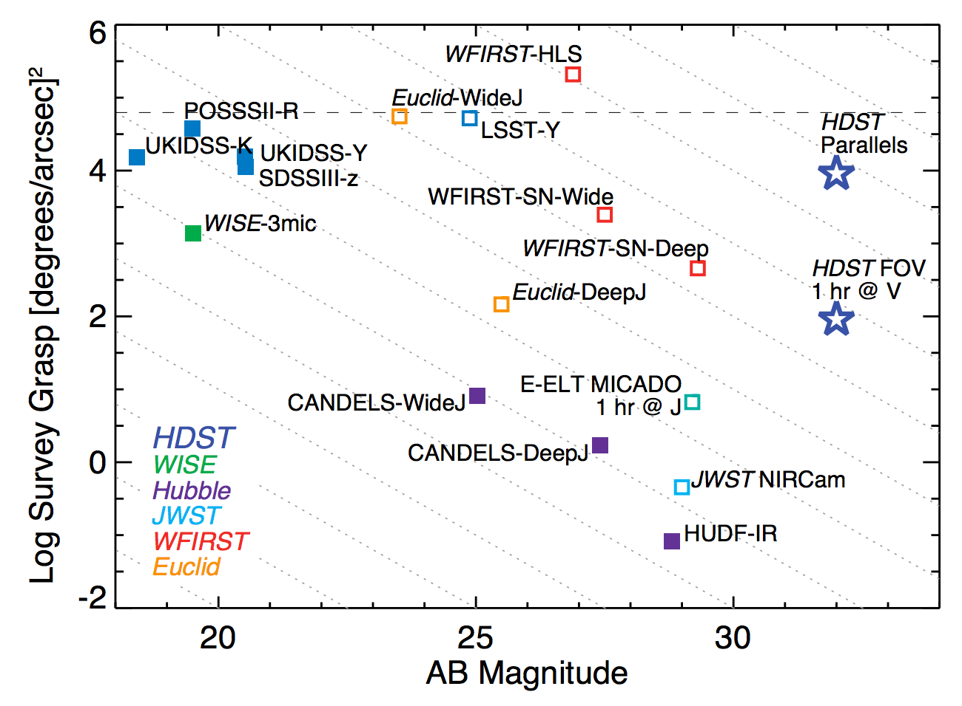
How Do Galaxies Grow, Evolve,
and Die?
Epoch
z = 1 - 8
Resolution
30-100 pc
WFIRST-HLS
entire sky observed @ 1” resolution
UKIDSS (K)
Euclid-Wide (J)
LSST (Y)
HDST-Parallels
SDSSIII (z)
WFIRST-SN-Wide
WISE (3μm)
HDST-FOV
70 hr @ V
WFIRST-SN-Deep
Euclid-Deep (J)
HDST-FOV
1hr @ V
CANDELS-Wide (J)
E-ELT MICADO
(1hr @ J)
CANDELS-Deep (J)
JWST NIRCAM
Dwarf Galaxy at z = 8
G Dwarf star at 10 Mpc
HUDF (IR)
number of spatial resolution elements in the observed field
32
34
Adapted from AURA Report by Kate Whitaker, U. Mass. Amherst
Notes:
From space, LUVOIR will readily probe the ultra faint universe. If LUVOIR acquires a deep field in parallel with its exoplanet exposures, the accumulated survey volume over the course of 2 years will be comparable to that in the SDSS! Reaching to depths below 31 mag will be key for studying unlensed dwarf galaxies at z=8 and detecting individual solar like stars in galaxies out to 10 Mpc.

Slide 5
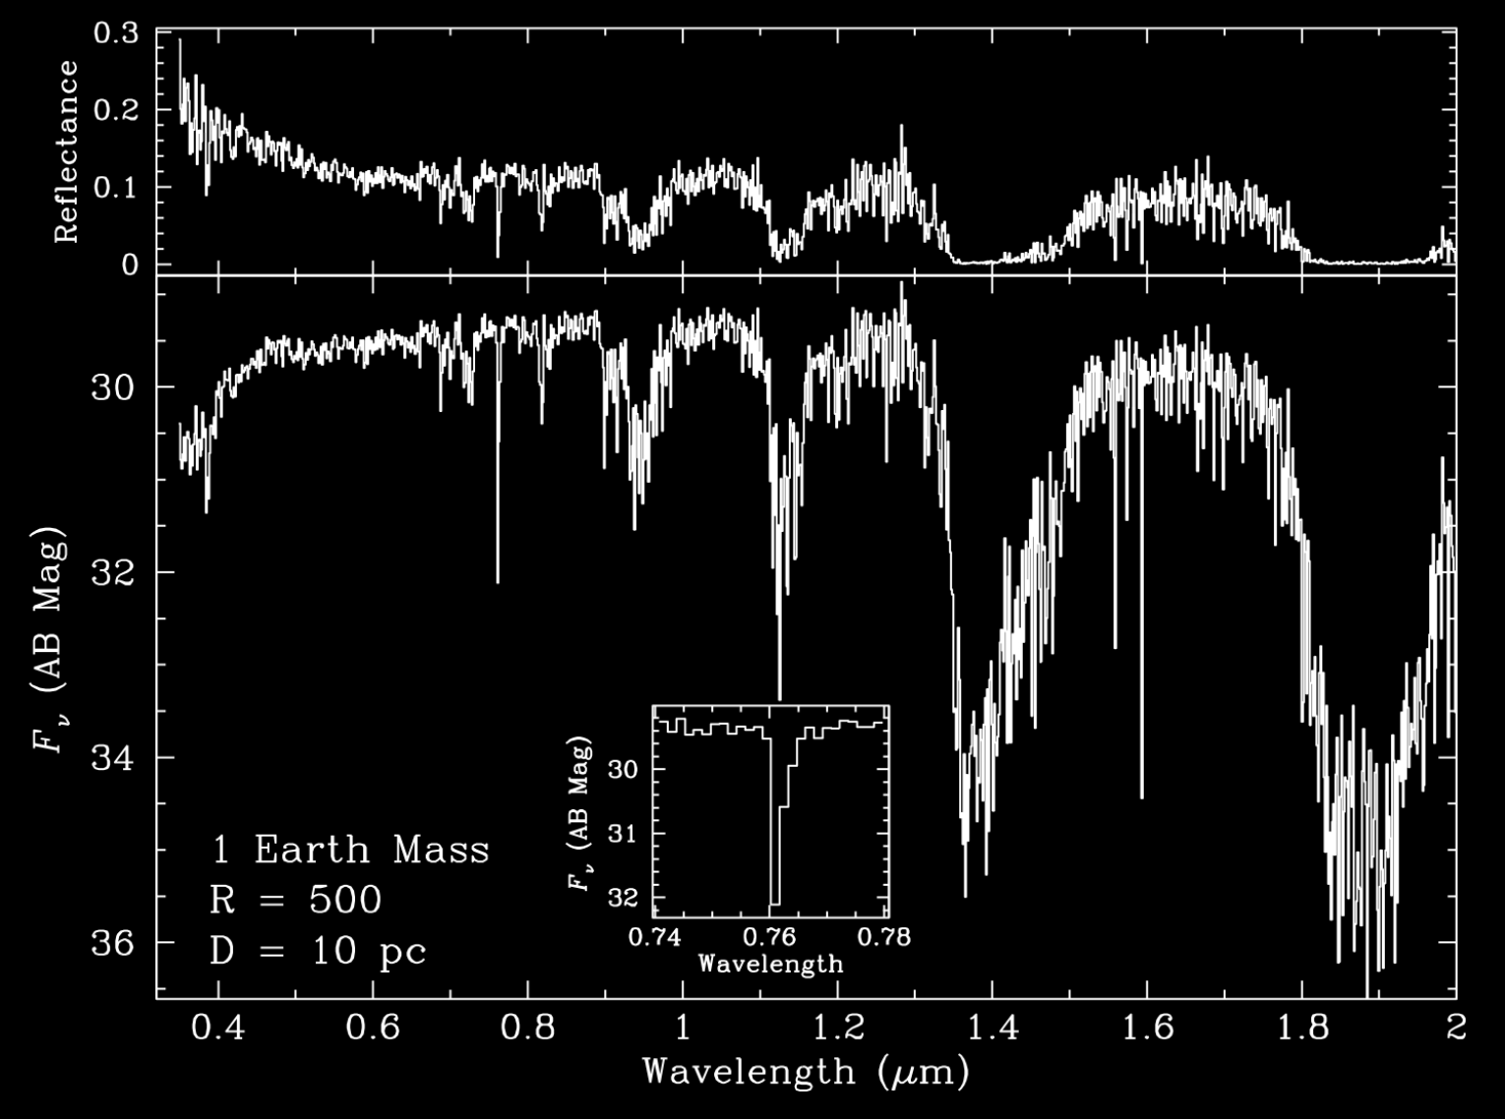
R=500 Spectrum of 1 Earth-mass Terrestrial Exoplanet at 10 pc
SNR=10 @ 760 nm
Rayleigh Scattering
SNR=10 @ 760 nm
H₂O
H₂O
H₂O
H₂O
O₂(α)
O₂(B)
H₂O
H₂O
O₂(A)
12 m: ~900 ksec
O₂(A)
Detail:
@ 750 nm
@ 750 nm
We don’t expect all potentially habitable worlds to have spectra like this but interpreting their spectra will likely require this kind of instrumental capability. High spectral resolution will allow us to derive the temperature and pressure profiles of exoplanet atmospheres and constrain atmospheric opacities and excitation processes.

Slide 6
How Did the Milky Way Form
from its Earliest Seeds?
Epoch
z = 1 - 8
Spatial Resolution
30-100 pc
Milky Way Progenitor at z = 2
HST (V,I,H)
JWST* (z,J,H)
HDST (V,I,H)
400 pc
250 pc
100 pc
With unique 100 parsec resolution in the optical at all redshifts, HDST can resolve the building blocks of galaxies: individual star forming regions and dwarf satellites, including progenitors of the present-day dwarf spheroidals.
These high-resolution images will complement spectroscopy from 30m class ground-based telescopes and ALMA of the galaxies and their molecular gas. HDST will spatially resolve SFR, Hα/Hβ, BPT diagnostics, HeI/Hβ, etc.
Images simulated by
Greg Snyder (STScI)
Notes:
Seeing galaxies at the time the Milky Way formed (10 Gyr ago). Greg Snyder slide – z=2 simulated galaxy, but even with HST zoomed in view doesn’t really allow you to see the detail you know that must be there. JWST will do somewhat better but will do that much better than HST. At z = 10, of course, JWST will win big because that’s what it’s optimized for. But at this key epoch in cosmic history, ALMA, LUVOIR and ELTs will probe remarkable details across a broad swath of the galaxy’s output energy distribution.

Slide 7
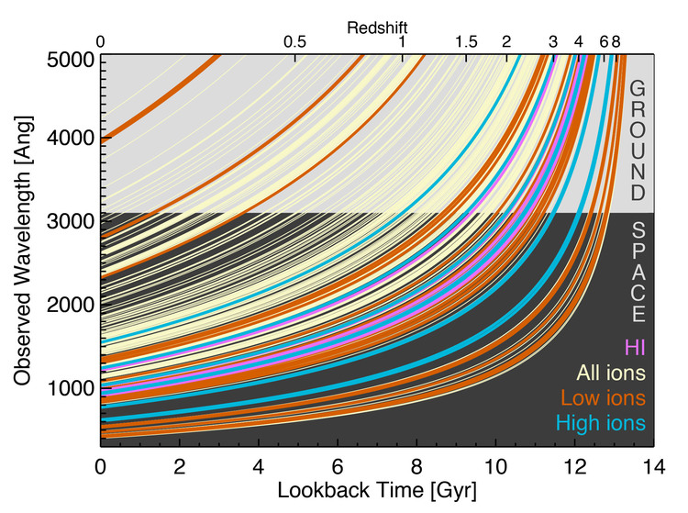
UV Access is Essential!
UV spectral features provide the some of the best, and often unique, constraints on:
Ionization state of ISM, IGM
Structure in ISM, IGM
Sources of ionization
Gas Temperature
Metallicity of ISM, IGM
Gas Density
Star formation rate
Gas kinematics and outflows
High spectral resolution is often required to make such measurements (R > 20,000)

Slide 8
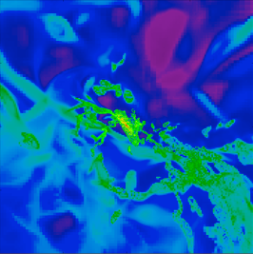
The Gas - Galaxy Connection
How do galaxies transition to quiescence?
What are the dynamics of flows into and out of galaxies?
How (and where) does the baryonic lifecycle evolve?
HST+COS & stacking of multiple FOV:
Simulated Milky Way galaxy at z = 0.25
(Joung, Fernandez, Bryan, Putman and Corlies (2012, 2015)
HDST + UV MOS for any single FOV:
200 kiloparsec
Using powerful and unique multi-object UV spectroscopy, HDST will be able to map the “faintest light in the Universe” emitted from gas filaments entering galaxies and energetic feedback headed back out.
Notes:
You may recognize this as a Galaxy. But what HST has shown is that galaxies are surrounded by a gaseous medium that extends to circumgalactic scales and with a total mass that outweighs the stars in the galaxy. But we have not been map in detail this gas. However if we could place a multiobject UV spectrograph – a truly novel instrument mode – we could take a picture that looks like this. We could map this structure - the material blown out by star formation and see the flow of metals back into the Galaxy. No other facility has or will have this ability other than HDST. It will be able to study such details for hundreds of galaxies.

Slide 9
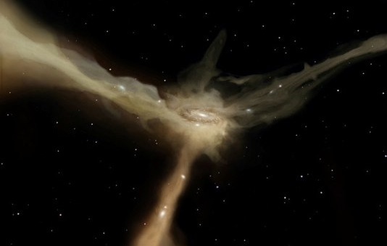
How Do Galaxies Acquire, Process, and Recycle Their Gas?
Epoch
z < 1
Resolution
10-100 pc
With the same UV multiplexing, HDST will also be able to map the properties of young stellar clusters and, using them as background sources, the outflows they drive into the ISM and IGM in nearby galaxies.
These observations require UV capability and ~ 10+ meter aperture.
Notes:
With that same UV multislit capability applied to nearby Galaxies (like M51 shown here) one can study in unprecedented detail the formation of stars in individual star clusters, measure their IMFs, and using each cluster as a flashlight map the gas flowing in and out of galaxies in the local universe as well. ELTs and HDST will work well here with ELTs measuring the low-mass end of the IMF and HDST measuring the high mass end.

Slide 10
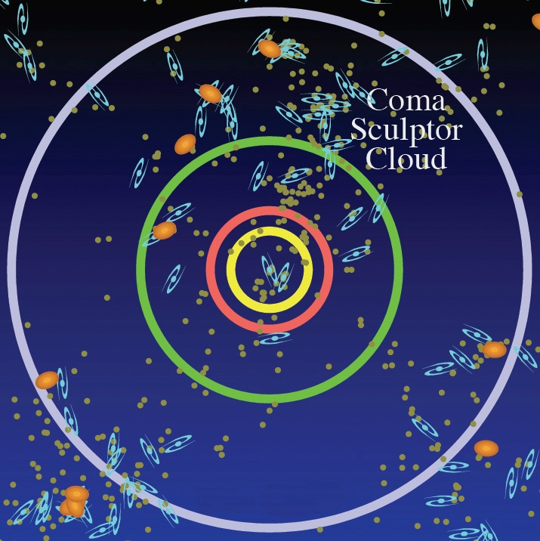
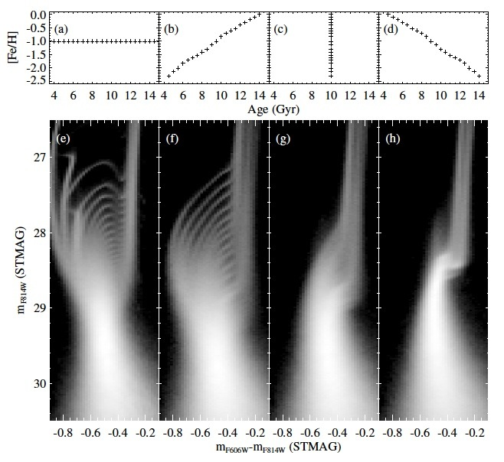
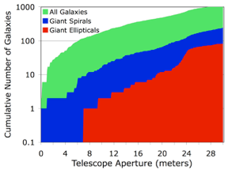
How Does Star Formation History Create the Diversity Shapes and Sizes of Galaxies?
Volume
< 100 Mpc
Resolution
1 - 10 pc
HST
F814W
JWST
8m
F606W-F814W
Star formation history sets both chemical evolution and planet formation rates. Visible bands provide best discrimination.
16m
Elliptical
Spiral
Dwarf
Requires diffraction limited
optical imaging and high PSF stability.
With HDST one could observe ~10 QSOs behind all galaxies within ~10 Mpc (purple line) and >1 QSO behind every galaxy out to 30 Mpc . Gives gas halo characteristics in the SAME galaxies that you get complete SFHs.
Aperture Driver: > 10 m needed to resolve stellar pops down to 1 M⦿ out to the nearest giant ellipticals.
Notes:
Stellar archeology can tell us important details of how galaxies assembled their stars. This is a unique tool that is only applicable where one can detect individual stars. Hence, it requires high angular resolution and high sensitivity. The idea behind this technique is that broadband photometry can distinguish between different models for the star formation history of an entire individual galaxy. It allows us to determine when the stars in a given region of an individual galaxy formed, and when the died. This is a key observation if we are to truly understand galaxy formation and evolution.

Slide 11
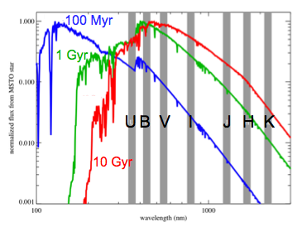
Visible and UV Sensitivity is Essential!
Volume
< 100 Mpc
Resolution
1 - 10 pc
JWST will observe the integrated populations of stars at high redshift but will not reconstruct their detailed star formation histories.
ELTs will probe stellar pops in NIR and primarily study later phases of stellar evolution (stars not on the Main Sequence).
HDST will provide essential (highly age-sensitive) data in UV/optical. HDST will also reach below the main sequence turn off (MSTO) for all stellar populations out to 10 Mpc. ELTs cannot do this!
Far UV
Spectra of MSTO stars as a function of their age

Slide 12
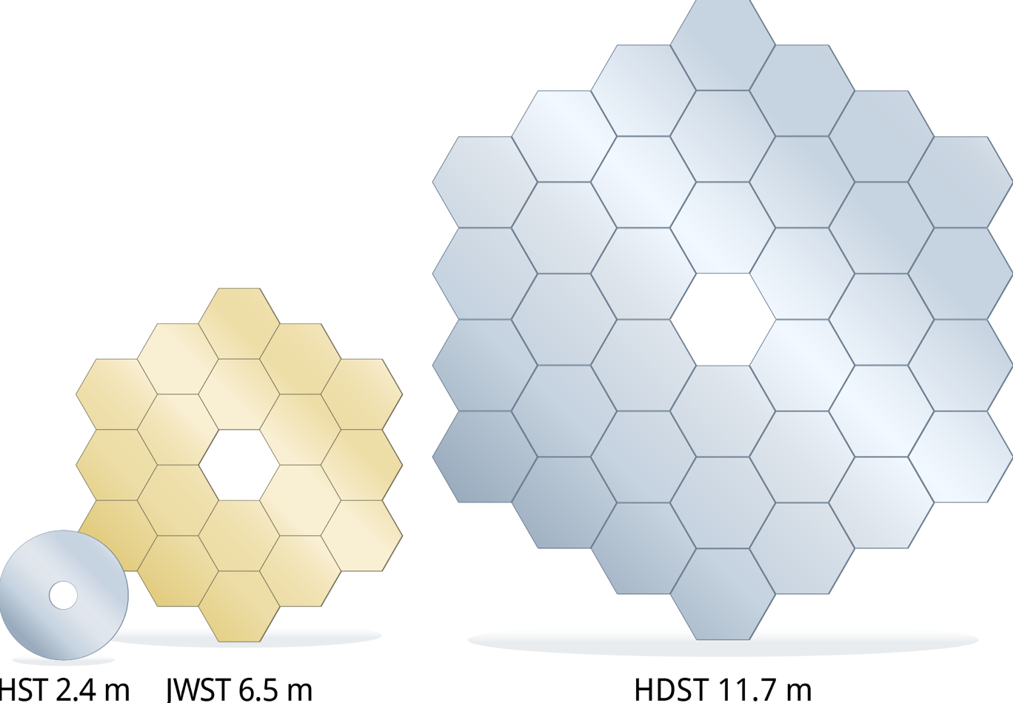
10m+ Aperture Drivers
UV Sensitivity Drivers
Characterize upwards of 30-50 exoEarth candidates. Obtain statistically significant constraint on eta-habitable and eta-life, even in presence of null result.
Resolve all galaxies to 100 parsec or better, to individual SF regions.
Identify stellar progenitors and host environments for diverse transients, key to unraveling causes.
Detect UV emission from gas accreting into and ejected from galaxies.
Reach > 100s of background QSOs/AGN for outflow and IGM/CGM studies. Stringent and unique test of cosmological structure formation models.
Detect hot plasma ejected by SMBHs acting as feedback on their galaxies.
Resolve stellar pops down to 1 M⦿ out to the nearest ellipticals. Definitive understanding of the stellar IMF.
Use UV MOS/IFU to dissect multiphase gas feedback flows in nearby galaxies.
Detect transverse motions of virtually any Milky Way star, Local Group satellites, and giant ellipticals in the Virgo cluster (~15 Mpc). New constraints on nature of Dark Matter.
Obtain disk abundances of C, N, O, Si, Fe (from UV lines) that strongly influence planet mass and composition.
Examine protoplanetary disks at ~1-3 AU resolution out to > 100 pc. Key constraints on planet formation.
Resolve individual stars in young clusters everywhere in the MW and Magellanic Clouds. Galaxy - Gas connection at unprecedented spatial resolution.
Measure protostellar accretion rates from UV continuum and lines out to MCs.

Slide 13
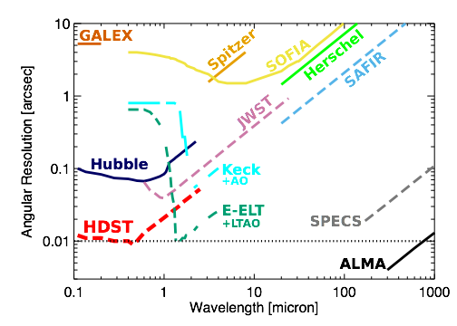
HDST in Context:
Synergy with Other Facilities
Spatial Resolution at z=2
85 kpc
Spatial Resolution at 1 Mpc
50 pc
8.5 kpc
5 pc
850 pc
1.6 light years
85 pc
10,300 AU

Slide 14
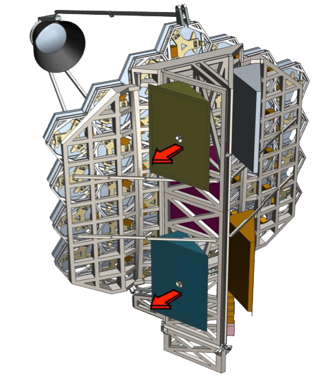
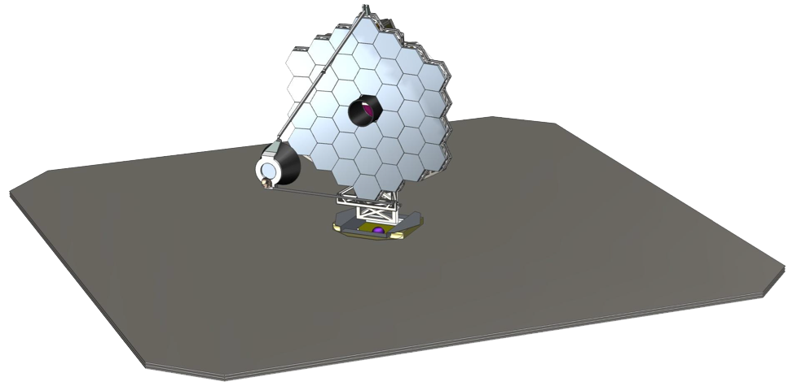
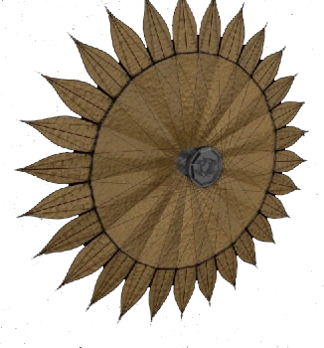
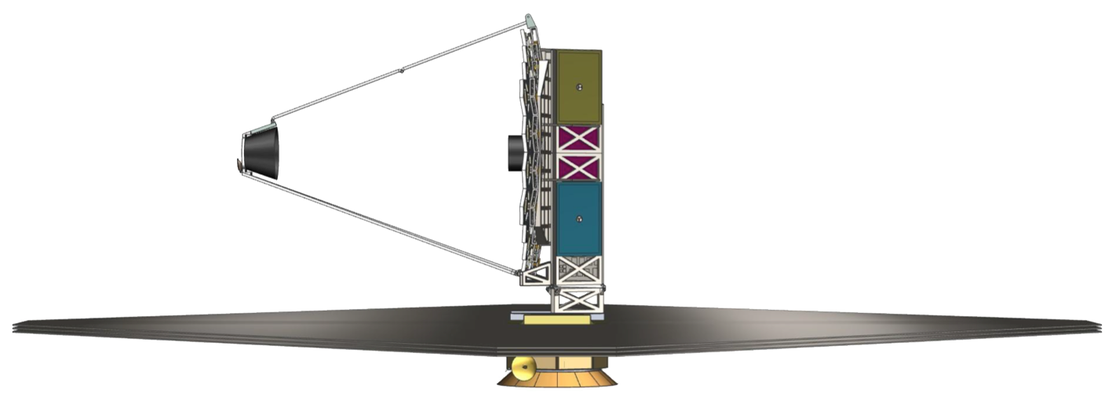
HDST Technologies Needed:
Lightweight Optics
Starshade,
Formation Flying
Thermal Control
Scattered Light Mitigation
Serviceable Instruments and Avionics
High Performance Coronagraph (10⁻¹⁰ contrast)
Large Deployable Structures
Active Wavefront Sensing & Control System
Disturbance Isolation
Milli-arcsecond Pointing Control

Slide 15
The Path Forward
6
5
2024
4
Readiness Level
2019?
3
2
Current
Starlight
Suppression
Telescope
Technologies
Other
Tech
1
Stability
Starshade
Mirrors
Structure
Detector
(Ultra low noise)
Coronagraph
(Segmented Telescope)

Slide 16
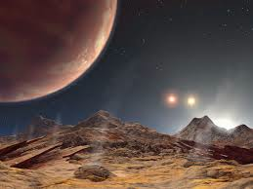
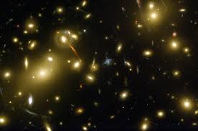
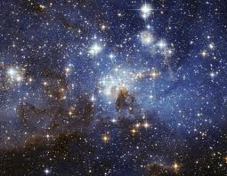
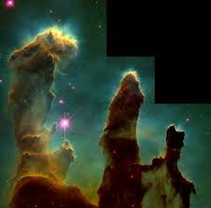
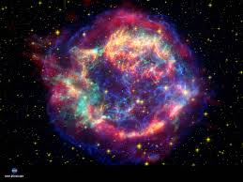
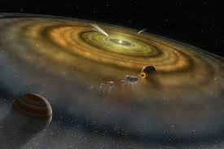
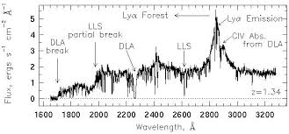
As astonishing as it might be to find life on other worlds, we already know that the story of all life in the cosmos, regardless of how alien it may be, arises from galaxies, stars, and planets formed from heavy elements made in stars.
ExoEarths
Cosmic Origins
A worthy endeavor is to design a long-lived space observatory that can both enable revolutionary studies in astrophysics and allow us to embark on a serious search for life elsewhere in the Galaxy.
Wide Community Ownership and Participation is Essential!

