Slide 1
Considerations for HabEx Architecture Selection
Karl Stapelfeldt
Jet Propulsion Laboratory,
California Institute of Technology
August 4, 2016
© 2016 California Institute of Technology. Government sponsorship acknowledged

Slide 2
Key Issues/Assumptions
For HZ planet science case and architecture selection:
HabEx STDT needs to choose a floor value for number of habitable planets the mission should be designed to characterize. Back in May, we were discussing 10 as perhaps the right number. Step 0 !
HabEx study will have to adopt a working value of η⊕. Use SAG 13 value ? Official Kepler project result ? We should not adopt the most pessimistic/conservative values.
HabEx DRM will have to build in time to search for HZ planets: Can’t count on RV or astrometry to exist at needed sensitivity levels. If we demand either, HabEx becomes Astro 2030’s flagship.
For exploration of planetary systems, need to define scope of what we might do beyond the HZ planet targets
For trades between coronagraph, starshade, or multiple starshades, need to identify total number of high contrast visits the mission should be doing.

Slide 3
Sizing the mission elements
for the HZ science goals

Slide 4
Step 1: Adopt eta_earth value (I picked 20%) Determines target sample 10/η⊕= 50
Belikov et al. SAG 13 presentation at ExoPAG 14

Slide 5
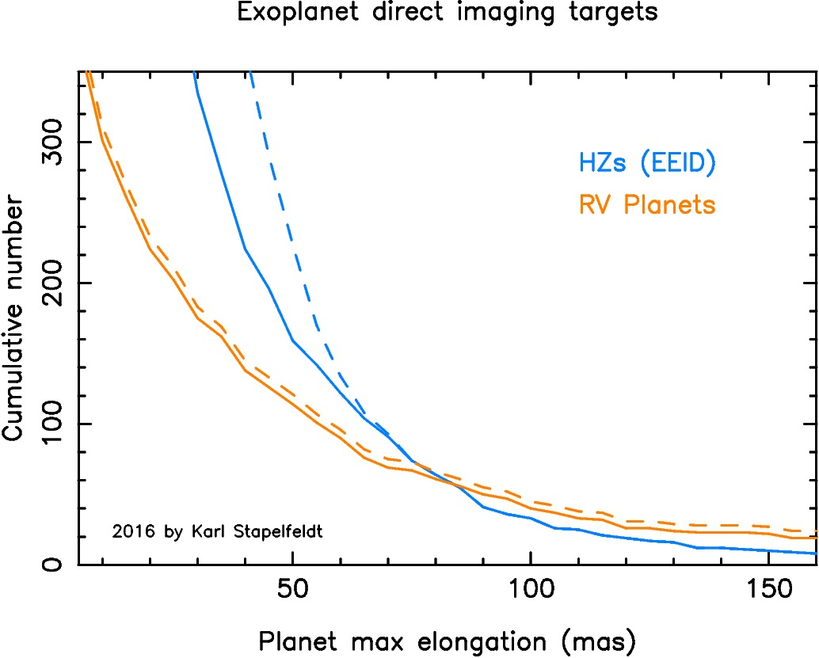
Step 2: Choose inner working angle that provides 50 HZ targets: 87 mas

Slide 6
Step 3: Choose longest wavelength at which this IWA must be achieved in all HZ targets
Ideally this would be 2.4 μm to enable the CH₄ false positive descriminator. But for 87 mas IWA this will be too challenging:
20 m telescope for internal coronagraph (3 λ/D IWA)
∼140 m starshade (for this IWA, scaling from Steve’s charts yesterday)
More modest goal : 0.8 μm for coronagraph
encompasses 0.76 μm O₂ A band for all targets, goes to longer wavelengths on a subset of the full sample
Move IWA to 75 mas to enable sufficient search completeness
Results in following aperture trade:
6.6 m telescope if coronagraph operates at 3 λ/D IWA
5.5 m telescope if coronagraph operates at 2.5 λ/D IWA
4.4 m telescope if coronagraph operates at 2.0 λ/D IWA
Modest goal: 1.0 μm for starshade → 60 m diameter
Both could be used for the search – need to choose !

Slide 7
Capability of this mission scale
for non-HZ exoplanet science

Slide 8
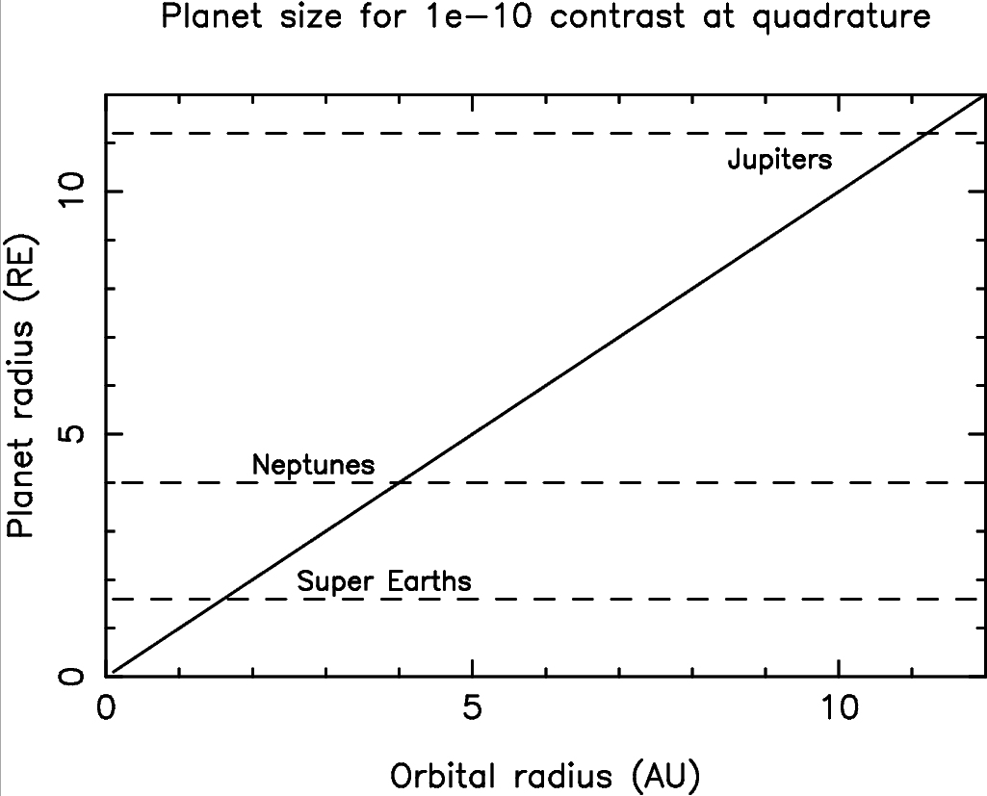
Planet detectability in reflected light:
Mission designed to detect Earth at 1 AU can also detect rocky super-Earth to 1.6 AU,
Neptune to 4 AU, Jupiter to 11 AU. Large search space !

Slide 9
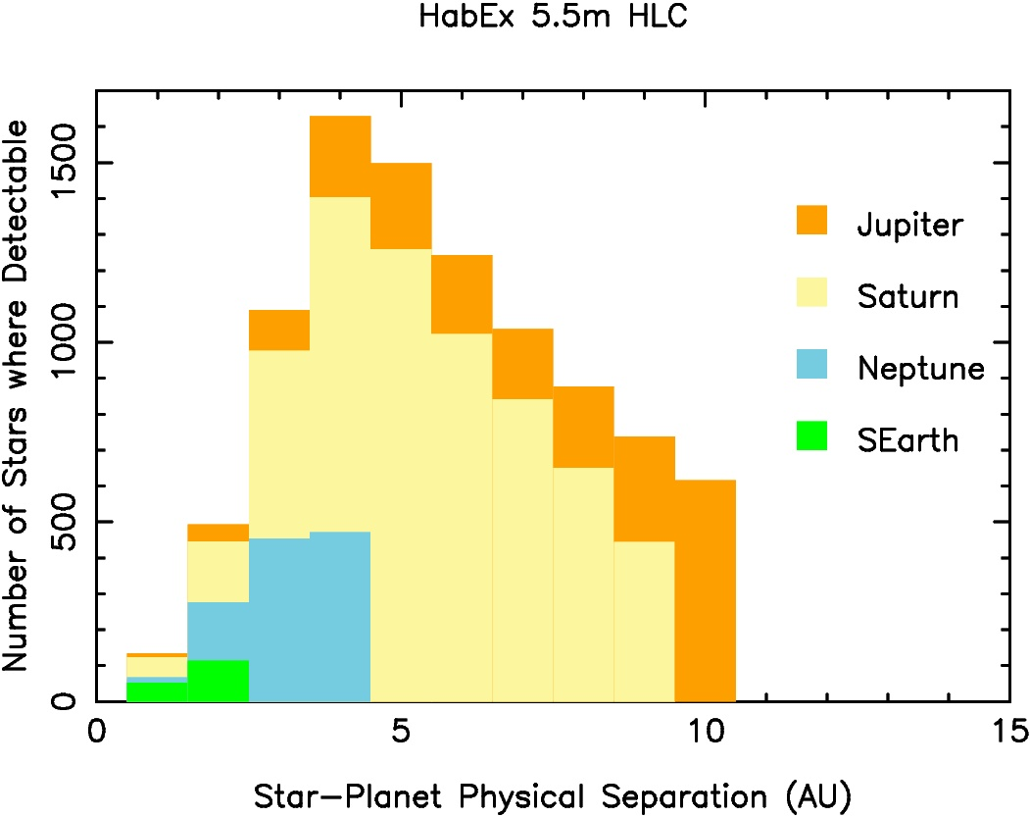
Planets in 1-10 AU region are accessible in a large target sample

Slide 10
Assumptions for search space figure
5.5m unobscured telescope, 2.5 λ/D (0.075″) IWA at V band
Coronagraph image core throughput 9%
Hybrid Lyot coronagraph as for Exo-C / Exo-C ES
20% bandwidth at V, S/N of 10 on the quadrature brightness
Planet albedo as for Jupiter: 50% at V band
0.75 year of total integration time
a/IWA ≥ 1.4 ( ∼80% single visit obscurational completeness)
Integration time per visit is 12 hours maximum, 2 visits/target
Actual performance should be better because:
HabEx would require higher performance internal coronagraph, larger OWA than I simulated here
Starshade would have higher throughput than assumed here
With more visits, can search closer-in for smaller planets

Slide 11
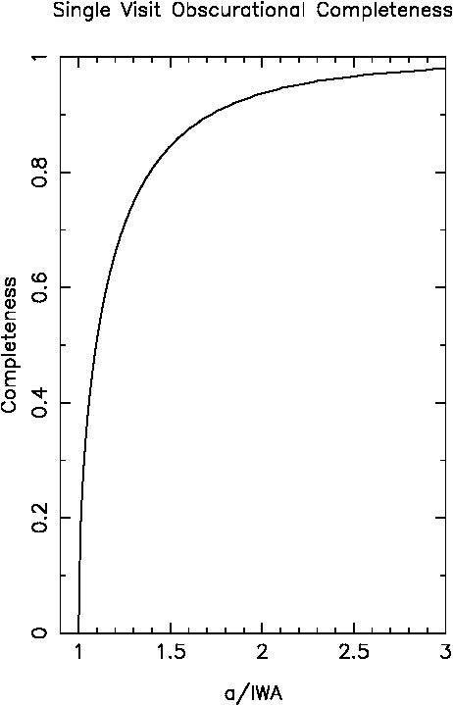
Planet Searches: Some intuition before Monte Carlo
Far from the IWA, a planet is visible over a wide rage of inclinations and orbital longitudes
Close to the IWA the planet visibility is far more restricted
Tailor search strategy to planet expected location: target higher quadrature S/N when far from IWA, lower when closer in
a/IWA | Orbital longitude range | S/N | # of visits | Revisit interval
1.41 | 2x 45-135º | 10 | 2 | P/4
1.15 | 2x 60-120º | 7 | 3 | P/6
1.05 | 2x 75-105º | 5 | 6 | P/12
a is the orbital semi-major axis
For optimally spaced revisits, completeness can approach 100% for the semi-major axis of interest

Slide 12
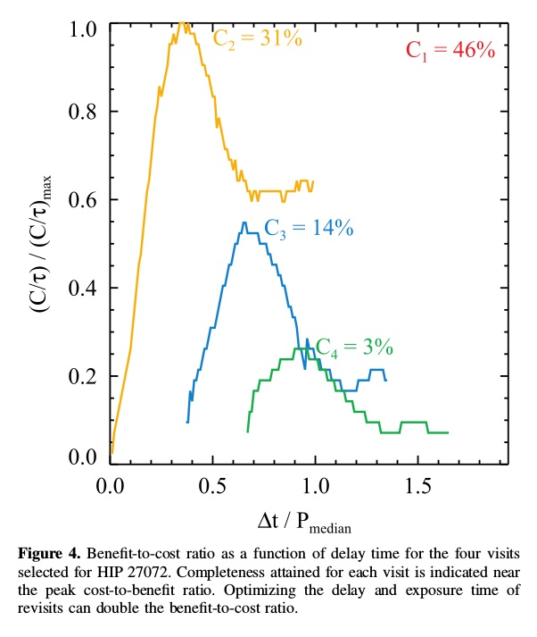
Optimizing revisits
Right: Stark et al. 2015 results for HZ orbital period distribution, case of a single star
HabEx field of regard needs to be specified to support revisit strategy that we decide on
Sun angle range of 90°±45° would support ability to revisit up to ∼¼ orbital period later

Slide 13
Concluding comments

Slide 14
Need to develop approach for how coronagraph & starshade might work together
WFIRST now considering this – what is their thinking ?
Need coronagraph’s agility to look at many targets/epochs. Could do spectroscopy of brighter targets.
Want starshade to view full system in subset nearest targets (no OWA), do spectroscopy of fainter targets, access longer wavelengths, do separate fuel-limited sample of HZs too close in for the coronagraph. A 100 m starshade would allow spectroscopy to 1.7 μm in all 50 HZ targets
Number of visits needed for HZ search is likely to be
≈ (1+η⊕)*50*3 = 180
Number of visits to do non-HZ science could start at ∼200 and range over 1000 (planet search, disk imaging, high contrast general astrophysics, …)
Sizing starshade for longer wavelengths seems sensible → go big.

