Slide 1
HabEx in Context, and why we should study precursor observations.
Scott Gaudi

Slide 2
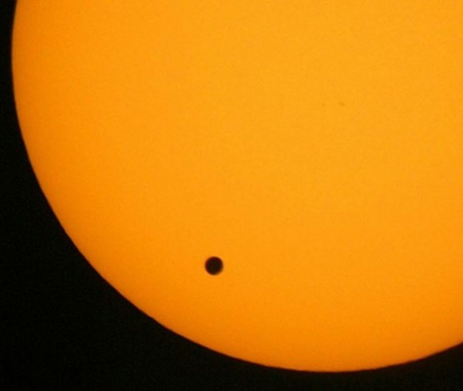
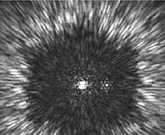
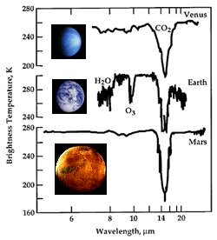
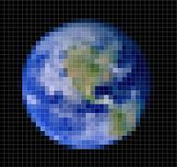
Stage 0
(current)
Stage 1
(2020-2030)
Stage 2
(2030-2040)
Stage 3
(>2040)
A Complete Exoplanet Census
Science Roadmap
The Search for Habitable Climates and Life.
Characterizing Atmospheres of Other Worlds
TESS
Direct Detection Mission (1+2+…?)
w/ Transit Characterization?
Earth Mapper
JWST
Mission
Roadmap
HST
WFIRST+C (+S?)
Mid-IR Interferometer
Spitzer
Transit Characterization Mission?
Astrometry Mission?
Kepler

Slide 3
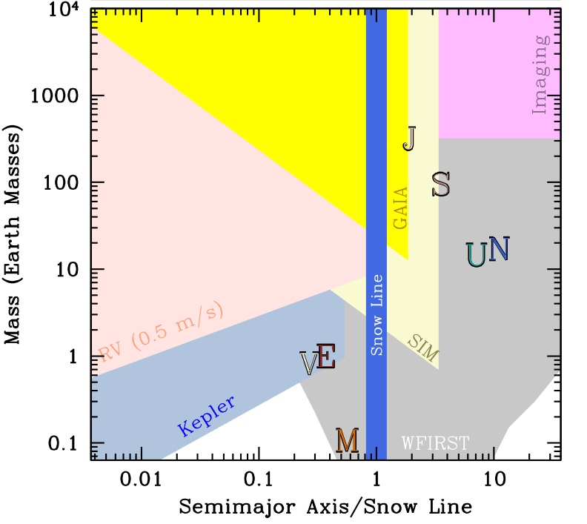
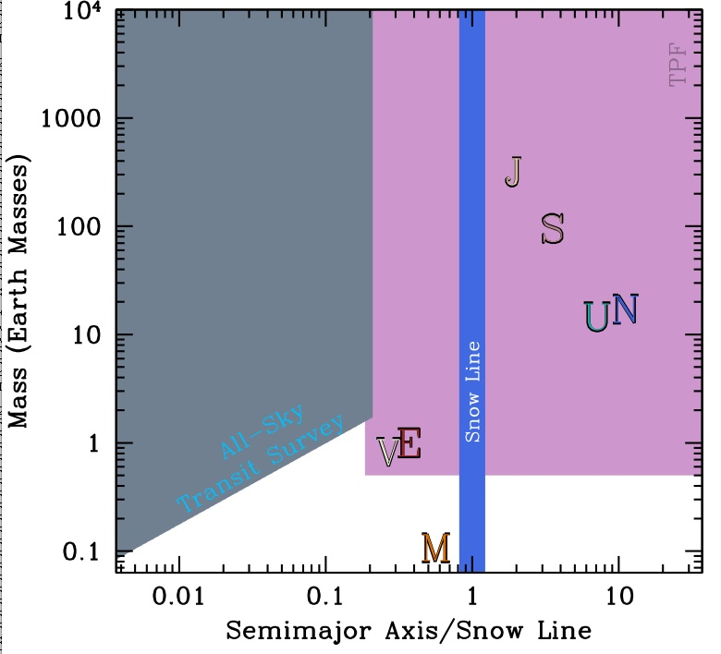
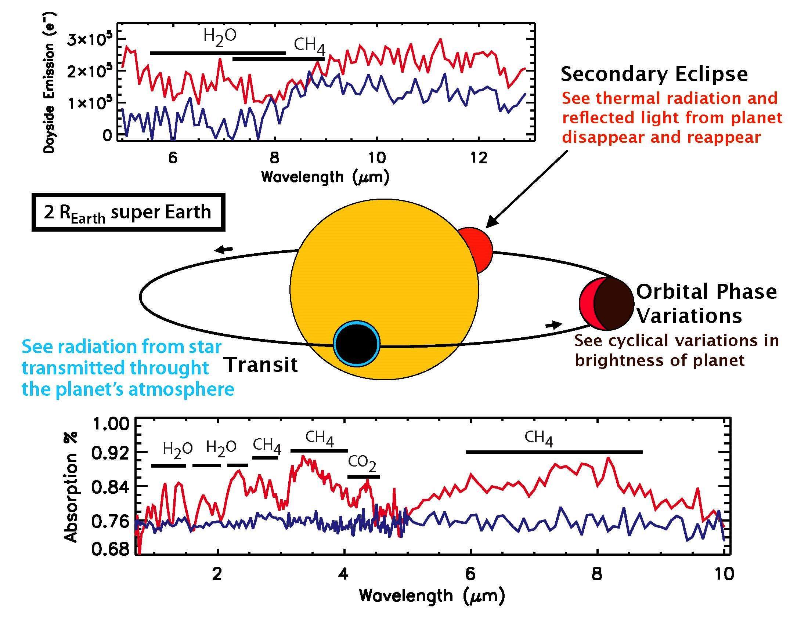
Physics of Planet
Formation and Evolution
Physics, Frequency,
Evolution of Habitability and Inhabitance
Secular evolution
Water delivery
instability
Impacts
Physics of Planetary
Atmospheres and Interiors
Protoplanetary and Debris Disk Observations
Theory
Demographics
Planet mass/radius/spin | Stellar environment
Semimajor axis, period, eccentricity, alignments | Rare & unique systems
Host star mass, luminosity, abundances, age | Free floating planets
Host star binarity | System multiplicity, coplanarity, architecture
Giants, subdwarfs, remnants | …
Characteristics
Mass/Radii | Emission/Transmission Spectra
Phase Curves | Variability
Rotation rates | Magnetic Fields
Internal Structure | Atmospheric Velocities
Satellites/Rings | Atmospheric escape
Coupled Demographics
and Characteristics
RV Surveys
Kepler
PLATO/TESS
WFIRST_S
Ground-Based
Transit Surveys
JWST
WFIRST/Euclid
HabEx/LUVOIR?
Ground-Based
Direct Imaging
FINESSE/ARIEL
SIM-2?
GAIA
HST/Spitzer

Slide 4
The Search for Habitable Climates and Life.

Slide 5
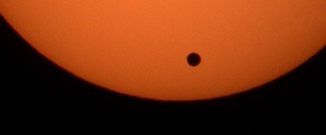
Pale Blue Dots
Small Black Shadows

Slide 6
The Search for Life.
Need to complete the planet census (Kepler + WFIRST) and characterize a diversity of planetary atmospheres (JWST + WFIRST-C,S? + HabEx/LUVOIR).
Low-mass stars:
TESS+RV+JWST + ? (luck + control of systematics)
GSMT with extreme AO
High-mass stars:
Technology development (coronagraph and starshade)
Need a robust estimate of η_{Earth} (or RV or astrometry).
Need a robust estimate of exozodi levels (LBTI).
Need to figure out how to measure masses and if we can identify the targets first (and figure out if it helps).
Need to understand false positives.

Slide 7
The airtight argument for investing in RV technologies now.
Learn it, love it, use it.
We have to measure the masses of directly-imaged habitable planets somehow.
We have two choices:
Astrometry (0.1 μas)
RV (1 cm/s)
Astrometry must be done from space, so is likely >~$1B regardless (unless as an add-on to another mission).
RV at 1 cm/s may be doable from the ground*. It will cost ~$50M to figure this out, and $200M to measure the masses if it is possible.
So, we will have to try to do RV eventually anyway, we might as well start now.
If we can achieve ~1cm/s from the ground, we can find the habitable planets first, and then we only have to observe 1/η_{Earth} times fewer targets for a direct imaging mission.
*People will tell you it is impossible. This may be true, but we do not know this yet. It is an opinion, not a demonstrated fact.

Slide 8
Precursor observations: how they may affect trades.
Generally help if t_{detect} >> t_{characterize,} for example:
Low completeness per visit:
Small dark hole.
Large IWA.
Small η_{Earth}.
Also help if the target sample size is resource limited:
Sharing time with other science.
Limited number of slews for a starshade.
Long integration times for characterization.

Slide 9
Example 1: detection-limited, mission-time-limited, blind survey with a coronagraph. (Courtesy of Peter Plavchan)

Slide 12
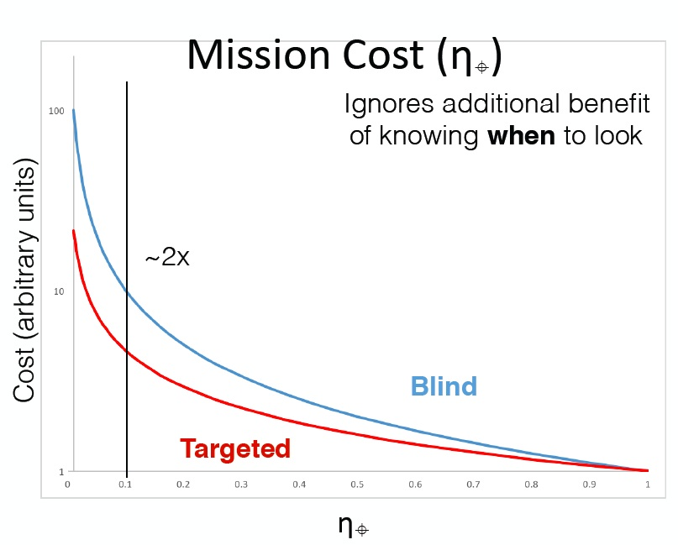

Slide 13
Example 2: resource-limited blind survey with a starshade. (Stark et al. 2016)

Slide 14
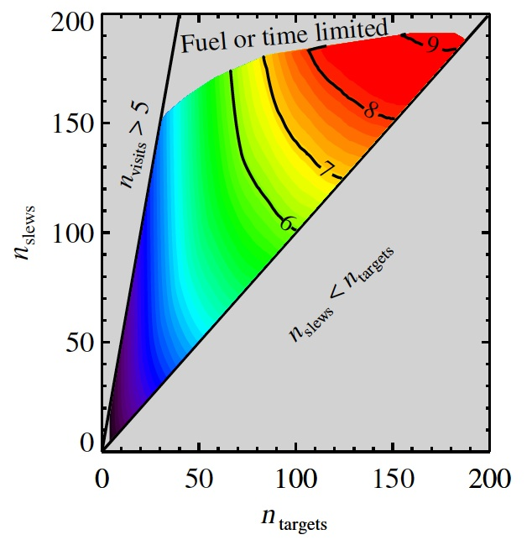
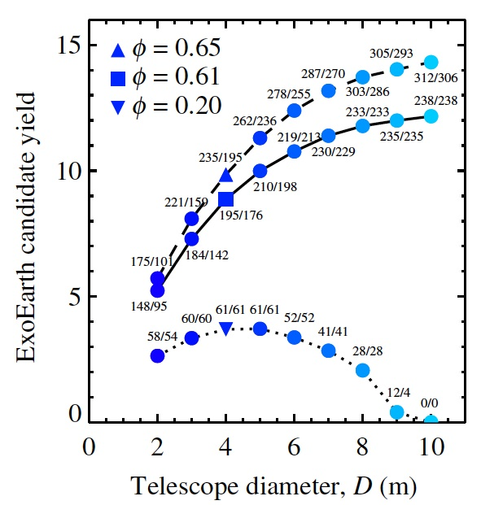
Stark et al. 2016
Optimal blind starshade missions are typically either mission time or fuel limited.

Slide 15
Detecting Earth Analogs with RV.
Signal:
Semiamplitude ~ 10 cm/s and Period ~1 yr
Requirements:
Statistical SNR ~ (N/2)^{1/2} (K/σ)
Wavelength and instrument calibration stable to ~ 1 cm/s over many years
Removal/suppression/separation of intrinsic stellar noise to ~1 cm/s.

Slide 16
Removal/suppression of intrinsic Doppler noise to ~1 cm/s.
Impossible (in principle)?
No: Doppler variation due orbiting bodies has a unique signature: all the lines (regardless of wavelength) move by the same amount without changing their shape.
But!
This won’t be solved using current methods, specifically:
Current instruments, telescopes, and time.
Current detection algorithms.
The problem of stability is hard, but likely tractable and on its way to being solved.
Need to solve the problem of intrinsic stellar noise.

Slide 17
PRV “Dream Machine”.
Attributes:
Large aperture (one large or many medium)
Dual Optical + IR channel
Very high optical resolution (R>150,000)
High IR resolution (>50,000)
Broad wavelength coverage (0.4-1.7μm)
Fiber-fed, bench mounted, stable
Advanced wavelength calibration (e.g., LFC)
Advanced fiber scrambling techniques (e.g., octagonal fibers, double fiber scrambling, etc.)
Resources:
Cost: O($20M) per instrument (?)
Lots of observing time (~>25% of time for 10 years for N~50)
Total cost $100M-$200M?
By the way:
Going to space first to try to do this is not cost effective and generally precludes a precursor survey

Slide 18
A roadmap:
Demographics:
Kepler + WFIRST.
Characterization:
TESS+JWST, WFIRST+C+S, future direct imaging mission.
Search for Life:
TESS+JWST+GSMT
Measure η_{Earth} and exozodi levels.
Determine if finding the planets first helps, and if so invest $50M-$200M to see if can we this (and if so, do this) from the ground with RV.
If it is important and we can’t do this with RV, think about an astrometry mission.
Technology development (WFIRST+C+S)
Architecture downselect.
Figure out how to measure masses (see above).

Slide 19
Questions…
How do we measure η_{Earth} if Kepler is unsuccessful? Do we need to?
How do we measure the exozodi level if LBTI fails? Do we need to?
Can we reach ~1 cm/s with RV from the ground? If not, then do we consider a space-based RV and/or astrometry mission?
Can we or should we attempt to complete the detection and characterization of a large sample of potentially habitable in one step?

Slide 20
A proposition: the HabEx story.
In order to place any detections and characterizations of potentially habitable worlds in context, we need to understand demographics and to study a large sample and broad diversity of other kinds of planets.
HabEx: Get in the game now, rather than continually playing in the sandbox of the future. Take the first step sooner, rather than wait and take a giant leap much later.
Support direct imaging technology development, preparing for as many potential futures as possible.
Figure out whether precursor observations help (dramatically).
Support RV technology development regardless.
AO-fed instruments
Very high resolution instruments
Broad wavelength coverage (including near-IR)
Wavelength calibration
“Post-processing” to remove stellar noise
If precursor observations help, and RV at 1 cm/s from the ground is possible, build the RV dream machines and start a survey as soon as possible.
If RV at 1 cm/s isn’t possible from the ground, then consider RV in space or astrometry (in space).

